Slide 1
Kamna Malviya MCA 2 SEM
ROLL NO - 14

Slide 2
Microsoft Azure AI Language
Azure AI Language is a suite of AI-powered services provided by Microsoft Azure, designed to understand and process natural language.
It offers a range of capabilities that can be integrated into applications to enhance their ability to interact with users in a more human-like manner.
Here’s a breakdown of its core components and functionalities:

Slide 3
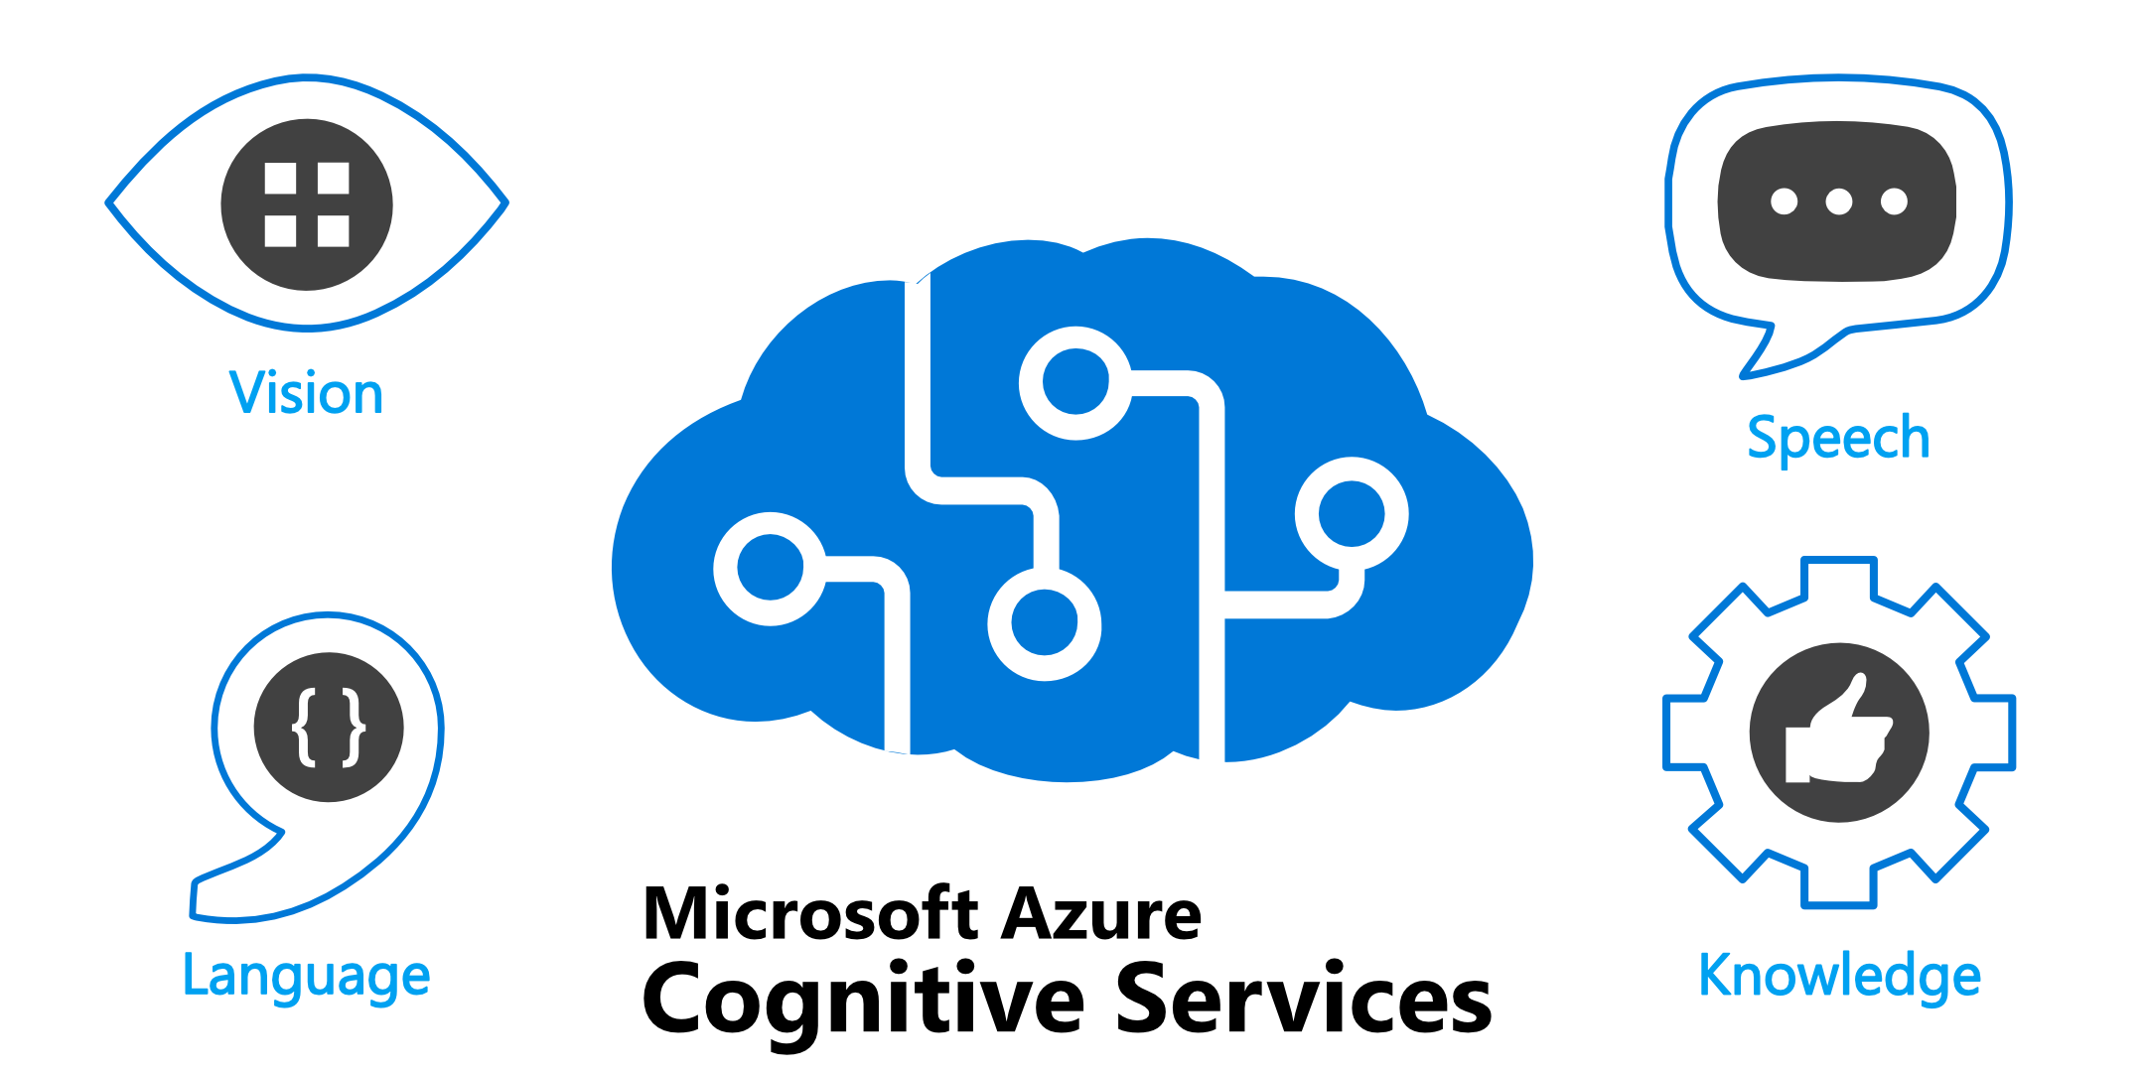

Slide 4
+-------------------------------------+
| Azure AI Language |
+-------------------------------------+
/ | | \
/ | | \
/ | | \
/ | | \

Slide 5
+----------------+ +----------------+ +----------------+ +----------------+ | LUIS | | Text Analytics| | Translator | | QnA Maker | +----------------+ +----------------+ +----------------+ +----------------+ | | | |
| | | |
+--------+--------+ | | |
| | | | |
| Intents & | | | |
| Entities | | | |
+-----------------+ | | |
\ / | |
\ / | |
+-----------------------------+-------------------+ |

Slide 6
Azure OpenAI Service |
+-----------------------------+
/ \
/ \
+----------------+ +----------------+
| Text Generation | | Text Completion | +----------------+ +----------------+
```
Explanation
1. **Azure AI Language**: - **Central Node**: Represents the overall suite of language services provided by Azure.

Slide 7
2. **LUIS (Language Understanding Intelligent Service)**:
- **Function**: Understands user intent and extracts specific entities from the text.
- **Components**:
- **Intents**: The purpose or goal of the user’s input (e.g., booking a flight).
- **Entities**: Key pieces of information (e.g., dates, destinations).
3. **Text Analytics**:
- **Function**: Analyzes text for various features.
- **Capabilities**:
- **Sentiment Analysis**: Determines the sentiment behind the text (positive, neutral, negative).
- **Key Phrase Extraction**: Identifies important phrases.
- **Named Entity Recognition**: Recognizes entities like names of people, places, and organizations.

Slide 8
4. **Translator**:
- **Function**: Translates text between multiple languages.
- **Usage**: Facilitates multilingual communication by converting text from one language to another.
5. **QnA Maker**:
- **Function**: Provides question-and-answer capabilities based on a knowledge base.
- **Usage**: Answers questions by retrieving relevant information from FAQs or other documents.
6. **Azure OpenAI Service**:
- **Function**: Uses advanced AI models for natural language understanding and generation.
- **Capabilities**:
- **Text Generation**: Creates human-like text based on input prompts.
- **Text Completion**: Completes partial text or provides coherent responses.

Slide 9
How It Works:
- **User Input**: Users provide text or speech input to the services.
- **Service Interaction**: The input is processed by the relevant Azure AI Language service(s) based on the required functionality.
- **Output**: Each service generates specific outputs like intent recognition, sentiment scores, translations, answers, or generated text.
This diagram helps illustrate how Azure AI Language services are structured and how they interact with each other to process and analyze natural language.

