Slide 1
Microsoft Azure AI Language
This document provides an overview of Microsoft Azure AI Language, a suite of cloud-based services that offer Natural Language Processing (NLP) capabilities. It explores the various features, functionalities, and applications of Azure AI Language, highlighting its potential for businesses and developers to extract insights from text and build intelligent applications.

Slide 2
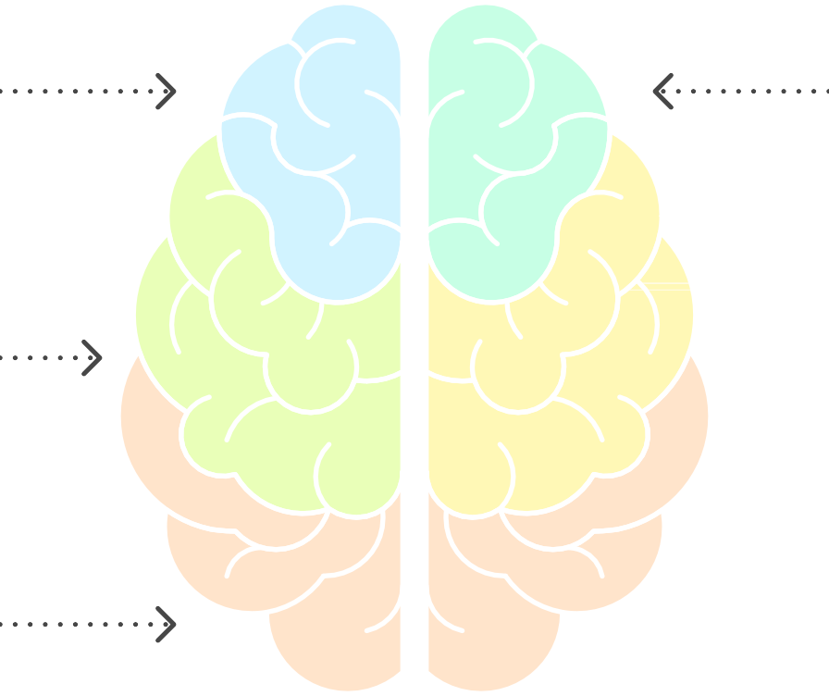
Exploring Azure AI Language
Features
Functionalities
Applications
Insights Extraction
Intelligent Applications

Slide 3
Overview
Azure AI Language is a collection of cloud-based AI services for building intelligent applications that understand and analyze text. It provides a range of NLP capabilities, including:
Language Detection: Automatically identify the language of a given text.
Sentiment Analysis: Determine the sentiment (positive, negative, or neutral) expressed in a text.
Key Phrase Extraction: Identify the main talking points in a text.
Named Entity Recognition (NER): Identify and categorize entities in a text, such as people, organizations, locations, and dates.
Entity Linking: Disambiguate entities identified by NER and link them to entries in a
knowledge base, such as Wikipedia.
PII Detection: Identify and redact personally identifiable information (PII) in a text.
Text Summarization: Generate concise summaries of longer documents.
Question Answering: Extract answers to questions from unstructured text.
Conversation Analysis: Analyze conversations to extract insights, such as sentiment, topics, and intents.
Custom Text Classification: Train custom models to classify text into categories
specific to your business needs.
Custom Named Entity Recognition: Train custom models to recognize entities specific
to your business needs.

Slide 4
Key Features and Functionalities
complex NLP workflows.
Pre-built Models
Azure AI Language offers a variety of pre-built models that are ready to use out-of-the-box. These models are trained on large datasets and can be used to perform common NLP tasks without requiring any custom training. This allows developers to quickly integrate NLP capabilities into their applications.
Custom Models
For more specialized NLP tasks, Azure AI Language allows you to train custom models using your own data. This gives you the flexibility to tailor the models to your specific business needs and achieve higher accuracy. Custom models can be trained for text classification, named entity recognition, and other tasks.
REST API and SDKs

Slide 5
4. Azure AI Studio
Azure AI Language provides a REST API and SDKs for various programming languages, making it easy to integrate the services into your applications. The API allows you to send text to the service and receive the results in a structured format. The SDKs provide a more convenient way to interact with the API from your code.
Azure AI Studio is a web-based platform that provides a user-friendly interface for exploring and experimenting with Azure AI Language services. It allows you to easily test different models, train custom models, and deploy them to production.
Integration with Other Azure Services
Azure AI Language integrates seamlessly with other Azure services, such as Azure Cognitive Search, Azure Bot Service, and Azure Machine Learning. This allows you to build end-to-end AI solutions that leverage the power of multiple Azure services.
Responsible AI
Microsoft is committed to responsible AI development and deployment. Azure AI Language includes features and guidelines to help you build AI systems that are fair, reliable, safe, and transparent.

Slide 6
Use Cases
Azure AI Language can be used in a wide range of applications, including:
Customer Service: Analyze customer feedback to identify areas for improvement. Build chatbots that can understand and respond to customer inquiries.
Content Moderation: Automatically detect and remove offensive or inappropriate
content from online platforms.
Market Research: Analyze social media data to understand customer sentiment and
identify emerging trends.
Knowledge Management: Extract key information from documents and build
knowledge bases.
Healthcare: Analyze medical records to identify patients at risk for certain conditions.
Finance: Detect fraud and analyze financial news to identify investment opportunities.
Human Resources: Analyze resumes and job descriptions to find the best candidates for open positions.
Example Scenario: Sentiment Analysis for Customer Reviews

Slide 7
Imagine a company that wants to understand how customers feel about their products. They can use Azure AI Language to analyze customer reviews and determine the sentiment expressed in each review.
Collect Customer Reviews: Gather customer reviews from various sources, such as online marketplaces, social media, and customer surveys.
Send Reviews to Azure AI Language: Use the Azure AI Language API to send each
review to the Sentiment Analysis service.
Analyze Sentiment: The Sentiment Analysis service will analyze each review and return
a sentiment score, indicating whether the review is positive, negative, or neutral.
Visualize Results: Use a dashboard or reporting tool to visualize the sentiment scores
and identify trends.
Take Action: Based on the sentiment analysis results, the company can take action to
address customer concerns, improve product quality, and enhance customer satisfaction.
Code Example (Python)
from azure.ai.textanalytics import TextAnalyticsClient from azure.core.credentials import AzureKeyCredential

Slide 8
endpoint = "YOUR_ENDPOINT" key = "YOUR_KEY"
credential = AzureKeyCredential(key)
text_analytics_client = TextAnalyticsClient(endpoint=endpoint, credential=credential)
text = "I love this product! It's amazing." documents = [text]
response = text_analytics_client.analyze_sentiment(documents=documents)[0]
print("Sentiment:", response.sentiment)
print("Positive score:", response.confidence_scores.positive) print("Negative score:", response.confidence_scores.negative) print("Neutral score:", response.confidence_scores.neutral)
This code snippet demonstrates how to use the Azure AI Language SDK for Python to perform sentiment analysis on a text. You will need to replace
`YOUR_ENDPOINT` and `YOUR_KEY` with your actual Azure AI Language endpoint and key.

Slide 9
Pricing
Azure AI Language pricing is based on a pay-as-you-go model. You are charged based on the number of transactions you make to the service. The pricing varies depending on the specific service you are using and the volume of transactions. Refer to the Azure AI Language pricing page for the most up-to-date pricing information.
Conclusion
Azure AI Language provides a comprehensive suite of NLP capabilities that can be used to build intelligent applications that understand and analyze text. Its pre-built models, custom model support, and integration with other Azure services make it a powerful tool for businesses and developers looking to extract insights from text and automate tasks. By leveraging Azure AI Language, organizations can improve customer service, enhance content moderation, gain market insights, and streamline knowledge management.

