Slide 1
Kamna Malviya MCA 2 SEM
ROOL NO - 14

Slide 2
Looker (Google Cloud Product) Looker is a data analytics and business intelligence (BI) tool within Google Cloud that helps organizations explore, analyze, and visualize data. It integrates seamlessly with Google Cloud’s data ecosystem and offers powerful features for interactive data exploration, modeling, and reporting. Here’s an explanation of Looker in Google Cloud, along with a simplified diagram to illustrate its components and interactions: Key Components of Looker in Google Cloud 1. Looker Platform: The core of Looker, providing tools for building data models, creating reports, and visualizing data. 2. Data Sources: The databases and data warehouses where your data is stored. Looker connects to these sources to fetch and analyze data. 3. LookML: Looker’s modeling language used to define data relationships, metrics, and dimensions. It abstracts the complexity of SQL queries and makes data exploration user-friendly. 4. Dashboards and Reports: Interactive visualizations and reports created within Looker, used for data analysis and sharing insights.

Slide 3
5. Google Cloud Integration: Looker integrates with various Google Cloud services to enhance its functionality. Simplified Diagram Here’s a simplified diagram to visualize how Looker fits into the Google Cloud ecosystem:
sql Copy code +------------------+ | User Interface | | (Looker Web App)| +------------------+ | v +------------------+ | Looker | | Platform | | (LookML & | | Data Models) | +------------------+ / \ / \ v v +----------------+ +------------------+ | Data Sources | | Google Cloud | | | | Integration | | SQL Databases | | (BigQuery, | | Cloud Storage | | Google Sheets, | | APIs, etc. | | etc.) | +----------------+ +------------------+ \ / \ / v v +------------------+ | Dashboards & | | Reports | | (Interactive | | Visualizations) | +------------------+

Slide 4
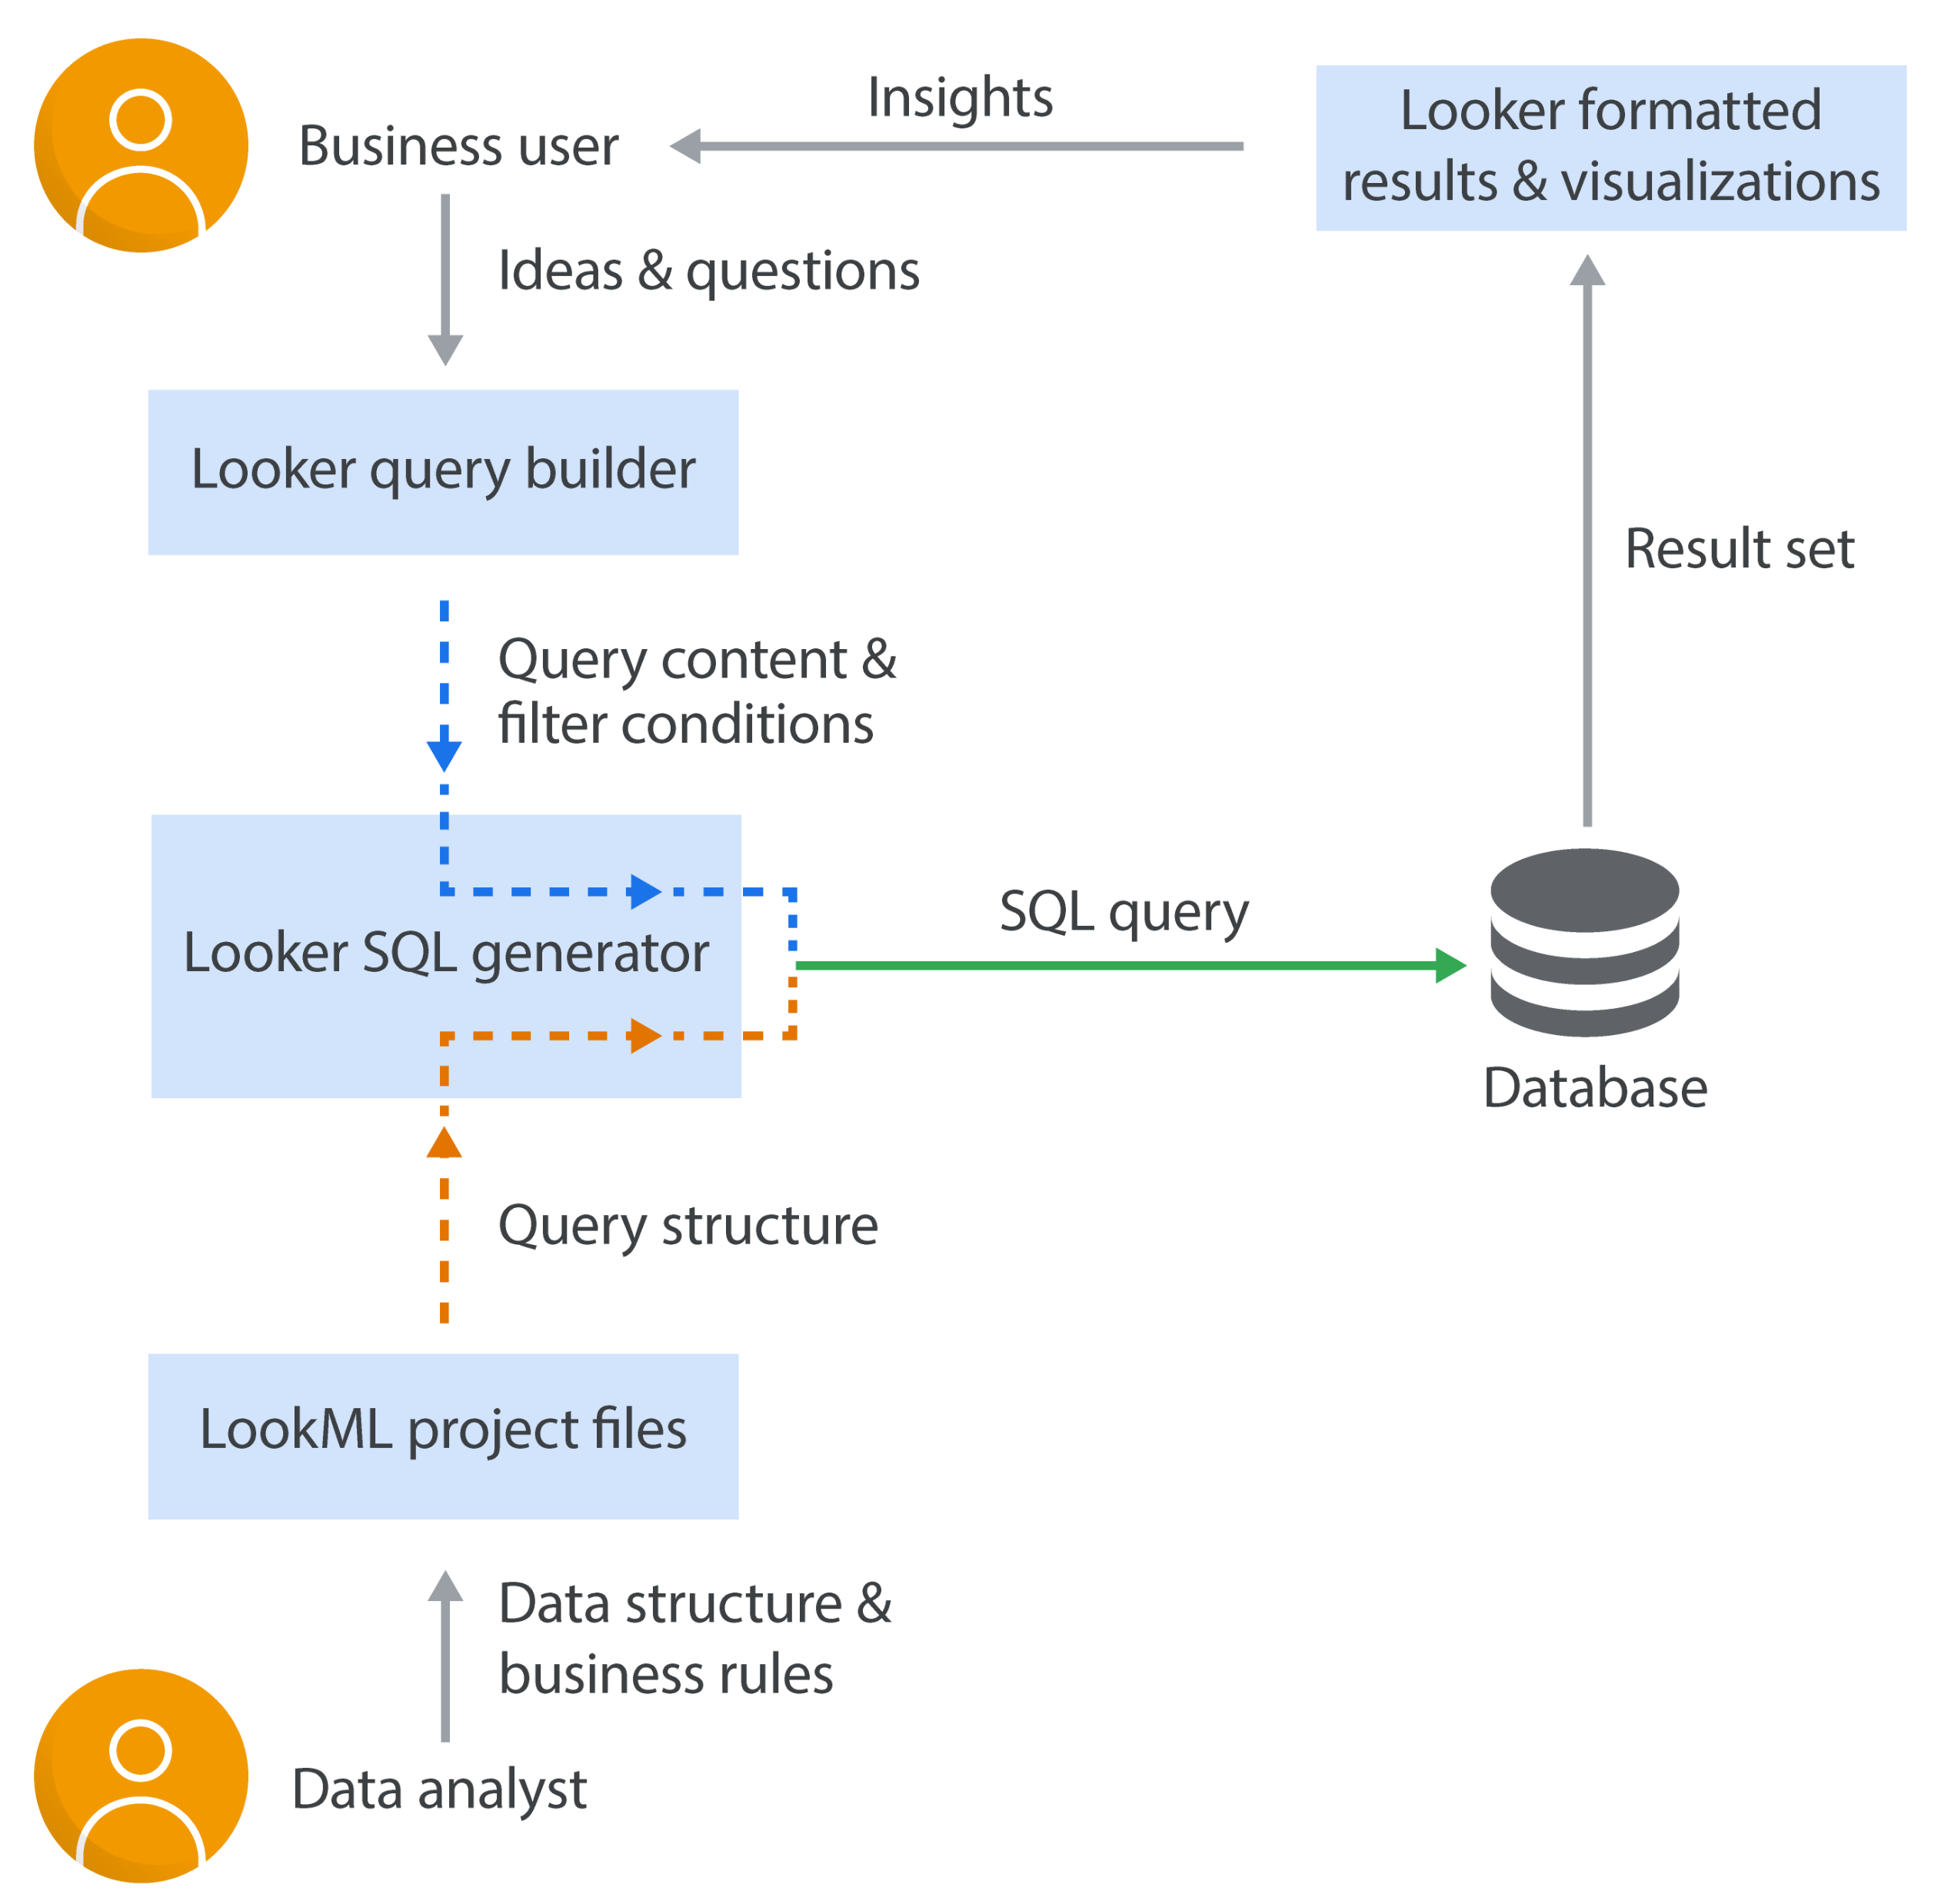

Slide 5
Explanation of the Diagram: 1. User Interface (Looker Web App): o Users interact with Looker through its web interface to create reports, dashboards, and perform data analysis. 2. Looker Platform: o LookML: This modeling language is used to define how data should be queried and displayed. It simplifies complex queries and ensures consistent metrics across reports. o Data Models: Looker uses these models to structure data for easy exploration and visualization. 3. Data Sources: o Looker connects to various data sources, including SQL databases, cloud storage, and other APIs. These are where your raw data resides. 4. Google Cloud Integration: o BigQuery: Looker integrates with Google BigQuery, a fully-managed data warehouse, to perform large scale data queries and analytics. o Google Sheets: Integration allows for importing and exporting data to and from Google Sheets. o Cloud Storage: Looker can access and analyze data stored in Google Cloud Storage. 5. Dashboards & Reports: o Looker allows users to create interactive dashboards and reports based on the data models. These visualizations help in analyzing data and sharing o insights with stakeholders. Benefits of Using Looker:

Slide 6
• Centralized Data Model: By defining data models in LookML, organizations can maintain a single source of truth and ensure consistency across reports and dashboards. • Scalability: Looker is designed to handle large volumes of data, making it suitable for organizations of all sizes. • Real-Time Analysis: With its direct integration with cloud data warehouses like BigQuery, Looker supports real-time data analysis.

