Slide 1
CNMS
College Notes Management System

Slide 2
Objectives of Project: The College Notes Management System website will be a user-friendly platform that allows faculty members to upload, and share notes for different classes and subjects with student. The website will be accessible from any device with internet access and will be optimized for both desktop and mobile devices. The website will be designed with a clean and modern user interface
Introduction: The College Notes Management System (CNMS) is a web application designed to help college students manage and organize their notes and study materials. The application allows students to access notes and study material shared by teachers. The CNMS will provide a centralized location for all notes, making it easy for students to access the information they need when they need it.

Slide 3
Hardware And Software
Hardware:
Laptop/Desktop
It must be Pentium-4.
It must have 128MB or above RAM capacity.
Internet Connection.
HDD: - 40GB
Software:
IDE: Eclipse
Operating System: Windows
Browser: Google Chrome/Microsoft Edge/Mozilla Firefo
Database: XAMPP Server
Technology/Language Used:
Front-end: HTML, CSS, JavaScript, Tailwind CSS
Back-end: JAVA, (JSP/Servlet)
Database: MySQL

Slide 4
Functional Requirements
Admin portal
Users will be able to login in the website using their email and password provided by admin
Once logged in, users will be able to upload and download notes for different classes and subject
Users will be able to mark notes as private or public.
Users will be able to reset their password if they forget it.
Non-Functional Requirements
The website will be designed to be responsive and accessible on all devices and screen sizes.
The website will be designed with a clean and modern user interface.
The website will be designed to be user-friendly and easy to navigate.
The website will be designed to be secure and protect user data from unauthorized access and breaches.

Slide 5
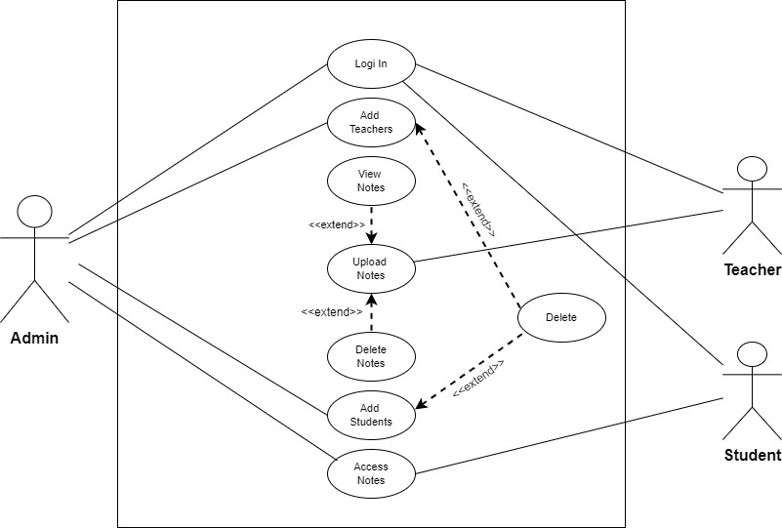
USE CASE DIAGRAM

Slide 6
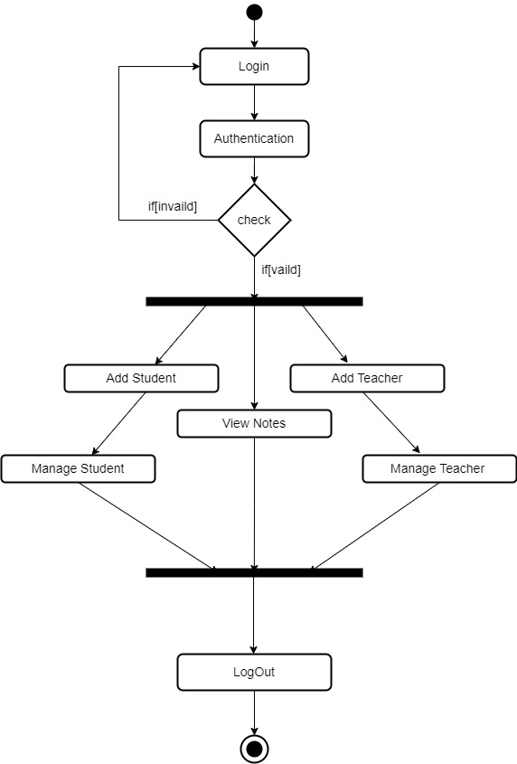
Activity Diagram For Admin

Slide 7
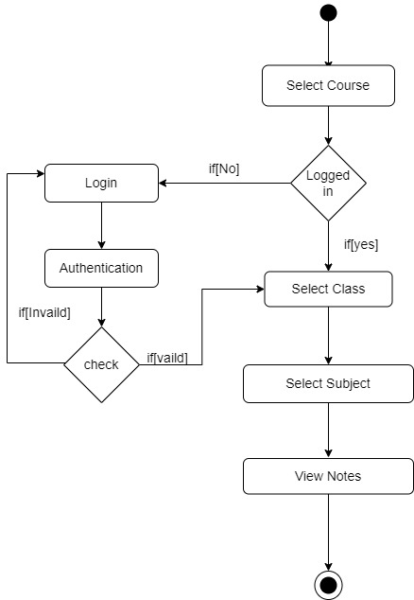
Activity Diagram For Student

Slide 8
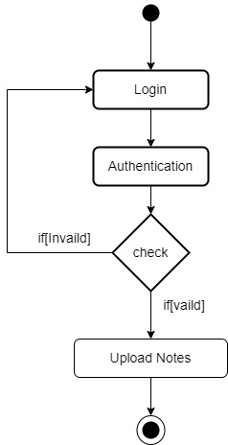
Activity Diagram For Teacher

Slide 9
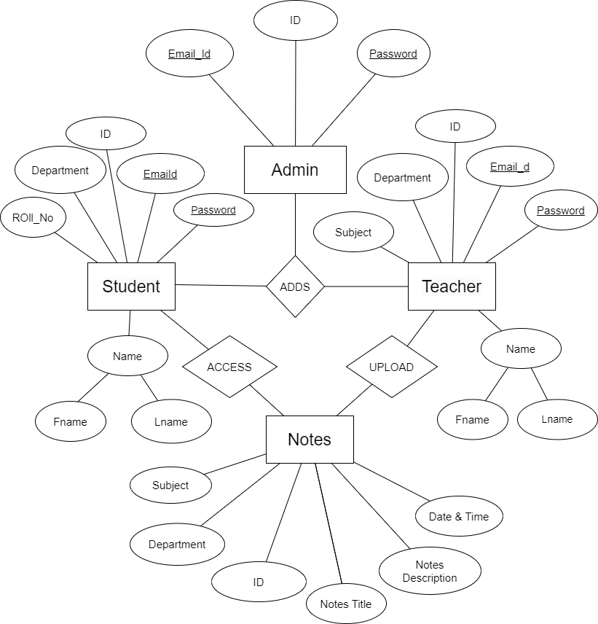
Er Diagram

Slide 10
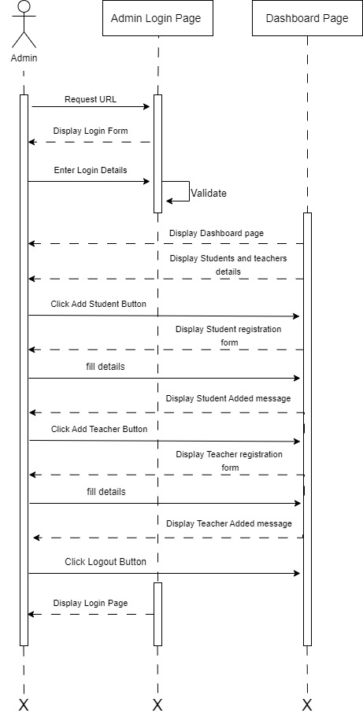
Admin Sequence

