Slide 1
Modelling the FX Skew
Dherminder Kainth and Nagulan Saravanamuttu
QuaRC, Royal Bank of Scotland

Slide 2
Overview
FX Markets
Possible Models and Calibration
Variance Swaps
Extensions

Slide 3
FX Markets
Market Features
Liquid Instruments
Importance of Forward Smile

Slide 4
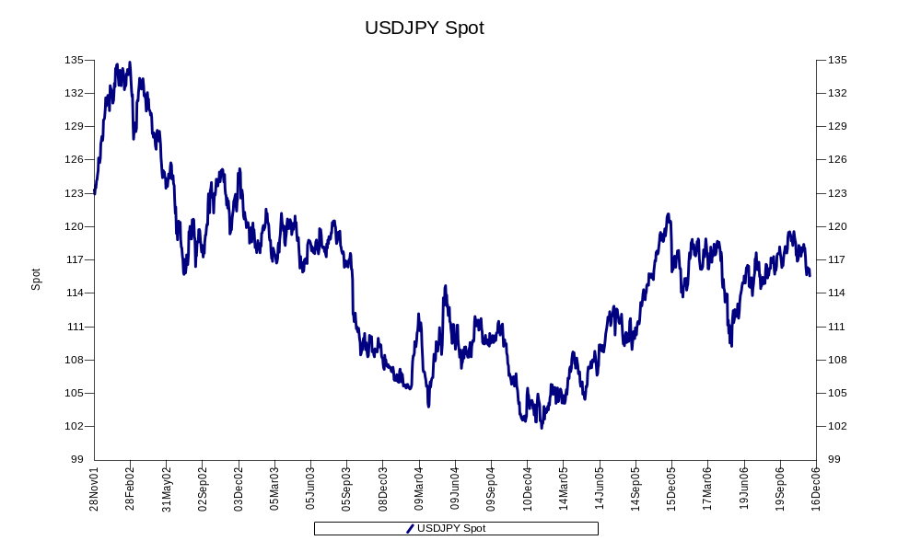
Spot
Spot

Slide 5
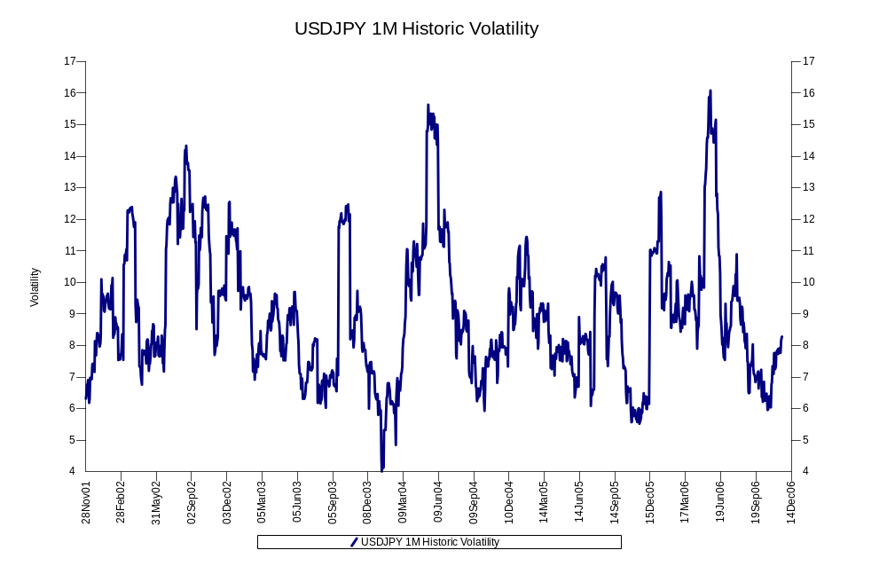
Volatility
Volatility

Slide 6
European Implied Volatility Surface
Implied volatility smile defined in terms of deltas
Quotes available
  Delta-neutral straddle ⇒ Level
  Risk Reversal = (25-delta call – 25-delta put) ⇒ Skew
  Butterfly = (25-delta call + 25-delta put – 2ATM) ⇒ Kurtosis
Also get 10-delta quotes
Can infer five implied volatility points per expiry
  ATM
  10 delta call and 10 delta put
  25 delta call and 25 delta put
Interpolate using, for example, SABR or Gatheral

Slide 7
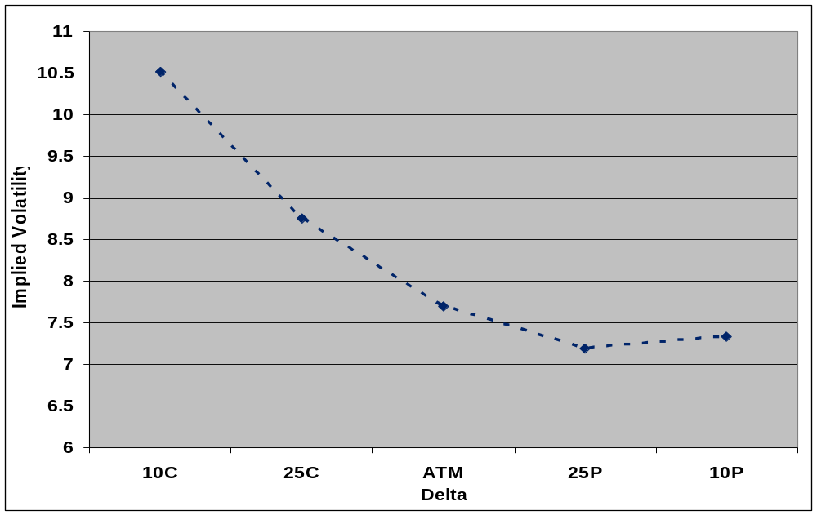
Risk-Reversals

Slide 8
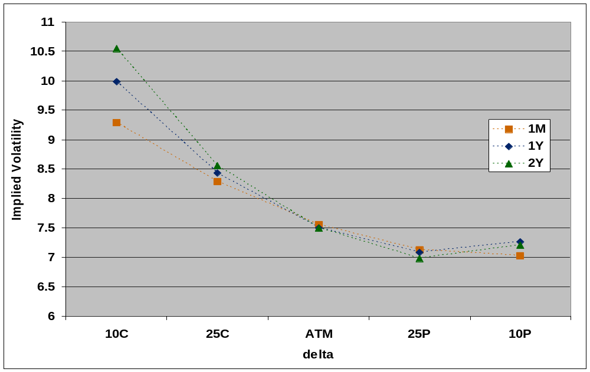
Implied Volatility Smiles

Slide 9
Liquid Barrier Products
Some price visibility for certain barrier products in leading currency pairs (eg USDJPY, EURUSD)
Three main types of products with barrier features
  Double-No-Touches
  Single Barrier Vanillas
  One-Touches
Have analytic Black-Scholes prices (TVs) for these products
High liquidity for certain combinations of strikes, barriers, TVs
Barrier products give information on dynamics of implied volatility surface
Calibrating to the barrier products means we are taking into account the forward implied volatility surface

Slide 10
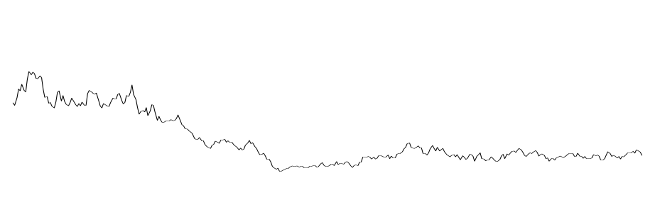
Double-No-Touches
Pays one if barriers not breached through lifetime of product
Upper and lower barriers determined by TV and U×L=S²
High liquidity for certain values of TV : 35%, 10%
U
FX rate
S
L
0
T
time

Slide 11
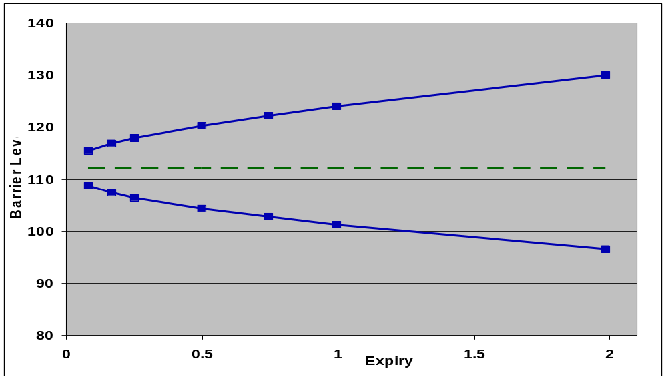
Double-No-Touches
For constant TV, barrier levels are a function of expiry

Slide 12
Single Barrier Vanilla Payoffs
Single barrier product which pays off a call or put depending on whether barrier is breached throughout life of product
Three aspects
  Final payoff (Call or Put)
  Pay if barrier breached or pay if it is not breached (Knock-in or Knock-out)
  Barrier higher or lower than spot (Up or Down)
Leads to eight different types of product
Significant amount of value apportioned to final smile (depending on strike/barrier combination)
Not as liquid as DNTs

Slide 13
One-Touches
Single barrier product which pays one when barrier is breached
Pay off can be in domestic or foreign currency
There is some price visibility for one-touches in the leading currency markets
Not as liquid as DNTs
Price depends on forward skew

Slide 14
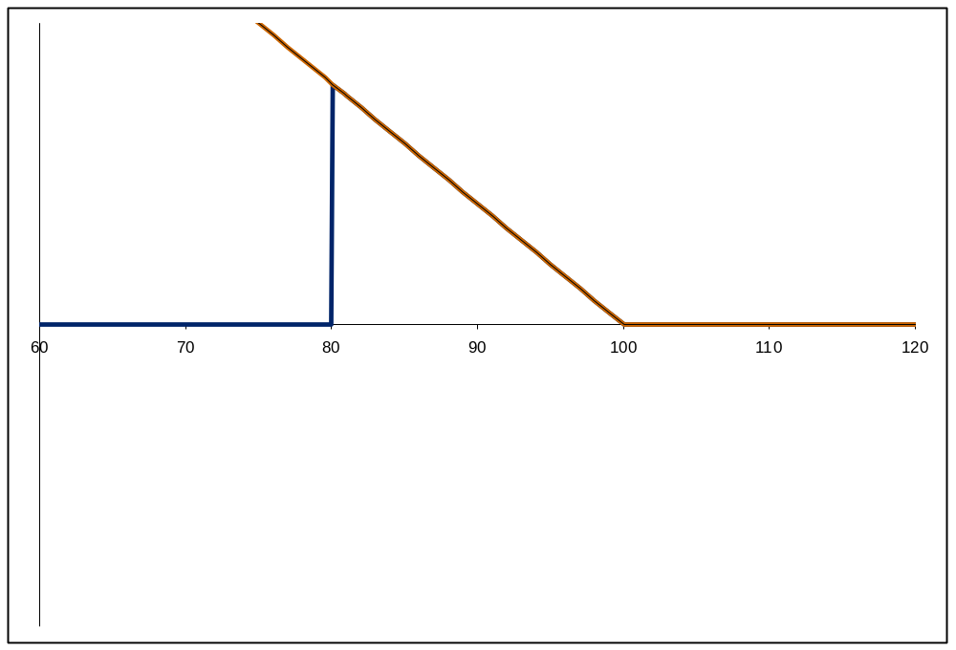
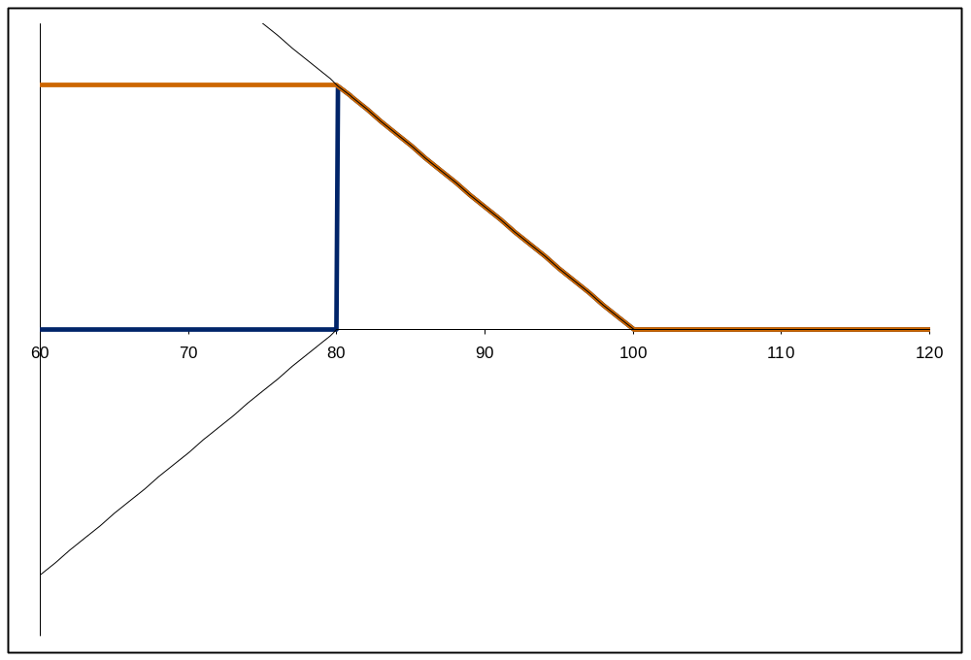
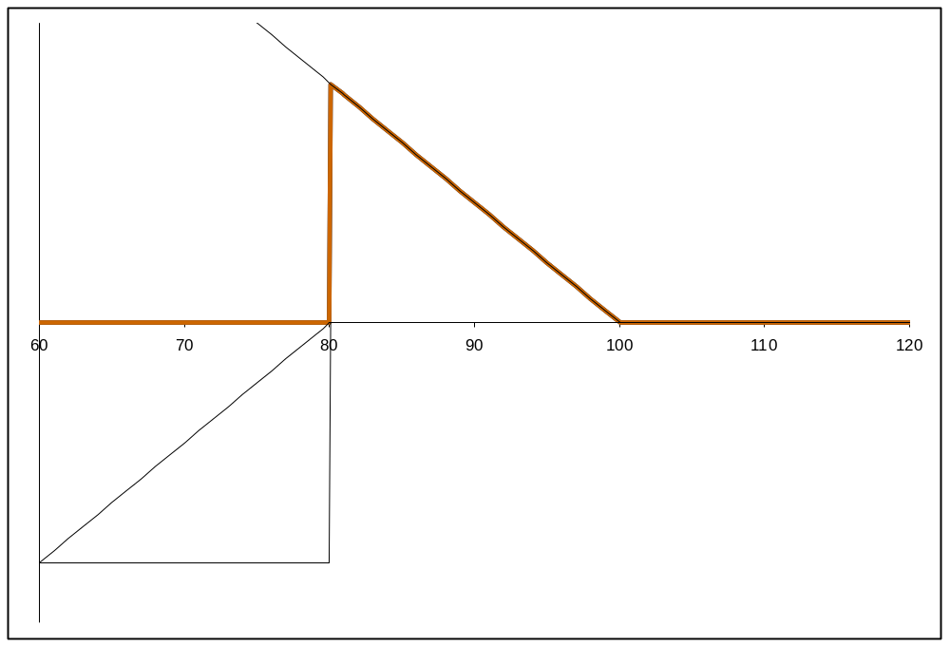
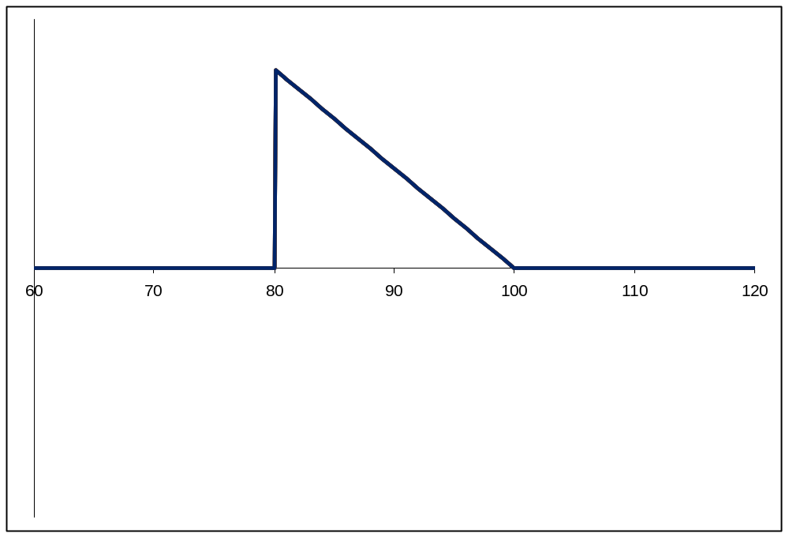
Replicating Portfolio
B
K
Spot

Slide 15
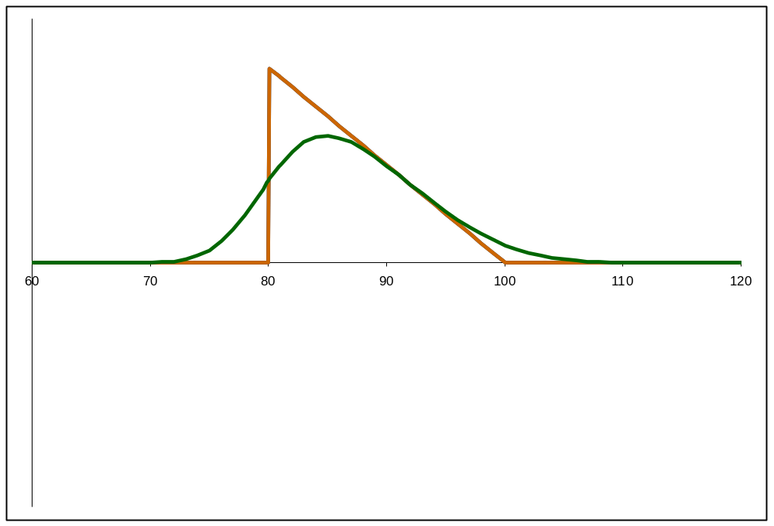
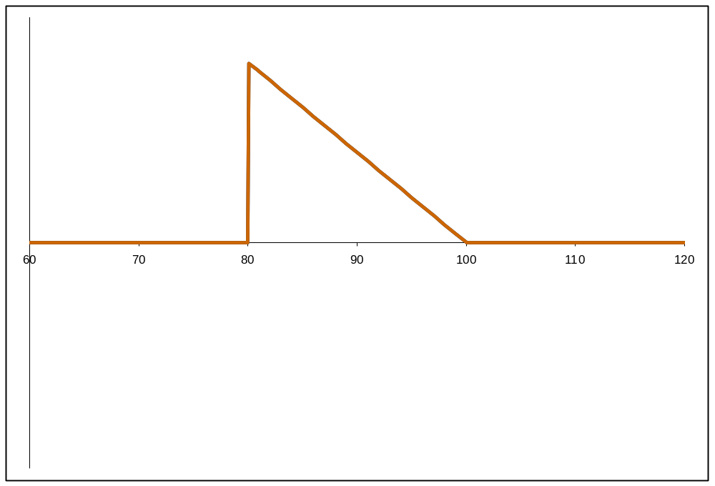
Replicating Portfolio
u < T
T
B
K
Spot

Slide 16
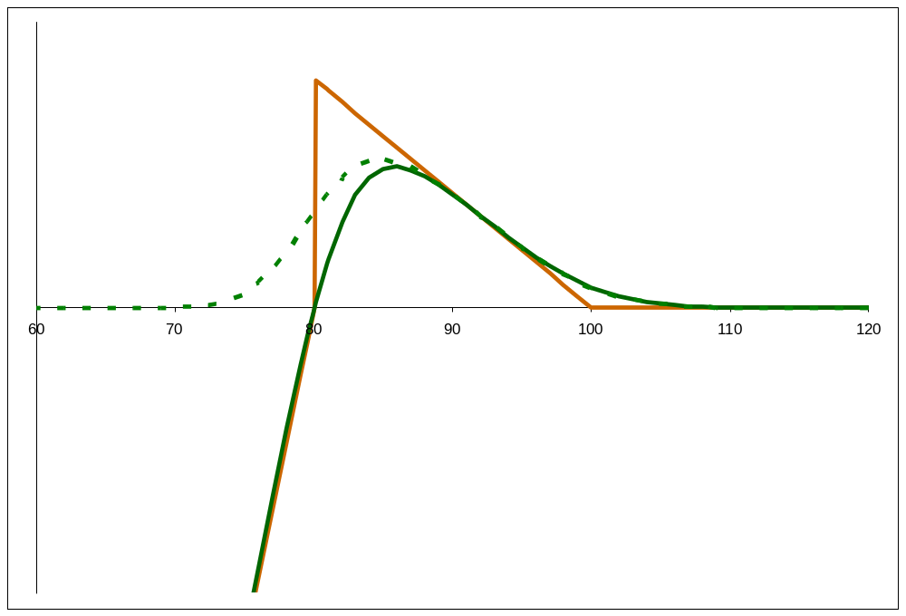
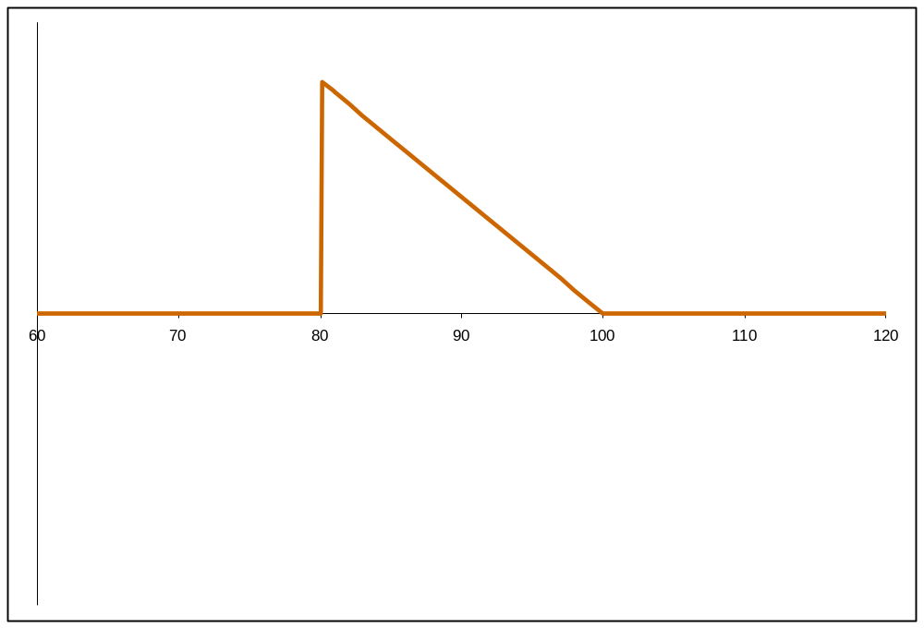
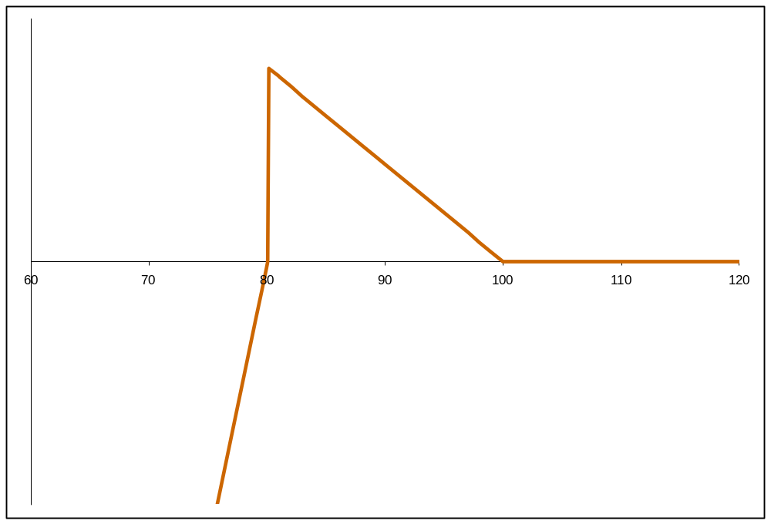
Replicating Portfolio
u < T
T
B
K
Spot

Slide 17

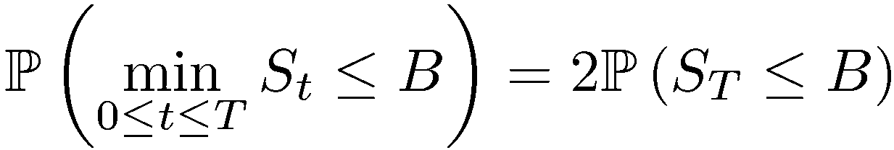

One-Touches
For Normal dynamics with zero interest rates
Price of One-Touch is probability of breaching barrier
Static replication of One-Touch with Digitals

Slide 18
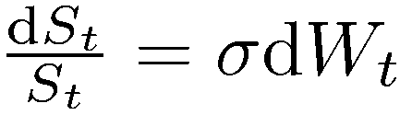

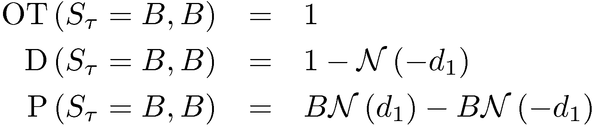
One-Touches
Log-Normal dynamics
Barrier is breached at time
Can still statically replicate One-Touch

Slide 19
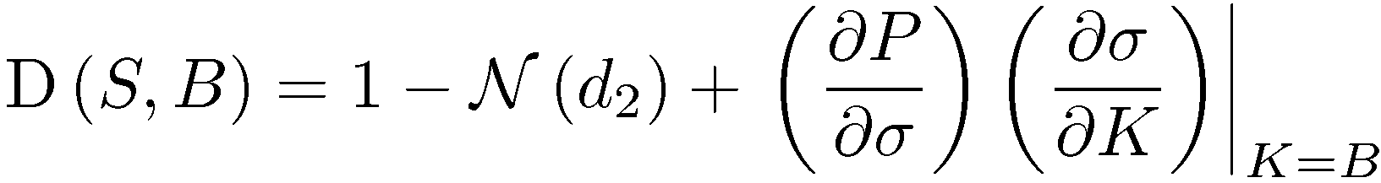
One-Touches
Introduce skew
Using same static hedge
Price of One-Touch depends on skew

Slide 20
Model Skew
Model Skew : (Model Price – TV)
Plotting model skew vs TV gives an indication of effect of model-implied smile dynamics
Can also consider market-implied skew which eliminates effect of particular market conditions (eg interest rates)

Slide 21
Possible Models and Calibration
Local Volatility
Heston
Piecewise-Constant Heston
Stochastic Correlation
Double-Heston

Slide 22
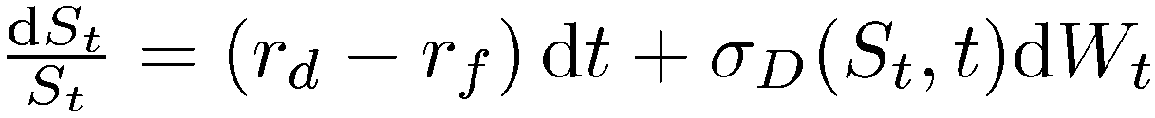
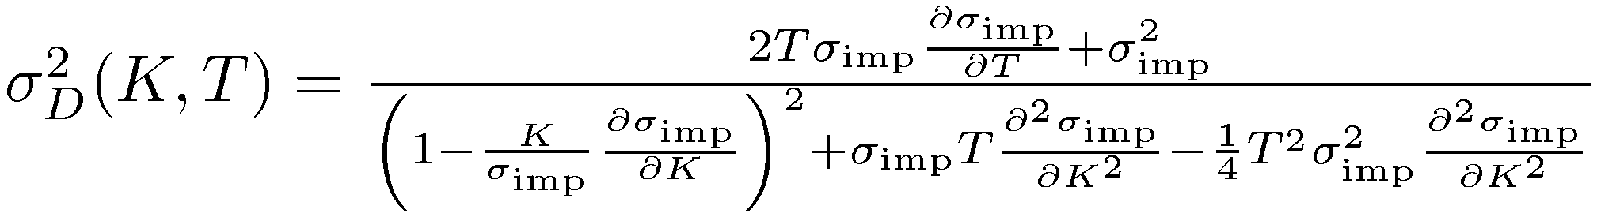
Local Volatility
Local volatility process
Ito-Tanaka implies
Dupire’s formula

Slide 23
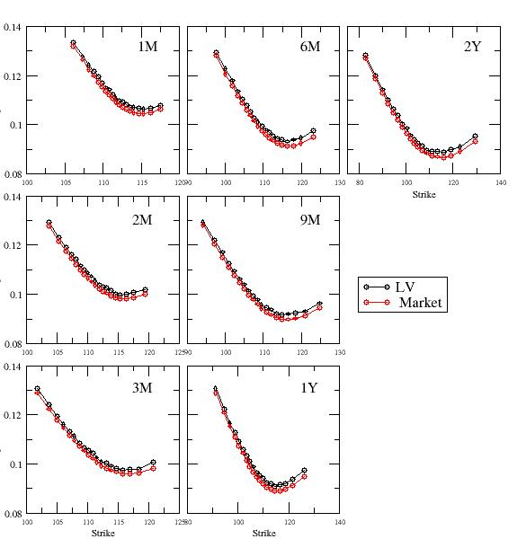
Local Volatility Calibration to Europeans

Slide 24

Local Volatility
Gives exact calibration to the European volatility surface by construction
Volatility is deterministic, not stochastic
implies spot “perfectly correlated” to volatility
Forward skew is rapidly time-decaying

Slide 25
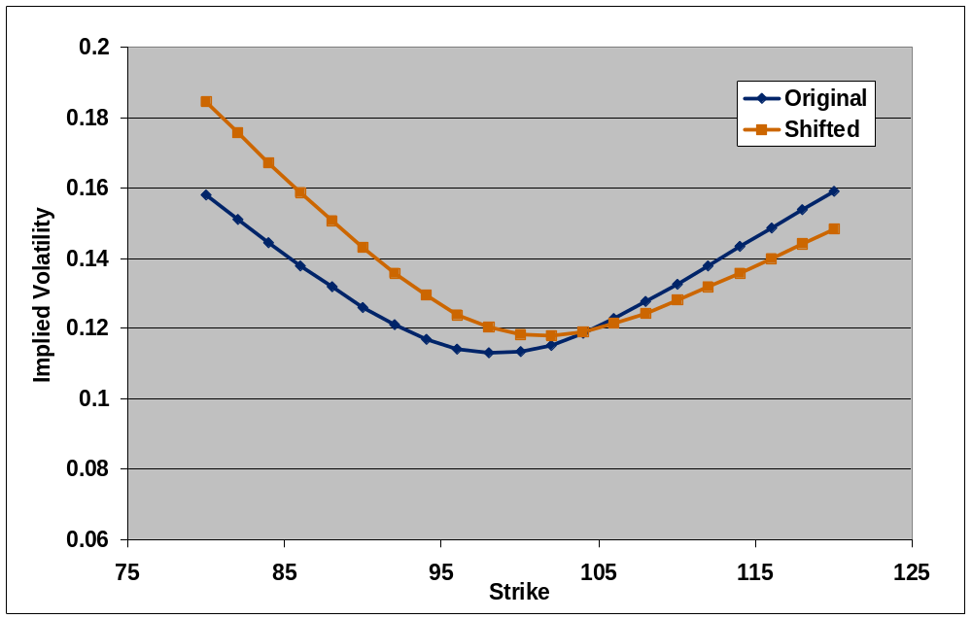
Local Volatility Smile Dynamics
ΔS

Slide 26
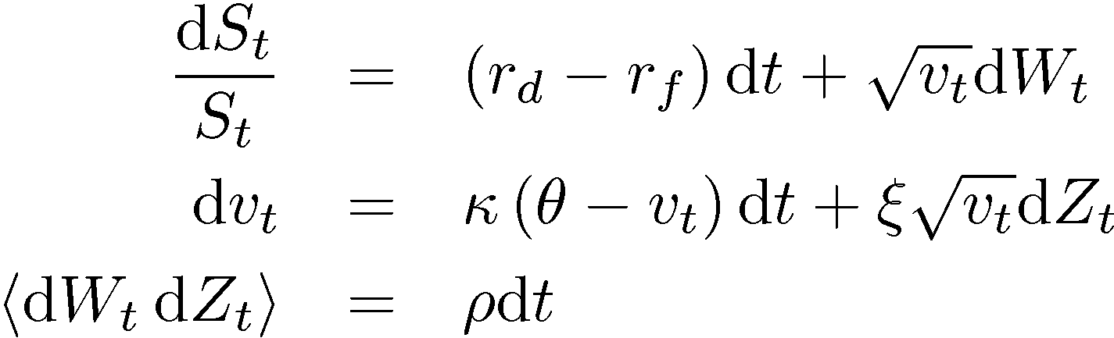


Heston Model
Heston process
Five time-homogenous parameters
Will not go to zero if
Pseudo-analytic pricing of Europeans

Slide 27
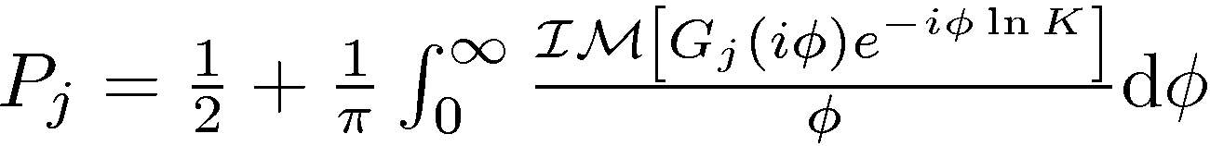
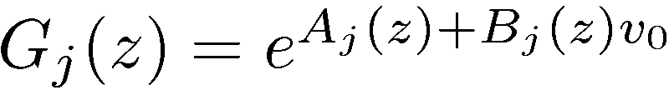
Heston Characteristic Function
Pricing of European options
Fourier inversion
Characteristic function form

Slide 28
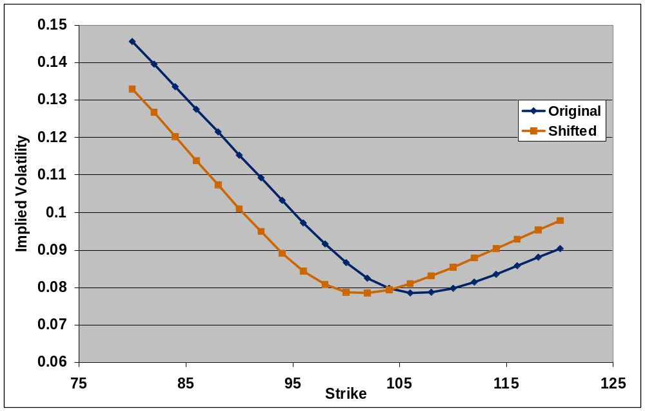
Heston Smile Dynamics
ΔS

Slide 29
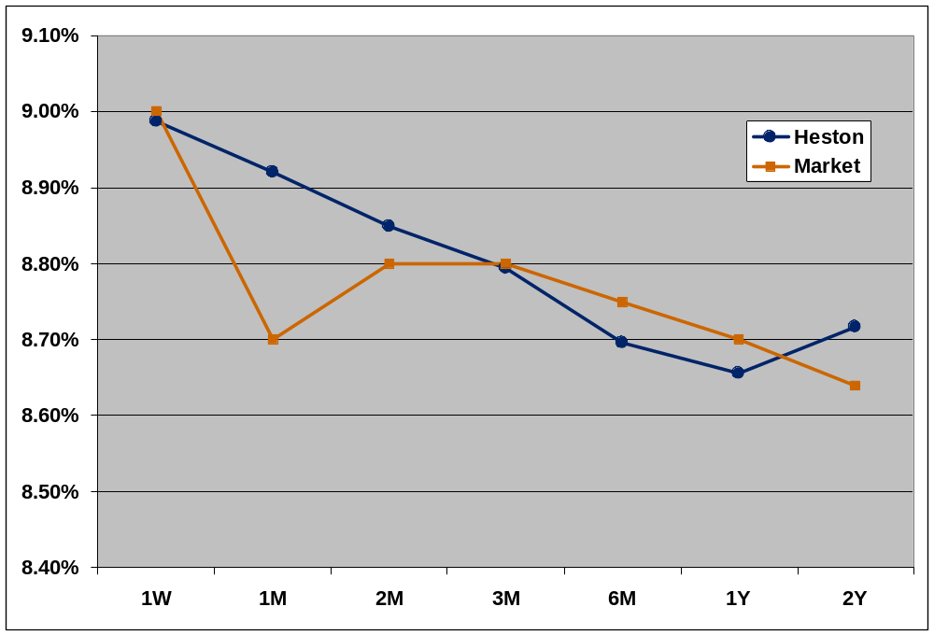
Heston Implied Volatility Term-Structure

Slide 30
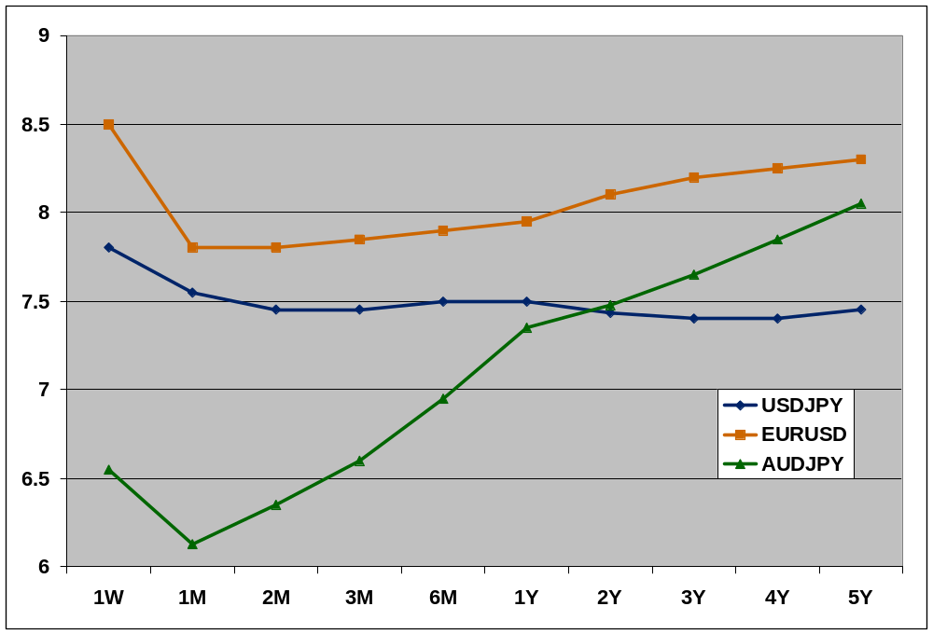
Implied Volatility Term Structures

Slide 31
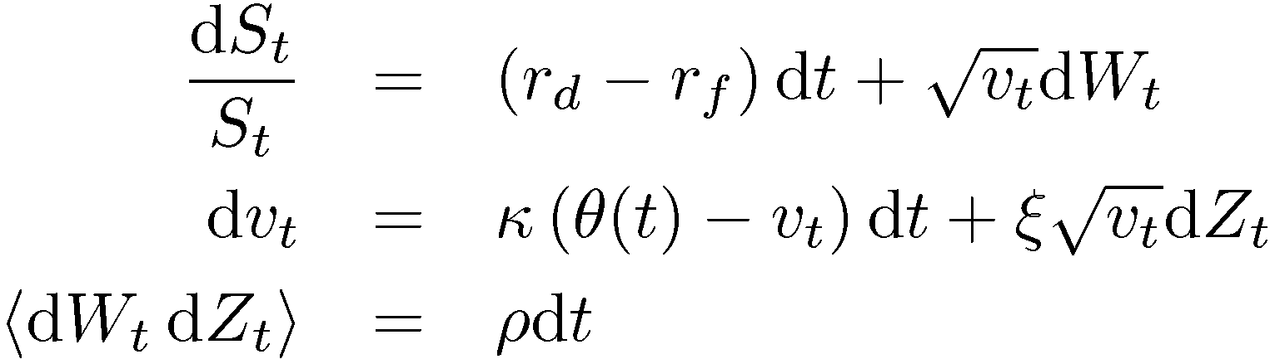
Piecewise-Constant Heston Model
Process
Form of reversion level
Calibrate reversion level to ATM volatility term-structure
0
1W
1M
2M
3M
time

Slide 32
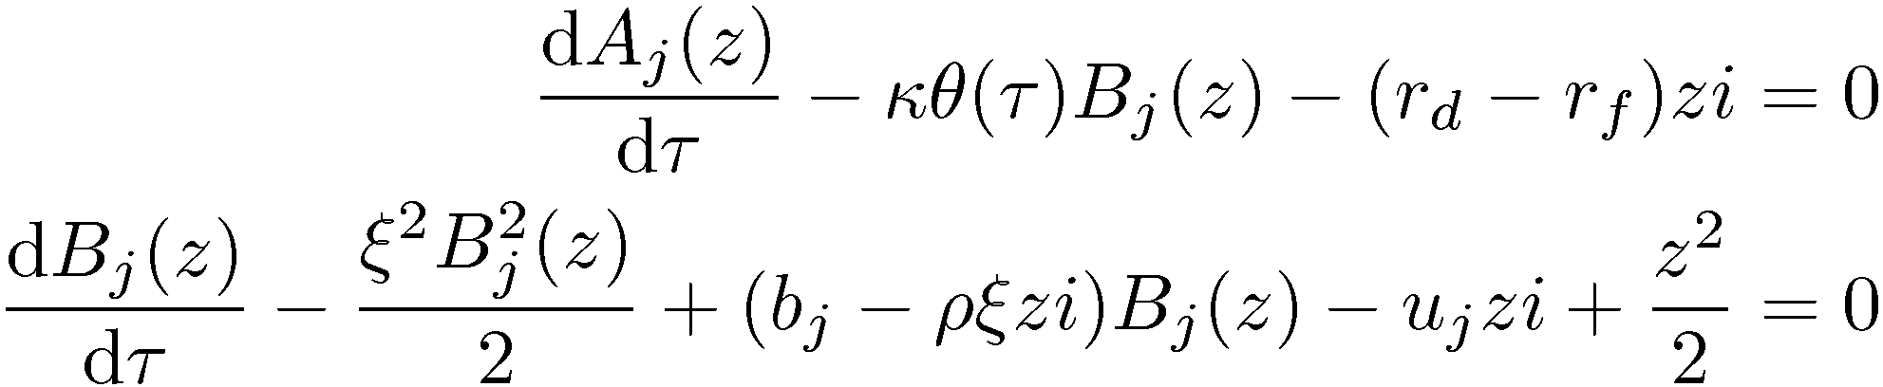



Piecewise-Constant Heston Characteristic Function
Characteristic function
Functions satisfy following ODEs (see Mikhailov and Nogel)
and independent of

Slide 33
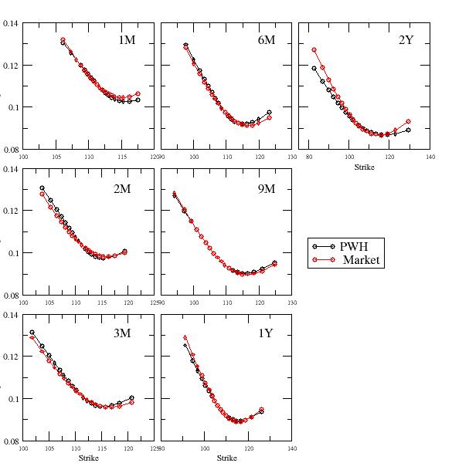
Piecewise-Constant Heston Calibration to Europeans

Slide 34
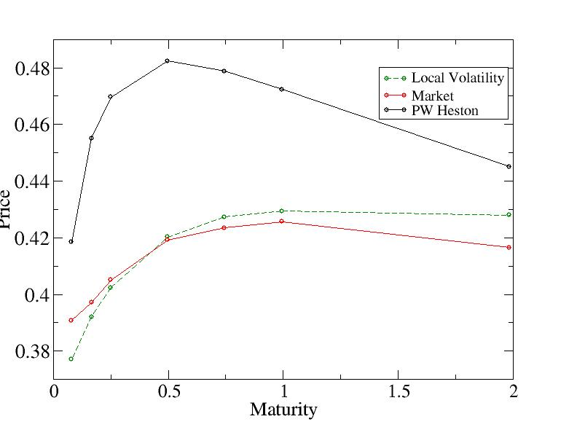
DNT Term Structure

Slide 35
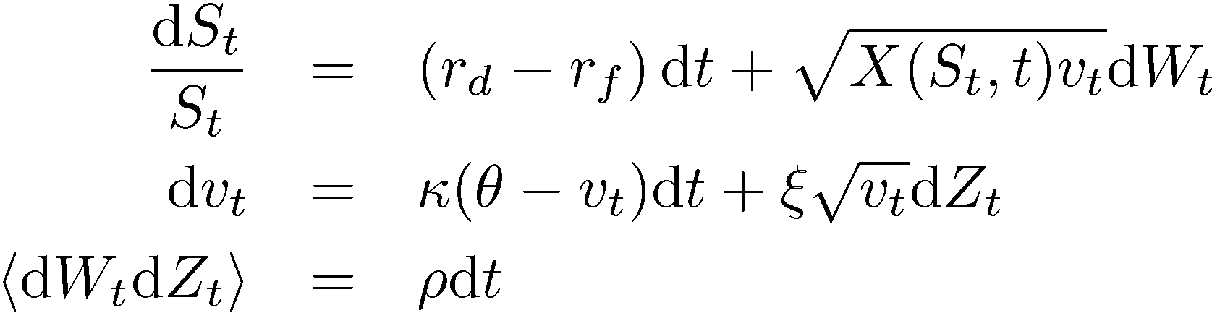
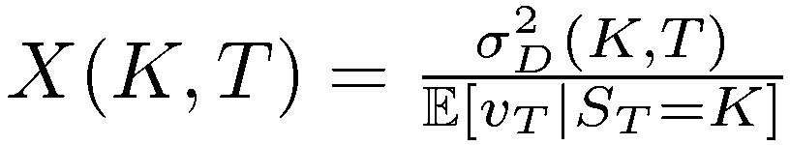
Stochastic Volatility/Local Volatility
Possible to combine the effects of stochastic volatility and local volatility
Usually parameterise the local volatility multiplier, eg Blacher

Slide 36
Stochastic Risk-Reversals
USDJPY 6 month 25-delta risk-reversals
USDJPY (JPY call) 6M 25 Delta Risk Reversal
2.2
2.2
2.0
2.0
1.8
1.8
1.6
1.6
1.4
1.4
Risk Reversal
1.2
1.2
1.0
1.0
0.8
0.8
0.6
0.6
0.4
0.4
08Nov04
21Nov05
26Nov06

Slide 37
Stochastic Correlation Model
Introduce stochastic correlation explicitly but what process to use?
Process has to have certain characteristics:
  Has to be bound between +1 and -1
  Should be mean-reverting
Jacobi process
Conditions for not breaching bounds

Slide 38

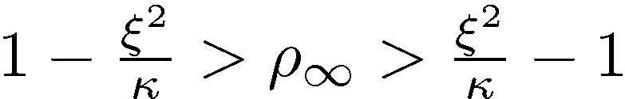
Stochastic Correlation Model
Transform Jacobi process using
Leads to process for correlation
Conditions

Slide 39
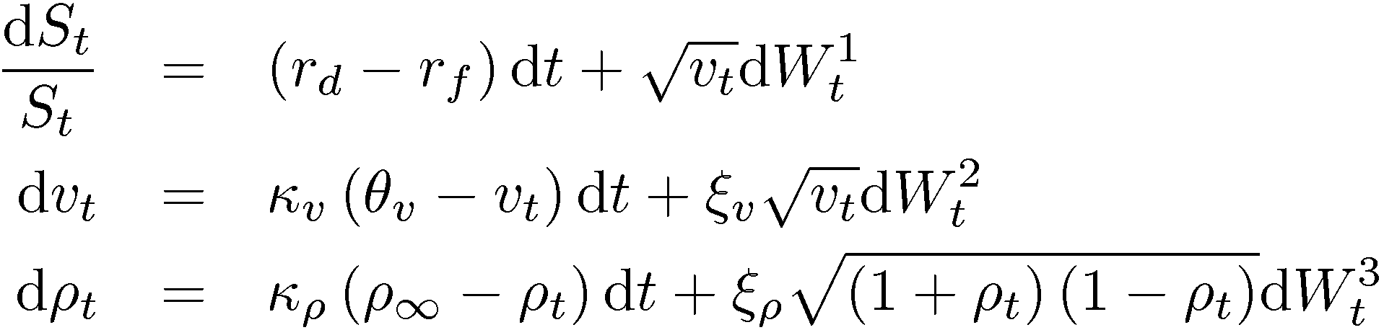
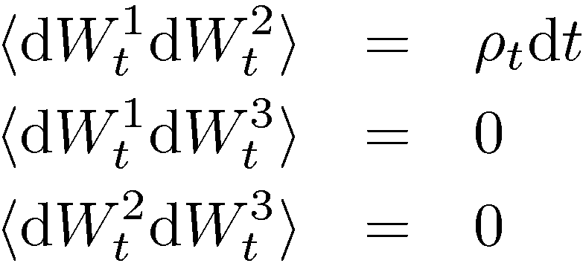
Stochastic Correlation Model
Use the stochastic correlation process with Heston volatility process
Correlation structure

Slide 40
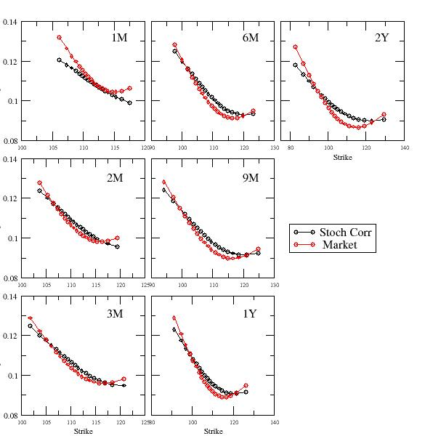
Stochastic Correlation Calibration to Europeans and DNTs
Loss Function : 14.303

Slide 41
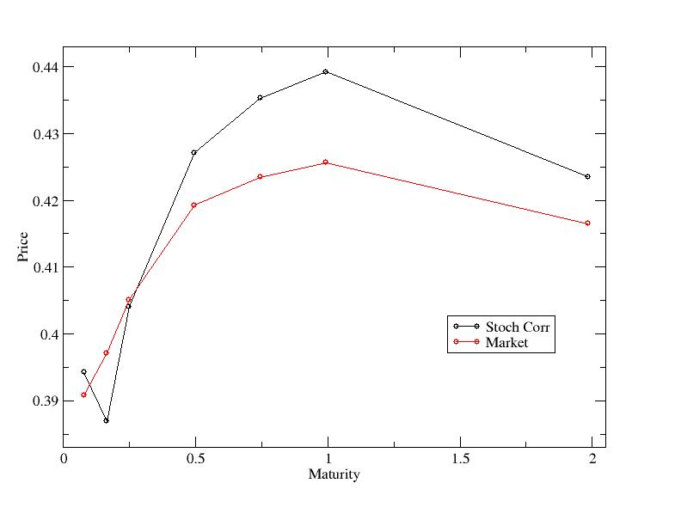
Stochastic Correlation Calibration to Europeans and DNTs

Slide 42
Multi-Scale Volatility Processes
Market seems to display more than one volatility process in its underlying dynamics
In particular, two time-scales, one fast and one slow
Models put forward where there exist multiple time-scales over which volatility reverts
For example, have volatility mean-revert quickly to a level which itself is slowly mean-reverting (Balland)
Can also have two independent mean-reverting volatility processes with different reversion rates

Slide 43
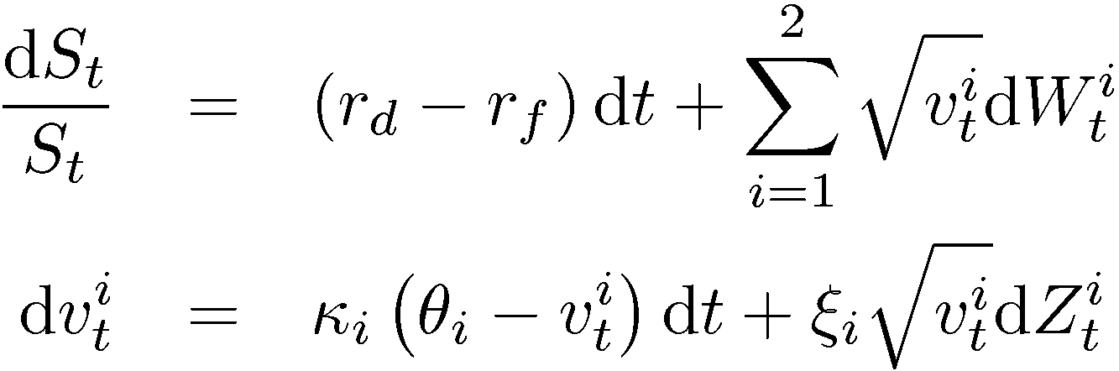
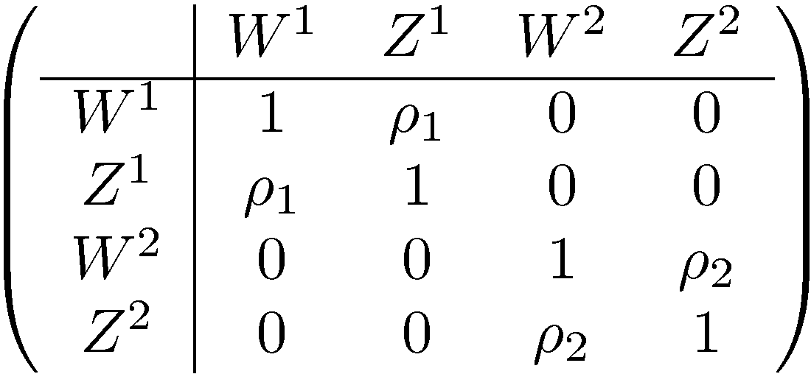
Double-Heston Model
Double-Heston process
Correlation structure

Slide 44
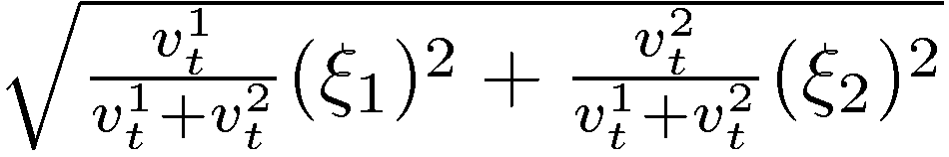
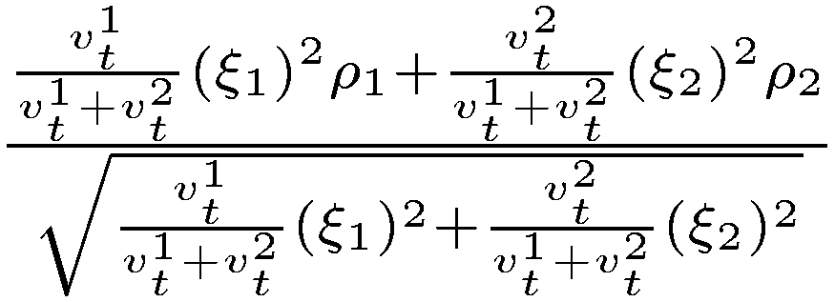
Double-Heston Model
Stochastic volatility-of-volatility
Stochastic correlation

Slide 45
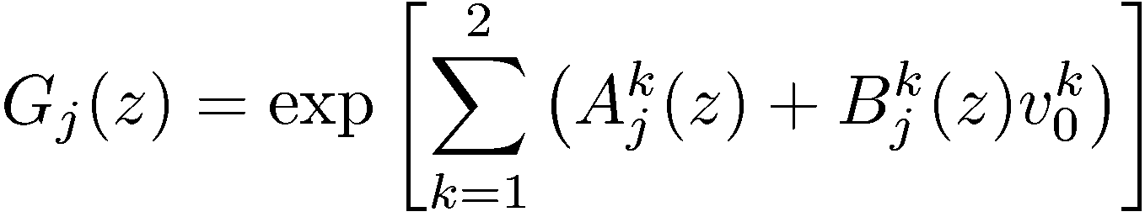
Double-Heston Model
Pseudo-analytic pricing of Europeans
Simple extension to Heston characteristic function

Slide 46
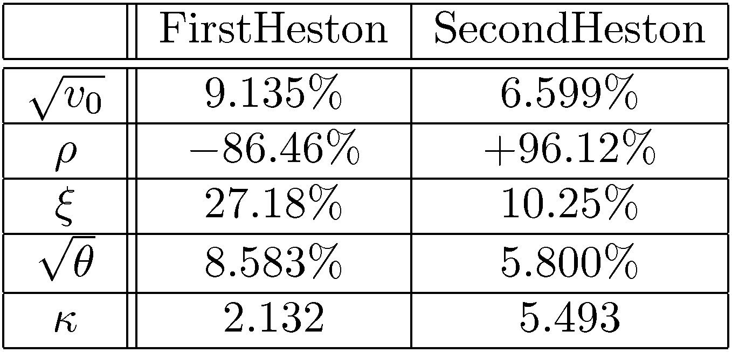
Double-Heston Parameters
Two distinct volatility processes
  One is slow mean-reverting to a high volatility
  Other is fast mean-reverting to a low volatility
  Critically, correlation parameters are both high in magnitude and of opposite signs

Slide 47
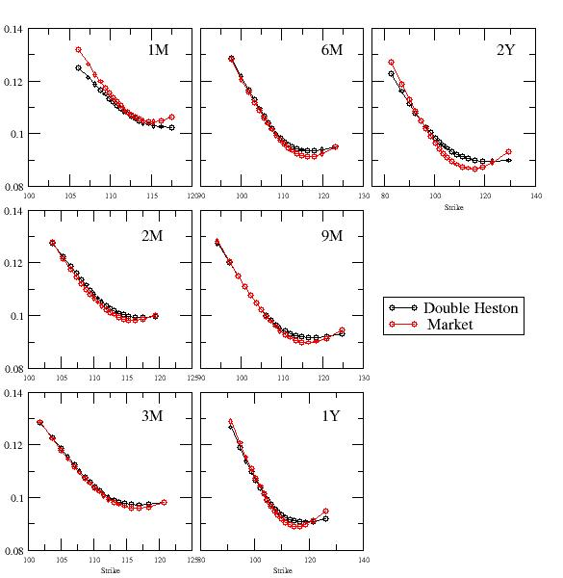
Double-Heston Calibration to Europeans and DNTs
Loss Function : 4.309

Slide 48
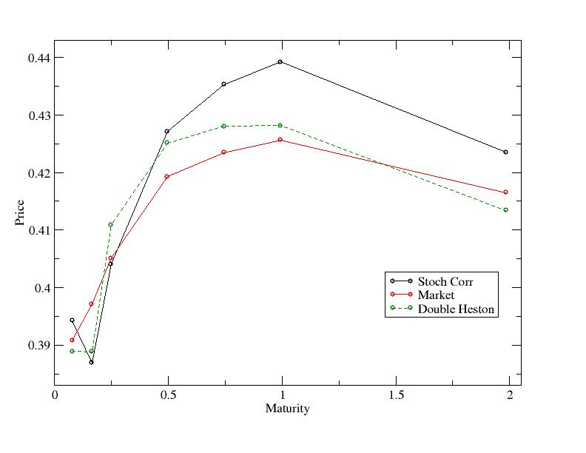
Double-Heston Calibration to Europeans and DNTs

Slide 49
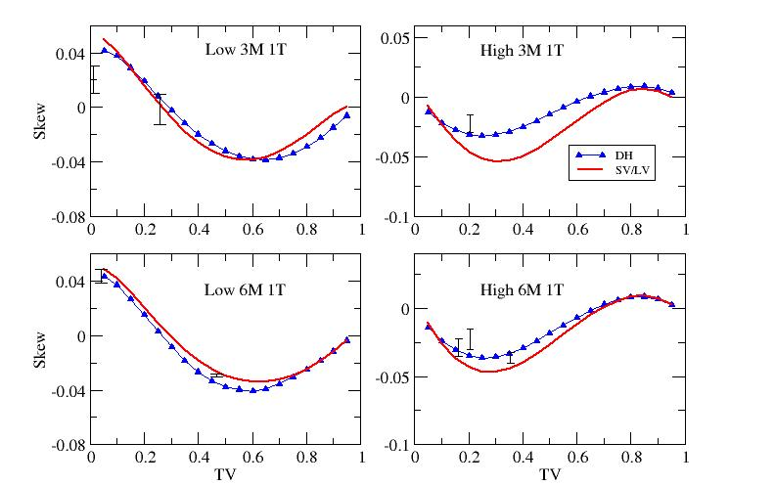
One-Touches

Slide 50
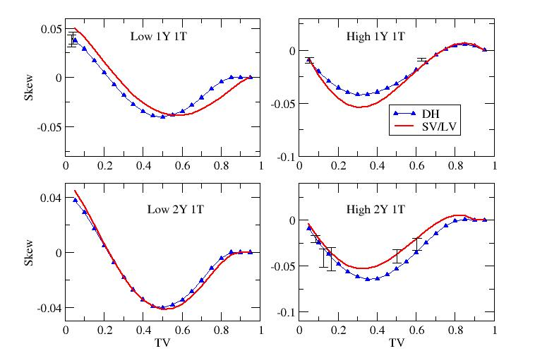
One-Touches

Slide 51
Variance Swaps
Product Definition
Process Definitions
Variance Swap Term-Structure
Model Implied Term-Structures

Slide 52



Variance Swap Definition
Quadratic variation
Variance swap price
Price process

Slide 53





Variance Process Definitions
Define the forward variance
Define the short variance process
We already have models for describing
  Heston
  Double-Heston
  Double Mean-Reverting Heston (Buehler)
  Black-Scholes

Slide 54


Variance Swap Term Structure
Heston form for variance swap term structure
Double-Heston
Note the independence of the variance swap term-structure to the correlation and volatility-of-volatility parameters

Slide 55



Double-Heston Term Structures

Slide 56

Volatility Swap Term Structure

Slide 57
Extensions
Stochastic Interest Rates
Multi-Heston

Slide 58
Stochastic Interest Rates
Long-dated FX products are exposed to interest rate risk
Need a dual-currency model which preserves smile features of FX vanillas
Andreasen’s four-factor model
  Hull-White process for each short rate
  Heston stochastic volatility for FX rate
  Short rates uncorrelated to Heston volatility process
  Pseudo-analytic pricing of Europeans
  Can incorporate Double-Heston process for volatility and maintain rapid calibration to vanillas

Slide 59

Multi-Heston Process
Can always extend Double-Heston to Multi-Heston with any number of uncorrelated Heston processes
Maintain pseudo-analytic European pricing
In fact, using three Heston processes does not significantly improve on the Double-Heston fits to Europeans and DNTs

Slide 60
Summary
FX markets exhibit certain properties such as stochastic risk-reversals and multiple modes of volatility reversion
Barrier products show liquidity - especially DNTs - and their prices are linked to the forward smile
The Double-Heston model captures the features of the market and recovers Europeans and DNTs through calibration
It also prices One-Touches to within bid/offer spread of SV/LV and exhibits the required flexibility for modelling the variance swap curve
Advantages are that it is relatively simple model with pseudo-analytic European prices, and barrier products can be priced on a grid

Slide 61
References
D. Bates : “Post-’87 Crash Fears in S&P 500 Futures Options”, National Bureau of Economic Research, Working Paper 5894, 1997
S. Heston : “A Closed-Form Solution for Options with Stochastic Volatility with Applications to Bond and Currency Options”, Review of Financial Studies, 1993
H. Buehler : “Volatility Markets – Consistent Modelling, Hedging and Practical Implementation”, PhD Thesis, 2006
M. Joshi : “The Concepts and Practice of Mathematical Finance”, Cambridge, 2003
J. Andreasen : “Closed Form Pricing of FX Options under Stochastic Rates and Volatility”, ICBI, May 2006
P. Balland : “Forward Smile”, ICBI, May 2006
S. Mikhailov and U. Nogel : “Heston’s Stochastic Volatility, Model Implementation, Calibration and Some Extensions”, Wilmott, 2005
A. Chebanier : “Skew Dynamics in FX”, QuantCongress, 2006
P. Carr and L. Wu : “Stochastic Skew in Currency Options”, 2004
P. Hagan, D. Kumar, A. Lesniewski and D. Woodward : “Managing Smile Risk”, Wilmott, 2002
J. Gatheral : “A Parsimonious Arbitrage-Free Implied Volatility Parameterization with Application the Valuation of Volatility Derivatives”, Global Derivatives & Risk Management, 2004
dherminder.kainth@rbos.com, nagulan.saravanamuttu@rbos.com
www.quarchome.org

