Slide 1
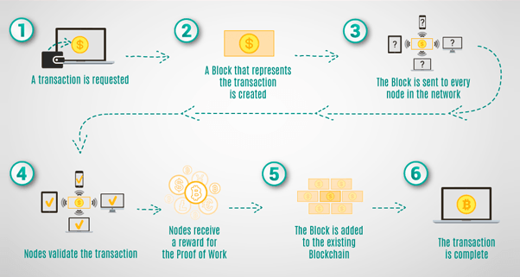
CSC307::BLOCKCHAIN ARCHITECTURE
AND DESIGN-I
Lecture 0

Slide 2
Course details
LTP – 2 0 2
Text Book:
BLOCKCHAIN APPLICATIONS - A HANDS-ON APPROACH by ARSHDEEP BAHGA AND VIJAY MADISETTI
Reference Book:
MASTERING BLOCKCHAIN by IMRAN BASHIR

Slide 3
Course Outcomes
Through this course, students should be able to:
CO1 :: describe the concept of a blockchain application through examples
CO2 :: establish a development environment for blockchain applications
CO3 :: discuss popular blockchain application templates
CO4 :: demonstrate the application of distributed applications on the Ethereum blockchain for various use cases
CO5 :: use Solidity to develop code covering basic data types, variables, operators, control flow statements, functions, and modifiers
CO6 :: analyze the potential benefits and challenges of implementing blockchain solutions in non-financial domains

Slide 4
Program Outcomes as specific to the particular course
PO-1:Engineering knowledge::Apply the knowledge of mathematics, science, engineering fundamentals, and an engineering specialization to the solution of complex engineering problems.
PO-2: Problem analysis::Identify, formulate, research literature, and analyze complex engineering problems reaching substantiated conclusions using first principles of mathematics, natural sciences, and engineering sciences.
PO-3:Design/development of solutions::Design solutions for complex engineering problems and design system components or processes that meet the specified needs with appropriate consideration for the public health and safety, and the cultural, societal, and environmental considerations.
PO-4:Conduct investigations of complex problems::Use research-based knowledge and research methods including design of experiments, analysis and interpretation of data, and synthesis of the information to provide valid conclusions.
PO-5: Modern tool usage::Create, select, and apply appropriate techniques, resources, and modern engineering and IT tools including prediction and modeling to complex engineering activities with an understanding of the limitations
PO-8:Ethics::Apply ethical principles and commit to professional ethics and responsibilities and norms of the engineering practice.
PO-9:Individual and team work::Function effectively as an individual, and as a member or leader in diverse teams, and in multidisciplinary settings.
PO-12: Life-long learning::Recognize the need for, and have the preparation and ability to engage in independent and life-long learning in the broadest context of technological change.
PO-13: Competitive Skills::Ability to compete in national and international technical events and building the competitive spirit

Slide 5
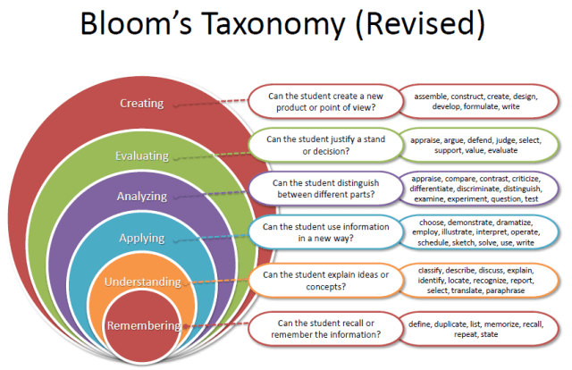
Revised Bloom’s Taxonomy

Slide 6
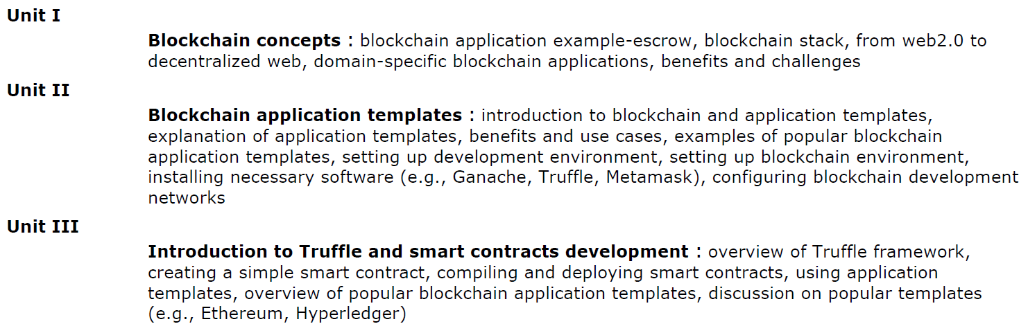
The course contents

Slide 7
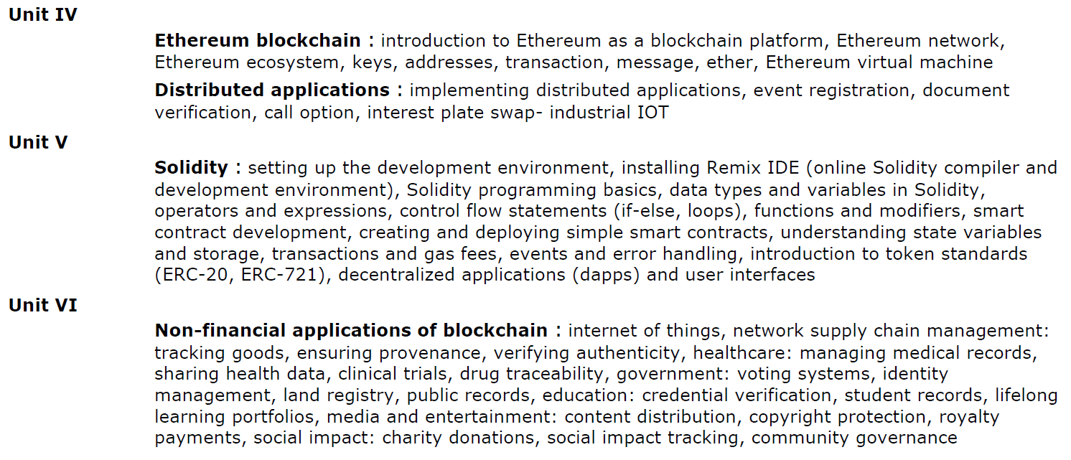
The course contents

Slide 8
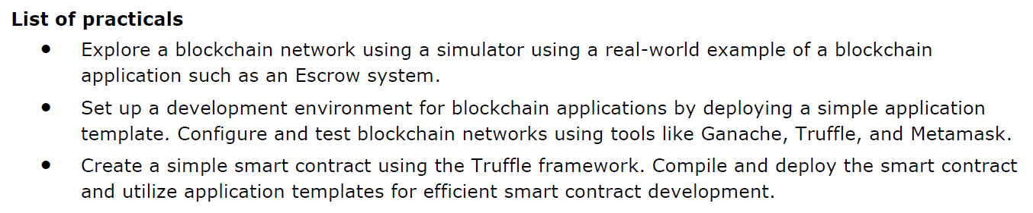
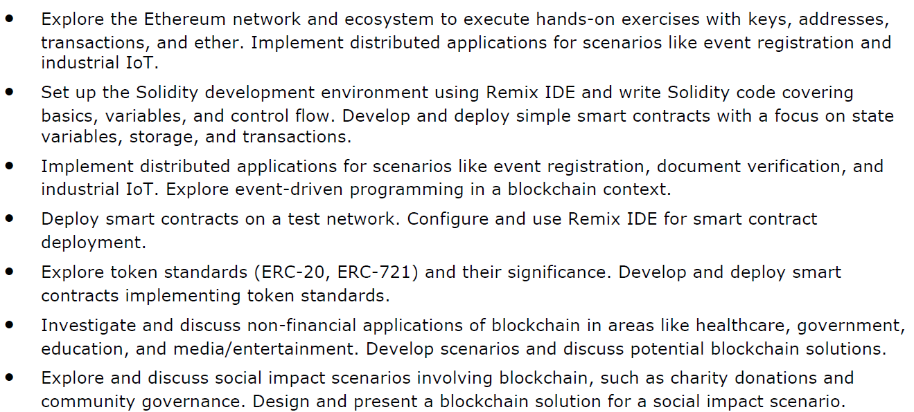

Slide 9
References: Introduction to blockchain concepts: https://www.ibm.com/topics/blockchain Ethereum Development: https://ethereum-blockchain-developer.com/ Ethereum and Solidity developer: https://www.udemy.com/course/ethereum-and-solidity-the-complete-developers-guide/

Slide 10
Course Assessment Model
Marks break up
Attendance 5%
CA 25%
MTE 20%
ETE 50%
Total 100%
Three Class test – One before MTE and Two after MTE
CA 1- Subjective - Two questions of 10 marks and two questions of 5 marks.
CA 2- BYOD practical - Code based test consisting of a question of 30 marks.
CA 3- BYOD practical – Code based test consisting of a question of 30 marks.

Slide 11
Career prospects of Blockchain Architect
Blockchain Application Developer
Blockchain Application Auditor

Slide 12


