Slide 1

Portfolio - Statistics
Quants & Ratios
Month-end AUM | INR 11,203 Cr
Total Stock Count | 58
Active Share | 32%
Top-10 Holdings | 49%
Sharpe Ratio | 0.18
Beta | 0.89
Standard Deviation | 11.72%
Portfolio Turnover Ratio | 41%
Market Capitalization
Segment | Fund | BM
Large Cap | 89% | 91%
Mid Cap | 9% | 7%
Small Cap | 2% | 2%
Portfolio Composition
Operating Cash Flow (OCF) |  |  | Return on Capital Employed
Tier | Fund | BM | Tier | Fund | BM
C1 | 89% | 88% | R1 | 63% | 56%
C2 | 2% | 3% | R2 | 31% | 37%
C3 | 9% | 9% | R3 | 6% | 7%
Parameters | Fund | BM
Price to Book | 3.38 | 2.96
Price to Earnings | 23.63 | 21.16
Return on Equity | 18.81% | 20.11%
Source: Bloomberg, BSE, Internal Portfolio Analytics as of 30/Mar/2026. Quants calculated using BSE 100 TRI as benchmark.
Operating Cash Flow (OCF) Tiers: C1 = OCF/EBITDA > 75%, C2 = 50-75%, C3 < 50%. RoCE Tiers: R1 > 18%, R2 = 10-18%, R3 < 10%.
1

Slide 2
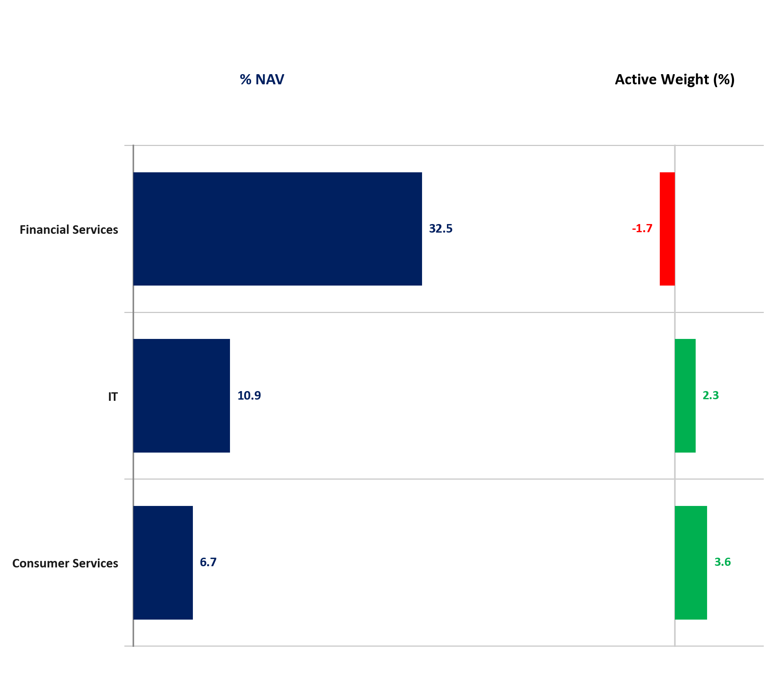
Portfolio - Sectoral Allocation
Sectoral Breakdown & Active Position (%)
Overweight (Top 3)
Sector (%NAV / %AW) | Sector Overview
Consumer Services (6.7% / +3.6%) | • Changing lifestyles
Consumer Durables (4.5% / +3.1%) | • Brand recall
IT (10.9% / +2.3%) | • Cloud and AI
Underweight (Top 3)
Sector (%NAV / %AW) | Sector Overview
Power (0.2% / -3.2%) | • Capital intensive
FMCG (6.8% / -1.9%) | • Uneven recovery
Financial Services (32.5% / -1.7%) | • NIM compression
2
Source: Internal Portfolio Analytics, FactSet, BSE 100 TRI as of March 30, 2026. Active Weight = Fund Weight - Benchmark Weight.

Slide 3
Portfolio - Holdings & Investment Insights
Top 10 Holdings & Benchmark Comparison
Key Active Stock Positions & Recent Activity
Stock Name | Sector | Fund % | BM % | Active %
Stock 1 | Financial Services | 5.0% | 4.0% | +1.0%
Stock 2 | Financial Services | 5.0% | 4.0% | +1.0%
Stock 3 | Financial Services | 5.0% | 4.0% | +1.0%
Stock 4 | Financial Services | 5.0% | 4.0% | +1.0%
Stock 5 | Financial Services | 5.0% | 4.0% | +1.0%
Stock 6 | Financial Services | 5.0% | 4.0% | +1.0%
Stock 7 | Financial Services | 5.0% | 4.0% | +1.0%
Stock 8 | Financial Services | 5.0% | 4.0% | +1.0%
Stock 9 | Financial Services | 5.0% | 4.0% | +1.0%
Stock 10 | Financial Services | 5.0% | 4.0% | +1.0%
Top 10 Total | - | 50.0% | 40.0% | +10.0%
Stock Name | Sector | Active % | Positioning Note
Stock 1 | Financial Services | +1.0% | Core Holding
Stock 2 | Financial Services | +1.0% | Core Holding
Stock 3 | Financial Services | +1.0% | Core Holding
Stock 4 | Financial Services | +1.0% | Core Holding
Stock 5 | Financial Services | +1.0% | Core Holding
AI-Generated Portfolio Observations & Key Risks
• High quality bias: 89% of portfolio companies reside in top Operating Cash Flow tier (C1) and 63% in top RoCE tier (R1 vs 56% for BSE 100 TRI).
• Concentrated high-conviction positioning: Top 10 holdings represent ~49% of portfolio NAV with disciplined risk management.
• Balanced cyclical and defensive exposure providing resilience across market regimes.
3
Source: Internal Portfolio Analytics, BSE 100 TRI as of March 30, 2026. Top holdings represent ~49% of Fund NAV.

