Slide 1
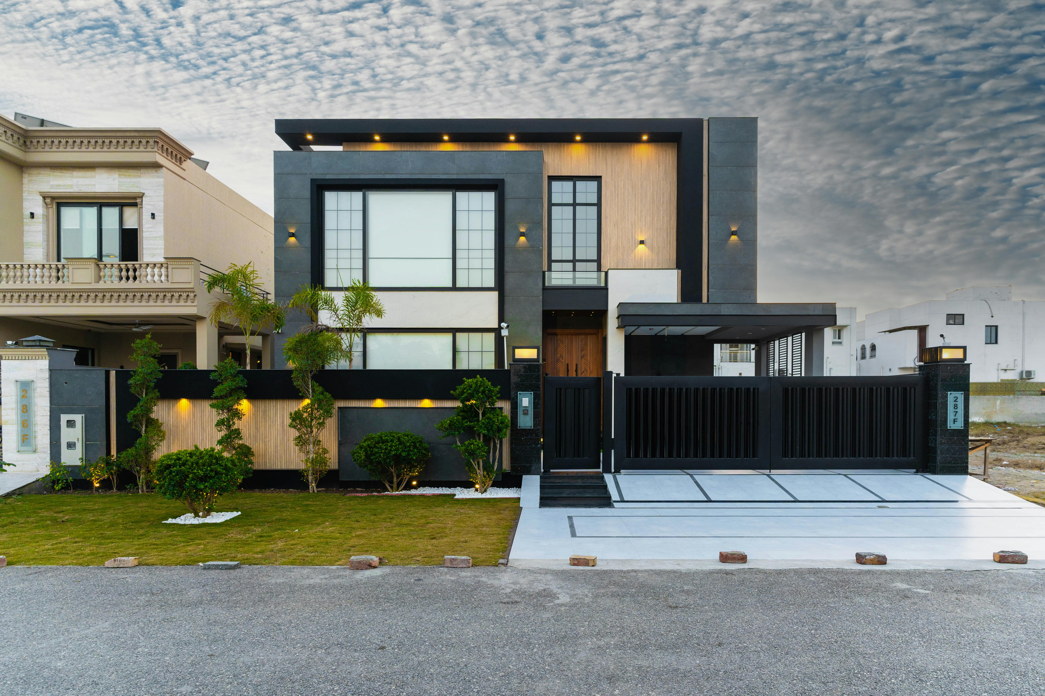


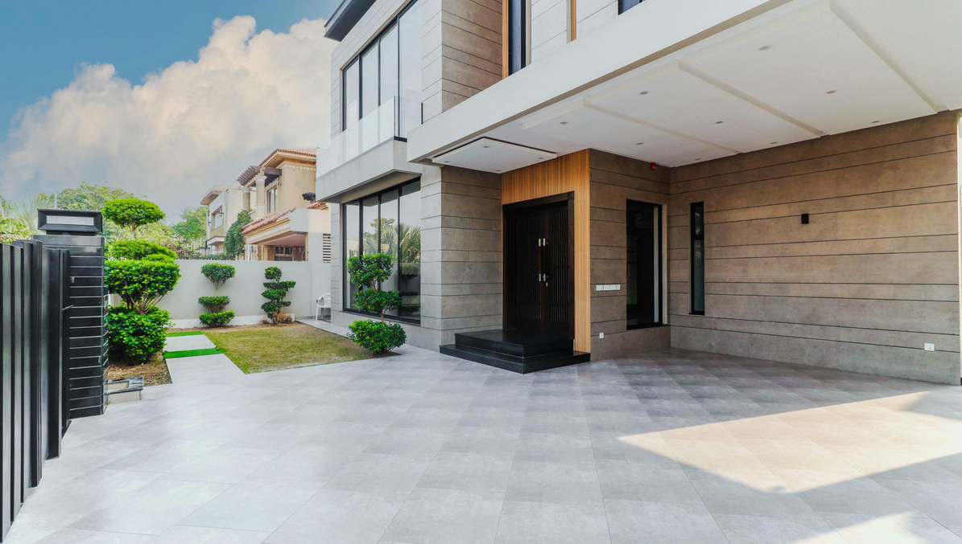


THANE
HOUSE
RENT PREDICTION SYSTEM

Slide 2
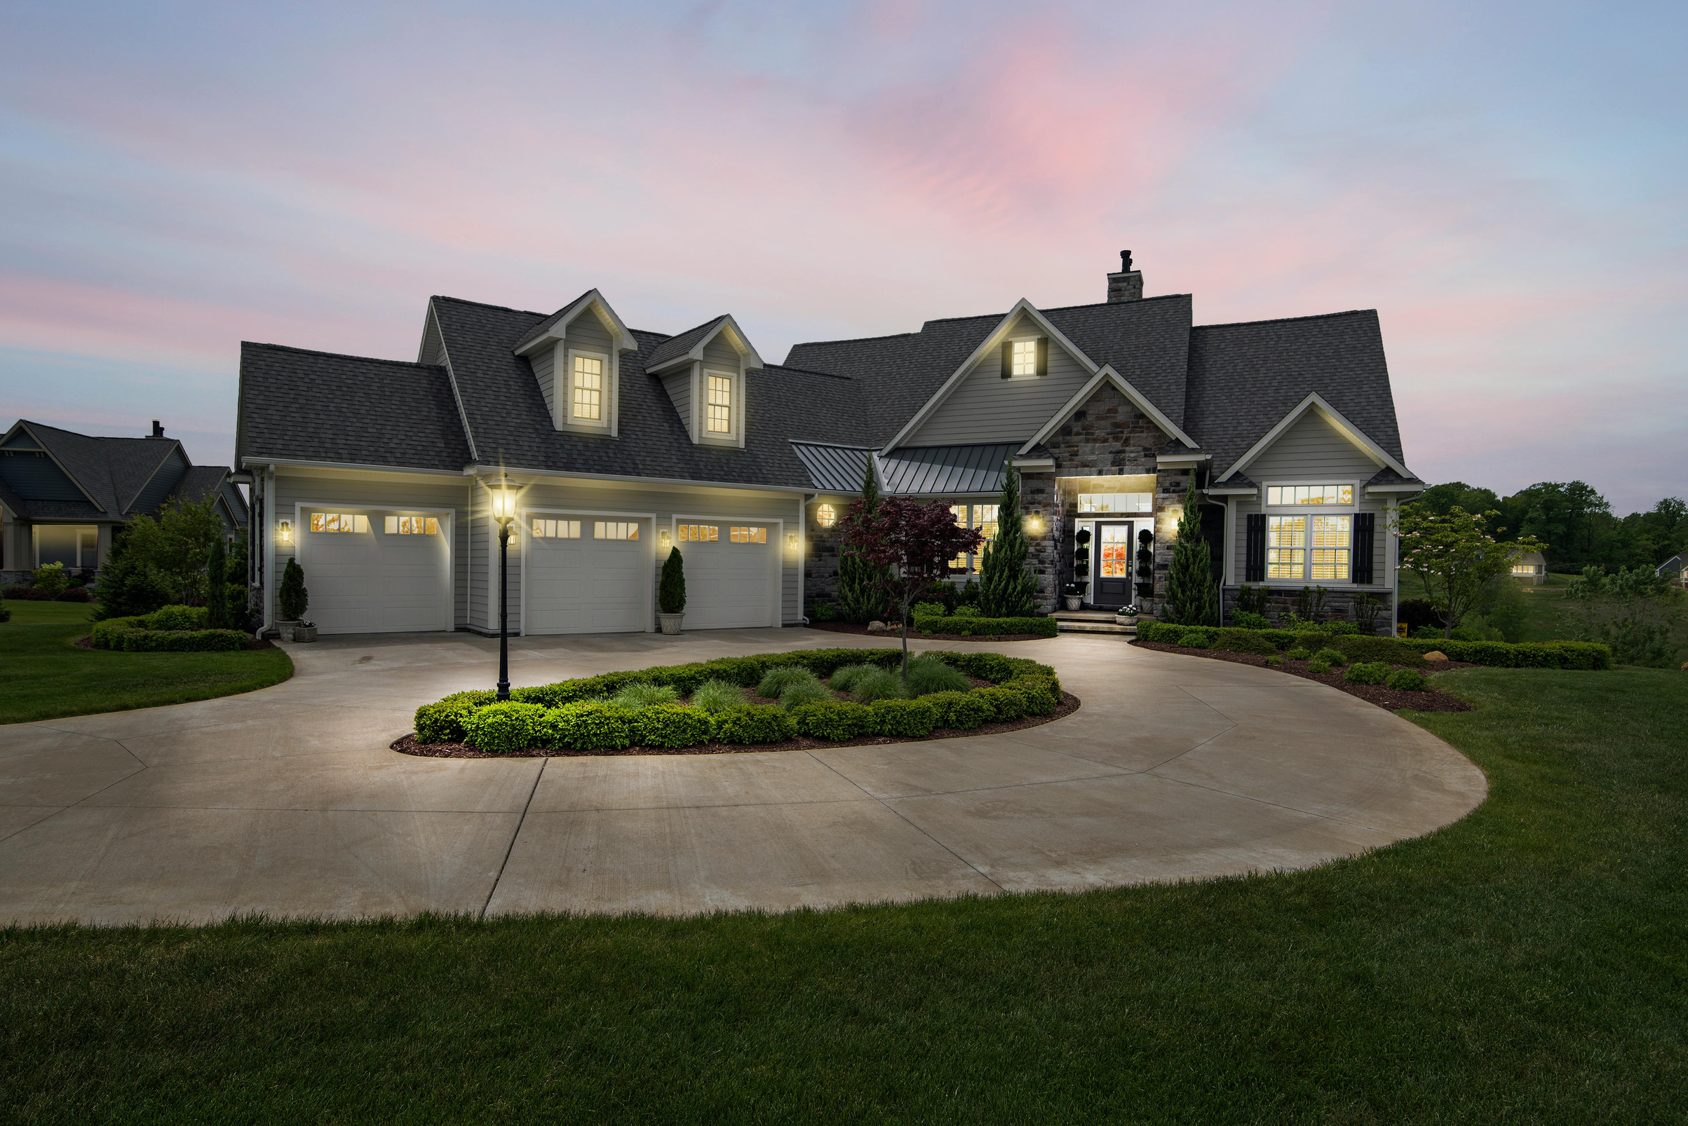
PROBLEM STATEMENT & OBJECTIVE
01.
• People often don't know the correct rent for a house.
• Rent depends on many factors like area, bedrooms, bathroom, and furnishing.
• Manual estimation may not be accurate.
• Therefore, we developed a machine learning based house rent prediction system.
• This system uses machine learning to predict house rent based on these factors.
02.
Predict house rent accurately using machine learning.
Understand how different house features like area, bedrooms, bathrooms, and furnishing affect the rent.
Provide a simple and user-friendly web interface for anyone to estimate rent quickly.

Slide 3
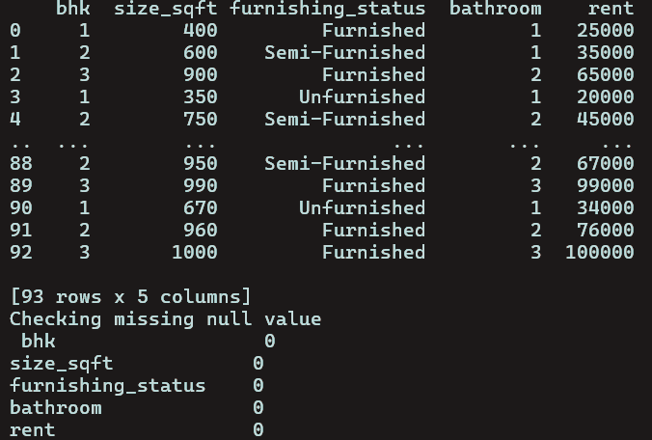
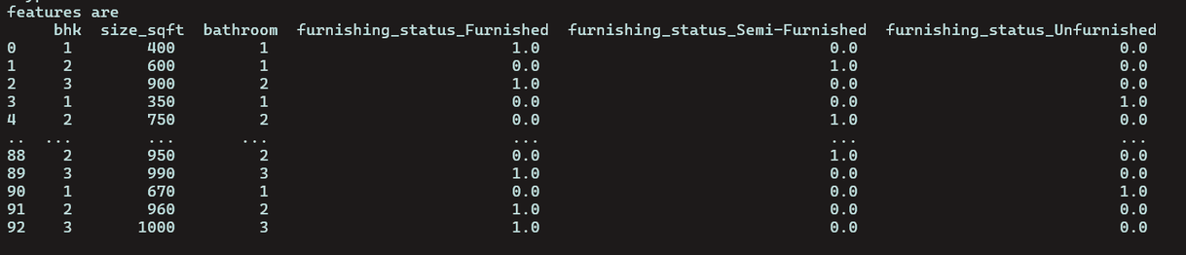
DATASET & PREPROCESSING
01.
The dataset contains house information in Thane to predict rent.
Features included:
Bedrooms – Number of bedrooms in the house
Area – Size of the house in square feet
Bathroom – Number of bathrooms
Furnishing Status – Furnished, Semi-Furnished, or Unfurnished
Rent – Target variable to predict monthly rent
02.
Data Preprocessing Steps:
Checked for missing values and cleaned the data.
Converted categorical data (Furnishing Status) into numbers using OneHotEncoder.
Combined encoded features with original numerical features to form the final dataset for model training.

Slide 4
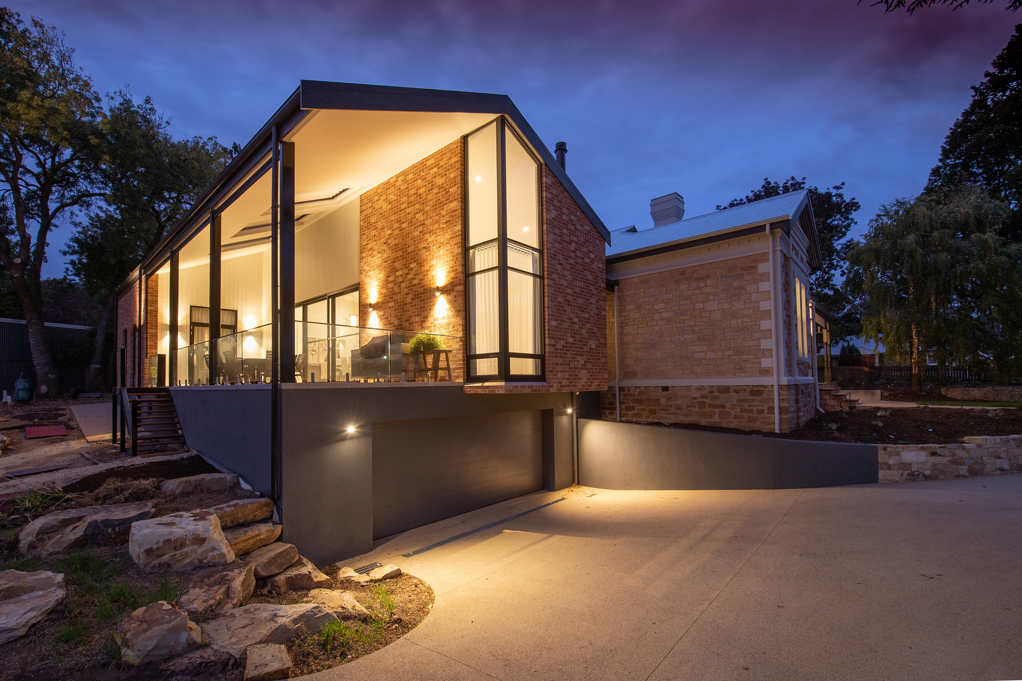
TECH STACK & TARGET USER
TECHNOLOGY
• Python – Main programming language used for development
• Pandas – Used for data loading and data handling
• Scikit-learn – Used to build and train the machine learning model
• Pickle – Used to save the trained model file for future prediction
• Flask – Used to create the web interface for user interaction
• OneHotEncoder – To convert categorical features like Furnishing Status into numerical data
TARGET USER
This system is designed for:
Tenants / Renters – To estimate fair rent before renting a house.
Property Owners / Landlords – To set accurate rent for their properties.
Real Estate Analysts – To analyze how house features affect rent.
Students & Researchers – To learn how machine learning can predict real-world house rents.

