Slide 1
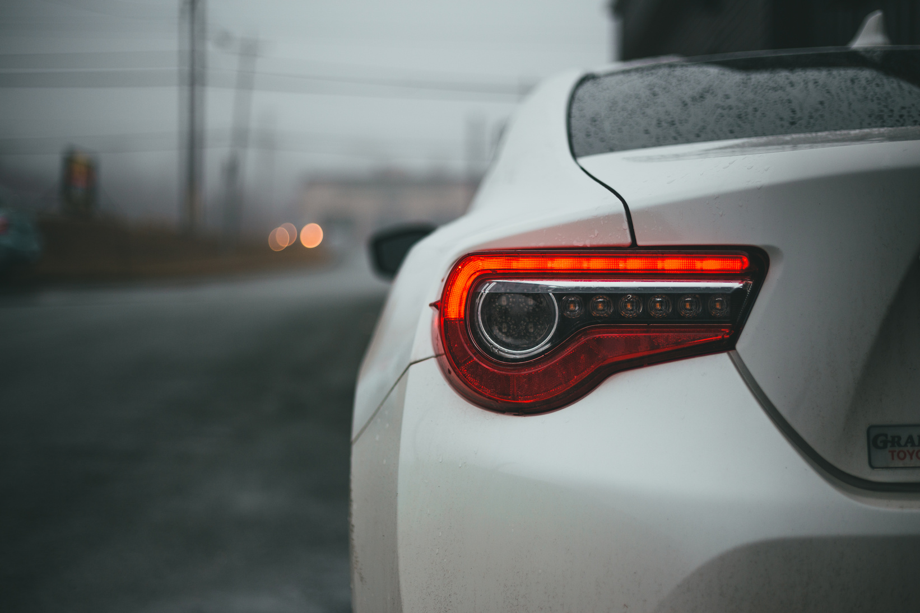
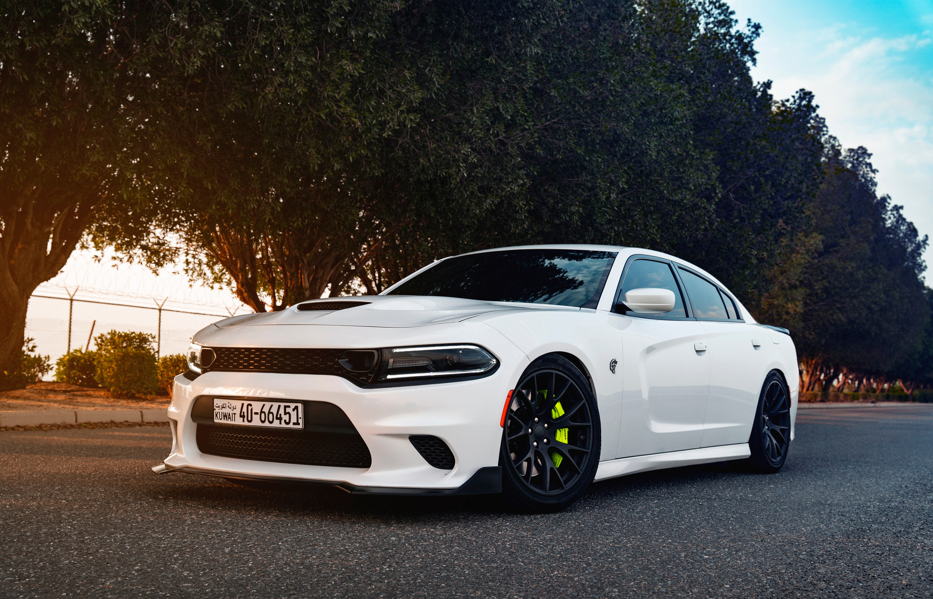
AUTOVALUER
SMART CAR RESALE PRICE PREDICTOR

Slide 2

PROBLEM STATEMENT
& OBJECTIVE
People often face problems while selling or buying used cars because:
They do not know the accurate market price.
Car prices depend on many factors such as.
1. Car brand
2. Age of the car
3. Kilometers driven
Manually estimating the correct resale value of a car can be difficult and inaccurate.
To solve this problem, we developed AutoValuer, a machine learning based system that predicts the approximate resale price of a car using historical data.
The system takes car details as input and returns an estimated market price.

Slide 3
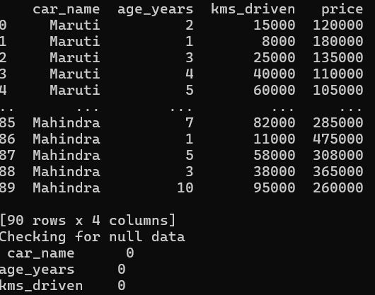
DATASET & PREPROCESSING
The dataset used in this project contains information about used cars and their selling prices.
Features in the dataset include:
Car Name
Age of car
Kilometers Driven
Target Variable: Selling Price (Car Resale Value)
Before training the model, data preprocessing is applied.
Check for missing values .
Encode categorical column car_name into numerical format using OneHotEncoder
This ensures the model can properly understand the input data.

Slide 4

TECH STACK &
TARGET USER
TECH STACK
•Python – Main programming language
•Pandas – Data handling and preprocessing
•Scikit-learn – RandomForestRegressor Machine learning algorithm used to predict the resale price of cars
• ColumnTransformer – Used to apply preprocessing to specific columns.
• Pipeline (make_pipeline) – Combines preprocessing & model training into a single workflow.
•OneHotEncoder – Categorical data encoding
•Flask – Web interface for user input and prediction
•Pickle – Save trained model for deployment
TARGET USERS
Car Sellers – To estimate the resale value of their car
• Car Buyers – To check if the car price is fair
• Car Dealers – To quickly evaluate used car prices
• Online Car Platforms – For automatic price estimation

