Slide 1


Salary Predictor
Predict Salary Based on Experience Using Machine Learning
presented By: vishal verma

Slide 2
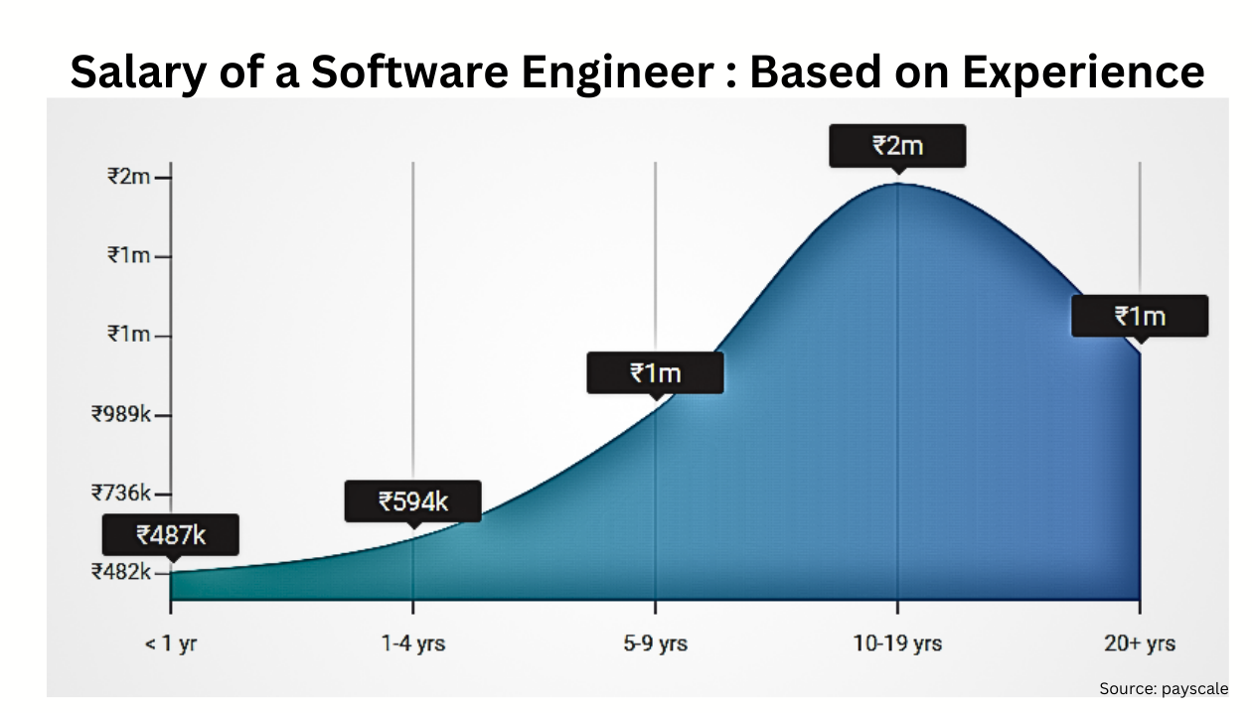
Problem Statement
  Employees often want to know expected salary based on experience, leading to uncertainty.
  Manual estimation processes are inconsistent, subjective, and time-consuming for all parties involved.
  HR departments and recruiters currently lack a fast, reliable, and data-driven tool for accurate salary prediction.

Slide 3
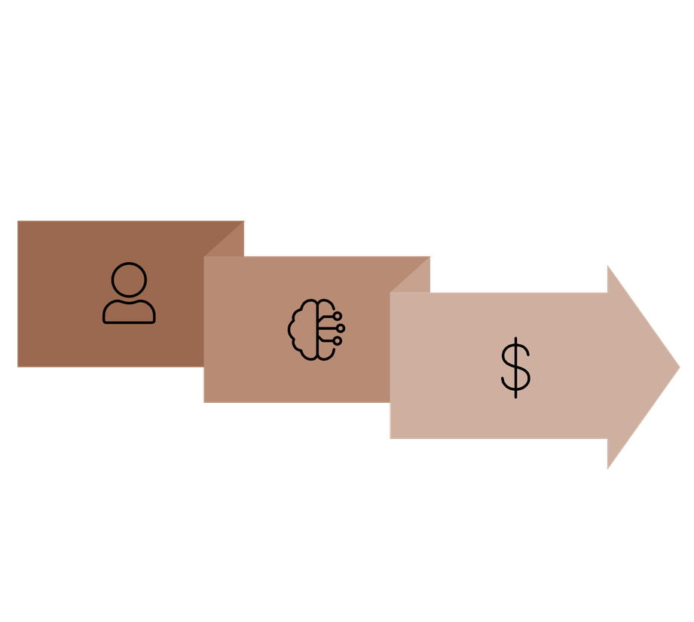



Our Solution
We offer a robust machine learning solution designed to streamline salary predictions.
Input
Output
ML Model
This model provides quick, accurate, and consistent salary estimates, empowering HR, recruiters, and job seekers with reliable information.
  A machine learning model predicts salary using years of experience as its primary input.
  Output: Predicted salary in ₹ for any given experience level.
  Provides quick, accurate, and consistent salary estimates.
  Supports HR, recruiters, and job seekers in making informed decisions for compensation and career planning.

Slide 4
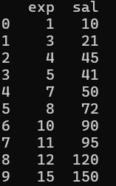
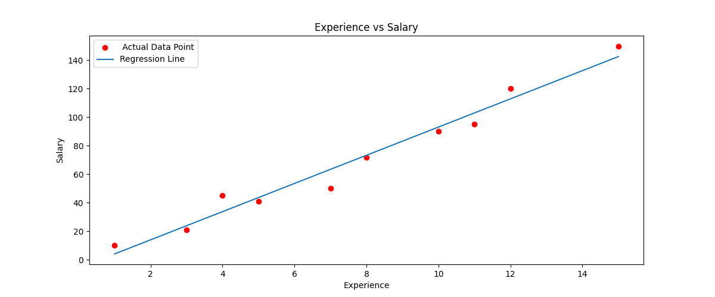
Dataset Overview
Our model is trained on a meticulously curated dataset to ensure predictive accuracy.
  The dataset comprises two crucial columns: Experience (in years) and Salary (₹).
  Experience precisely represents the number of years of professional work in a given field.
  Salary indicates the corresponding compensation for each specific experience level.
  The dataset underwent thorough cleaning and preparation, ensuring optimal quality for model training.

Slide 5







Tech Stack & Target Users
Tech Stack
Target Users
Python
HR Professionals
Core language for computational tasks and scripting.
For data-driven salary analysis and compensation benchmarking.
Pandas
Recruiters
Essential for efficient data manipulation and analysis.
To streamline recruitment, set expectations, and plan compensation strategies effectively.
Scikit-learn
Library for machine learning model training and evaluation.
Job Seekers
To understand expected compensation, negotiate confidently, and make informed career decisions.
Matplotlib/Seaborn
Used for comprehensive data visualization and plotting.

Slide 6

Workflow
Input: Years of Experience
User enters experience in years
Salary Prediction Workflow
Output: Predicted Salary
ML Model Prediction
Estimated salary presented to user
Model processes input to predict salary
This streamlined workflow ensures automated and accurate salary predictions based solely on experience data, providing a seamless and efficient process for all users.
  Input (Years of Experience): Users provide their professional experience in years.
  ML Model Prediction: Our trained machine learning model processes the input data.
  Output (Predicted Salary): The model generates an estimated salary in Indian Rupees (₹).

