Slide 1

DIABETES
CLASSIFIER
SYSTEM
UNDERSTANDING GLUCOSE IN THE BODY
PRESENTED BY:VISHAL VERMA

Slide 2
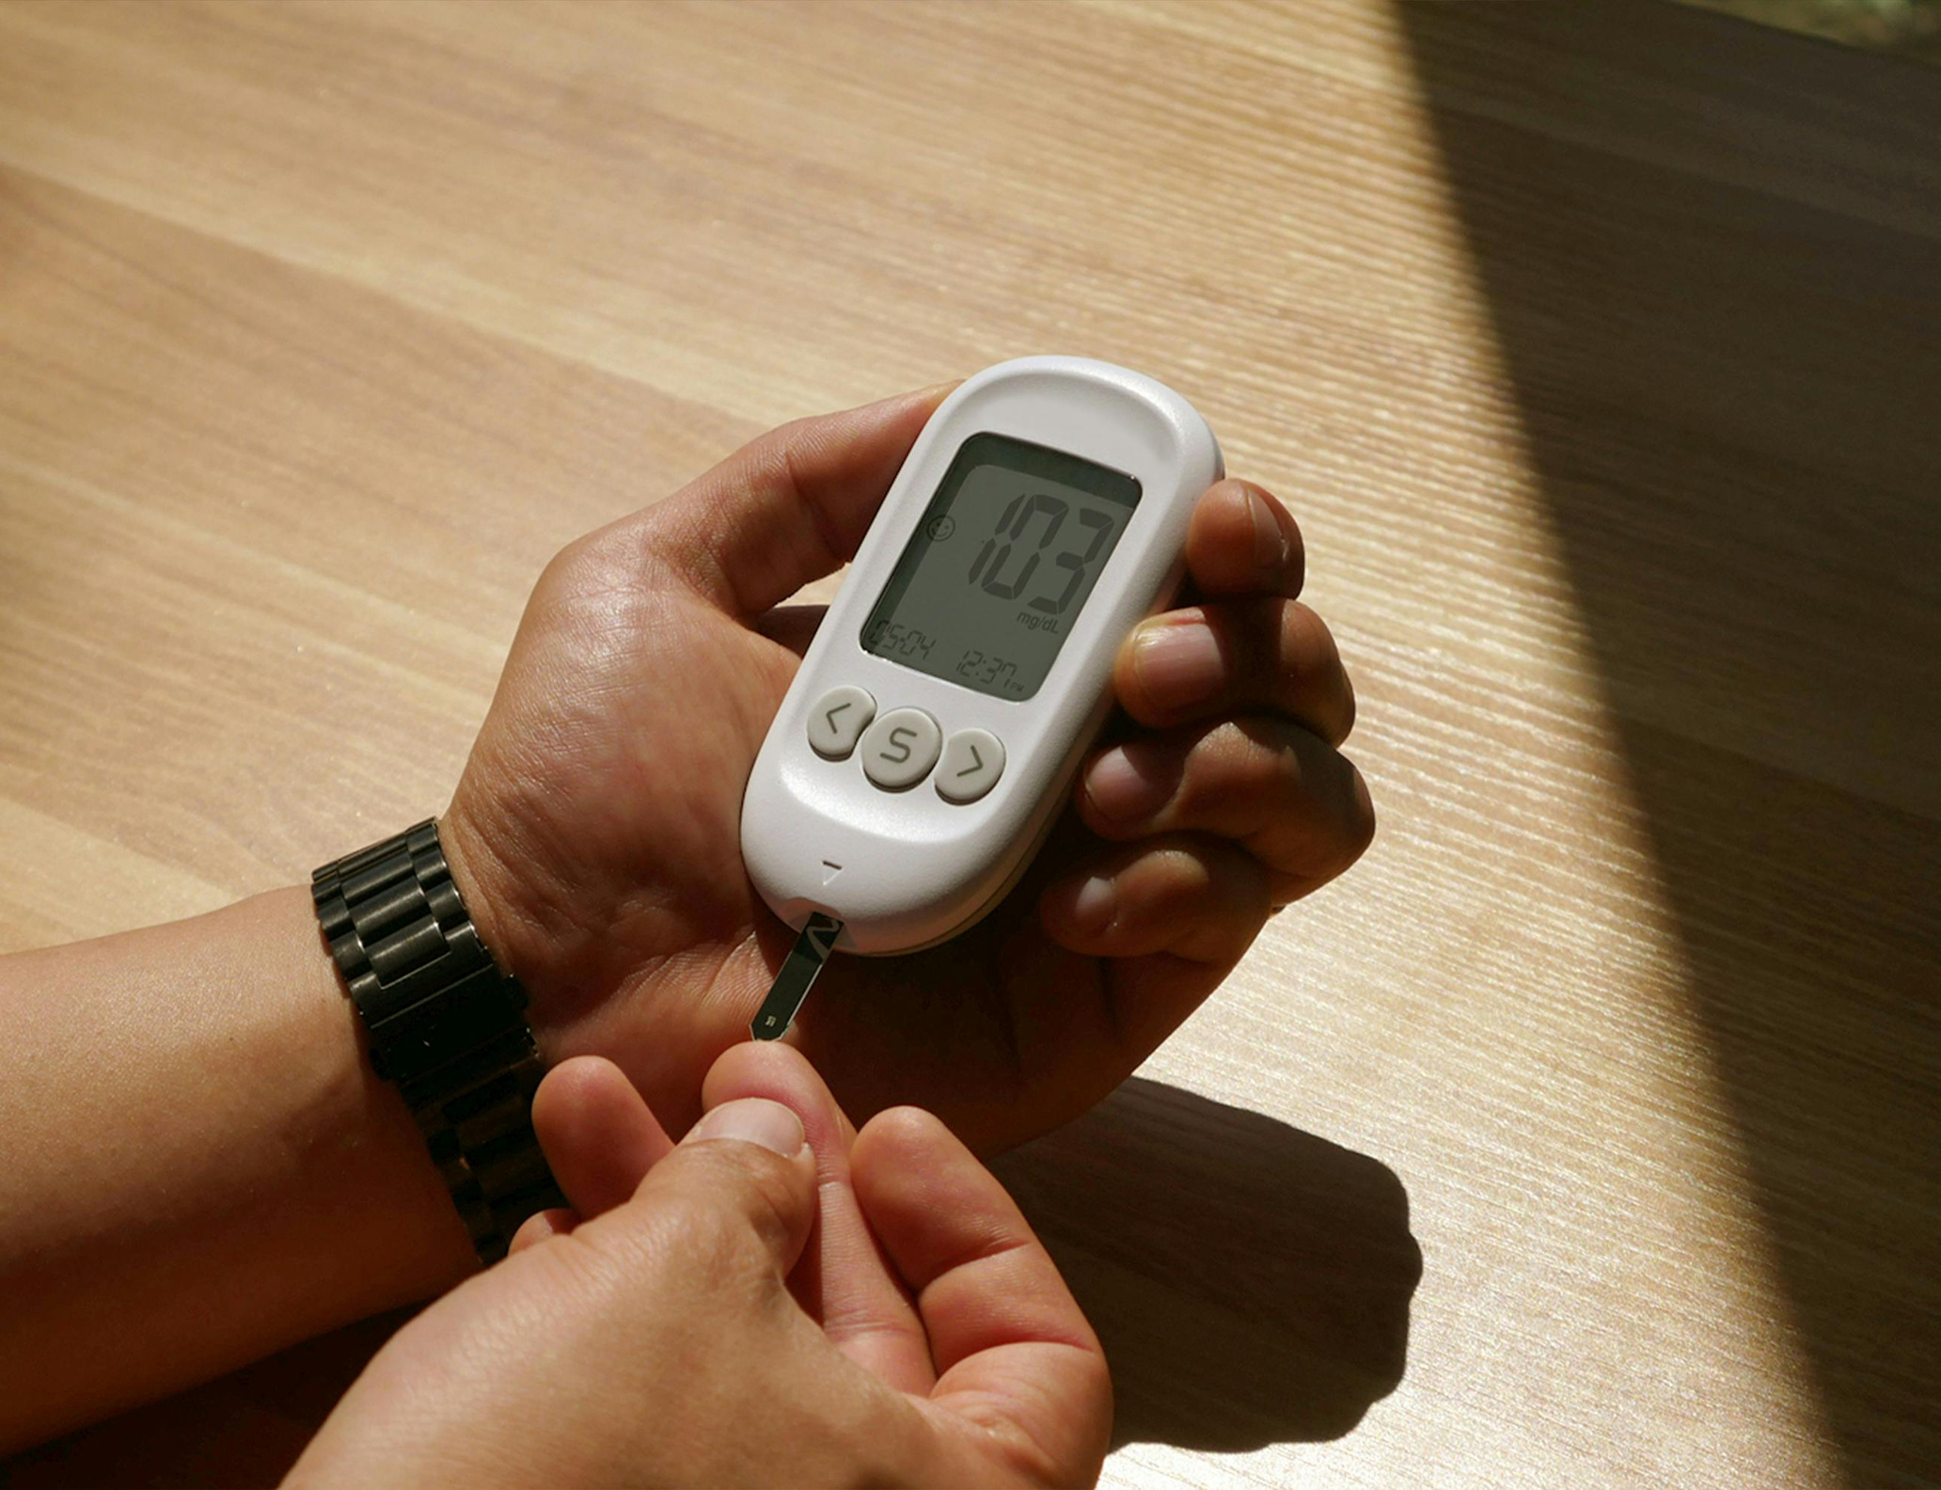
INTRODUCTION
Diabetes is a common health problem and early detection is important.
Many people do not know whether they are at risk, and manual assessment is slow and error-prone.
This system predicts Diabetes risk based on features like age, BMI, fasting sugar, HbA1c, gender, hypertension, and family history.
It provides a fast and accurate prediction using machine learning.
This project solves the problem by predicting diabetes risk using Logistic Regression.

Slide 3
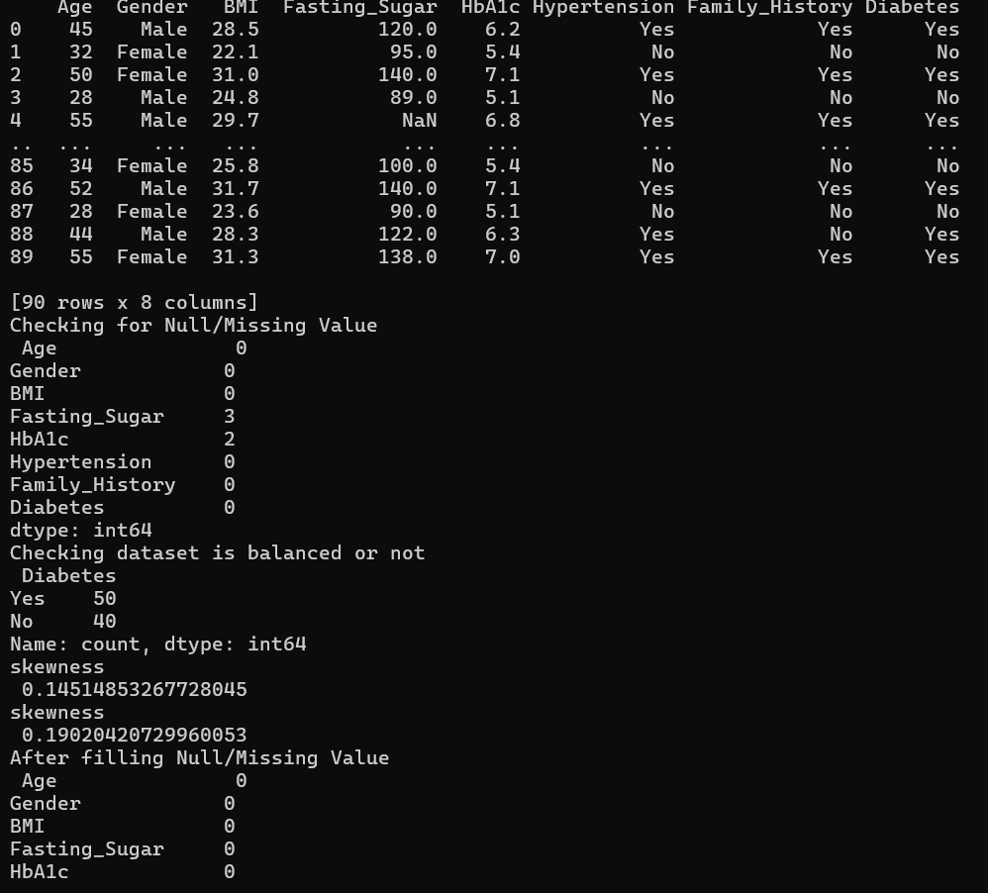
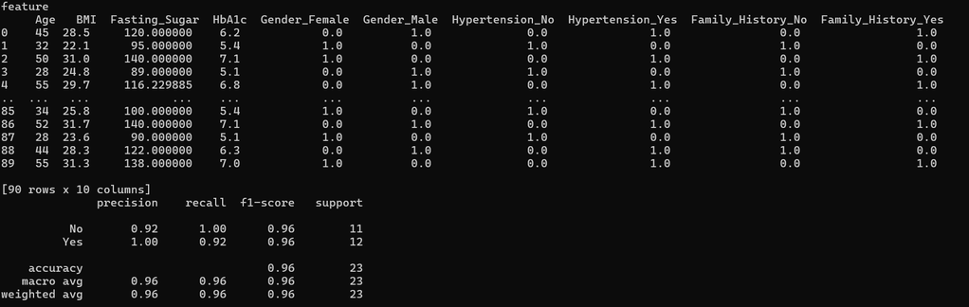
DATASET & PREPROCESSING
The dataset contains patient data to predict diabetes risk.
Features included:
Age – Patient’s age
BMI – Body Mass Index
Fasting Sugar – Blood sugar level after fasting
HbA1c – Average blood sugar level over 3 months
Gender – Male or Female
Hypertension – Yes/No
Family History – Yes/No
Diabetes – Target variable (Yes/No)
Data Exploration & Preprocessing:
Checked skewness of Fasting Sugar and HbA1c to understand data distribution.
Checked for missing values and filled Fasting Sugar & HbA1c with mean.
Encoded categorical features (Gender, Hypertension, Family History) using OneHotEncoder.
Combined numerical and encoded categorical features to create the final dataset for model training.

Slide 4
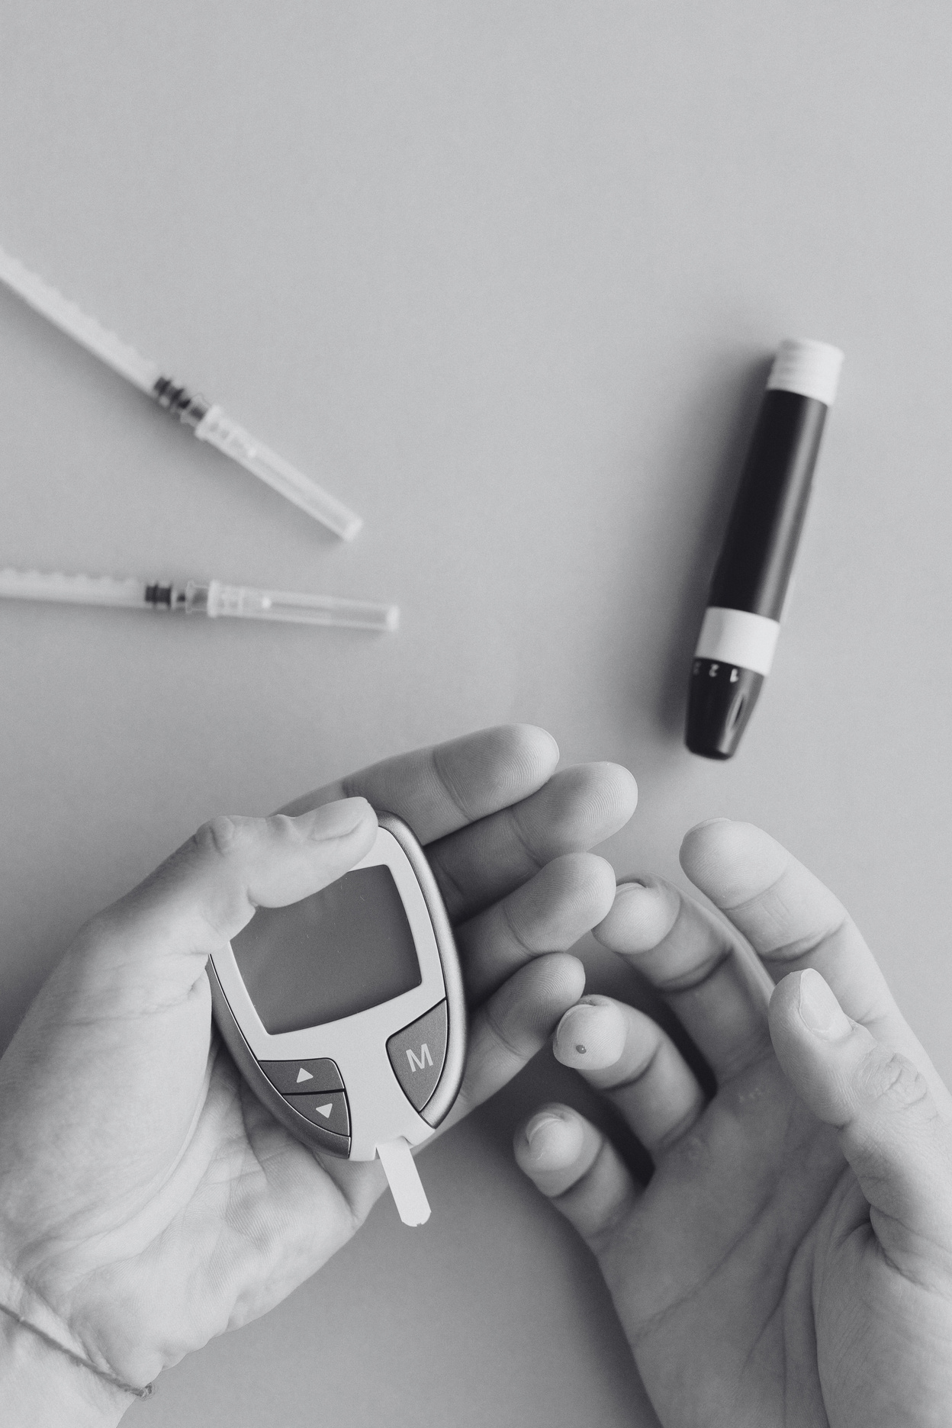

TECH STACK & TARGET USER
TECHNOLOGY STACK
Python – Main programming language
Pandas – Data handling and preprocessing
Scikit-learn – Logistic Regression and model evaluation
OneHotEncoder – Categorical data encoding
Flask – Web interface for user input and prediction
Pickle – Save trained model for deployment
TARGET USERS
This system is designed for:
Patients / General Public – To quickly check their diabetes risk.
Doctors & Healthcare Professionals – To assist in early detection and patient monitoring.
Researchers & Students – To study how different health features affect diabetes risk.
Healthcare Organizations – To help in screening programs and preventive care.

