Slide 1

PRACTICAL NO.4
VERSION CONTROL SYSTEM
BY SIMRAN.OMPRAKASH.DUBEY

Slide 2
INTRODUCTION
Git is a version control system for tracking changes in computer files and coordinating work on those files among multiple people. It is primarily used for source code management in software development, but it can be used to keep track of changes in any set of files. As a distributed revision control system it is aimed at speed, data integrity, and support for distributed, non-linear workflows.
Git is free software distributed under the terms of the GNU General Public License version 2.

Slide 3
WHAT IS VERSION CONTROL SYSTEM?
Version control is a system that records changes to a file or a set of files over time so that you can recall specific version later

Slide 4
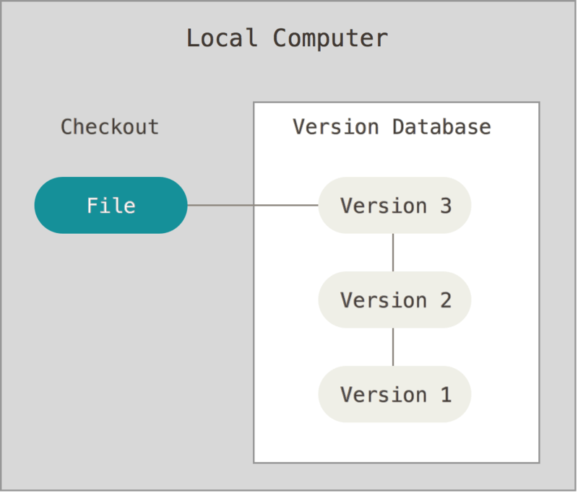
Types of Version Control Systems
1. Local Version Control Systems

Slide 5
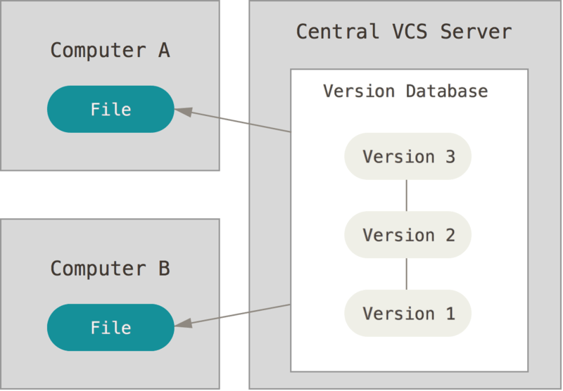
Types of Version Control System
2. Centralized Version Control Systems
There is a single central repository and
all of the changes that are made to the
Documents are saved in that repository

Slide 6
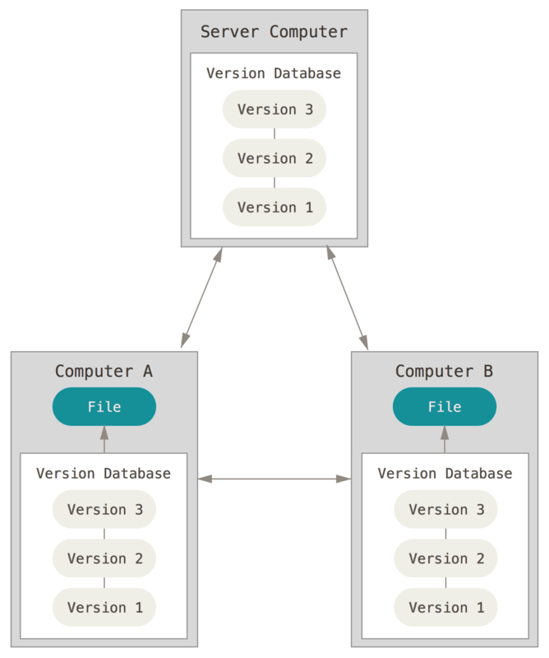
Types of Version Control Systems
3.Distributed Version Control Systems
There is a peer-to peer approach that clients can
Synchronize with by exchanging patches from
Peer to peer .Clients can make changes in the
repositories and those changes will be local to
them unless they synchronize with someone else.

Slide 7
HISTORY
Developed by LINUS TORVALDS

Slide 8
DEVELOPMENT
- Git is a version control system for tracking changes in computer files and co-ordinating work on those files among multiple people
- Git was created by Linus Torvalds in 2005 for development of the Linux kernel.
- Git is free software distributed under the terms of the GNU General Public License V2
- Latest version of Git is 2.14
- Git can run on both Windows & Linux OS

Slide 9
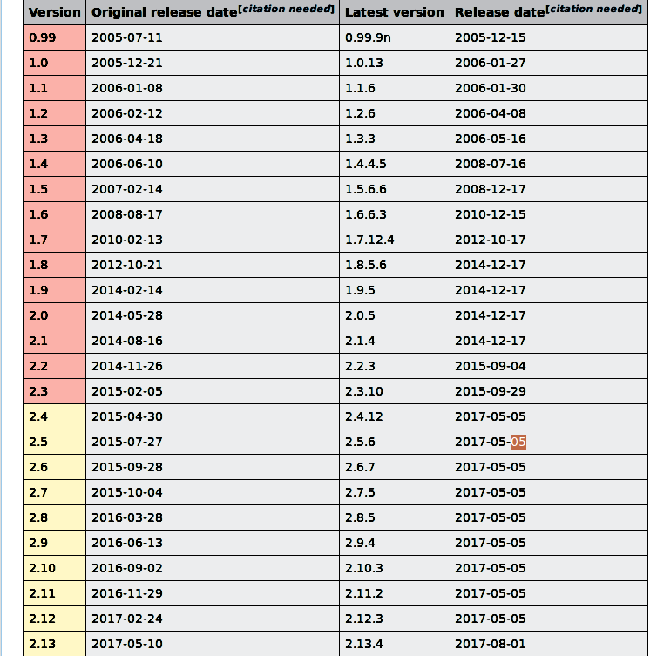
VERSIONS OF GIT

Slide 10
FEATURES
GENERAL FEATURES OF VERSION CONTROL
> Maintains complete long-term change history of every file
This means every change made by many individuals over the years. Changes include the creation and deletion of files as well as edits to their contents
> Branching and Merging
Allows team member to work concurrently on same file
> Traceability
Being able to trace each change made to the software and connect it to project management and bug tracking software such as JIRA
GIT FEATURES
> Branching and Merging
> Small and Fast
> Distributed
> Free and Open source

Slide 11
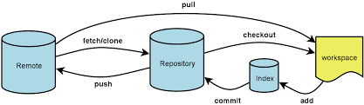
GIT COMMANDS
Pull Git :To pull the file into your local repository, do the following: Open your terminal window and navigate to the top level of your local repository. The git pull command merges the file from your remote repository (Bitbucket) into your local repository with a single command.
Enter the git pull --all command to pull all the changes from Bitbucket.

Slide 12
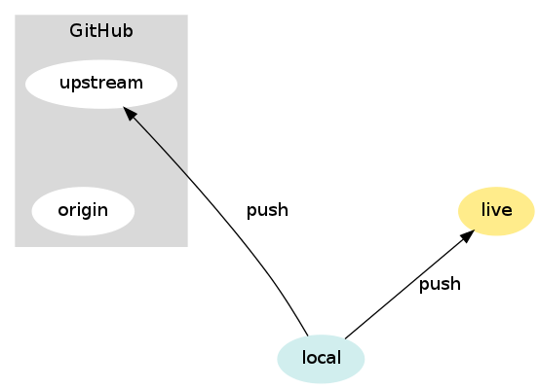
Push Git : Use git push to push commits made on your local
branch to a remote repository.
The git push command takes two arguments:
A remote name, for example, origin.
A branch name, for example, master.
git push <REMOTENAME> <BRANCHNAME> this commmand to push your local
changes to online repository

Slide 13
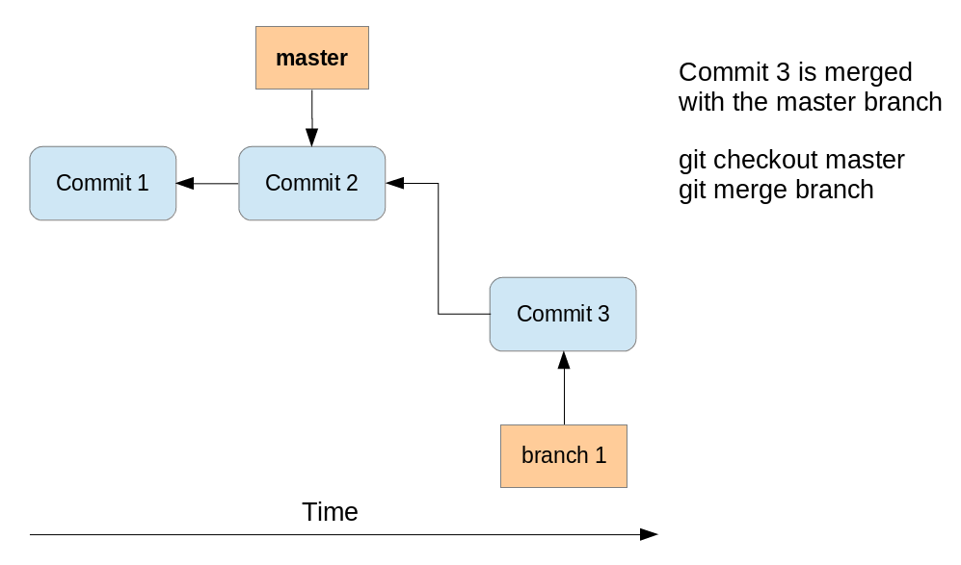
CheckOut Git :To check out" means that you take any given
commit from the repository and re-create the
state of the associated file and directory tree in the
working directory.
When you check out a commit that is not a
branch head (e.g. git checkout HEAD~2 ),
you are on a so-called detached head

Slide 14
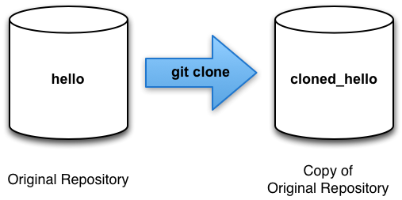
Clone Git : git clone is a Git command line utility
which is used to target an existing repository and
create a clone, or copy of the target repository.
git clone <repo url> git clone command creates repository
locally by copying remote repository
For example: git clone https://omprakash@gitlab.lavu.com/scm/php/myrepo.git

Slide 15
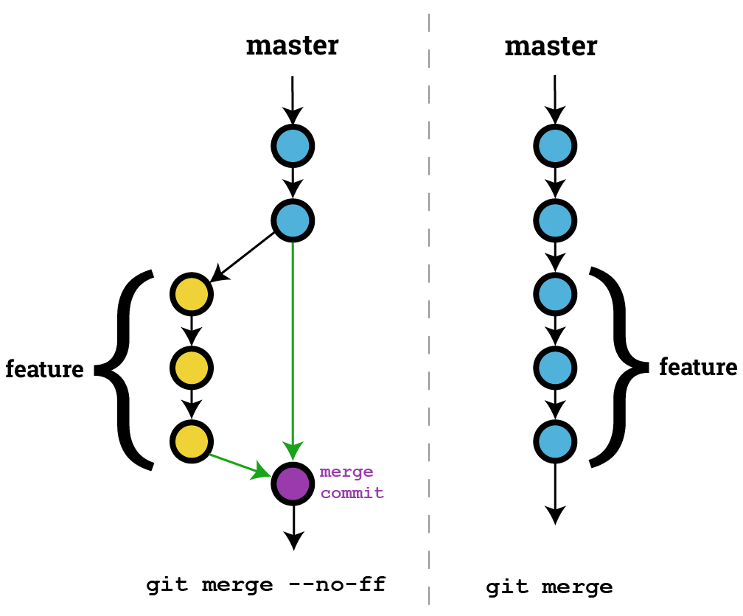
Merge Git : git merge. Merging is Git's way of putting a forked
history back together again. The git merge command
lets you take the independent lines of development
created by git branch and integrate them into a
single branch.
git merge <branch> this command will Merge the specified branch into the current
branch.

Slide 16
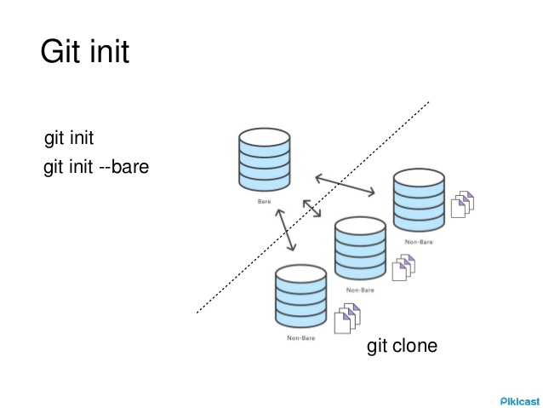
Git InIt :The git init command creates a new Git repository.
It can be used to convert an existing, unversioned project
to a Git repository or initialize a new, empty repository.
Most other Git commands are not available outside of an
initialized repository, so this is usually the first command
you'll run in a new project.

Slide 17
THANK YOU!!!

