Slide 1
GIT For Version Control

Slide 2
About Git
• Created by Linus Torvalds, creator of Linux, in 2005
– Came out of Linux development community
– Designed to do version control on Linux kernel
• Goals of Git:
– Speed
– Support for non-linear development (thousands of parallel branches)
– Fully distributed
– Able to handle large projects efficiently
– (A "git" is a cranky old man. Linus meant himself.)

Slide 3
Installing and Learning
• Git website: http://git-scm.com/
–Free on-line book: http://git-scm.com/book
– Reference page for Git: http://gitref.org/index.html
– Git tutorial: http://schacon.github.com/git/gittutorial.html
– Git for Computer Scientists: http://eagain.net/articles/git-for-computer-scientists/
•
At command line:
(where verb = config, add, commit, etc.)
git help v erb

Slide 4
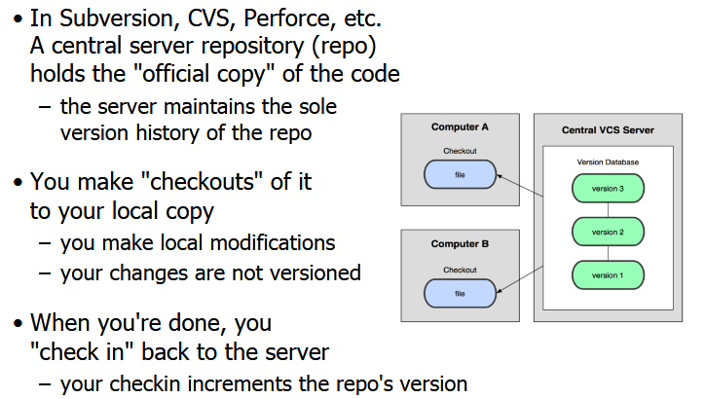
Centralized VCS

Slide 5
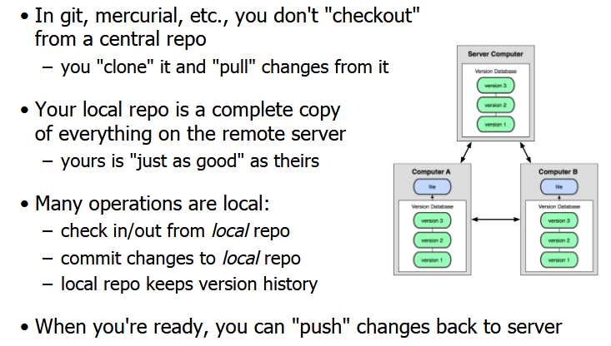
Distributed VCS (Git)

Slide 6
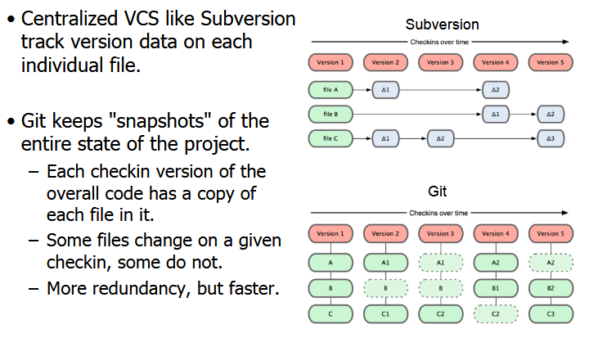
Git SnapShots

Slide 7
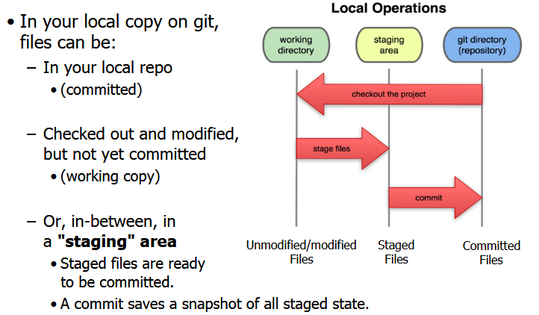
Local Git Areas

Slide 8
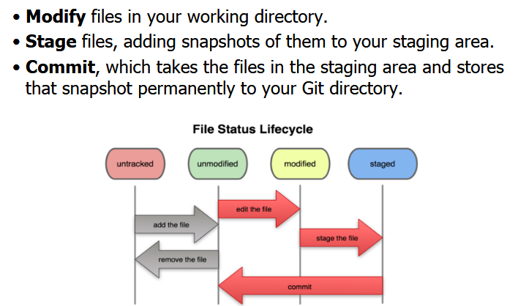
Basic Git Workflow

Slide 9
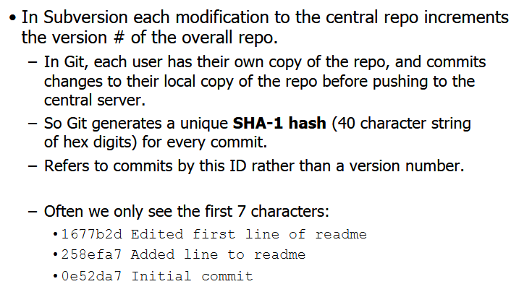
Git Commit Checksums

Slide 10
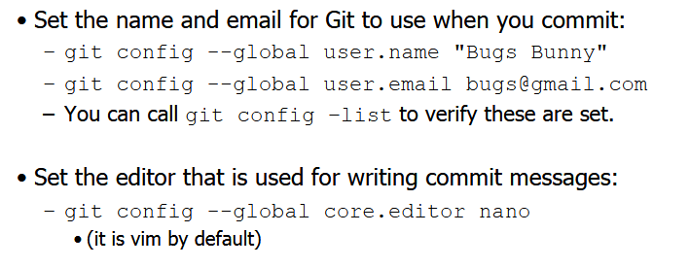
Initial Git Configurations

Slide 11
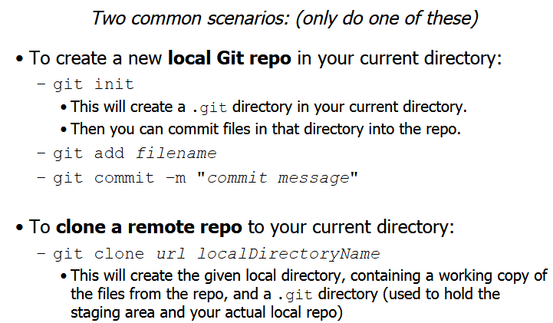
Creating a Git Repo

Slide 12
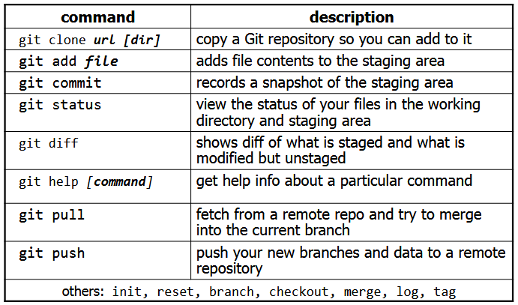
Git Commands

Slide 13
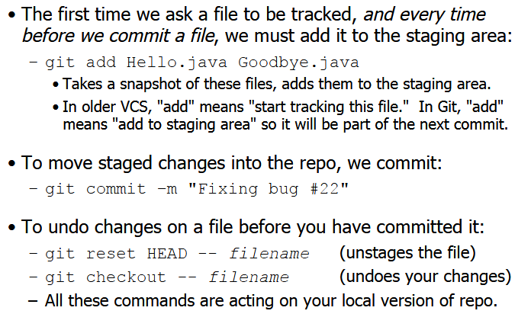
Add and Commit a File

Slide 14
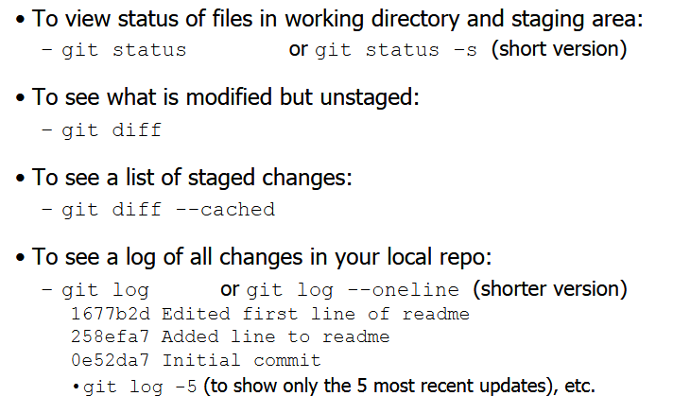
View/Undo Changes

Slide 15
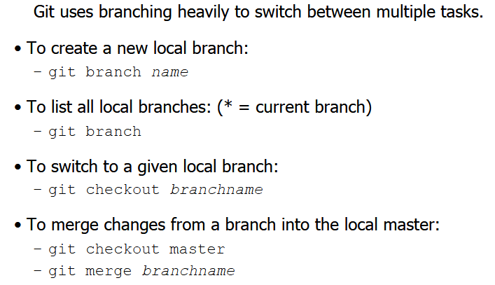
Branching and Merging

Slide 16
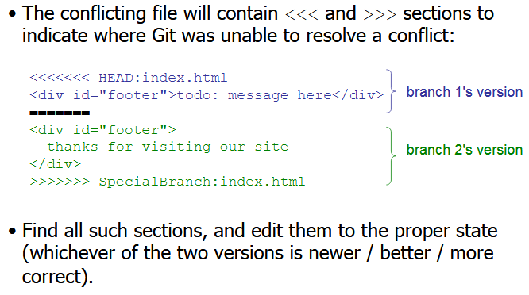
Merge Conflicts

Slide 17
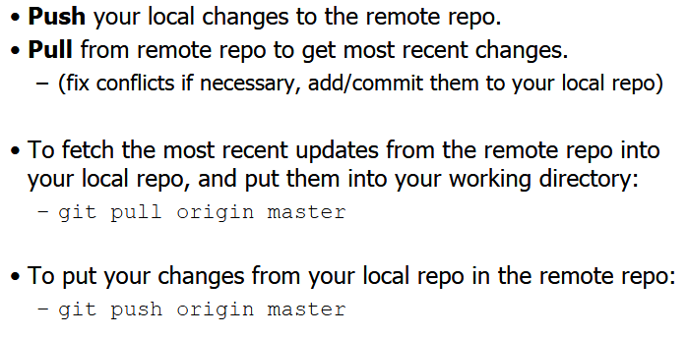
Interaction w/ remote repo

Slide 18
GitHub

Slide 19
Thanks!
Any questions?
You can find me at deepak.awslearn@gmail.com

