Slide 1
HAND GESTURES RECOGNITION USING STOCHASTIC POOLING

Slide 2
Pooling
The major problems in downsampling (application of pooling layers) is loss of important features while classification of images.
When using max pooling after convolutional layer we assume that the pixel with maximum value is corresponding to maximum features. But main drawback of this technique is that it suffers from overfitting.
When using average pooling after convolutional layer we take mean pixel value for all pixels and use it for next layer. In this all elements in a pooling region are considered, even if many have low magnitudes.
The main complication in hand gesture recognition comes in feature selection. When important features (pixels) are missed the classification accuracy is lowered. These important features may correspond to hand positions, angle and shape of hands.

Slide 3
Max Pooling
Pooling is a non-linear transformation that permits to summarize the output of a net at a certain location with a single value. This single value is obtained from the statistic of the neighboring outputs which makes the feature descriptions more robust and invariant to small translations of the input data.
Max Pooling Example
No consideration of previous layer
1 | 5 | 8 | 0
4 | 6 | 6 | 6
2 | 2 | 5 | 5
8 | 0 | 4 | 1
Max Pooling with 2x2 Filter and Stride value 2
6 | 8
8 | 5

Slide 4
Average Pooling
Average Pooling
No consideration of previous layer
1 | 5 | 8 | 0
4 | 6 | 6 | 6
2 | 2 | 5 | 5
8 | 0 | 4 | 1
Average Pooling with 2x2 Filter and Stride value 2
4 | 5
3 | 5

Slide 5
Stochastic Pooling
Stochastic Pooling
1 | 5 | 8 | 0
4 | 6 | 6 | 6
2 | 2 | 5 | 5
8 | 0 | 4 | 1
0.06 | 0.31 | 0.40 | 0.00
0.25 | 0.37 | 0.9 | 0.9
0.16 | 0.16 | 0.33 | 0.33
0.67 | 0.00 | 0.27 | 0.07
Non Negative
Activation Values
Probability Distribution
of Non Negative
Activation Values

Slide 6
Stochastic Pooling
Stochastic Pooling
0.06 | 0.31 | 0.40 | 0.00
0.25 | 0.37 | 0.9 | 0.9
0.16 | 0.16 | 0.33 | 0.33
0.67 | 0.00 | 0.27 | 0.07
Choosing Activation values randomly based on prob. distribution
4 | 8
2 | 5
Probability Distribution
of Non Negative
Activation Values

Slide 7
Result
We have trained our network for 10 epochs after resizing the images to 64x64, with a learning rate of 0.01 and using the optimizer momentum in theano library of python that runs over tensorflow. Batch size is selected as 16.
 | With Max Pooling | With Stochastic Pooling
Train Accuracy | 99.87% | 94.33%
Test Accuracy | 87.57% | 92.12%

Slide 8
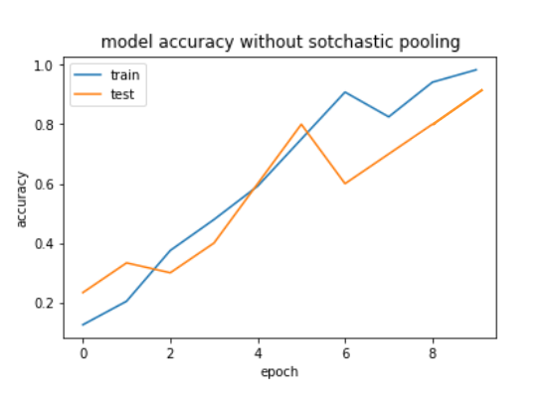
Result
Accuracy plot for Max Pooling

Slide 9
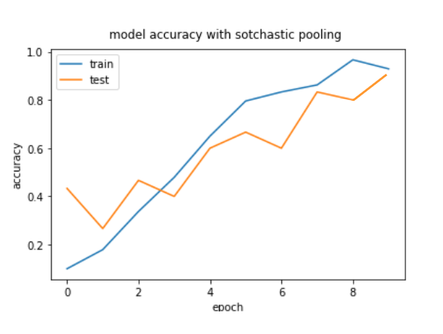
Result
Accuracy plot for Stochastic Pooling

Slide 10
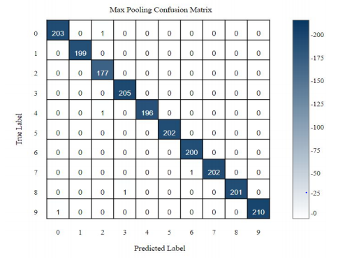
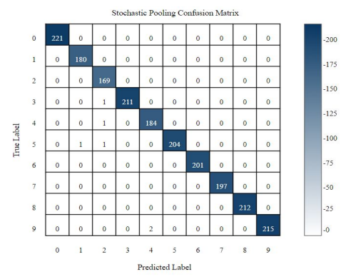
Result
Fig: Confusion Matrix with Max Pooling Fig:Confusion Matrix with Stochastic Pooling

Slide 11
Conclusion
Conclusion
Comparing models with max pooling and stochastic pooling we concluded that-
Max pooling suffers from the overfitting on training set, which make it hard to generalize well to test set.
But due to the random nature of stochastic pooling, model doesn’t overfit and provides almost similar accuracy on both train and test set.
Comparing the confusion matrices for both models on validation set the results justify the above mentioned points.

Slide 12
Limitations
Every Pooling methods has some limitations. Following are limitations with our project of hand gesture recognition using stochastic pooling-
Stochastic Pooling is limited to only non-negative activation values.
In stochastic pooling many arithmetic and tensor operations are involved due to which compared to max pooling it becomes computationally expensive.
Based on the detailed analysis of the pooling regimes and their performance for the task of classification, we found that the pooling operations largely depend upon the network architecture and the activation function for their performance.
Overlapping is another factor that affects the performance of the network as it decreases the chances of information loss during the pooling operation. While the step size of overlapping is very necessary to consider because a blind increment in step size can drop the model performance significantly.

