Slide 1

Firewall
A firewall is a network security system that monitors and controls incoming and outgoing network traffic based on predetermined security rules.

Slide 2
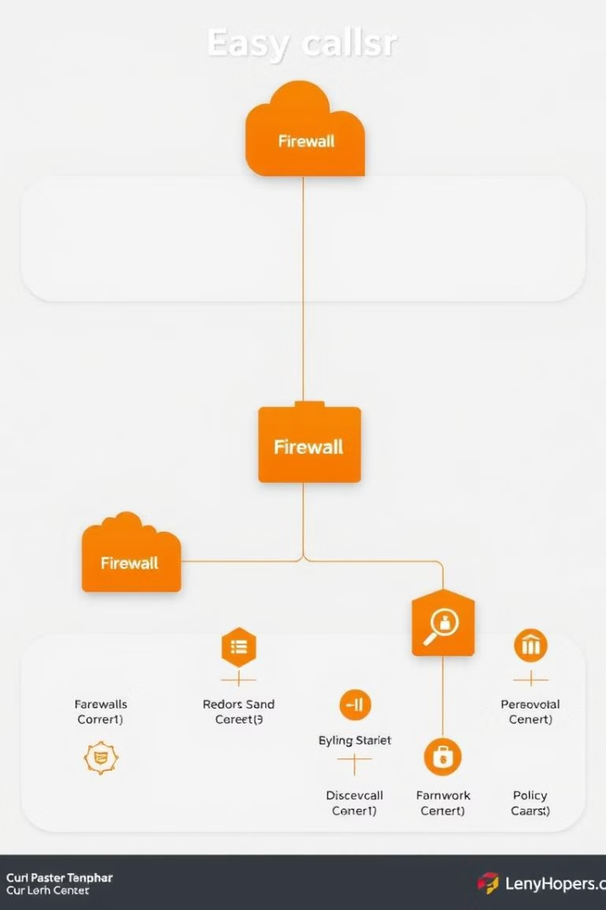
Types of Firewalls
Hardware Firewalls
Software Firewalls
These are physical devices dedicated to firewall protection.
These are software programs installed on individual computers or network devices.

Slide 3
Requirements and details
Firewall Package
Usage cases of firewall
yum install firewalld
Allow and deny - Ports, services, IPs, etc. Basically Controlling Network Traffic.
start, enable firewall service through systemctl.
Works on UDP and TCP protocols.

Slide 4
Types Of Firewall
1. Hardware Firewall
A hardware firewall is a physical device placed between a network and an external connection (e.g., the internet). It inspects traffic before it reaches internal devices.
Features:
Dedicated hardware, often built into routers or standalone firewall appliances.
Protects an entire network from external threats.
Can handle high network traffic efficiently.
Examples:
Cisco ASA (Adaptive Security Appliance)
Fortinet FortiGate
Pros:
✔ Protects multiple devices at once. ✔ Operates independently from the operating system. ✔ More effective for enterprise-level security.
Cons:
✘ Higher cost. ✘ Requires technical knowledge to configure. ✘ Limited control over individual devices.

Slide 5
2. Software Firewall
A software firewall is an application installed on a computer or server that filters network traffic at the host level.
Features:
Installed on individual devices.
Monitors incoming and outgoing traffic for that specific device.
Can control application access to the internet.
Often includes additional security features like antivirus integration.
Examples:
Windows Defender Firewall (built into Windows)
macOS Firewall
iptables (Linux)
Norton Firewall
Pros:
✔ Easy to install and configure. ✔ Provides per-device control. ✔ Can block specific applications from accessing the internet.
Cons:
✘ Protects only the device it's installed on. ✘ Can consume system resources. ✘ Less effective for securing entire networks.

Slide 6
Firewall Zones: Definition & Types
A firewall zone is a logical segmentation of a network that defines different levels of security and access control. Firewall rules apply to these zones to regulate traffic flow between them.
1. Block Zone 🚫
Purpose: A highly restricted zone where all traffic is completely denied.
Security Level: Maximum (No traffic allowed).
Traffic Flow:
Inbound: ❌ Blocked
Outbound: ❌ Blocked
Use Case:
Used for blacklisted IPs or networks.
Prevents any communication with known malicious sources.
✅ Best Practice:
Add known attacker IP addresses to the blocklist to prevent hacking attempts.
2. Public Zone 🌍
Purpose: Represents untrusted networks, such as public Wi-Fi or the internet.
Security Level: Low (Most restricted).
Traffic Flow:
Inbound: ❌ Blocked (except allowed services like HTTP/HTTPS).
Outbound: ✅ Allowed (with restrictions).
Use Case:
Default zone for external traffic (e.g., Internet).
Used when connecting to unknown networks (e.g., coffee shops, airports).
✅ Best Practice:
Block file sharing and remote desktop access.
Allow only essential outbound traffic (e.g., web browsing).

Slide 7
3. Trusted Zone ✅
Purpose: Represents secure internal networks where trusted devices operate.
Security Level: High (More permissive).
Traffic Flow:
Inbound: ✅ Allowed (from other trusted devices).
Outbound: ✅ Allowed.
Use Case:
Office LAN, corporate networks, and home networks.
Allows full communication between trusted devices.
✅ Best Practice:
Use VPN when accessing trusted networks remotely.
Monitor for internal threats, as trusted zones can still be attacked.
4. Home Zone 🏠
Purpose: Represents home networks with moderate security settings.
Security Level: Medium (More open than public but more secure than trusted).
Traffic Flow:
Inbound: ❌ Blocked (except local devices).
Outbound: ✅ Allowed.
Use Case:
Personal networks where users trust their own devices.
Allows file sharing, smart home devices, and gaming consoles.
✅ Best Practice:
Use WPA3 encryption for home Wi-Fi security.
Restrict smart devices (IoT) to prevent hacking.

Slide 8
5. External Zone 🌐
Purpose: Represents external connections such as the Internet or WAN.
Security Level: Low (Strict control needed).
Traffic Flow:
Inbound: ❌ Blocked (except public services like web servers).
Outbound: ✅ Allowed (with filtering).
Use Case:
Traffic coming from an ISP (Internet Service Provider).
Typically assigned to a firewall's WAN (Wide Area Network) interface.
✅ Best Practice:
Filter outbound traffic to prevent malware from communicating with attackers.
Enable Intrusion Prevention System (IPS) to detect threats.
6. Drop Zone 🚮
Purpose: A security zone where all traffic is silently dropped (ignored).
Security Level: Maximum (Nothing gets through).
Traffic Flow:
Inbound: ❌ Dropped (No response sent).
Outbound: ❌ Dropped.
Use Case:
Used for denying traffic without notifying the sender.
Prevents attackers from knowing if a firewall is active.
✅ Best Practice:
Use Drop Zone instead of Block Zone to prevent attackers from detecting active firewalls.

Slide 9
Ways to manage firewall
1 GUI Method - (firewall-config)
2 CLI Method - (firewall-cmd)
3 Configuration file - (not a best practice)

Slide 10
CLI Method
1 firewall-cmd
2 firewall-cmd - -list-all
3 firewall-cmd - -get-active-zones
4. firewall-cmd - -set-default-zone=drop (any can be set with this command)
5 firewall-cmd - -reload
6 firewall-cmd - -zone=public - -remove-service=ssh
7 firewall-cmd - -zone=public - -add-service=ssh
8 firewall-cmd --add-port=22/tcp --permanent --zone=public

