Slide 1

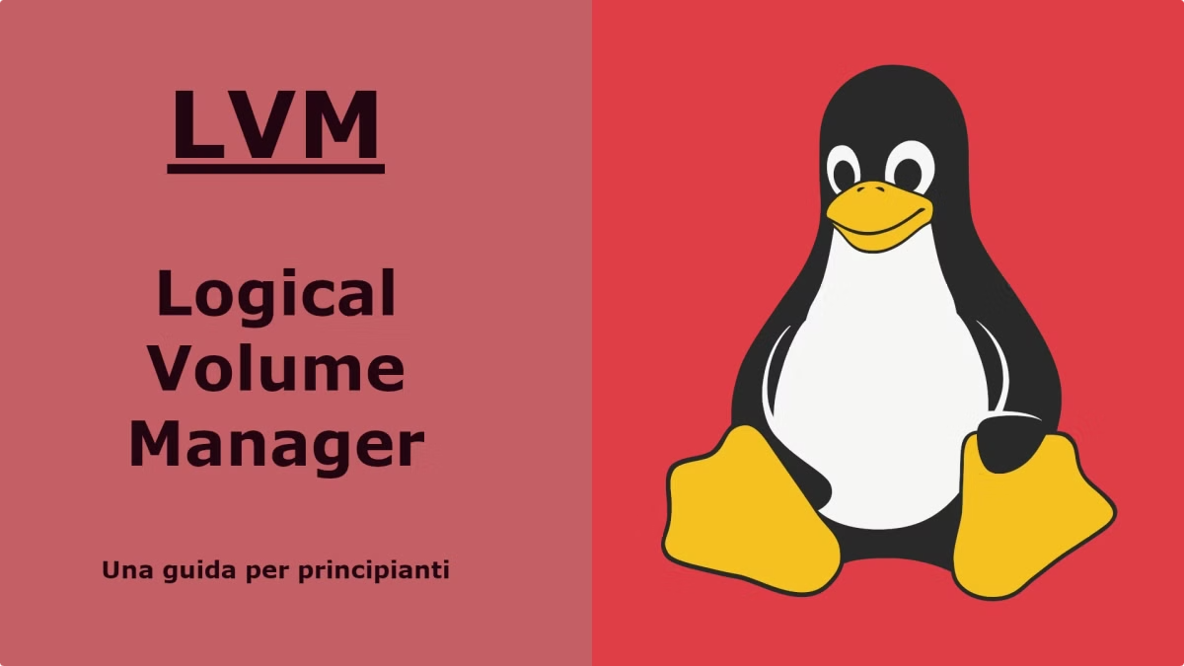
Linux Logical Volume Management (LVM)
A powerful tool for managing storage in Linux systems, offering flexibility and efficiency.

Slide 2
What is LVM?
Virtualization
Flexibility
LVM abstracts physical storage, allowing you to create logical volumes that span multiple physical disks.
It enables you to dynamically resize volumes, create snapshots, and manage storage space efficiently.

Slide 3

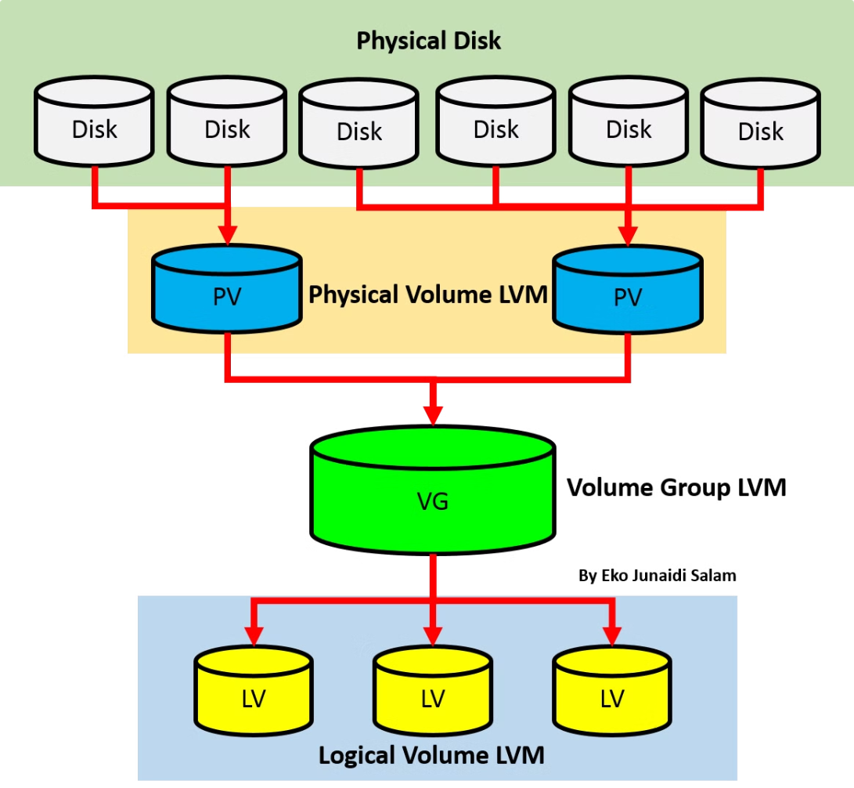
LVM Components
Physical Volumes (PVs)
Volume Groups (VGs)
Raw physical disks or partitions that serve as the foundation for LVM.
Collections of PVs that are grouped together to form a single logical unit.
Logical Volumes (LVs)
The actual storage units that are created within a volume group and are accessible to the operating system.

Slide 4
How to create LVM
Create LVM partition
fdisk /dev/sda
press n for new partition.
press t to change type to LVM
w for save and exit.
Create Physical Volume (PV)
pvcreate /dev/sda1
check with pvs and pvdisplay.
Create Volume Group (VG)
1. vgcreate (provide vgname ) /dev/sda1
2 vgcreate -s 8M vgname /dev/sda1
3 check with vgs and vgdisplay.
4. vgextend vgname /dev/sda2

Slide 5
Create LVM
lvcreate -L +300M -n lvname vgname
check with lsblk, lvs, lvdisplay.
Provide filesystem or mount point to lvm also we can do permanent mounting of it.
LV Extend or resize
1 . Lvresize -L +130M /dev/myvg/mylv
2 resize2fs or xfs_growfs /dev/myvg/mylv

