Slide 1

WordPress: Powering the Modern Web
WordPress is a popular open-source content management system (CMS) that allows users to create and manage websites easily. It is written in PHP and uses a MySQL or MariaDB database. WordPress is widely used for building blogs, business websites, eCommerce stores, portfolios, and more.

Slide 2
Why WordPress? Benefits and Key Features
WordPress offers unmatched flexibility. It provides a vast plugin ecosystem. Its open-source nature fosters community support.
Flexibility
Extensibility
Adaptable to various website types. From blogs to e-commerce platforms.
Enhance functionality with plugins. Tailor to your specific needs.

Slide 3
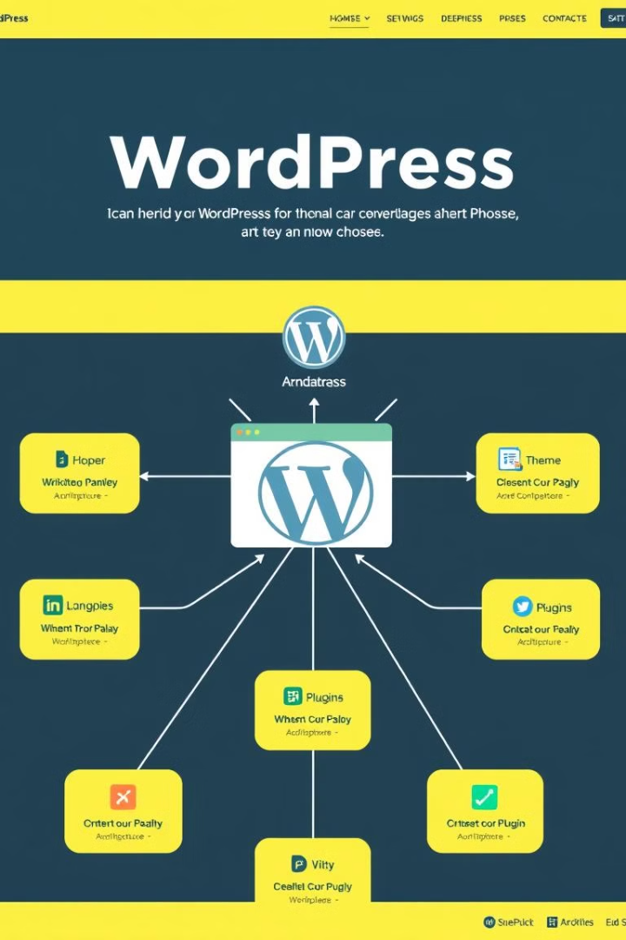




Understanding WordPress Core Components
Delve into the heart of WordPress. Grasp the essential elements. See how they work together. Understand database and file structure.
Database
Stores content, settings, and user data.
Themes
Controls visual appearance and layout.
Plugins
Adds extra features and functionalities.
Security: Protecting Your WordPress Site
safeguard your WordPress site. Implement robust security measures. Prevent hacks and malware. Update regularly.

Slide 4
configuration (server 1)
Install Packages.
yum install httpd -y
yum install -y php-mysqlnd php-fpm php-json -y
yum install vim bash-completion wget -y
systemctl start and enable services for httpd.
Maintain A record for wordpress server.
Allow port 80 and 443 for httpd
make selinux off (setenforce 0)

Slide 5
Mariadb (server 2)
yum install vim mariadb* -y
yum install bash-completion -y
systemctl start and enable mariadb.
sudo mysql_secure_installation
mysql -u root
create database wordpress_db;
create user 'wordpress_user'@'172.31.10.152' identified by 'red';
grant all on wordpress_db.* to 'wordpress_user'@'172.31.10.152'; (IP of wordpress machine)
Allow port 3306 for database.
Now install mariadb on server 1 to check connection with user.
mysql -u wordpress_user -h 172.31.3.99 -p (check if user is able to login run this command on server 1 with server 2 IP)
restart mariadb service.

Slide 6
WordPress
wget https://wordpress.org/latest.tar.gz
tar -xvf latest.tar.gz paste this content to /var/www/html
cp -rf wordpress/* /var/www/html
you will find a sample file wp-config-sample.php copy this file change the name and edit.
cp wp-config-sample.php wp-config.php.
Edit this file and provide detail (database-name, user-name, user-password, database-server IP)
check your IP on google.

Slide 7
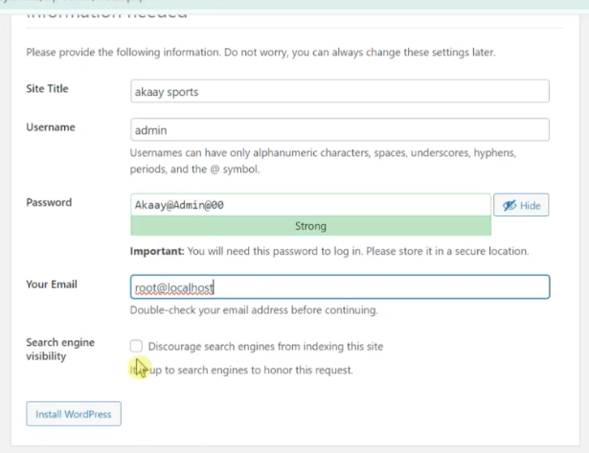
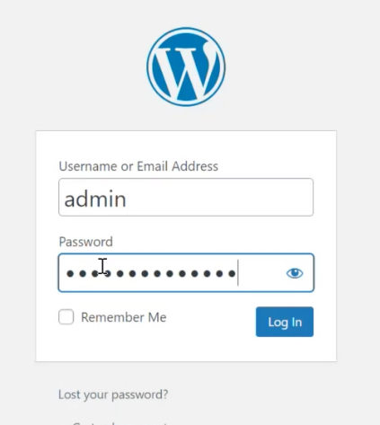
WordPress

