Slide 1

Ansible

Slide 2
Today’s Agenda
Intro about Inventory
Building an Inventory
Intro about Ansible Configuration File
Building an Ansible Configuration file
Intro about Adhoc command
Intro about Modules
Running Adhoc command

Slide 3
Intro about Inventory
An inventory defines a collection of hosts that Ansible will manage. These hosts can assigned to groups. Groups can contain child groups, and hosts can be members of multiple groups.
There are two types of inventory:-
Static Inventory
Dynamic Inventory

Slide 4
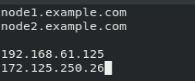
Building an Inventory
Default Path of Inventory= /etc/ansible/hosts
Simple Inventory Example:-

Slide 5
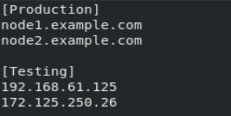
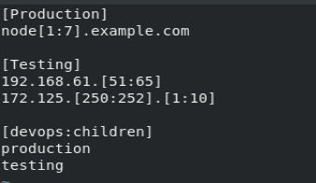
Host assigned to group:-
Nested group with Host range:-

Slide 6
Command for manage inventory:-
Syntax:-
#ansible [HOSTNAME/GROUP] –list-hosts
#ansible all –list-hosts
#ansible production –list-hosts
#ansible ungrouped –list-hosts
#ansible devops –list-hosts –i [INVENTORY PATH]

Slide 7
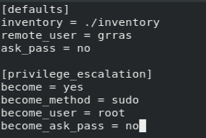
Intro about ansible config
Ansible configuration file defines how your task perform on your managed host.
Default path of Ansible config= /etc/ansible/ansible.cfg

Slide 8
Priority of Config file
/etc/ansible/ansible.cfg
~/.ansible.cfg
./ansible.cfg
ANSIBLE_CONFIG = path of ansible.cfg

Slide 9
Intro about Adhoc command
Ad hoc commands are commands which can be run individually to perform quick task. These commands are of one time usage.
Syntax of Adhoc Command:-
#ansible [host/group] –m [module name] –a [arguments]

Slide 10
Intro about Module
Module are small peace of code which is used to perform your tasks. These module written in python, powershell or any other language.
Command for list modules:-
#ansible-doc -l

Slide 11
Some useful modules:-
User :- for user administration
Group: for manage groups
Yum :- for package management
Yum_repository :- for configure repo
File :- for file management
Copy :- for copy content
reboot :- for reboot system

Slide 12
Running Adhoc command
Creating File:-
Creating user:-
Install Package:-

Slide 13
Thank You

