Slide 1

Ansible

Slide 2
Today’s Agenda
Adhoc command v/s Playbook
What is play and playbook
Format of playbook
Commands for manage playbook
Writing multiple play
Remote user and privilege escalation in playbook

Slide 3
Adhoc command v/s Playbook
Ad hoc commands can run a single, simple task against a set of targeted hosts as a one-time command.
But real power of ansible is ansible playbook.
Playbook is used to run complex and manual administrative task against a set of targeted hosts into an easily repeatable routine with successful outcome.

Slide 4
What is ansible play and playbook?
A play is an ordered set of tasks that is run against hosts selected from your inventory.
A playbook is a text file that contains a list of one or more plays to run in order. A playbook is a text file written in YAML format, and is normally saved with the extension yml.

Slide 5
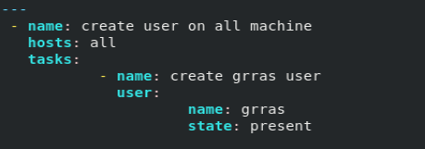
Format of Playbook
Adhoc command:-
This task in playbook written as:-

Slide 6
Commands for manage Playbook
#ansible-playbook –syntax-check [PLAYBOOK NAME]
#ansible-playbook –C [PLAYBOOK NAME]
#ansible-playbook [PLAYBOOK NAME]

Slide 7
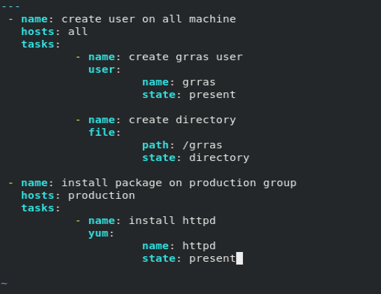
Writing Multiple play

Slide 8
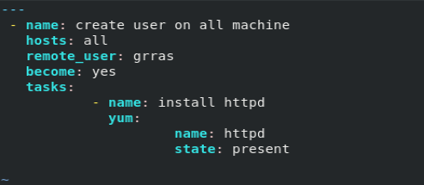
Remote user and Privilege escalation

Slide 9
Thank You

