Slide 1

Ansible

Slide 2
Today’s Agenda
What is variable?
Variable naming and where you can define them?
Using variable in plays
Array and registered variable
Managing secrets and vault commands
Managing facts and how we can use facts to gather information

Slide 3
What is variable?
Variables can be used to store values that can be reused throughout files in an Ansible project.
This can simplify the creation and maintenance of a project and reduce the number of errors.
Basically we can use variables for:-
create users
install packages
manage services
remove files
Archives to retrieve from the internet

Slide 4
Correct variable naming
web server = web_server
remote.file = remote_file
1st file = file_1 or file1
remoteserver$1 = remote_server_1 or remote_server1

Slide 5
Where we can define variables
Global Scope
Variable set form command line
Variable set from ansible.cfg
Play Scope
Variable set in play
Variable set through external file
Host Scope
Variable set in inventory
Variable set in host_vars and group_vars directory

Slide 6
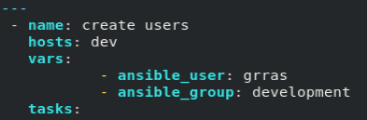

Defining and using variables
Define in play:-
Define in host_vars and group_vars directory:-

Slide 7
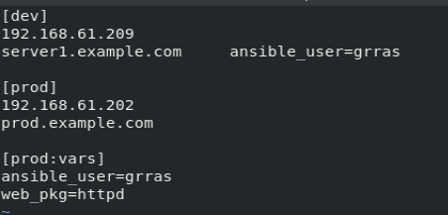
Defining and using variables
Define in inventory:-
Define in command line:-

Slide 8
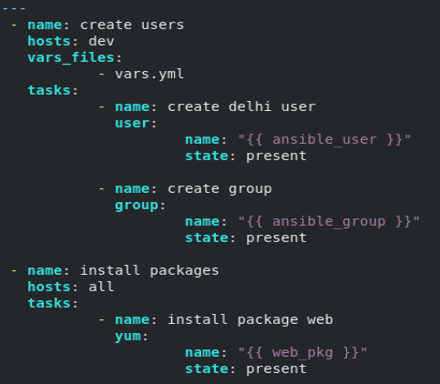
Use variable in play

Slide 9
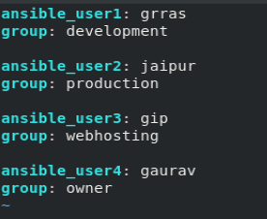
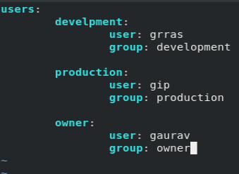
Array
Array can be written as:-

Slide 10
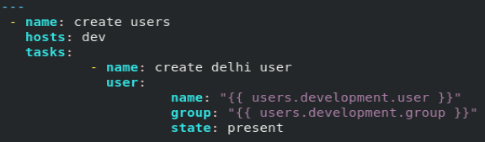
Calling Array variable

Slide 11
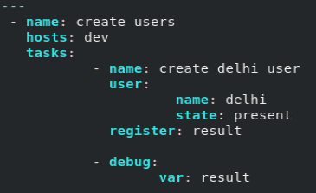
Register Variable
Register variable is used to capture command output:-

Slide 12
Managing secrets and vault command
Ansible Vault, can be used to encrypt and decrypt any structured data file used by Ansible.
ansible-vault command is used to create, edit, encrypt, decrypt, and view files.
Vault include inventory variables, included variable files in a playbook, variable files passed as arguments when executing the playbook, or variables defined in Ansible roles.

Slide 13
Vault Commands
#ansible-vault create [ FILE_NAME]
#ansible-vault edit [ FILE_NAME]
#ansible-vault view [ FILE_NAME]
#ansible-vault encrypt [ FILE_NAME] [ NEW_FILE_NAME]
#ansible-vault decrypt [ FILE_NAME] --output=[ NEW_FILE_NAME]
#ansible-vault rekey [ FILE_NAME]
Some Options:-
--vault-id @prompt
--ask-vault-pass
--vault-password-file=

Slide 14
What is facts
Ansible facts are variables that are automatically discovered by Ansible on a managed host.
Facts contain host-specific information that can be used just like regular variables in plays, conditionals, loops, or any other statement that depends on a value collected from a managed host.

Slide 15
Facts uses
Some examples of using facts:-
• host name.
• kernel version.
• network interfaces.
• IP addresses.
• version of the operating system.
• Various environment variables.
• number of CPUs.
• available or free memory.
• available disk space.

Slide 16
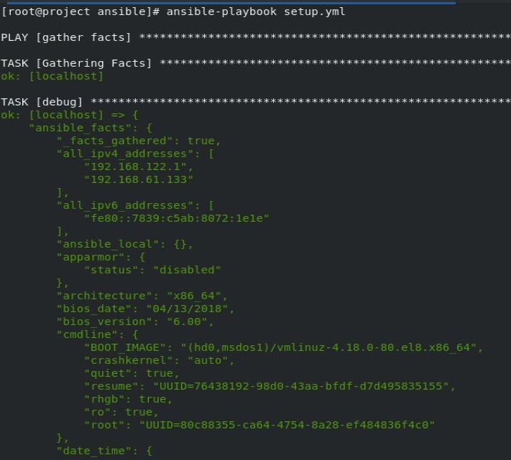
Gathering facts
You can use setup module in play or adhoc command to gather facts:-
#ansible dev –m setup

Slide 17
Thank You

