Slide 1

Ansible

Slide 2
Today’s Agenda
Introduction to loop and task iteration with loops
Loop over list of hashes/dictionaries
Task conditional and Running task conditionally
Intro about handlers and using handlers
Handling task failures

Slide 3
What is loop?
Loop is used where multiple task uses same module
Ansible supports iterating a task over a set of items using the loop keyword.
You can configure loops to repeat a task using each item in a list, the contents of each of the files in a list, a generated sequence of numbers, or using more complicated structures.

Slide 4
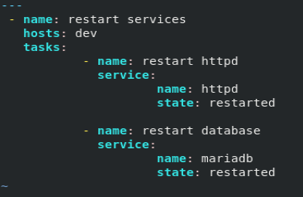
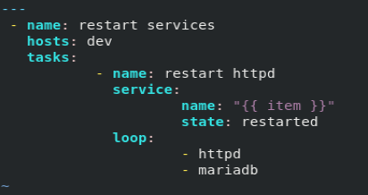
Task Iteration
This can be written as:-

Slide 5
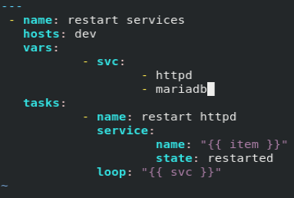
Loop with variable

Slide 6
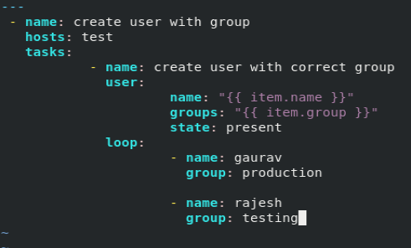
Loop over hashes/dictionaries

Slide 7
Task conditional
Ansible can use conditionals to execute tasks or plays when certain conditions are met.
Conditionals can differentiate between managed hosts and assign them functional roles, based on the conditions that they meet.

Slide 8
Example of conditionals
OPERATION EXAMPLE
Equal (value is a string) ansible_machine == "x86_64"
Equal (value is numeric) max_memory == 512
Less than min_memory < 128
Greater than min_memory > 256
Less than or equal to min_memory <= 256
Greater than or equal to min_memory >= 512
Not equal to min_memory != 512
Variable exists min_memory is defined
Variable does not exist min_memory is not defined

Slide 9
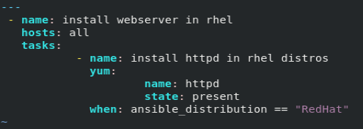
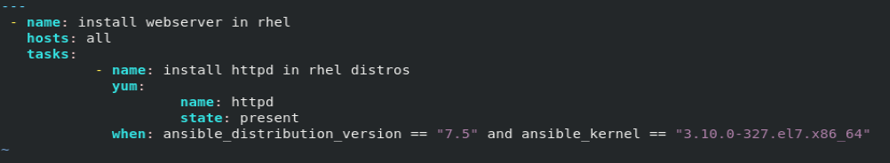
Running task conditionally

Slide 10
Intro about Handlers
Handlers are tasks that respond to a notification triggered by other tasks.
Tasks only notify their handlers when the task changes something on a managed host.

Slide 11
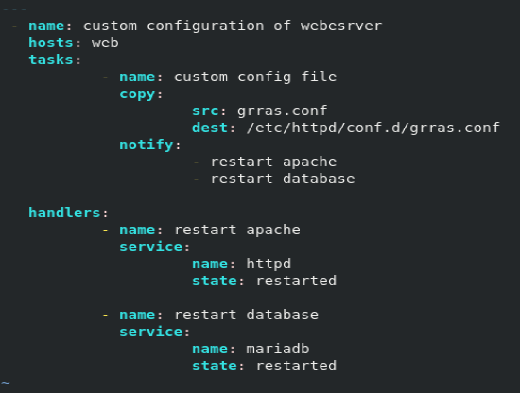
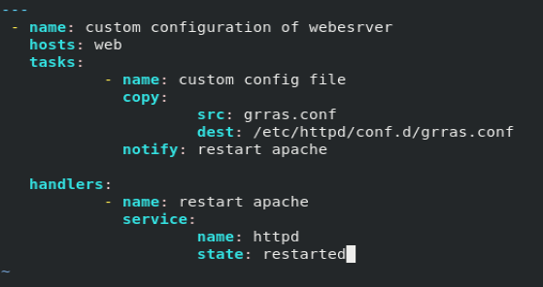
Using handlers

Slide 12
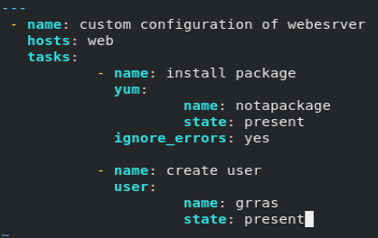

Handling task failure
For ignore erros:-
Force handler to run:-

Slide 13
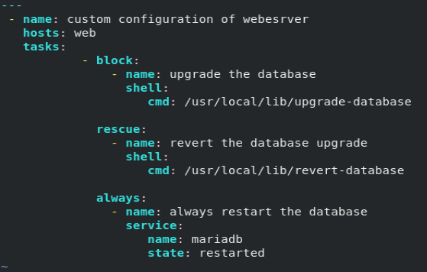
Ansible blocks and error handling

Slide 14
Thank You

