Slide 1

Ansible

Slide 2
Today’s Agenda
Overview of file management module
Intro about jinja2 template
Working with jijna2 template

Slide 3
File Management Module
File - create, remove, set permission and symlink/hardlink
Copy - copy files to managed host
Lineinfile - add or replace particular line in file
Blockinfile - insert, update or remove block in file
Fetch - fetch file from managed host to control node
Synchronize - use like rsync command
Sefcontext - manage selinux types

Slide 4
Jinja2 Template
We always use some module to modify files on managed host like – lineinfile, blockinfile etc. but this is not the right way, and they are not always easy to use and effectively and correctly.
A powerful way to manage files is to template them. With this method, we can write a template configuration file that is automatically customized for the managed host when the file is deployed, using Ansible variables and facts.

Slide 5
Syntax of jinja2 template
Always use .j2 extension with template file
Syntax:-
{# any information line #} = for comment lines and not output in final file
{{ vars/facts }} = for using variable and facts
{% loop/condition %}
{% endfor %} for using loop or condition in template

Slide 6
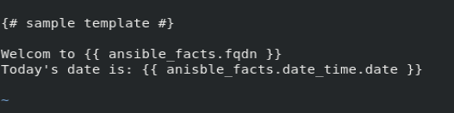
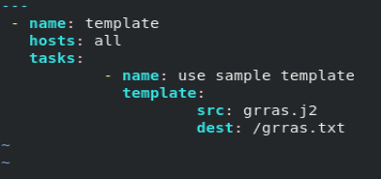
Sample template

Slide 7
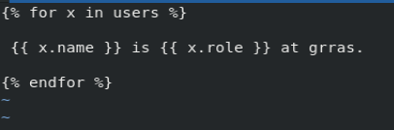
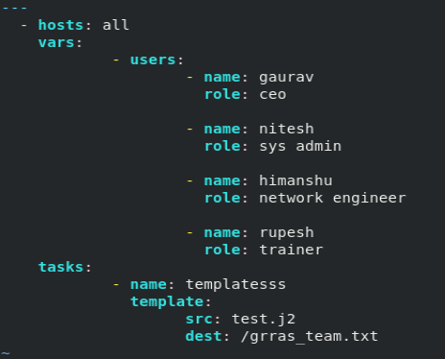
Using loop in template

Slide 8
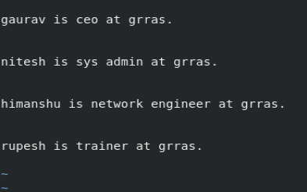
Output:-

Slide 9
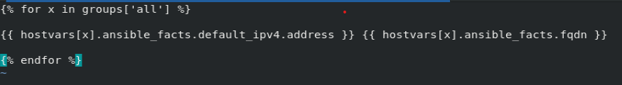
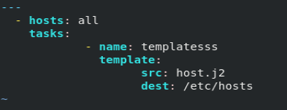
Generating host file using template

Slide 10
Thank You

