Slide 1

Ansible

Slide 2
Today’s Agenda
Intro about role and it’s structure
Create roles and use in playbook
Download roles from ansible galaxy
Using system roles

Slide 3
What is role?
Ansible roles provide a way for you to make it easier to reuse Ansible code in a generic way.
You can package, in a standardized directory structure, all the tasks, variables, files, templates, and other resources needed to provision infrastructure or deploy applications.
You can copy that role from project to project simply by copying that role's directory. You can then simply call that role from a play to execute it.

Slide 4
role’s benifit
Roles group content, allowing easy sharing of code with others
Roles can be written that define the essential elements of a system type:web server, database server, Git repository, or other purpose
Roles make larger projects more manageable
Roles can be developed in parallel by different administrators

Slide 5
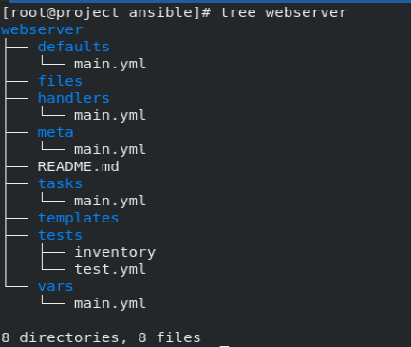
Role’s structure

Slide 6
Role’s overview
Defaults - for variable, low presedent, for customization in play
Files - files and directories used in task
Handlers - for define handler task
Meta - author, license, platforms, and optional role dependencies.
Tasks - for define tasks
Template - for writing template
Test - contain inventory and use to test roles
Vars - for define variable, high precedence, not customize in play

Slide 7

Create role
#ansible-galaxy init ROLE_NAME

Slide 8
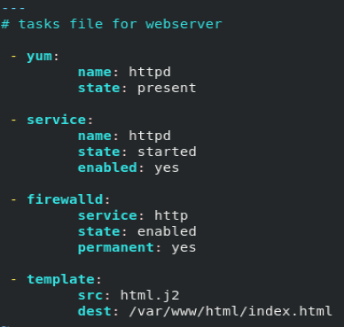

Configure role

Slide 9
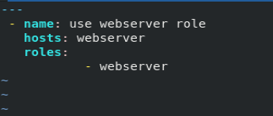
Roles in playbook

Slide 10
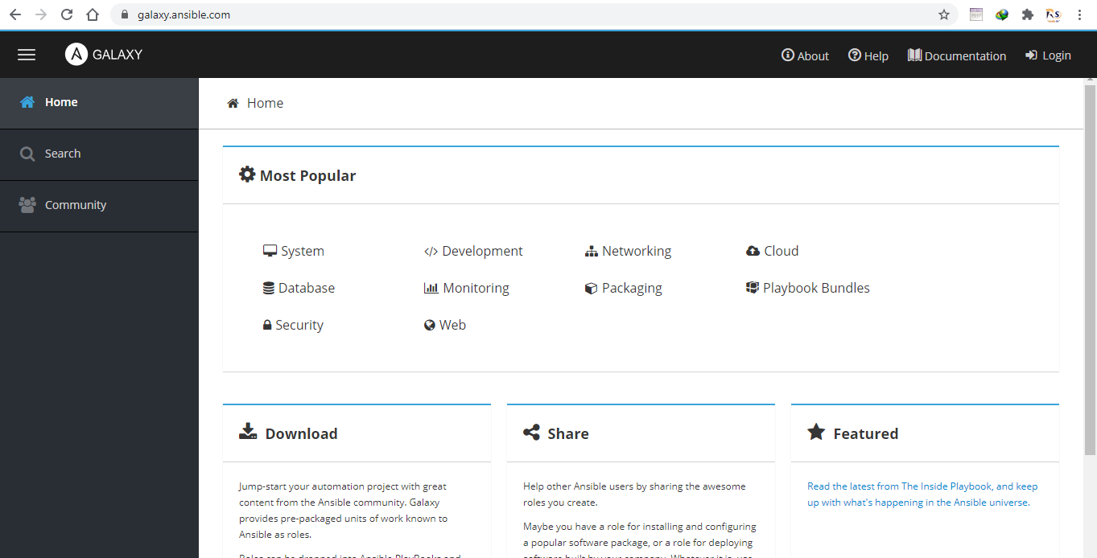
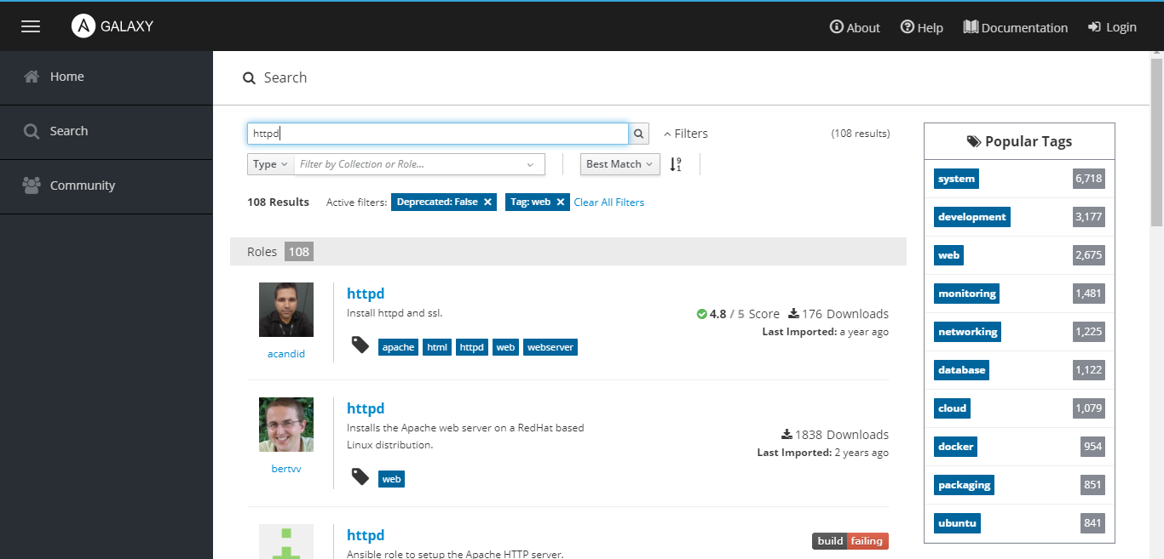
Ansible galaxy
#ansible-galaxy install httpd –p ./roles

Slide 11

Install roles using requirement file
#ansible-galaxy install –r requirement.yml –p ./roles

Slide 12
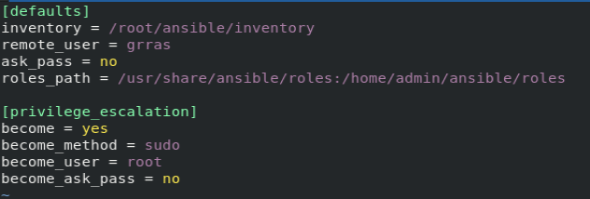
Install system roles and define roles path
#yum install rhel-system-roles
Roles default path = /usr/share/ansible/roles

Slide 13
Thank You

