Slide 1


Slide 2

What is DevOps ?
DevOps combines development (Dev) and operations (Ops) to increase the efficiency, speed, and security of software development and delivery compared to traditional processes. A more nimble software development lifecycle results in a competitive advantage for businesses and their customers.

Slide 3


Development Department
Operations Department
Design
Code & Develop
Manage Servers
Check Security
Scaling & Backup
Dev – Team Oper Team
Key points of DevOps in brief:
Benefits of DevOps in brief:
Communication and Collaboration.
Continuous Integration
Continuous Delivery
Micro services
Infrastructure as Code
Monitoring and Logging
Productivity UP
Speed UP
Collaboration
Load Decrease

Slide 4
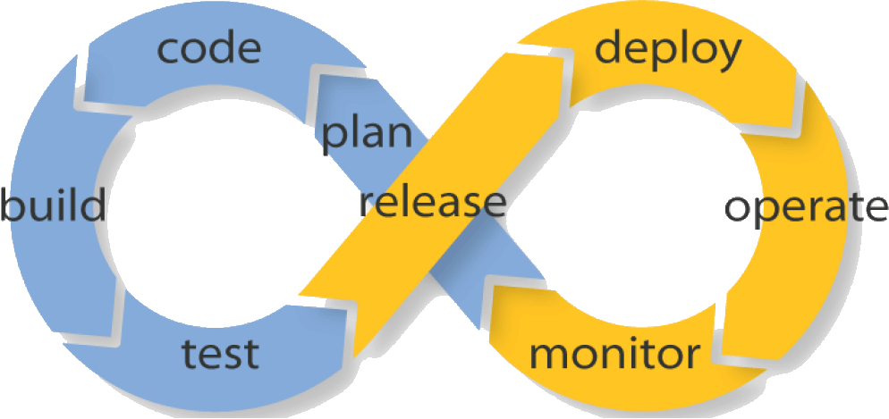
Continuous delivery - CD
Process of DevOps
Development >
< Operations
Continuous integration – CI

Slide 5
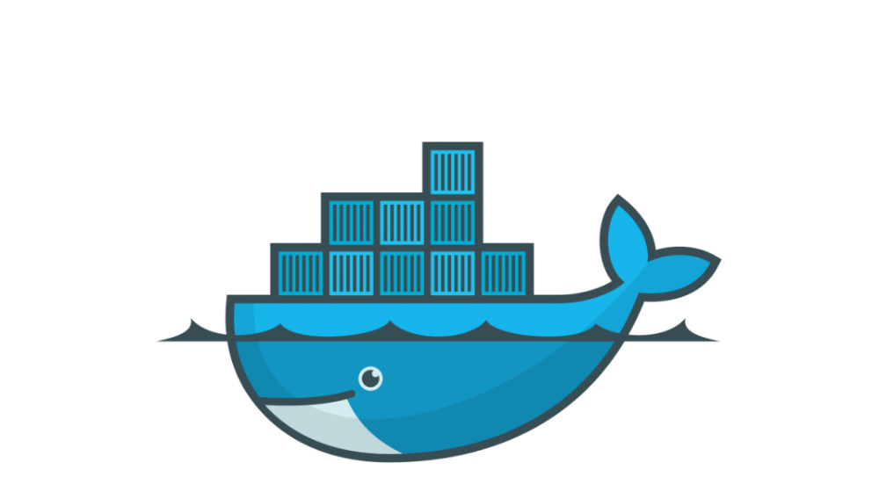







** TOOLS CONTAIN **
Docker
Terraform

