Slide 1
PDF AGILE
An E book download website
Presented In:
G P AADAMPUR TARABGANJ GONDA
Presented By:
Vikas Mishra(Group Head
and Backend developer)
Alok Sahu(Frontend developer And
SEO Auditor)
Utkarsh Singh(Tester)
Jaysingh Kushwaha(Content
Researcher)
Guided By:
Mr. Rahul Singh
(Lecturer of CS
department)

Slide 2
Contents
Introduction
Purpose
User Classes
Product Functions
Hardware Interface
Software Interface
UI Design
ER Diagram

Slide 3
Introduction
PDF AGILE is an E book download website.
We provide you pdf of books absolute free of costs. You can choose different types of books according to your choice.
We will happy to got you happy!

Slide 4
Purpose
Interaction: Best and your favorite books download in single click.
Free download engineering book and pdf.
Compare: This website could be better than other websites.
The best thing is free audio books and pdf books on a single platform.
Access from anywhere.
Easy to choose any of books because of listing.
Our mission is to transform the most popular work of legendary authors to modern reading virtual world .

Slide 5
User classes
The users of the system are
Admin
Users

Slide 6
Product Function
The functions of the system include the system providing different type of services based on the type of users.
User accounts and dashboard with login facilities .
Provide updated information about books and contents through notifications.
Admin can get information about the users and books and many more.

Slide 7
Hardware Interface
Processor : Intel i3 or higher.
RAM: 512 MB or more
Hard drive: 10 GB or more.

Slide 8
Software Interface
Operating system : windows XP/7 or higher
Front end : HTML, CSS, Bootstrap and JavaScript
Back end : php and MySQL server
IDE : notepad++ or visual studio code

Slide 9
ER DIAGRAM FOR USER
id
name
Name
User id
registeration
HAS
User
favorite
E-mail Id
Upload book
password
Confirm password

Slide 10
ER DIAGRAM FOR ADMIN
Admin_registration
id
name
E mail
password
C_password
HAS
id
Book_name
books
messages
Pending_books
b_name
pdf
pic
User_id
msg
book_id
pdf
User_email
User_id
pic

Slide 11
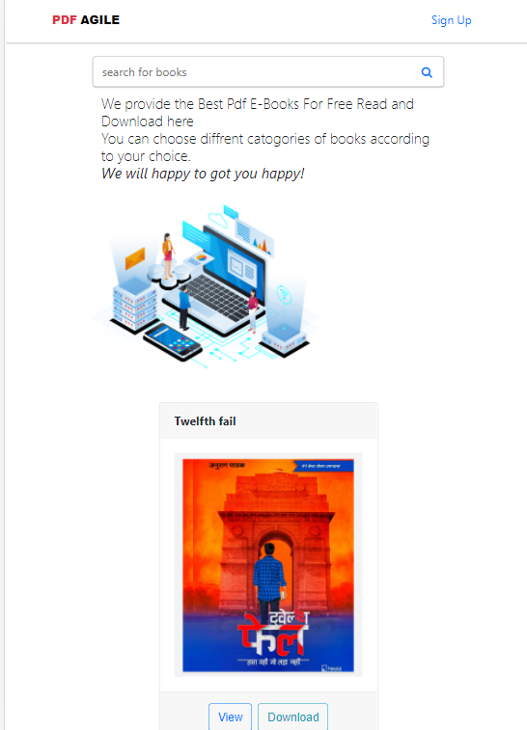
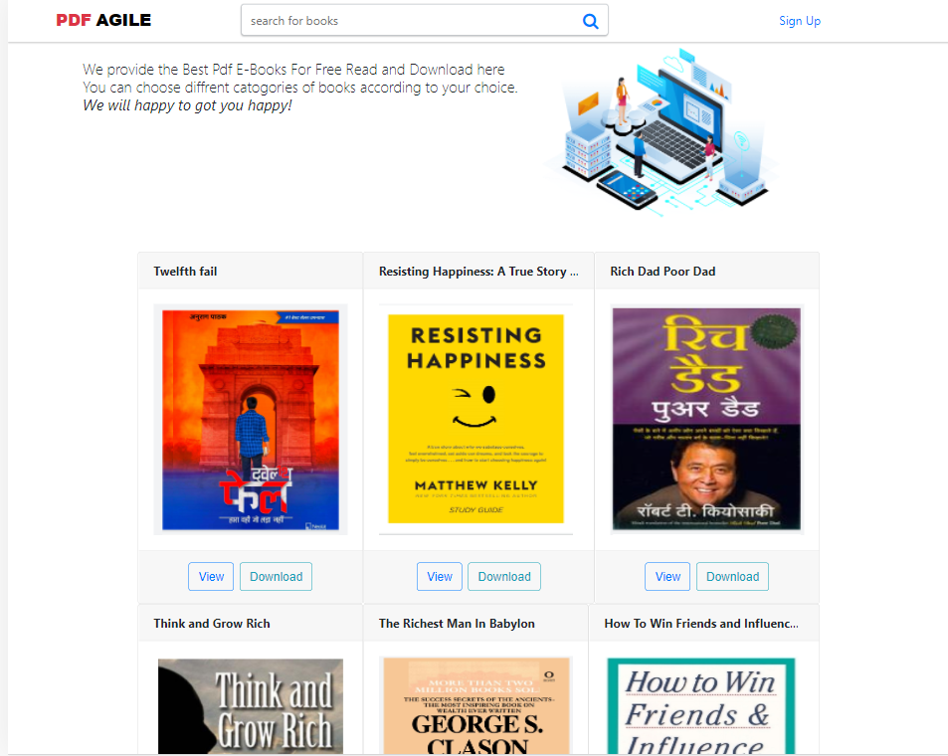
UI Design
Mobile View
Desktop View

Slide 12
THANK YOU
PDF AGILE

