Slide 1

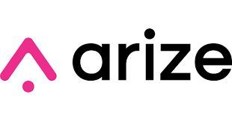
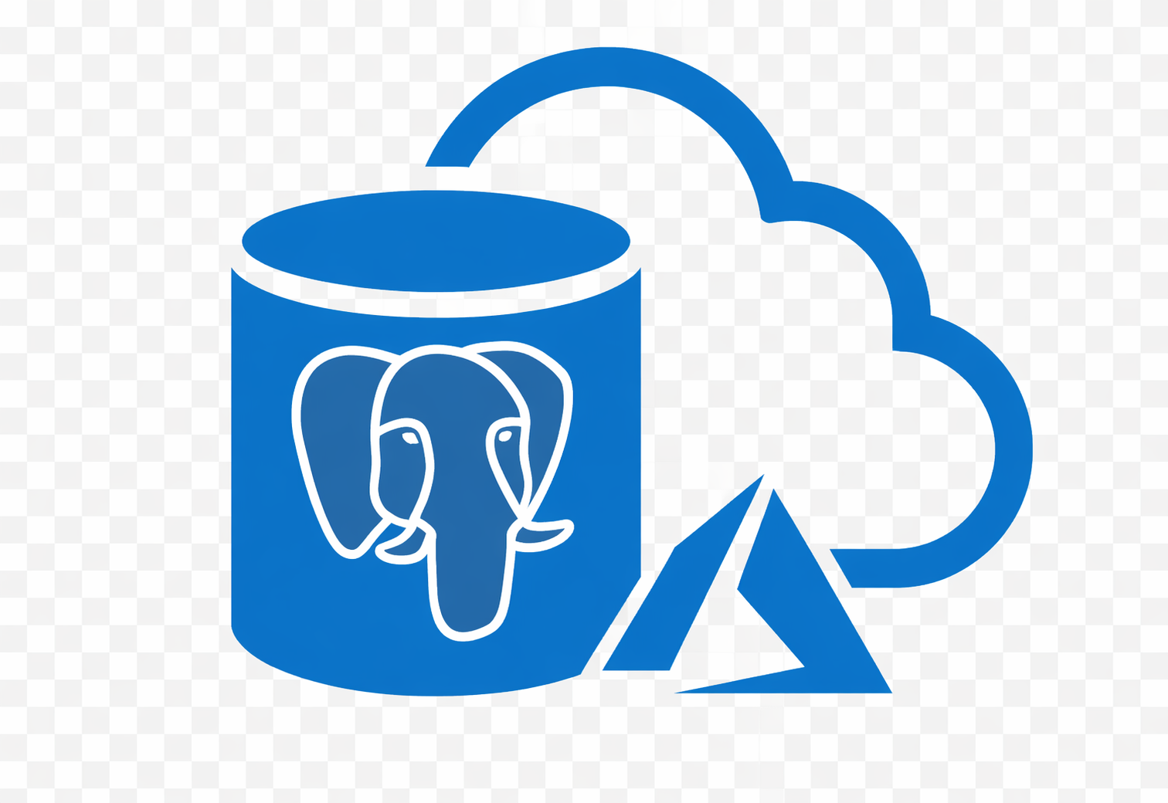


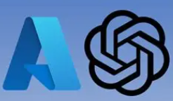
API Layer
Monitoring & Observability
Azure Webapp / App Service
OpenTelemetry
Deployment
Development/Production
API Calls
Supervisor Node
Data Layer
Experience Layer
Advisor UI
Workflow Orchestration Engine(LangGraph)
Agent Pool
(8 Specialized Agents)
MCP Server Layer
Azure PostgreSQL
Loveable UI
Agent Factory
Persona Based login
Synthesizer Node
Orchestration/Backend Layer
State Memory
Long Term Memory
Domain Agent Schema
Aeon2 schema
Prompt Versioning
Vector Db
4 workflows
Azure OpenAI
Router
Planner
Supervisor
Agent Factory(9 domain agents)

