Slide 1
WEEK 12 FINAL CAPSTONE
DG Interns Hub
Full-Stack SaaS Recruitment & Internship Portal
UI/UX Redesign, Role Workspaces, Security Hardening & Live Atlas Analytics
Stack: React 19 + Vite 8 + Node.js + Express 5 + MongoDB Atlas (Mongoose 9)
Developer: Vishal (vishal2006t) | Project Isolation: D:\DG INTERNS HUB\WEEK 12\WEB
Verification: oxlint (0 warnings/errors) | 20/20 E2E Security Tests | 26/26 Chrome CDP Responsive Checks

Slide 2
02
Problem Statement
Gaps audited across the Week 11 baseline before the Week 12 Capstone upgrade
1. UI/UX Fragmentation & Missing Views
• Mixed legacy CSS classes lacked consistent Light/Dark tokens.
• No persistent sidebar shell connecting authenticated workspaces.
• Missing dedicated Saved Jobs, Notifications & Settings pages.
• Lazy route fallback spinners lacked aria-busy readiness attributes.
2. Missing Persistence & Search Facets
• Contact page form did not persist tickets into MongoDB or notify Admins.
• Jobs search lacked live facet extraction (/api/jobs/filters).
• Homepage lacked live database analytics metrics (/api/analytics/public).
3. Security & Authorization Gaps
• Potential cross-recruiter IDOR if passing unowned jobId filters.
• Resume checks needed %PDF- magic-byte signature verification.
• Query operators ($ne/$gt), unescaped RegExp & CSV formula injection risks.
• Production JWT_SECRET required strict fail-closed enforcement.
4. Code Quality & Responsive Polish
• Context exports mixed with JSX triggered oxlint fast-refresh warnings.
• Job pill alignment and mobile 375px navbar auth button overflowed cleanly needed fixing.
• Week 12 deployment configs required complete separation from Week 11.
DG Interns Hub — Week 12 Final Capstone | Slide 2 of 15

Slide 3
03
Project Objectives
Five measurable goals guiding the 12-phase engineering upgrade
▸ Complete SaaS UI/UX Overhaul: Upgrade every public and private route with consistent typography, Light/Dark themes, skeleton loaders, confirmation dialogs, and responsive mobile drawer navigation.
▸ Non-Destructive Feature Preservation: Retain every working Week 11 endpoint, schema contract, authentication policy, and MongoDB Atlas collection while eliminating legacy technical debt.
▸ Zero Mock Data Integrity: Power Homepage counters, Job facets, Role Dashboards, Notifications, and Contact Inquiries exclusively from live MongoDB queries.
▸ Defense-in-Depth Security & Optimization: Verify 0 oxlint issues, fail-closed JWT config, RBAC + IDOR blocking, NoSQL/XSS sanitization, %PDF- magic bytes, lazy chunking & 350ms debounced search.
▸ Isolated Deployment & Empirical QA: Verify 20+ E2E security tests and 1920/1440/768/375px Chrome responsive checks, and configure separate Week 12 Render & Vercel manifests.
DG Interns Hub — Week 12 Final Capstone | Slide 3 of 15

Slide 4
04
Proposed Solution & Week 12 Upgrade Scope
Transforming a baseline job board into an enterprise SaaS recruitment portal
Unified SaaS Frontend
• Persistent WorkspaceLayout sidebar.
• Light & Dark CSS custom property theme engine.
• New routes: /saved-jobs, /notifications, /settings.
• Refactored Profile (education, bio, headline, resume).
• Accessible ConfirmDialog & Toast portals.
Upgraded Express API & DB
• Added ContactMessage collection & Admin triage.
• Added GET /api/analytics/public live counters.
• Added GET /api/jobs/filters facet builder.
• Recruiter notes & Admin /applications/admin view.
• Compound Mongoose filter & sort indexes.
Hardened Security & QA
• Fail-closed server/config/jwt.js in prod.
• Global sanitizer + enum/string query checks.
• Recruiter jobId IDOR blocking (HTTP 403).
• %PDF- magic byte check & CSV neutralization.
• 20/20 E2E suite + 26/26 Chrome CDP checks.
DG Interns Hub — Week 12 Final Capstone | Slide 4 of 15

Slide 5
05
Role-Based Platform Features
Tailored workflows engineered cleanly for Candidates, Recruiters, and Administrators
Candidate Workspace
• 350ms debounced job search & live facets.
• Filters: Work Mode, Type, Experience, Location, Sort.
• Server-side paginated card directory.
• PDF-only application upload (5MB max).
• Application pipeline tracking & withdraw.
• Bookmarks, Profile readiness & Preferences.
Recruiter Hiring Studio
• Real-time company KPIs from MongoDB.
• Post Internship & Edit Job modals.
• Inspect applicant cover statements & resumes.
• Save internal recruiter review notes.
• Status pipeline transitions + instant alerts.
• Formula-safe CSV pipeline export.
Admin Control Center
• Platform totals: Users, Jobs, Apps, Inquiries.
• Users by Role & Applications Pipeline charts.
• Promote roles & toggle account isActive.
• Global job moderation & cascading cleanup.
• Platform-wide Applications oversight tab.
• Triage ContactMessage support tickets.
DG Interns Hub — Week 12 Final Capstone | Slide 5 of 15

Slide 6
06
Technology Stack
Modern JavaScript full-stack toolchain built for speed, maintainability, and scale
Frontend Client (React 19 + Vite 8)
• React 19 SPA with Hooks, Context & React.lazy Suspense.
• React Router DOM v7 (HashRouter) + destination memory.
• Axios v1 centralized HTTP client & JWT interceptors.
• Lucide React accessible SVG iconography + custom SaaS CSS.
Backend Service (Node.js + Express 5)
• Express 5.x modular routes, controllers & validators.
• Multer v2 multipart PDF handling with binary verification.
• bcryptjs (10-round hashes) & jsonwebtoken authentication.
• Unified sendSuccess / sendError API response wrappers.
Cloud Database (MongoDB Atlas + Mongoose 9)
• MongoDB Atlas Cluster0 cloud database (dg_interns_hub).
• 5 indexed schemas: User, Job, Application, Notification, ContactMessage.
• Text search + compound filter indexes + unique pair locks.
• Parallel Promise.all aggregations for zero-lag metrics.
Security, Testing & Deployment Tooling
• Helmet headers, strict CORS allowlists, Express Rate Limit.
• oxlint static analysis (104 rules across 88 files).
• 20-case E2E Security Suite + Google Chrome CDP UI Auditor.
• Render Web Service (render.yaml), Vercel SPA (vercel.json), Docker.
DG Interns Hub — Week 12 Final Capstone | Slide 6 of 15

Slide 7
07
System Architecture
Three-tier decoupled SPA, security-hardened REST API, and cloud MongoDB storage
MongoDB Atlas Cloud
• Database: dg_interns_hub
• 5 Indexed Collections
• Compound Filter & Text Indexes
• Parallel Public KPI Aggregations
Public Portal & UI
• Home, Jobs, Job Details, Contact
• Light / Dark CSS Tokens
Security & Sanitization
• Strict CORS (403) + Helmet
• Rate Limits + NoSQL/XSS Strip
Role WorkspaceLayout
• Candidate, Recruiter, Admin
• Lazy Route Chunks & Memo
Auth, RBAC & Validation
• JWT + isActive Enforcement
• ObjectId + Recruiter IDOR Check
Verified File Storage
• Multer Disk Upload Service
• /uploads/resumes/*.pdf
• %PDF- Magic-Byte Signature
• Strict 5MB Payload Limit
Axios API Client
• Bearer JWT Header
• CORS Credentials & Error Toast
7 Express REST Modules
• Auth, Jobs, Applications, Users
• Notifications, Analytics, Contact
DG Interns Hub — Week 12 Final Capstone | Slide 7 of 15

Slide 8
08
Database Design & ER Relationships
Five normalized Mongoose v9 models persisted live to MongoDB Atlas
User (users)
• Unique: email | Hidden: password (select:false).
• role (candidate | recruiter | admin), isActive.
• skills[], bio, education, headline, resumeUrl.
• notificationPreferences & lastLogin audit.
Job (jobs)
• FK postedBy -> User | UK sparse slug.
• category, workType, type, experienceLevel, status.
• Text Index (title, company, desc, skills).
• Compound indexes on filters, deadline & stipend.
Application (applications)
• FK job -> Job, applicant -> User, reviewedBy.
• Unique Index (job, applicant) stops duplicates.
• status (pending/reviewed/shortlisted/accepted).
• resumeUrl + Week 12 Recruiter notes.
Notification (notifications)
• FK recipient -> User, sender -> User.
• type (application_received, status_updated, job_posted, system).
• Compound Index (recipient: 1, createdAt: -1) + isRead index.
ContactMessage (contactmessages — Week 12)
• name, email, subject, XSS-sanitized message body.
• status workflow: new -> in_progress -> resolved.
• FK reviewedBy -> User | Compound Index (status: 1, createdAt: -1).
DG Interns Hub — Week 12 Final Capstone | Slide 8 of 15

Slide 9
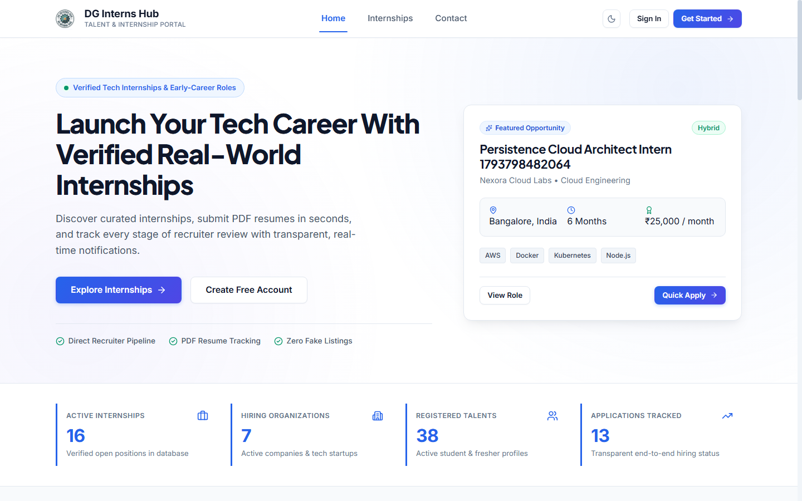
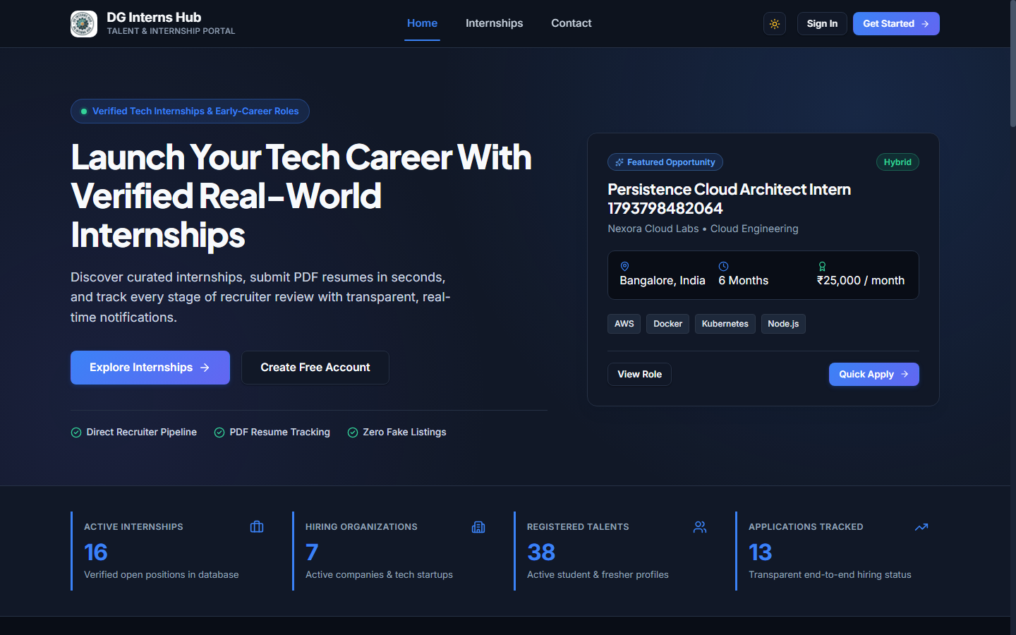
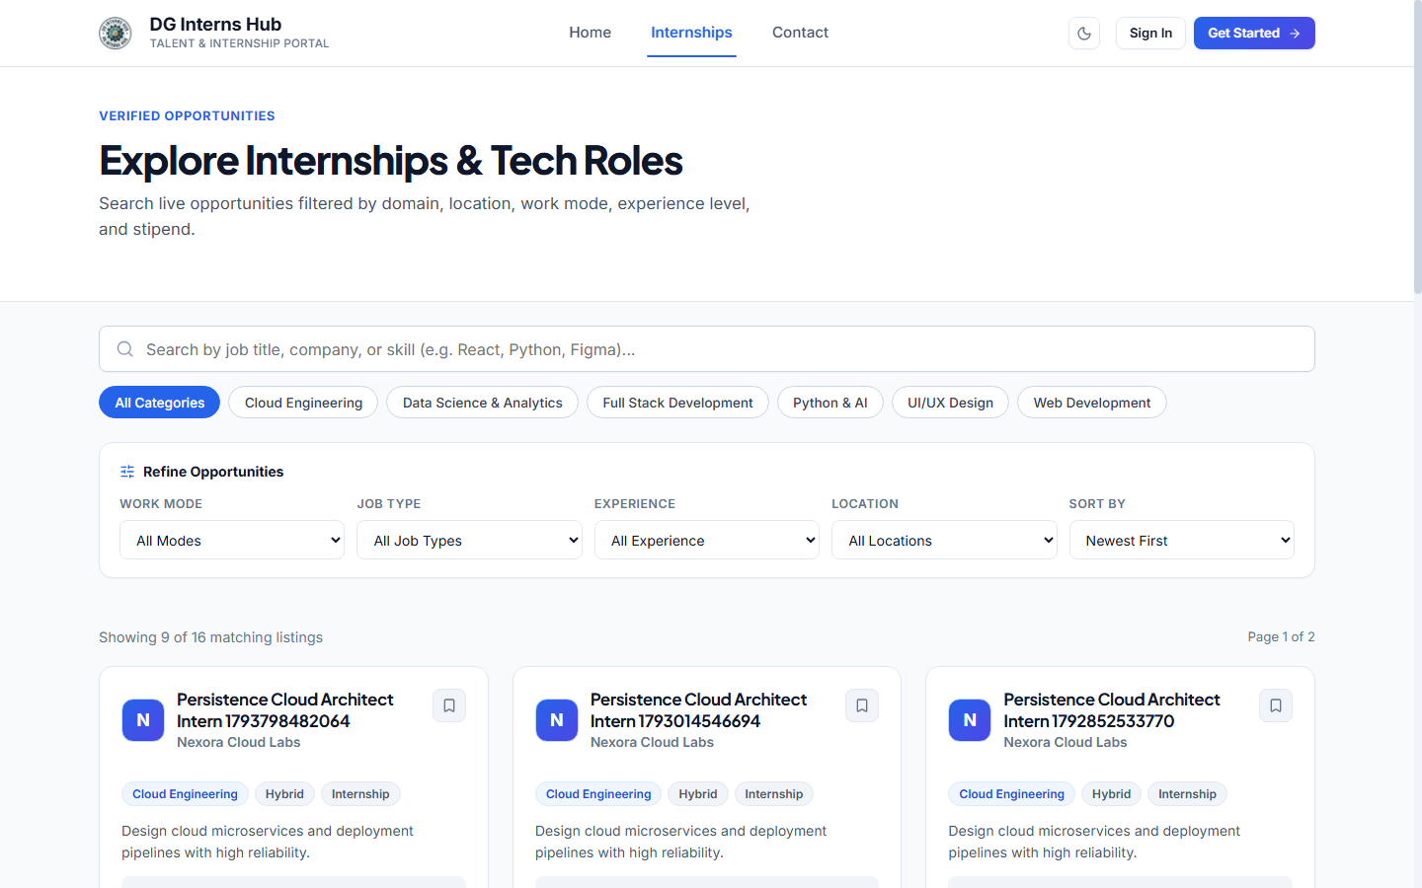
09
UI Screenshots — Public Portal & Theme System
Verified desktop captures rendered directly from built dist/ SPA & live MongoDB Atlas
Homepage Light Mode (1440px) — Live KPIs
Homepage Dark Slate Theme (1440px)
Jobs Directory — Search, Facets & Pills
Highlights: Live database counters (16 Open Internships, 7 Companies, 38 Candidates, 13 Applications), instant theme persistence, and aligned horizontal job pills.
DG Interns Hub — Week 12 Final Capstone | Slide 9 of 15

Slide 10
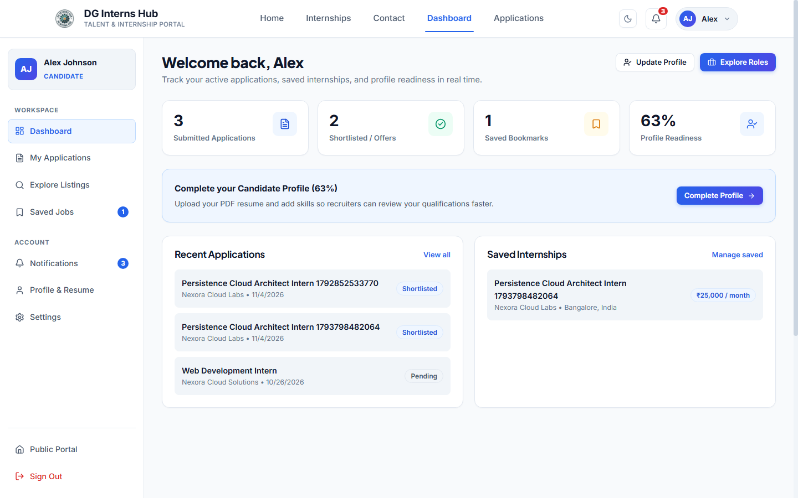
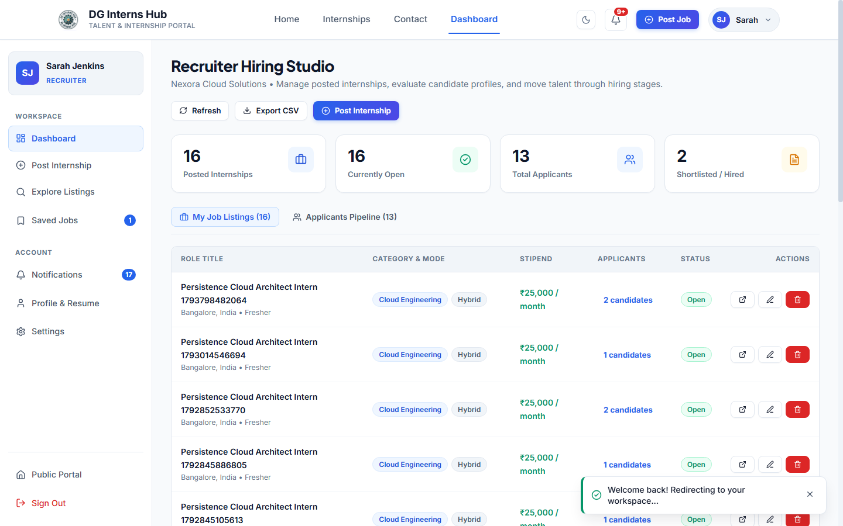
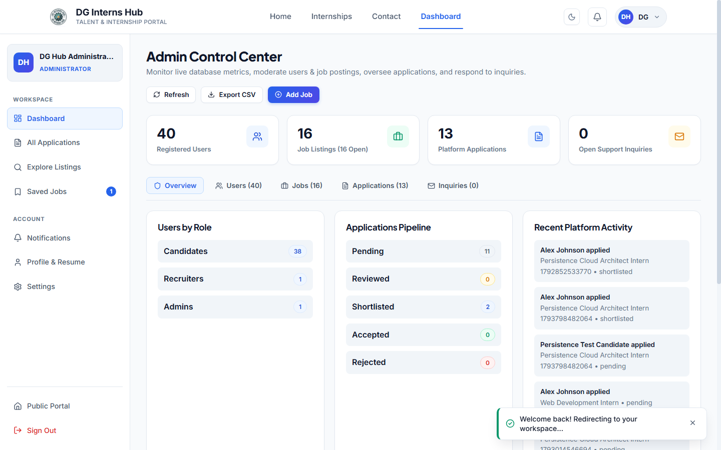
10
UI Screenshots — Role-Based SaaS Workspaces
Persistent sidebar layouts adapting cleanly for Candidate, Recruiter, and Admin accounts
Candidate Workspace (Light Mode)
Recruiter Hiring Studio (16 Jobs, 13 Apps)
Admin Control Center (40 Users, Moderation)
Highlights: Zero hardcoded dashboard metrics; every table row, notification badge, pipeline stage breakdown, and support inquiry reads live MongoDB Atlas collections.
DG Interns Hub — Week 12 Final Capstone | Slide 10 of 15

Slide 11
11
Authentication & Security Hardening
Defense-in-depth protections verified against OWASP API & injection vectors
Authentication & RBAC Controls
• 10-round bcrypt hashing & hidden password field (select: false).
• Fail-closed JWT_SECRET guard in NODE_ENV=production.
• isActive === false rejection (403) in authMiddleware.
• Blocks self-assigned admin registration & wrong-role access (403).
Injection, XSS & ReDoS Mitigation
• Global sanitizer strips $ / . keys while preserving password characters.
• Strict string + allowlisted enum checks block ?type[$ne]=... bypasses.
• XSS tags stripped cleanly before saving Contact messages.
• Search inputs escaped with escapeRegExp before Atlas $regex.
IDOR, Upload & CSV Pipeline Security
• Recruiter ?jobId= queries check postedBy ownership (403 IDOR block).
• Multer inspects %PDF- binary magic bytes (rejects renamed files).
• CSV export prefixes =, +, -, @ cells against formula injection.
• Strict 24-hex ObjectId validation across route parameters.
Network Transport & Burst Defense
• Helmet HTTP headers (nosniff, crossOriginResourcePolicy).
• CORS rejects unapproved origins with HTTP 403.
• Rate limiting emits RateLimit-* headers & returns HTTP 429.
• Strict 15kb JSON payload cap mitigates resource exhaustion.
DG Interns Hub — Week 12 Final Capstone | Slide 11 of 15

Slide 12
12
Backend REST APIs & Performance Optimizations
Structured Express 5 routes paired with 5+ measured speed optimizations
30+ REST Endpoints Across 7 Modules
• Auth: /register, /login, /me, /logout.
• Jobs: /api/jobs, /filters, /:id + full CRUD.
• Applications: /upload-resume, /my, /recruiter, /admin, /:id/status, /export/csv.
• Users: /profile (GET/PUT/DELETE), Admin role & deletion.
• Notifications: list, read, read-all & delete.
• Analytics: /public, /recruiter, /admin.
• Contact & Health: /api/contact CRUD + /api/health.
Implemented Performance Optimizations
• Route Code Splitting: React.lazy + Suspense splits 15+ routes & vendor chunks.
• 350ms Debounced Search: Avoids excessive Atlas calls while typing.
• Memoization: React.memo (JobCard), useMemo & useCallback hooks.
• Server-Side Pagination: Bounded page/limit queries across directories.
• Indexed Queries & Parallel Aggregations: Promise.all + .lean() queries.
• Fast Production Builds: Vite built 28 optimized assets in 471ms.
DG Interns Hub — Week 12 Final Capstone | Slide 12 of 15

Slide 13
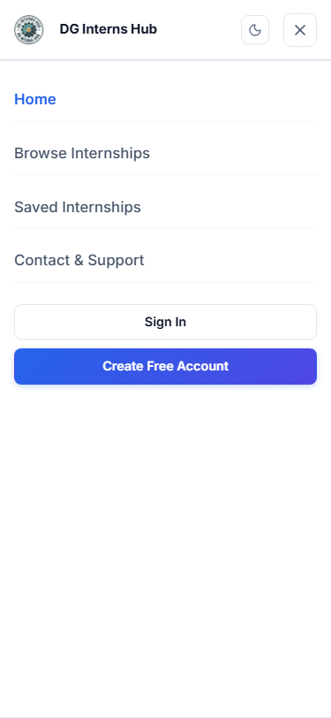
13
Testing Results & Responsive Breakpoint Audit
Every metric recorded from real post-edit execution against live MongoDB Atlas
Executed QA Suites (100% Real Runs, Zero Mocks)
• oxlint (npm run lint): 0 warnings, 0 errors across 88 files (104 rules).
• Week 12 Backend Security E2E (npm run test:e2e): 20 / 20 PASSED.
• Chrome Headless CDP Audit: 26 / 26 checks PASSED (0 console/page/5xx errors).
• Search Filter Proof: 'Python' 9 -> 2 cards; Work Mode 'Remote' 9 -> 4 cards.
Responsive 375px Mobile Drawer
Breakpoint Matrix (overflow=false on ALL Views)
• 1920x1080 Desktop: Home & Admin Control Center -> scrollWidth <= 1920.
• 1440x900 Desktop: Light & Dark Home, Jobs, Details, Dashboards, Contact -> PASS.
• 768x1024 Tablet: Home & Admin Control Center -> PASS (zero clipped grids).
• 375x812 Mobile: Home Drawer, Jobs, Register, Candidate/Recruiter/Admin -> PASS.
DG Interns Hub — Week 12 Final Capstone | Slide 13 of 15

Slide 14
14
Isolated Deployment & Challenges Overcome
Zero impact on Week 11 production infrastructure + key engineering fixes
Separate Week 12 Deployment Blueprint
• Preserved Week 11 repo, Render API & Vercel UI intact.
• Added render.yaml targeting new service dg-intern-hub-week-12-api.
• Added vercel.json (Vite dist/, X-Frame-Options: DENY, nosniff, SPA fallback).
• Updated Dockerfile (/api/health check) & docker-compose.yml.
• Added secretless .env.example & git-ignored .env verification.
• Verified NODE_ENV=production boot, Atlas health, CORS 200/403 & fail-closed JWT.
Real Engineering Challenges Solved
• Legacy Pill Cascade: Fixed vertical .job-card-pills override in saas-redesign.css.
• 375px Navbar Wrap: Hid .desktop-only-auth <=640px + added nowrap brand title.
• Recruiter IDOR Filter: Verified postedBy === req.user.id on ?jobId= queries.
• Contact Subtitle Drift: Overrode inherited margin: 0 auto alignment cleanly.
• Lazy Suspense Testing: Added aria-busy='true' to Loader.jsx + route-specific selectors.
• Oxlint Cleanliness: Split contextObjects.js & useContexts.js (0 warnings).
DG Interns Hub — Week 12 Final Capstone | Slide 14 of 15

Slide 15
15
Conclusion & Future Scope
Production-ready Week 12 Capstone summary and roadmap forward
Capstone Achievements Summary
• Redesigned every public & private page in cohesive Light & Dark SaaS themes.
• Completed all missing Candidate, Recruiter & Admin platform features.
• Hardened Auth, RBAC, IDOR, NoSQL/XSS/ReDoS, PDF uploads & CSV exports.
• Verified 20/20 E2E security tests & 26/26 Chrome UI checks on live Atlas DB.
• Packaged full API, DB, Architecture/ER, Test Matrix, Demo, Report PDF & PPTX.
Next-Phase Future Roadmap
• Cloud Object Storage (AWS S3 / Cloudflare R2) for multi-instance resume persistence.
• Real-Time Notification Push via Socket.IO & automated transactional emails.
• Multi-Factor TOTP / OAuth 2.0 single sign-on for enterprise recruiters.
• Skill-to-Role match scoring across parsed candidate PDF resumes.
• CI/CD automated E2E security regression pipeline per pull request.
DG Interns Hub — Week 12 Final Capstone | Slide 15 of 15

