Slide 1
Transformer-ACO for SFC Deployment in Non-Terrestrial Networks (NTN)
Abhishek Kumar(B220628CS)
Abhay kumar Bharti(B220628CS)
Vishal Sonkar(B220589CS)

Slide 2
AGENDA
Introduction & Motivation
Problem Definition
Proposed Solution: Transformer-ACO
Algorithm Details
Simulation & Experimental Setup
Results & Performance Analysis
Conclusion & Future Work

Slide 3
Introduction
NTNs (satellite networks) have dynamic topology and constrained resources.
SFC deployment requires routing + VNF placement under resource and delay constraints.
Traditional approaches:
Greedy: fast, poor load balance
ACO: may explore inefficient paths in large networks
Deep learning: retraining needed when topology changes
Goal: Combine AI + optimization for efficient, scalable SFC deployment

Slide 4
Problem Defintion
Given:
Network graph G =(V,E)
SFC request ρ with a sequence of VNFs VNF1 ,...,VNFk and resource demands
Find:
Routing path s∗ from source to destination
VNF embedding v∗ on nodes
Objectives:
Minimize resource variance and deployment cost
Maximize communication success rate
Keep communication delay low

Slide 5
Transformer-ACO Overview
Hybrid approach combining:
Transformer → encodes SFC and resource states
ACO → searches routing paths guided by neural heuristics
Process:
Neural modules learn heuristic functions for routing
Ant colony explores multiple candidate paths
Transformer decoder performs auto-regressive VNF embedding

Slide 6
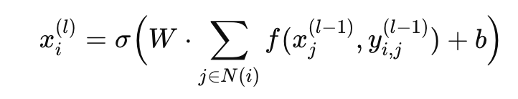
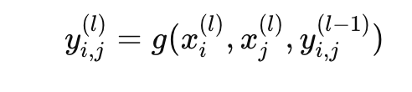
Network Encoder Module (GNN)
Captures topology and resource status of nodes/edges
Node update equation:
Edge update equation:
Output: enriched features Xi , Yi,j for Transformer encoder

Slide 7
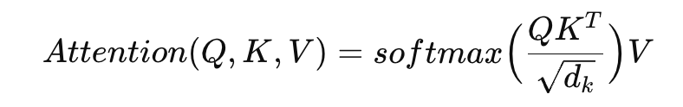
SFC Request Encoder
Input: VNF sequence matrix
Xk representing resource requirements
Self-Attention:
Output: contextual embedding for each VNF
Purpose: represent SFC request to guide decoder embedding decisions

Slide 8
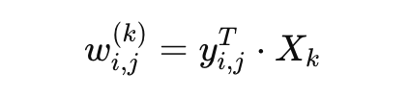
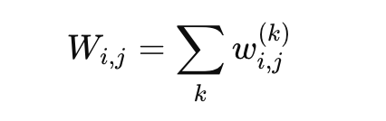
Resource-Node Matching Attention
.Computes compatibility score of each node/edge for embedding VNFs:
Aggregates scores across VNFs for a path:
Effect: highlights edges/nodes best suited for current VNF

Slide 9

VNF Embedding Decision Module
Transformer Decoder: auto-regressive embedding
Inputs:
Encoded SFC request HE
Residual path resources R
Encoder-Decoder Attention:
Softmax outputs probability for embedding each VNF on each node
Resources updated after each embedding

Slide 10



Loss Function & Training
. Resource variance function:
Training objective: minimize expected variance:
Gradient (REINFORCE):
Epsilon-greedy strategy used to explore node embeddings

Slide 11
Heuristic Function Generation
Neural module learns link-wise heuristic ηθ for ACO
Guides ants to low-cost paths considering resources and SFC requests
Trained via simulation with multiple ants and baseline cost evaluation

Slide 12
Transformer-ACO Algorithm (Steps)
Initialize pheromones τ
Generate heuristic ηθ using trained Transformer
For each ant:
Move from source to destination using combined τ+ηθ
Perform auto-regressive VNF embedding
Evaluate cost of path + embedding
Update pheromones: reinforce low-cost paths
Select best path s∗ and VNF embedding v∗

Slide 13
Simulation Setup
Topology: Walker constellation snapshot (66 & 192 satellites)
Software: Python 3.8, PyTorch 1.12, NetworkX
Hardware: i7-13700k, RTX 4080 GPU, 32GB RAM
Metrics: cost, communication success rate, delay

Slide 14
Convergence Analysis
VNF embedding cost drops: 35000 → 0 within 10 iterations
SFC deployment cost stabilizes below 10 after 60 training rounds
Transformer captures resource-aware embeddings effectively

Slide 15
Heuristic Function Visualization
Untrained heuristic: random, ineffective guidance
Trained heuristic: high intensity along optimal paths
Example: Source 17 → Destination 50: strong links 17→28, 28→39
Helps ants converge to lower-cost paths faster

Slide 16
Cost Performance
Untrained algorithm: cost > 50
Trained modules: cost ~10
Fully trained Transformer decoder: reduces cost up to 54.5% in 192 Walker network
Neural heuristics improve ACO performance significantly

Slide 17
Communication Success Rate
Success rate (%):
66 Walker: 73.5
192 Walker: 98.3
Larger network: 100
Outperforms: Greedy Optimal, ACO-ManyToOne, untrained models
Better resource utilization and load balancing

Slide 18
Delay Performance
Average delay (ms):
66 Walker: 38
192 Walker: 67
Larger network: 82
Slightly higher than greedy/ACO-ManyToOne
Reason: path selection avoids overloaded or under-resourced nodes

Slide 19
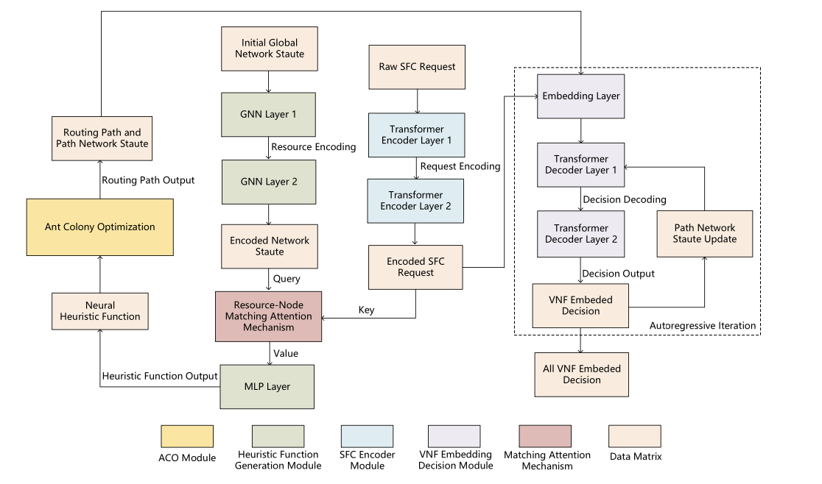

Slide 20
Modification
New Proposed Method: Genetic Algorithm (GA)
This is inspired by Darwin’s theory of natural evolution. It uses
a population of potential solutions that evolve through selection, crossover, and mutation to achieve optimization.
GA Workflow
1. Initialization: Create random routes as initial solutions.
2. Fitness Evaluation: Measure route efficiency based on total cost (delay, energy,
CPU).
3. Selection: Choose the best-performing routes for reproduction.
4. Crossover: Mix segments of parent routes to form new routes.
5. Mutation: Swap or modify nodes randomly to maintain diversity.
6. Termination: Repeat until cost converges or generations complete.

Slide 21
Cost Function
Total Cost = 0.5 × Delay + 0.3 × Energy + 0.2 × CPU
The goal is to minimize this total cost value across generations.
GA Parameters Used
• Population Size: 30
• Generations: 80
• Crossover Rate: 0.8
• Mutation Rate: 0.2
GA Results
• Best Route Found: [2, 24, 25, 10, 26]
• Minimum Cost: 292.2

Slide 22
Key Takeaways
Transformer-ACO efficiently combines learning + optimization
Achieves:
Lower cost
High success rate
Balanced resource utilization
Neural heuristic guides ACO and improves convergence
Future: integrate LLMs for more granular routing policies

Slide 23
Future Work
Neural Heuristic Fine-Tuning: Adjust heuristic function using pheromone updates to improve solution quality.
Large-Scale & Multi-Policy Deployment: Extend to bigger constellations and multiple SFCs with policy-aware routing.
LLM-based Heuristics: Use large language models for more adaptive and granular routing strategies.
Real-Time Deployment: Enable online learning and dynamic VNF embedding for changing network conditions.

Slide 24
Conclusion
Transformer-ACO effectively:
Encodes SFC and network states
Guides ants to low-cost routing paths
Embeds VNFs considering node resources
Achieves:
Lower cost, higher success rate, balanced load
Future work: integrate LLM-based heuristics for finer routing policies

Slide 25
Thank You !

