Slide 1
Mobile Game Development
- Vishal

Slide 2

Concept
A Story driven Adventure Game with multiple levels and various types of playstyles.
Seamless transition between each levels to have a immersed gaming experience.
Different types of genres are joined together . – Topdown , Shooting , Endless runner , Flappy bird , Puzzle .
Each level is going to be procedurally generated to have different gameplay experience each time.

Slide 3

Monetization
Small Banner ads from google play services .
In-game purchases of Skins and costumes.
In-Game purchase for multiplayer options and infinite gameplay experience.

Slide 4
Marketing
This game is focused on wide range of target audience as it is user friendly and immersive.
Why Should people play this game ?
Immersive gameplay by avoiding unwanted ads and distractions.
Multiple accessibility of games with various options of playstyle like touch or gyro or Mic at the same time.
Eye Captive UI and different versions of gameplay and playstyle each time the user plays.

Slide 5
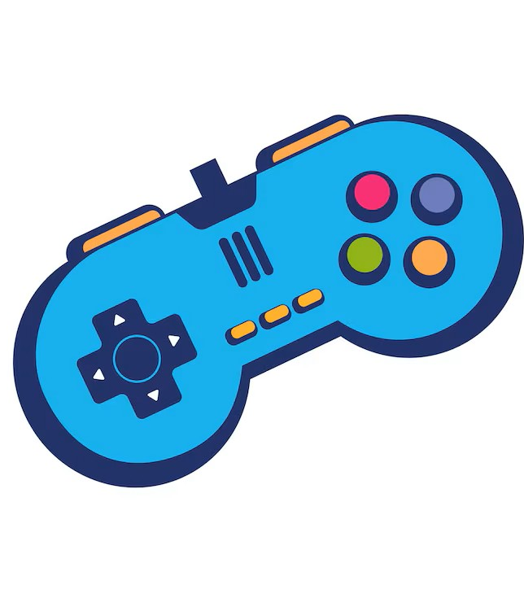
Gameplay
Level 1 – The user will be falling down where they should avoid some obstacles .
Level 2 – The user should be shooting the enemies which will be coming towards them by switching lanes towards the enemy.
Level 3 – The User should avoid multiple obstacles by switching lanes away from them.
Level 4 – Obstacles on top and bottom .The user should tap the screen in the require time to avoid crashing down or crashing in the top.
Level 5 – The User should answer 3 riddles which will be randomly selected with different difficulty.

Slide 6
Features
Currently there are 3 sensors
Swipe / Touch - To move the Ball in three different lanes
Gyroscope – To precisely control the ball move
Vibrations – When the ball hits an obstacle or When a level is completed.
Top Down level with working gyro and Collisions.

Slide 7

Plans
Procedural generation of each level.
Enemy mechanisms and Shooting Mechanisms
Background story using pop up annotations
Tap sensor – Flappy bird
Mic – Blowing
Voice to text – Puzzles
API for multiple riddles with different difficulties
Multiplayer feature where users can connect with another user and play the game as a race.
Live leaderboard system

Slide 8
Thank You

