Slide 1

E-Commerce Sales Performance Dashboard
Power BI Dashboard Walkthrough
Presented by Vishal Maurya

Slide 2
Company Background
The company is a mid-sized e-commerce retailer operating through platforms like Amazon.in. It sells consumer goods across various categories and sizes, with orders fulfilled either directly or via marketplaces.
However, it faces several operational challenges:
High cancellation and return rates
Delayed shipping and fulfillment
Demand planning issues and overstocking
Limited visibility into customer behavior
To overcome these, the company is shifting toward data-driven decision-making, using Power BI dashboards to monitor key performance indicators and uncover optimization opportunities.

Slide 3
Problem Statement
Despite being an active player in the e-commerce market, the company is struggling with:
Inefficient logistics (shipping delays, poor fulfillment speed)
High product return and cancellation rates
Inventory mismanagement (stockouts and overstocking)
Unclear customer insights (inability to differentiate B2B/B2C needs)
How This Analysis Helps:
Highlights areas of revenue loss and fulfillment failure
Identifies top-performing products and regions
Suggests where to optimize logistics (Amazon vs. Merchant fulfillment)
Helps tailor marketing by analyzing B2B/B2C and city-wise performance
Reduces cancellations through quality and service insights
Objective: Use Power BI to analyze sales data and generate actionable insights.

Slide 4
Objectives of the Dashboard
Analyze total revenue trends
Identify top categories and products
Monitor cancellation and return patterns
Evaluate shipping performance
Understand regional sales distribution

Slide 5
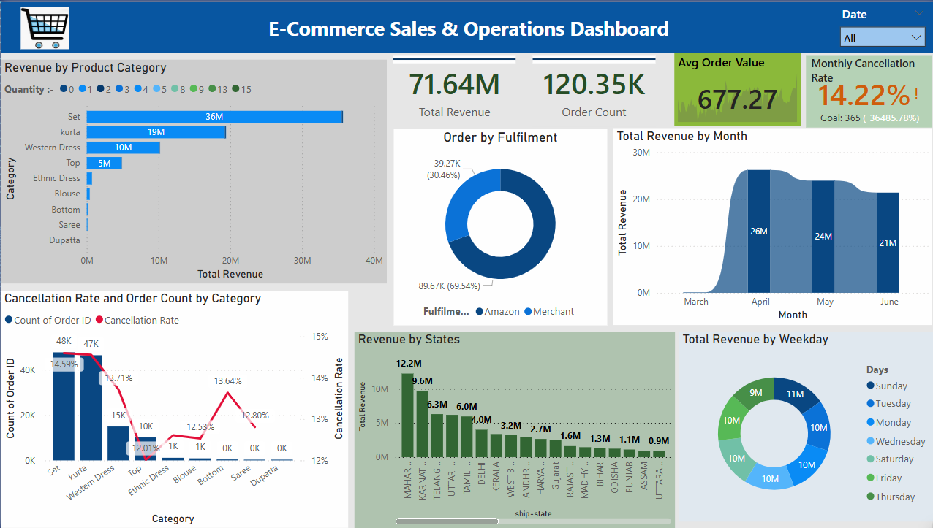
Dashboard Overview
This dashboard presents an overall view of sales, cancellations, product category performance, and fulfilment trends.

Slide 6
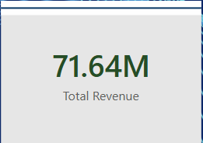
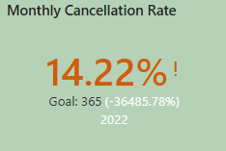
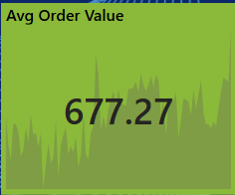
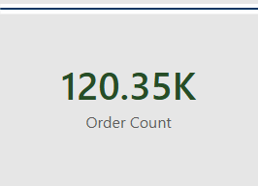
Key Performance Indicators (KPIs)
Total Revenue
Average Order Value
Cancellation Rate
Total Orders

Slide 7
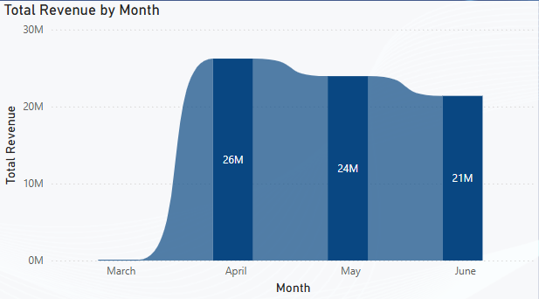
Monthly Sales Trend
Ribbon Chart: Total Revenue by Month
Analyzes seasonal patterns or performance changes over time.
Insight: Helps in strategic planning, especially during high-revenue months.

Slide 8
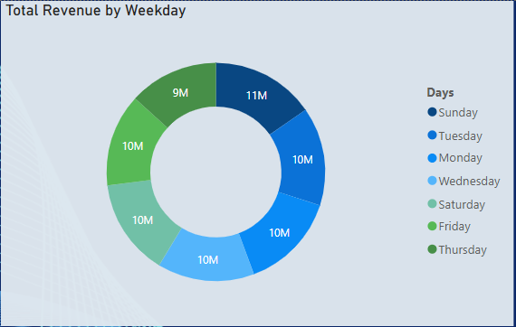
Weekly Sales
Donut Chat : Total Revenue by Weekday
Understands buying behavior by day of the week.
Insight: Optimize promotions and staffing on high-traffic days.

Slide 9
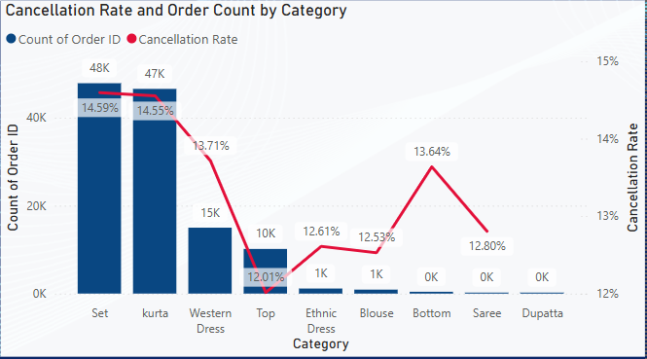
Cancellation Analysis by Category
Line and Stacked Column chart: Cancellation Rate and Order Count by Category
To monitor customer dissatisfaction and operational issues
Insight: High cancellations may indicate poor fulfillment or quality problems.

Slide 10
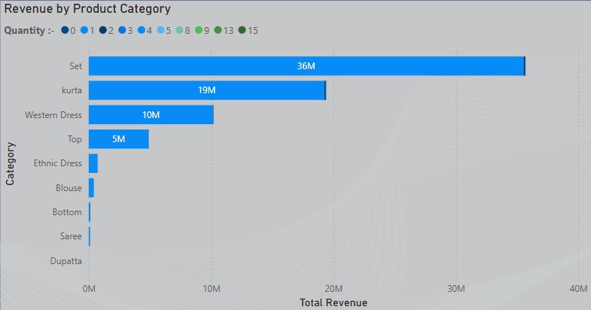
Product Performance
Stacked Bar Chart: Revenue by Product Category and Quantity Sold by Category
Understands which product lines are most profitable.
Insight: Focus efforts on stocking, promotion, and improving top-performing categories.

Slide 11
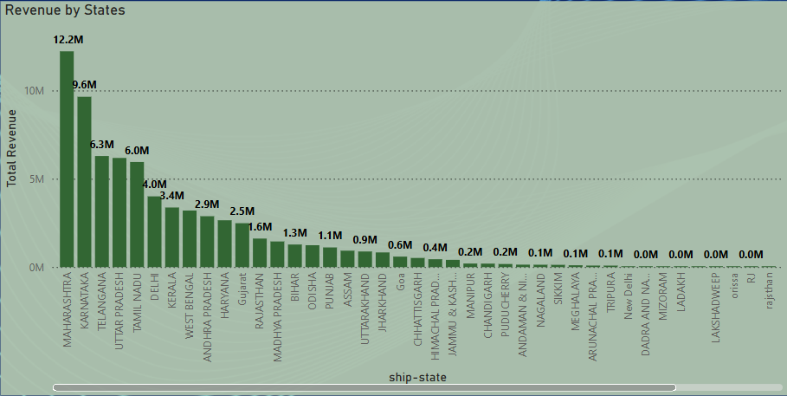
States Revenue
Stacked Column Chart : Revenue by States
Highlights States column concentration of sales.
Insight: Useful for regional marketing and logistics optimization.

Slide 12
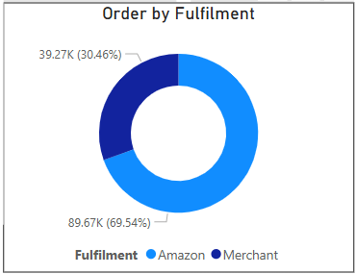
Order Fulfilment
Donut Chart: Order Count by Fulfilment
Amazon vs Merchant
Compare performance and reliability of fulfillment methods.
Insight: Enables optimization of logistics and selection of better partners.

Slide 13
DAX Summary
Total Revenue = SUM('sales_dataset'[Amount])
Cancellation Rate = DIVIDE(CALCULATE(COUNTROWS('sales_dataset'), 'sales_dataset'[Status] = "Cancelled"), COUNTROWS('sales_dataset'))
Weekday = FORMAT('sales_dataset'[Date], "dddd")

Slide 14
Insights from Dashboard
Revenue is highest on weekends, suggesting peak buying times.
Top categories like Apparel drive majority of sales.
Cancellation rate is higher for certain SKUs—needs investigation.
Fulfilled by Amazon orders are generally faster than Merchant.
Sales are concentrated in top states like Maharashtra and Karnataka.

Slide 15
Recommendations
Optimize shipping for merchant-fulfilled orders.
Merchant-fulfilled orders showed longer delivery times or higher cancellation rates compared to Amazon-fulfilled ones. Action: Work with merchants to improve processing times, enforce service level agreements, and track delivery reliability to enhance the customer experience.
Focus on advertising best-performing categories.
Certain product categories consistently generate higher revenue and order volume. Action: Allocate more ad budget and promotions to these top categories to boost conversions and ROI, while phasing out or reevaluating underperforming ones.
Review high-cancellation SKUs for quality issues.
Some specific products have unusually high cancellation or return rates. Action: Audit these SKUs for issues such as inaccurate descriptions, low product quality, or fulfillment errors. Addressing these can significantly reduce cancellations.
Use regional sales data for targeted campaigns.
The dashboard shows that sales are concentrated in certain cities or states. Action: Run localized campaigns, optimize delivery routes, and tailor product offerings to customer preferences in these regions for better results.
Maintain stock levels for high-demand products.
High-selling products risk going out of stock, affecting revenue and customer trust. Action: Monitor trends and reorder thresholds to ensure availability, avoiding both stockouts and excess inventory.

Slide 16
Conclusion
Conclusion: Our comprehensive analysis of the e-commerce data reveals that while the company has strong revenue-generating potential, operational inefficiencies and customer experience gaps are limiting growth. By leveraging data visualization in Power BI, we uncovered actionable insights that can guide strategic improvements.
Key Takeaways:
Revenue Trends: Seasonal peaks suggest scope for targeted marketing campaigns.
Customer Behavior: High cancellation rates point to service or product quality issues needing attention.
Geographic Insights: Top-performing cities offer scope for localized promotions and improved shipping hubs.
Fulfillment Strategy: Amazon-fulfilled orders outperform merchant-fulfilled ones in speed and reliability.
The Power BI dashboard provided clear, actionable insights for improving e-commerce performance through data-driven strategies.

Slide 17
Thank You
Thank you for watching!
Contact :- vishalmaurya491@gmail.com
LinkedIn :- www.linkedin.com/in/vishal-maurya-a410b2261
GitHub :- https://github.com/vishal29102002

