Slide 1
Designing of Free Space Optical Communication Network under Different Weather Conditions
Dr. Amardeep Singh
Professor and Head
Department of Computer Engineering, Punjabi University, Patiala
By:- Vishal Kumar
Roll no:-11401039(CE)

Slide 2
Aim
Transmit data using FSO
Connect two cities through wireless medium
Improve the data transfer rate in every weather
Send high speed data over long distance

Slide 3
Free Space Optics (FSO)
Optical communication technology that uses light propagating in free space to transfer data.
Line of sight technology
Bandwidth up to 2.5 Gbps.
Uses LED or Laser as a light source

Slide 4
Classification of FSO networks
Optical Wireless Satellite Networks (OWSNs)
Optical Wireless Terrestrial Networks (OWTNs)
Optical Wireless Home Networks (OWHNs)

Slide 5
Merits & Limitations
Merits:-
FSO is a high speed network, which delivers better data speed than broadband networks.
It takes less time as compared to other systems for installation at normal locations. So its installation is very easy and less time consuming.
No security system upgradation is needed because of line of sight operation.
Transmission is having speed of light because transmission of optical beam is done in air

Slide 6
Merits & Limitations
Limitations:-
A temporary blockage a single beam, when any physical obstructions like birds, tall trees and buildings architectures comes in line of sight (LOS) and disturbs the transmission of FSO system.
Due to the heat rising from the earth and the man-made drives like heating ducts, there would be temperature variations among different air packets. These variations in temperature can cause fluctuations in the signal amplitude at the FSO receiving end
The suspended water molecules in the terrestrial atmosphere known as absorption, decreases the optical beam power density and transmission availability in a FSO system.

Slide 7
Why Free space optics (FSO)?
Cost
Easy installation
Permits
Time

Slide 8
Introduction To OptiSystem
Provides global insight into system performance
Visually presents design options and scenarios to prospective customers
Delivers straightforward access to extensive sets of system characterization data
Integrates with the family of Optiwave products

Slide 9
APPLICATIONS
Single-mode/multi-mode transmission
Free space optics (FSO), Radio over fiber (ROF), OFDM (direct, coherent)
Signal processing (Electrical, Digital, All-Optical)
System performance analysis(Eye diagram ,Q-factor ,BER ,Signal power , etc.)

Slide 10
Network topologies used in Project
Bus topology
Ring topology
Hybrid topology

Slide 11
Network topologies used in Project
Bus topology :-
All networked nodes are interconnected, peer to peer, using a single, open-ended cable
Both ends of the bus must be terminated with a terminating resistor to prevent signal bounce

Slide 12
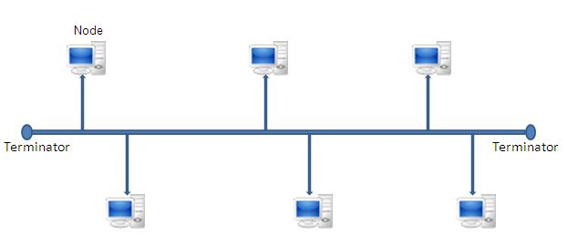
Bus topology

Slide 13
2. Ring topology :-
started out as a simple peer-to-peer LAN topology
Each networked workstation had two connections: one to each of its nearest neighbors
Data was transmitted unidirectional around the ring

Slide 14
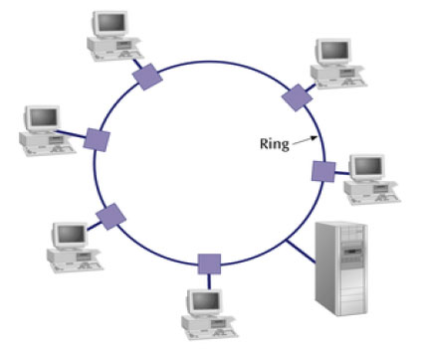
Ring topology :-

Slide 15
Weather in Patiala, Punjab, India
Summer
Monsoon
Post-Monsoon
Winter

Slide 16
Introduction To Project
FSO communication network has been proposed throughout the Patiala and Rajpura region
The FSO communication link performance through all Weather seasons of Patiala and Rajpura region has been observed.
Hybrid network of Ring topology and Bus topology is used to send data from Patiala to Rajpura.
the results at each node of the network have been calculated in terms of BER and Q-Factor.

Slide 17
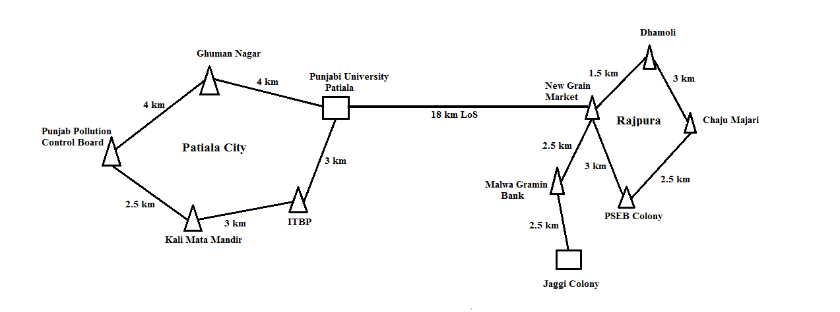
Architecture of Free space optics network

Slide 18
Seasonal details with respective attenuation
Weather Season | Time Duration | Attenuation (dB/km)
Clear Season | March to Last June | 0.23
Rain Season | July to September & September to October | 9.64
Fog Season | December to February | 2.37

Slide 19
Parameters of FSO channel
Parameters | Range
Input power | Clear weather: 20 dB Foggy weather: 30 dB Rainy weather: 40 dB
Wavelength | 1550 nm onwards (12 channels with equal channel spacing of 0.5 nm and 15 channels for high speed link between two rings)
Bit rate | 5 Gbps

Slide 20
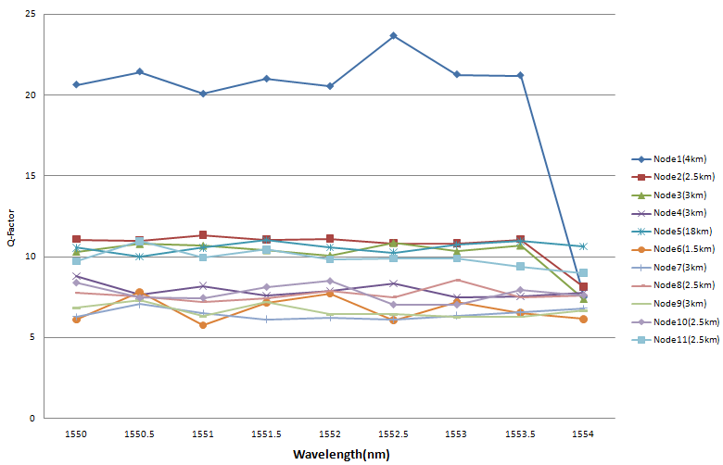
Graph of variation of Q factor with respect to the used wavelengths at each node for clear season.

Slide 21
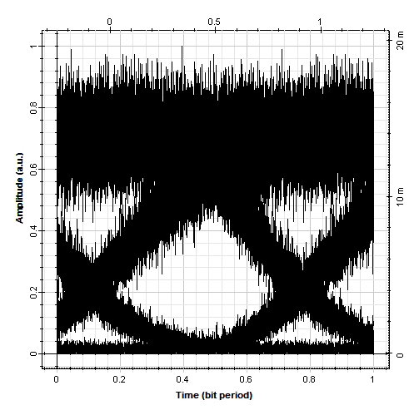
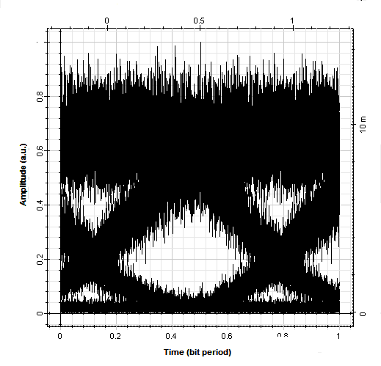
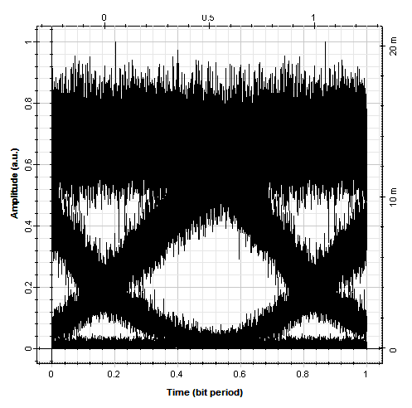
The received output eye diagrams at different nodes for clear season

Slide 22
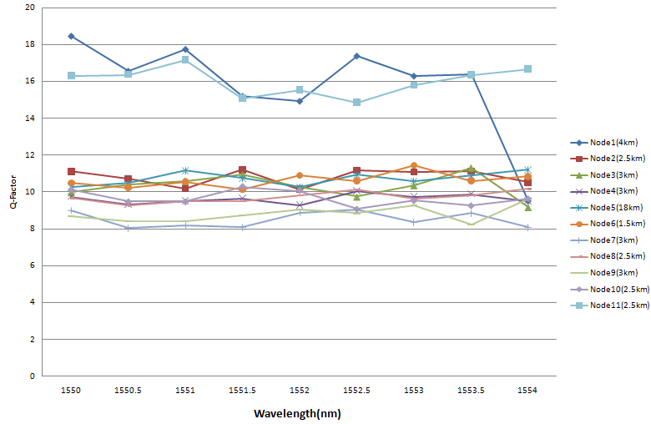
Graph of Q factor with respect to the used wavelengths at each node for foggy season.

Slide 23
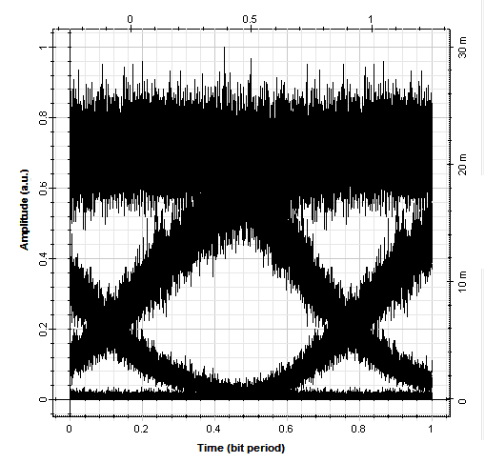
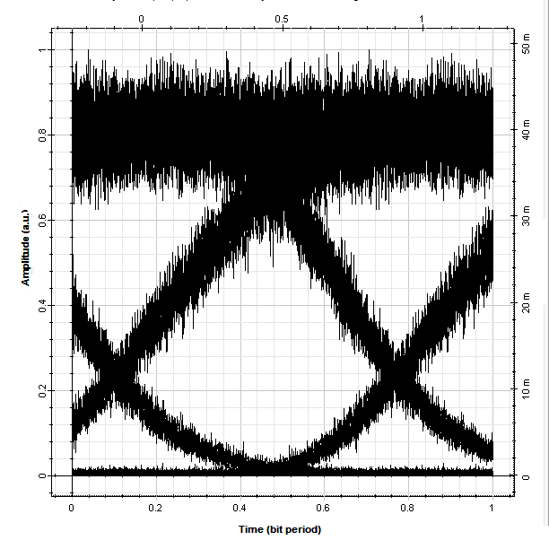
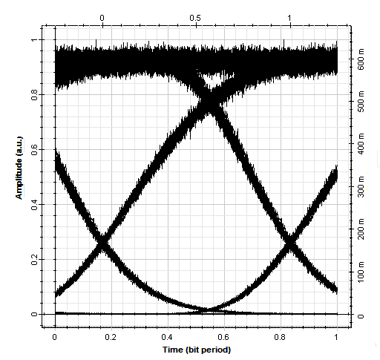
The received output eye diagram (1550 nm) at different nodes for foggy

Slide 24
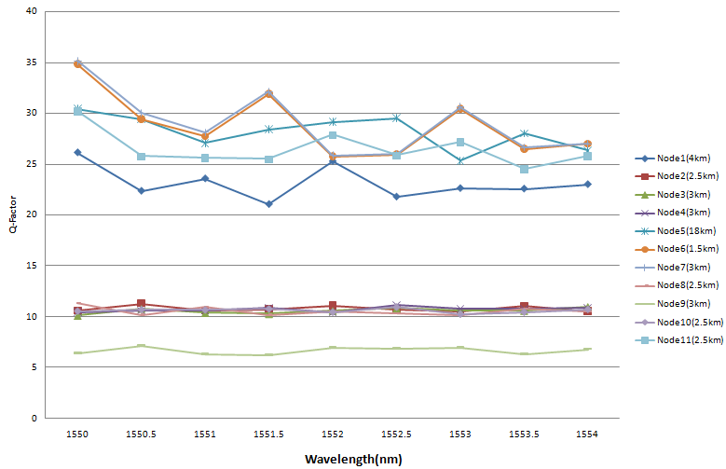
Graph of Q factor with respect to the used wavelengths at each node for rainy season.

Slide 25
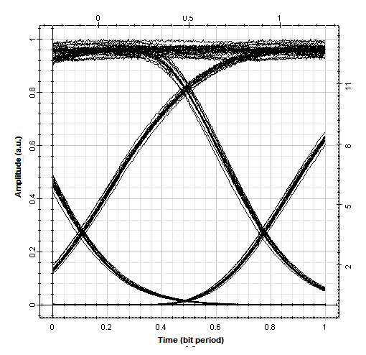
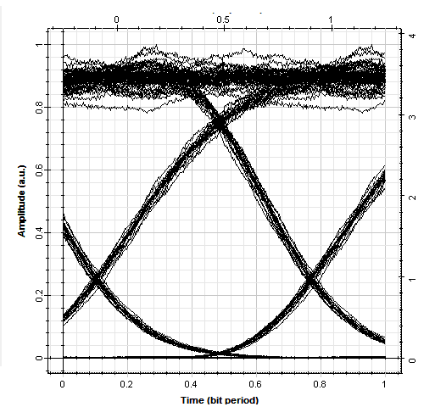
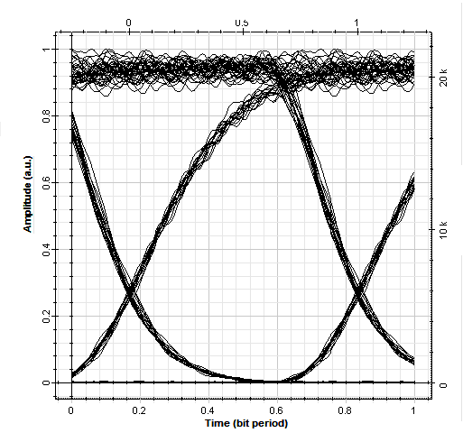
The received output eye diagram (1550 nm) at different nodes for rainy season.

Slide 26
Conclusion
FSO communication network has been proposed throughout the Patiala and Rajpura region
The FSO communication link performance through all-weather seasons of Patiala and Rajpura region has been observed.
In all the weather seasons, the results at each node of the network have been calculated in terms of BER and Q-Factor.
In rainy season, repeaters are needed after every 1km.
Acceptable quality factor on every node.

Slide 27
Publication
WECON 2018 (IEEE International Conference)
Designing of Free Space Optical Communication Network under Different Weather Conditions
Authors
Hardeepak Singh
Vishal Kumar
Vivek Takhi
Simranjit Singh
Amardeep Singh

Slide 28
Thank You

