Slide 1
Vishal Kumar · Shaishav Maisuria
Routes to Safety
An evacuation-services map from open geospatial data — datasets, tiles, routing, rendering
DuckDB · Overture Maps · Planetiler · PMTiles · MapLibre GL · OSRM
FOSS4G NA 2026 · Sacramento · Mon 2 Nov, 09:00–12:00 · Room Beavis · github.com/vishal4c/routes-to-safety-workshop
Notes:
Door slide stays up while people sit down: "Start your Codespace from your personal GitHub account, or run docker compose pull. Codespaces users: sit next to a Docker user."

Slide 2
Open geospatial data in.
An evacuation-services map — and the routes to it — out.
Hands-on with open datasets (OpenStreetMap, Overture Maps themes, CAL FIRE) → vector tiles → a routing graph for route-based analysis → rendered in the browser. Four open tools, one per phase.
Notes:
1 min. Say what people will walk out with: fluency with the open datasets, and four tools — one per phase — that take a rectangle of open data to a working map with routing. Then the next slide names them.

Slide 3
What we work with — open datasets and open tools
OPEN DATASETS
OPEN TOOLS — one per phase
OpenStreetMap
ODbL
DuckDB + spatial
Phase 1
the road network OSRM routes on — one .osm.pbf extract (Geofabrik) with turn restrictions and speed limits
SQL over GeoJSON — and over Overture's Parquet on S3: a county out of the planet in seconds (bbox pushdown)
Overture Maps
ODbL · CDLA-P 2.0
Planetiler → PMTiles
Phase 2a
themes transportation · places · divisions · base · buildings → roads, POIs, towns, water, land cover, 3D buildings — staged as GeoJSON
GeoJSON → vector tiles → one static file; no tile server, only HTTP Range requests
CAL FIRE FRAP
CC-BY
OSRM
Phase 2b · 2c · 3c
Fire Hazard Severity Zones and fire perimeters, pulled from ArcGIS feature services
routing graph from the OSM extract; /nearest · /table · /route → nearest by road, reach bands, closures
ESA WorldCover
CC-BY 4.0
MapLibre GL JS
Phase 3
land cover at 10 m resolution, via the Overture base theme
renders the tiles from a JSON style; three views over one file; routing wired into the page
Notes:
1.5 min. Left: where each piece of the map comes from, with its licence. Right: one tool per phase. Everything is open, pinned in versions.env, and runs on a laptop.

Slide 4
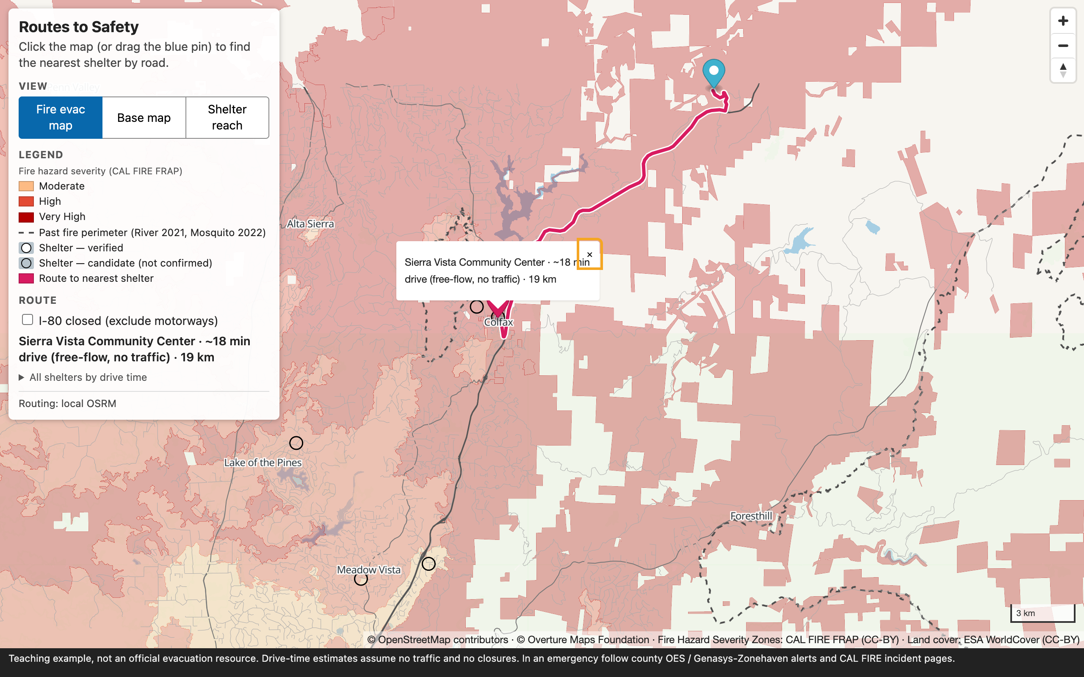
What we will have built
Our own vector tiles
roads · water · hazard zones · fire perimeters · city labels · shelters — one 6.5 MB PMTiles file
Three views, one at a time
Fire evac map · Base map · Shelter reach — the legend follows the view, nothing is overlaid
Live routing in every view
click anywhere → nearest shelter by road, route line, ranked list (OSRM)
"I-80 is closed"
one parameter, new answer — and why that is not the same as detection
Shelter reach
≤ 10 min green · ≤ 20 blue · ≤ 30 light red, from one OSRM /table call
Static files only
no database, no tile server; works offline in this room
Public demo: vishal4c.github.io/routes-to-safety-workshop/demo/ — Placer County I-80 corridor: Rocklin → Auburn → Colfax → Dutch Flat / Foresthill
Notes:
1 min. Point at each element: tiles you build in Phase 2, routing in Phase 3c, reach rings are precomputed in Phase 2c. Everything is a static file plus one small routing container.

Slide 5
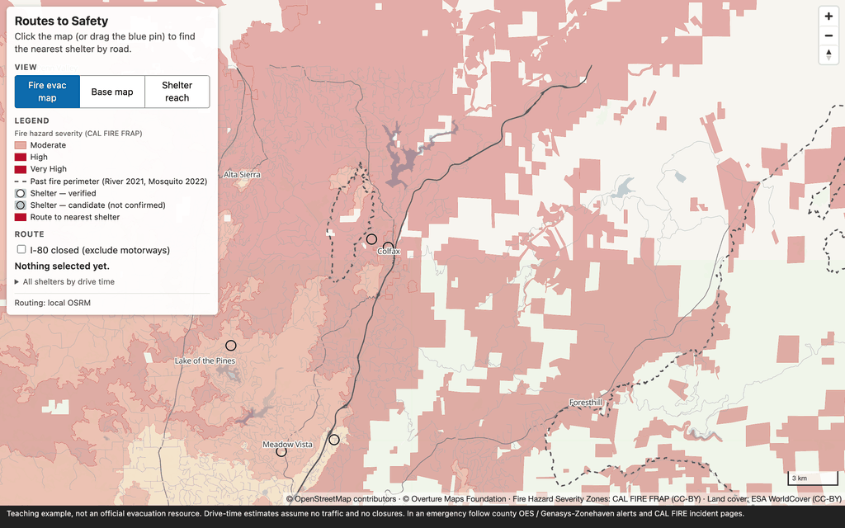
The app in motion
1 Drop a pin at Dutch Flat → Sierra Vista CC, 18 min
2 Tick "I-80 closed" → same shelter, 31 min via Dutch Flat Rd
3 Foresthill: nearest on the map (Georgetown, 12 km) ≠ nearest by road (Placer High, 36 min)
4 Shelter reach view → 10 / 20 / 30-min bands; click Placer High → only its reach
5 Base map view → a plain street map; the pin and the route stay — routing works in every view
Animated in slideshow mode. Recorded against the local OSRM container; the public demo uses router.project-osrm.org (no closure toggle there).
Notes:
Let the GIF loop once while you narrate the five beats. This is the whole workshop in 20 seconds. Stress: one view at a time — the legend changes with the view.

Slide 6
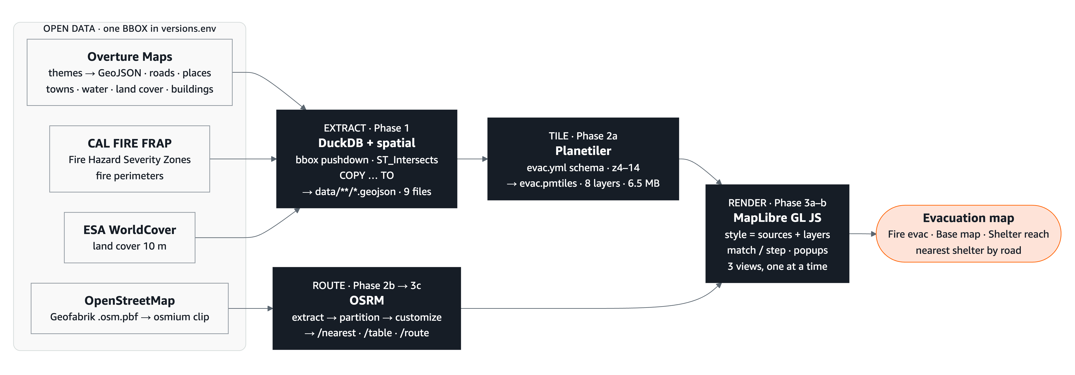
The pipeline: one extract → a basemap and live routes
Phase 4: change one bbox line in versions.env → the nine Phase 4 steps — fetch-overture.sh · fetch-osm.sh → build-osrm.sh · build.sh · make-coverage.py — rebuild everything for our own town. Everything is pinned (DuckDB 2.0.0 · Planetiler 0.10.2 · pmtiles 1.31.2 · MapLibre 6.14 · OSRM v26.10.0) and verified by CHECKSUMS.sha256.
Notes:
2 min. Read left to right: open data in, DuckDB extracts a rectangle and writes GeoJSON; Planetiler cuts tiles into one PMTiles file; MapLibre draws it. The OSM extract also feeds OSRM, whose three HTTP calls give routes, drive times and the reach bands. No database server, no tile server.

Slide 7
Agenda — five phases, one map
Phase | We do | Tools
0 · Setup | pick Codespaces / Docker / native · checkpoint line — the same green line on every screen | DuckDB
1 · Data prep | 1a explore · 1b shelters × hazard · 1c export | DuckDB · Overture
Break
2 · Map artifacts | 2a tiles · 2b routing graph · 2c reach bands — the three artifacts the app needs (2b, 2c prebuilt) | Planetiler · PMTiles · OSRM
3 · Application | 3a style · 3b three views · 3c routing (+ the I-80 closure) · 3d finished app | MapLibre · OSRM
4 · Adapt | one box in versions.env → the same nine steps for our own town; swap the hazard | versions.env · scripts/
Done | Questions in the hallway
Sticky note on the laptop lid: green = fine · red = stuck, come find me. Finish early → every phase card has a finish-early exercise.
Notes:
1 min. Both instructors are on the floor during the hands-on phases; the room is split geographically for triage.

Slide 8

Study area: the Placer County I-80 corridor
Rocklin → Auburn → Colfax → Dutch Flat / Foresthill
bbox -121.40, 38.72, -120.52, 39.20 (W, S, E, N) — about 0.4 square degrees, 36,294 drivable road segments, 10 shelters
Why here
River Fire, Aug 2021 — Colfax evacuated for ~2 days, 2,619 acres on the corridor
Mosquito Fire, Sep 2022 — 76,771 acres; the shelter moved mid-incident to Sierra College, Rocklin. The safe place is not a fixed point.
One interstate, steep canyons: nearest on the map is often not nearest by road
What we leave out
shelter status (open/closed/full) · drive time ≠ evacuation time · live closures · capacity
Shelters: 1 verified (Sierra College) + 9 candidates from Overture places; hazard: CAL FIRE FHSZ 2024 (SRA + LRA). Teaching example, not an official evacuation resource. Drive-time estimates assume no traffic and no closures.
Notes:
2 min. Two real incidents in this exact corridor. Then the honesty slide inline: today's map answers the two questions on a good day; it cannot tell you if today is a good day.

Slide 9
PHASE 0
Setup
Welcome · pick a way to run · setup checkpoint DuckDB 2.0.0 · Codespaces / Docker / native

Slide 10
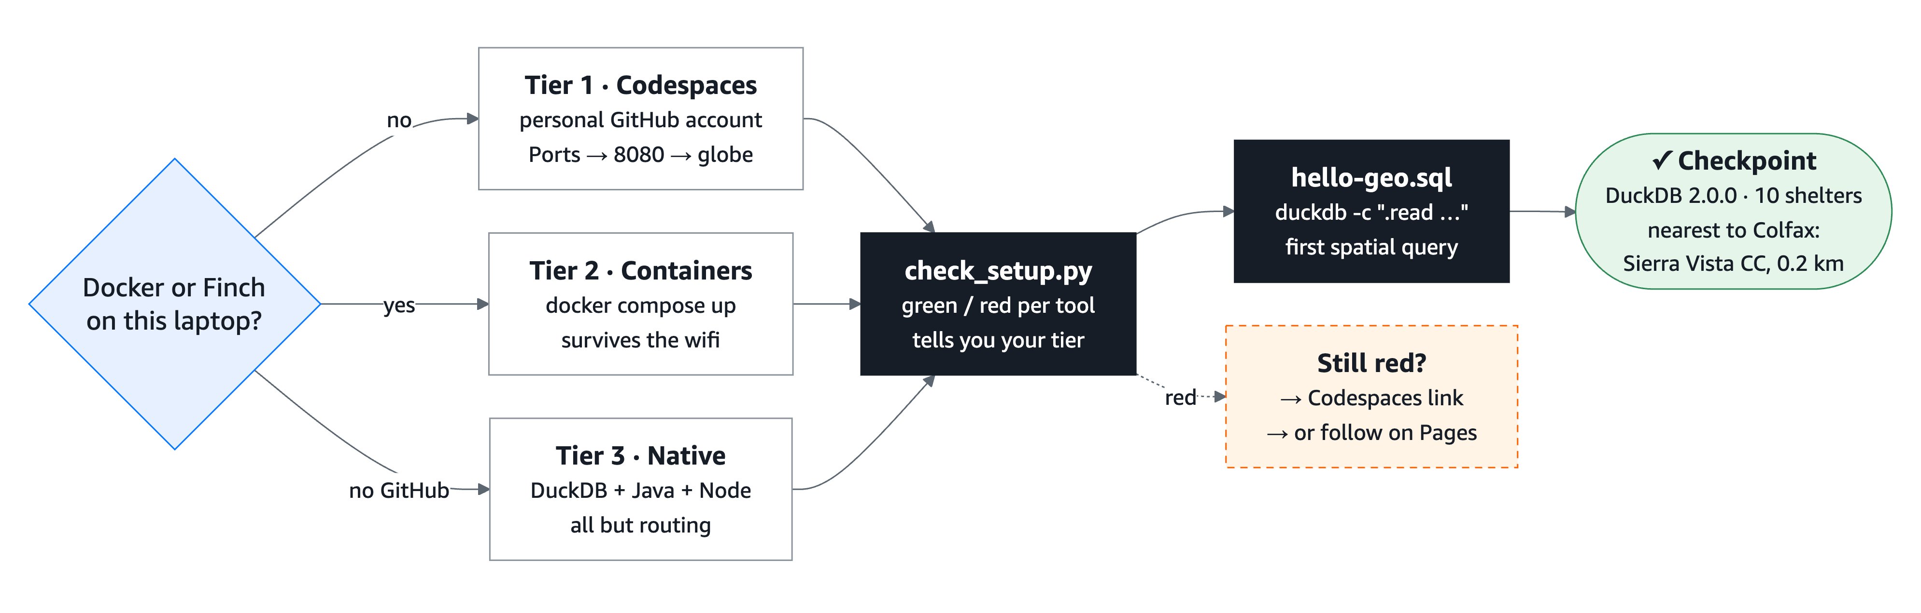
Phase 0 in one picture — pick a way to run, run two lines, hands up
Checkpoint: OK — DuckDB 2.0.0 · 10 shelters · nearest to Colfax: Sierra Vista Community Center, 0.2 km
Notes:
1 min. Walk the flow: the only decision is whether Docker/Finch is on the laptop. Everyone ends at the same two commands and the same checkpoint line. The dashed box is the bail-out — nobody debugs a laptop for more than 10 minutes.

Slide 11
Three ways to run — pick one, keep a neighbour
Tier | Who | Routing | Notes
1 · Codespaces | no Docker on the laptop | yes | personal GitHub account · sit next to a Docker user · 8080 via Ports tab → globe
2 · Local containers | recommended where Docker / Finch is available | yes | survives wifi loss · Finch for corporate laptops: finch compose up
3 · Native | DuckDB + Java + Node, no containers | no | Windows: Git Bash · map + shelters only (OSRM ships no native Win/Mac binary)
4 · Browser only | laptop failed | no | Pages site: follow along, demo still routes via the public OSRM server
PHASE 0 · setup checkpoint
Run both lines from the repo root. Hands up when the output matches the line on the right.
Still red? Open the Codespaces link. Codespaces blocked? Open the Pages link and follow along.
python3 setup/check_setup.py
duckdb -c ".read setup/hello-geo.sql"
OK — DuckDB 2.0.0 · 10 shelters (1 verified, 9 candidate)
· nearest to Colfax (crow-flies): Sierra Vista Community Center, 0.2 km
Notes:
5 min incl. the hands-on start. check_setup.py is green/red per tool and tells you which tier it thinks you are on and the exact next command.

Slide 12
PHASE 1
Data prep with DuckDB
1a look around · 1b candidate shelters · 1c export · exercises DuckDB 2.0.0 + spatial · Overture Maps 2026-09-23.1

Slide 13
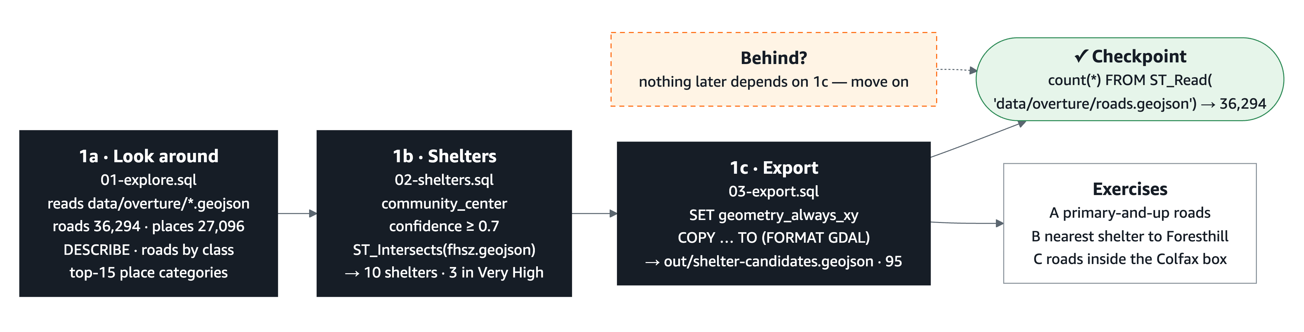
Phase 1 in one picture — three SQL files, one folder of GeoJSON
Phase 1: 1a explore · 1b shelters · 1c export · Checkpoint SELECT count(*) FROM ST_Read('data/overture/roads.geojson') → 36,294
Notes:
1 min. Three SQL files over the staged GeoJSON: look at the data, pick candidate shelters and tag them with the hazard class, export the candidates as GeoJSON. The checkpoint is a single count. Nothing later depends on 1c, so nobody falls behind.

Slide 14
Overture Maps in one slide
Open map data from the Linux Foundation, released monthly as GeoParquet in themes: transportation · places · base · buildings · divisions
Built from OpenStreetMap plus other sources; licence differs by theme (ODbL / CDLA-Permissive 2.0)
Parquet stores a bbox struct per row → DuckDB skips every file and row group outside the rectangle. Planet → Placer corridor without downloading the planet; we stage the result as GeoJSON in data/overture/.
Attribution on every published map: © OpenStreetMap contributors · © Overture Maps Foundation
36,294
27,096
drivable roads
places
121
1,920
towns (divisions)
water polygons
2,564
12,606
land-cover polygons
buildings (Auburn)
Our study area, release 2026-09-23.1 — fetched to GeoJSON by scripts/fetch-overture.sh in 24 s
Notes:
1 min. These are the real numbers for the extract that is already in the repo.

Slide 15
SQL in three lines, then one spatial predicate
LOAD spatial;
SELECT class, count(*) AS n -- what do I want back?
FROM ST_Read('data/overture/roads.geojson')
GROUP BY class ORDER BY n DESC; -- one row per group
LOAD spatial;
SELECT s.name FROM shelters s, fhsz h
WHERE ST_Intersects(s.geom, h.geom) -- yes / no
AND h.FHSZ_Description = 'Very High';
No GIS yet — this is just a table.
SELECT what · WHERE which rows · GROUP BY count per group
Three results to expect: residential 25,995 · tertiary 4,333 · secondary 2,792 · primary 1,305 · motorway 541 · trunk 63
A predicate is a yes/no question about two shapes.
It goes in WHERE like any other condition.
Phase 1b answer: three shelters sit in a Very High zone — Colfax High School, Sierra Vista Community Center, Georgetown School.
DuckDB 2.0 gotcha: SET geometry_always_xy = true; right after LOAD spatial; or the GeoJSON writer swaps lat/lon.
Notes:
2.5 min. Keep SQL to three words. The predicate slide is the only GIS theory of the phase.

Slide 16
Columns cheat sheet — raw Overture vs. our GeoJSON
We want | Raw Overture (S3) | Our data/overture/*.geojson
a place's name | names.primary | name
a place's category | taxonomy.primary | category
how sure Overture is | confidence (use >= 0.7) | same
road type | class, subclass | same
the shape | geometry | same
scripts/fetch-overture.sh already flattened these — today we type the right-hand column.
categories was removed in Sep 2026 → taxonomy.primary
There is no "fairground" category — Gold Country Fairgrounds hides under another one.
Writing GeoJSON: SET geometry_always_xy = true first, or lat/lon come out swapped.
The noise is the lesson: John L Sullivan Chevrolet is a community_center at confidence 0.92.
Notes:
1.5 min. This table is also on the printed phase card.

Slide 17
PHASE 1 · hands-on — data prep with DuckDB
1a · Look around
duckdb -c ".read 00-data/01-explore.sql"
DESCRIBE roads · roads by class · top-15 place categories → expected output printed in the file
1b · Candidate shelters
duckdb -c ".read 00-data/02-shelters.sql"
community_center + confidence ≥ 0.7 → spot the Chevrolet dealer → open data/shelters.geojson → ST_Intersects with FHSZ
1c · Export
write GeoJSON with SQL (right):
duckdb -c ".read 00-data/03-export.sql" → out/shelter-candidates.geojson, 95 places
Nothing later depends on 1c — behind? move on.
LOAD spatial; SET geometry_always_xy = true;
COPY (SELECT id, name, category, confidence, geom
FROM ST_Read('data/overture/places.geojson')
WHERE category IN ('school','community_center', … ))
TO 'out/shelter-candidates.geojson' (FORMAT GDAL, DRIVER 'GeoJSON');
Exercises
A count motorway + trunk + primary → 1,909
B crow-flies nearest shelter to Foresthill (-120.8182, 39.0199) → Georgetown School, 12.4 km. Remember it for Phase 3c.
C (finish early) count the roads inside the Colfax box with ST_Intersects
Checkpoint duckdb -c "LOAD spatial; SELECT count(*) FROM ST_Read('data/overture/roads.geojson')" → 36,294
Notes:
Stays on screen for the whole phase. Say: "Open a terminal at the repo root. Phase 1a — three queries, each has an expected result. Hands up when you match it."

Slide 18
PHASE 2 → 3
Map artifacts → the application
2a build the tiles · 3a serve & style · 3b three views Planetiler 0.10.2 · go-pmtiles 1.31.2 · MapLibre GL JS 6.14 · pmtiles.js 4.5

Slide 19
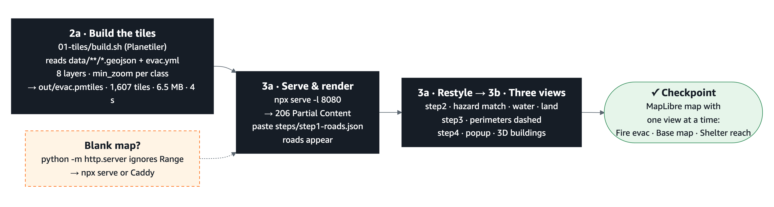
Phase 2 → 3 in one picture — GeoJSON → one tile file → a styled map
Phase 2a → 3b: 2a build the tiles · 3a serve, render, restyle · 3b three views · Checkpoint curl -sI -H "Range: bytes=0-15" …/out/evac.pmtiles → 206 Partial Content
Notes:
1 min. Planetiler reads the GeoJSON and the evac.yml schema and writes one PMTiles file in 4 seconds. A static server that answers Range requests serves it; MapLibre draws it. Then the hands-on part is pure styling: paste step files, see the map change. The dashed box is the one trap: python -m http.server leaves the map blank.

Slide 20
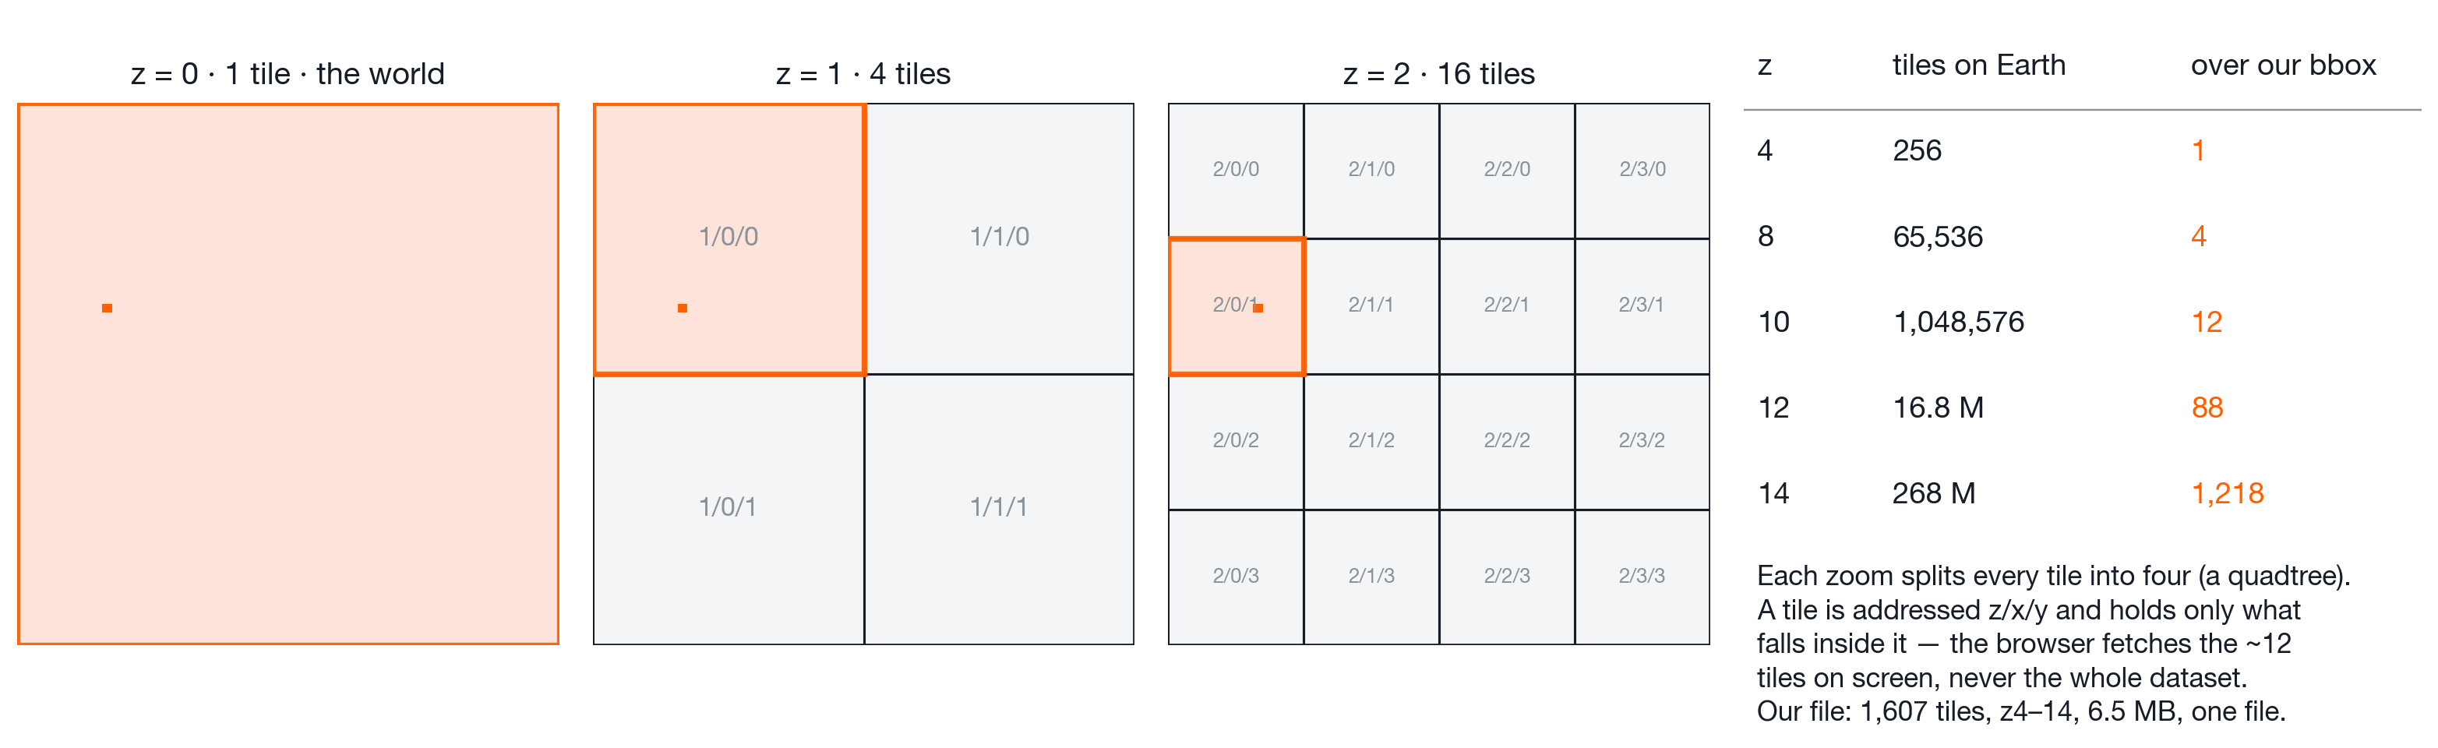
Why tiles: the map is cut into a z/x/y quadtree
Each zoom level splits every tile into four. z0 is the whole world in one tile; by z14 the planet is 268 million tiles — but our rectangle touches only 1,218 of them. The browser fetches the handful under the viewport, at the zoom it is showing, and nothing else.
That is why one 6.5 MB file replaces a 17 MB GeoJSON and a database: 1,607 tiles for z4–14, each holding only the geometry that matters at that zoom (motorways from z6, residential streets from z10). Zoom in → a new, smaller square; pan → the neighbour square.
Notes:
2 min. Walk the three panels left to right: same square, split in four, split in four again. Then the table: tiles on Earth explode, tiles over our bbox stay small. Land the point: a tile is addressed by z/x/y, so the client can ask for exactly the squares it needs — no server has to think.

Slide 21
Vector tiles, PMTiles and the Range-request trap
A browser cannot draw 36,294 roads from a 17 MB GeoJSON fast.
So we cut the map into a z/x/y grid. Each tile holds geometry + attributes, not pixels → the browser draws it, so you restyle without rebuilding.
PMTiles = every tile in one file with an index. The browser asks for byte ranges; no tile server, works from any static host (GitHub Pages, S3, a USB stick).
The trap: python -m http.server ignores Range headers → the map stays blank. Use Caddy (:8080) or npx serve -l 8080 . and look for 206 Partial Content.
# the only test needed
curl -sI -H "Range: bytes=0-15" http://localhost:8080/out/evac.pmtiles | head -1
HTTP/1.1 206 Partial Content
# 01-tiles/evac.yml (excerpt — 8 layers, all local files, zero network)
sources:
roads: { type: geojson, local_path: data/overture/roads.geojson }
towns: { type: geojson, local_path: data/overture/towns.geojson }
layers:
- id: roads
features:
- { source: roads, geometry: line, min_zoom: 6,
include_when: { class: [motorway, trunk, primary, secondary] } }
- { source: roads, geometry: line, min_zoom: 10, min_size: 1,
exclude_when: { class: [motorway, trunk, primary, secondary] } }
Notes:
4 min. Planetiler has no GeoParquet source — that is why Phase 1 exports GeoJSON. min_zoom / min_size / attributes are the whole "tile schema" lesson.

Slide 22
MapLibre style: sources, layers, and two expressions
"fill-color": ["match", ["get", "FHSZ_Description"],
"Moderate", "#fdbb84",
"High", "#e34a33",
"Very High", "#b30000",
"#cccccc"] // fallback
Moderate
High
Very High
A style is JSON: sources (our one PMTiles file) + layers (one per thing drawn, bottom to top).
Paste-in steps: index.html sorts pasted layers by a fixed order and de-duplicates by id, so paste order never matters and step 3 can be pasted over steps 1–2.
Labels: a symbol layer with text-field + text-font; glyph PBFs are vendored in 02-web/fonts so labels work offline.
Three views, one at a time: Fire evac map · Base map (Esri street raster) · Shelter reach — setLayoutProperty(visibility) over a list of ids, legend swapped with it; no style reload, so routing keeps working.
Shelter reach: a GeoJSON source + setFilter(shelter_id); the 0–10 / 10–20 / 20–30-min rings never overlap, so they stay translucent over the roads without blending. Precomputed with OSRM /table in Phase 2c.
"line-width": ["step", ["zoom"], 0.6, 10, 1.2, 13, 1.6]
match — one output per category (hazard class → OrRd)
step — one output per range (zoom → width)
Case and spelling must match exactly: "Very High", not "very_high". FHSZ is also there as 1 | 2 | 3.
Notes:
3 min. Show the expressions, then flip to the screenshot slide for what they produce.

Slide 23
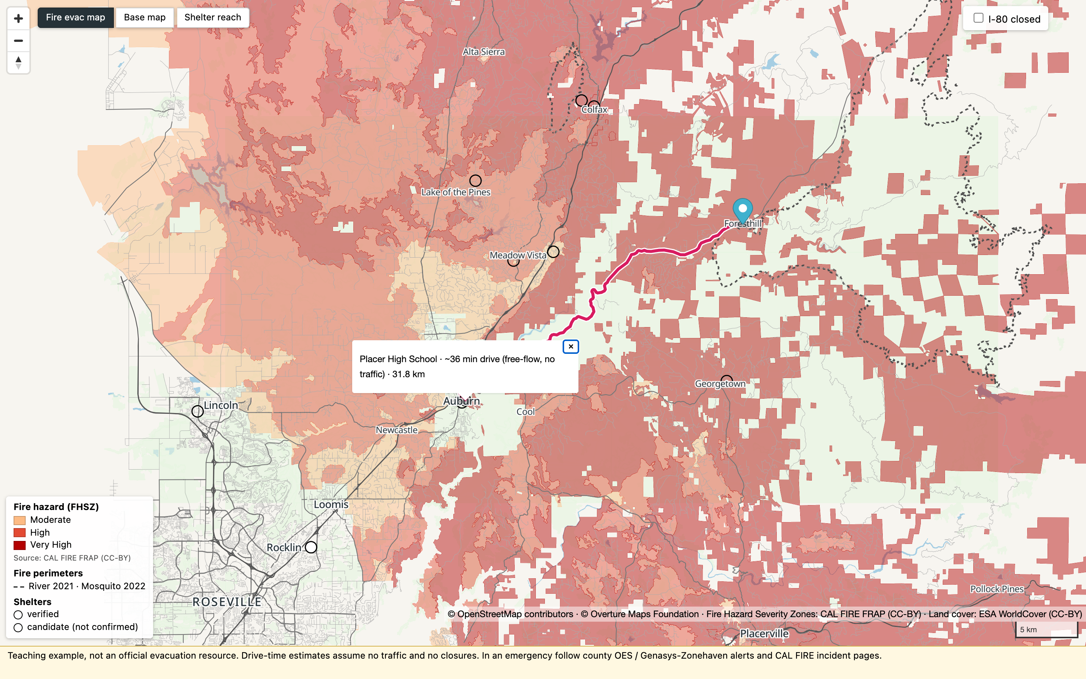
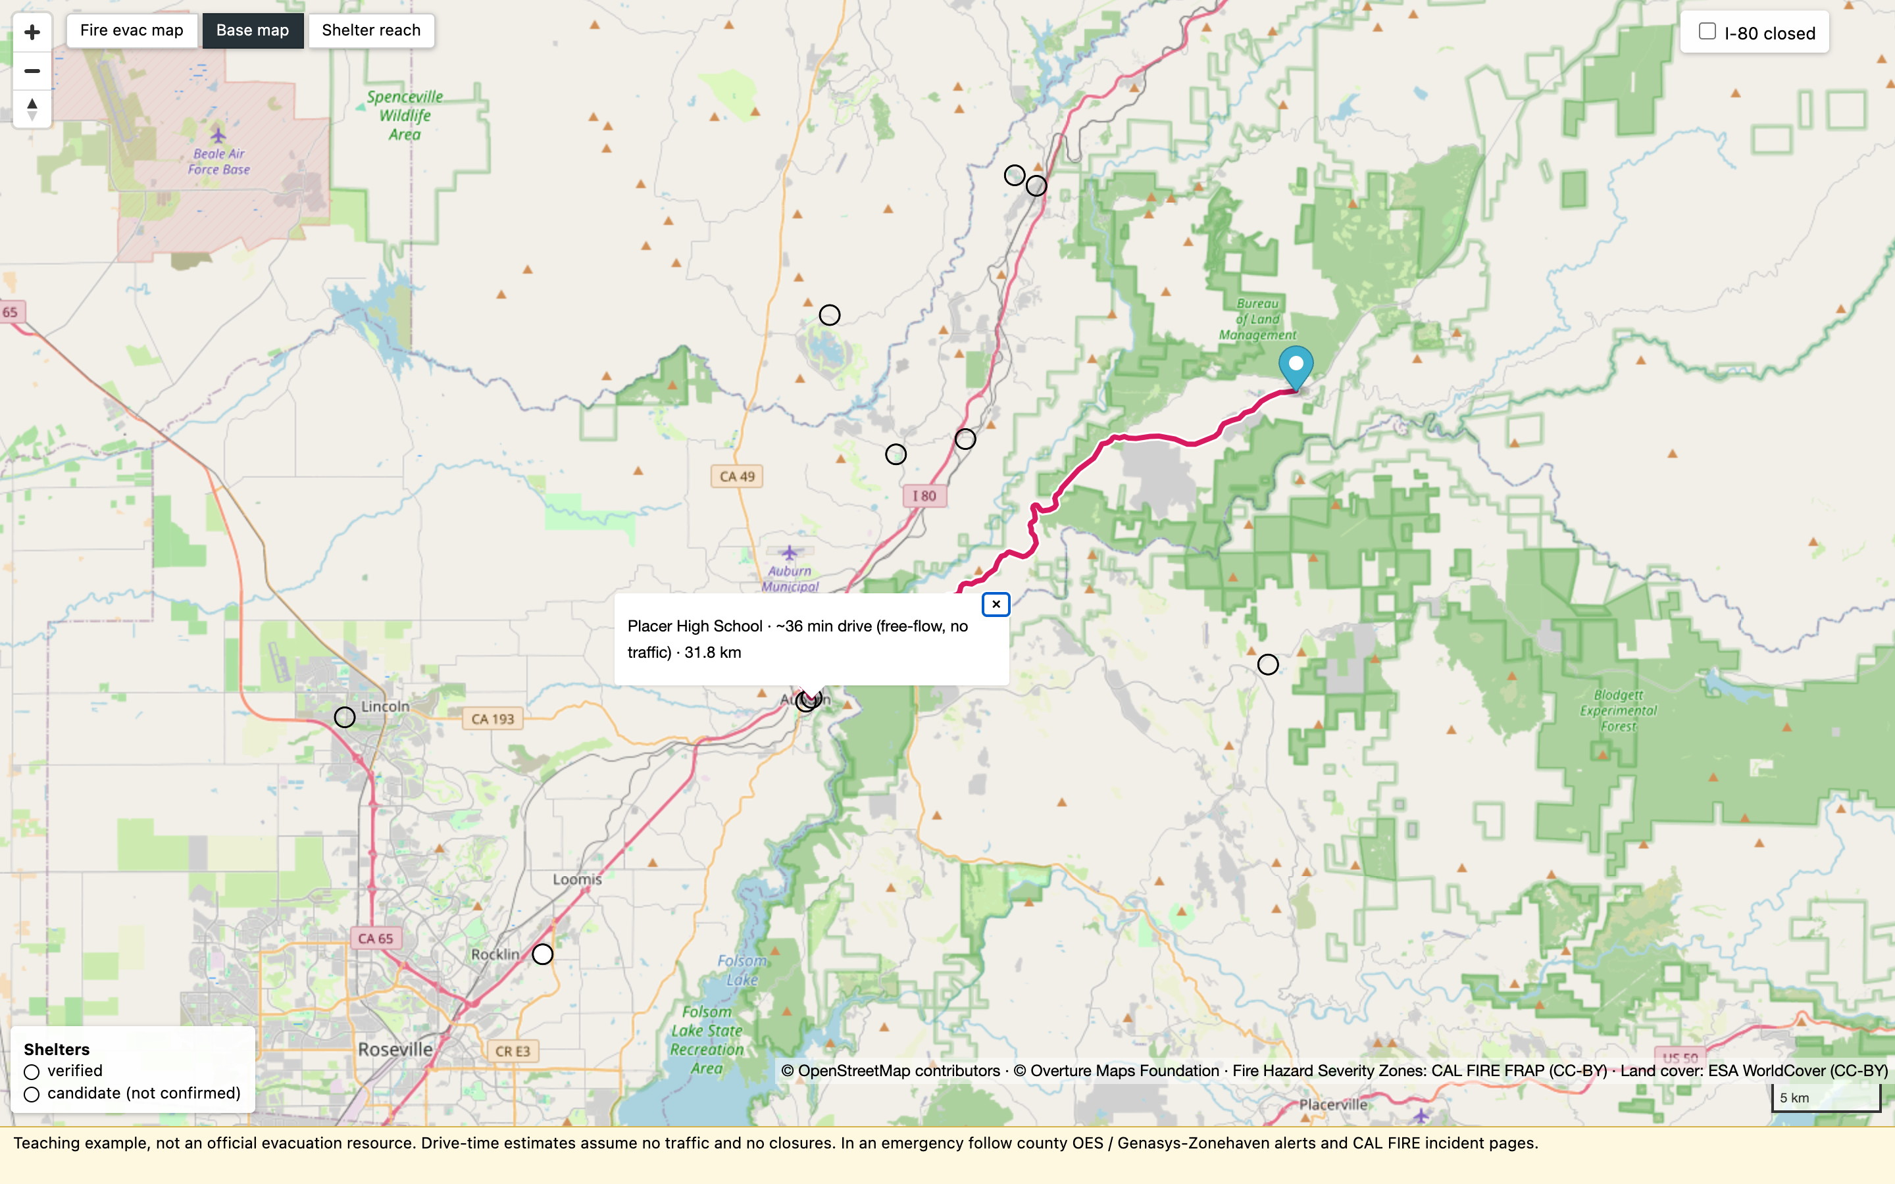
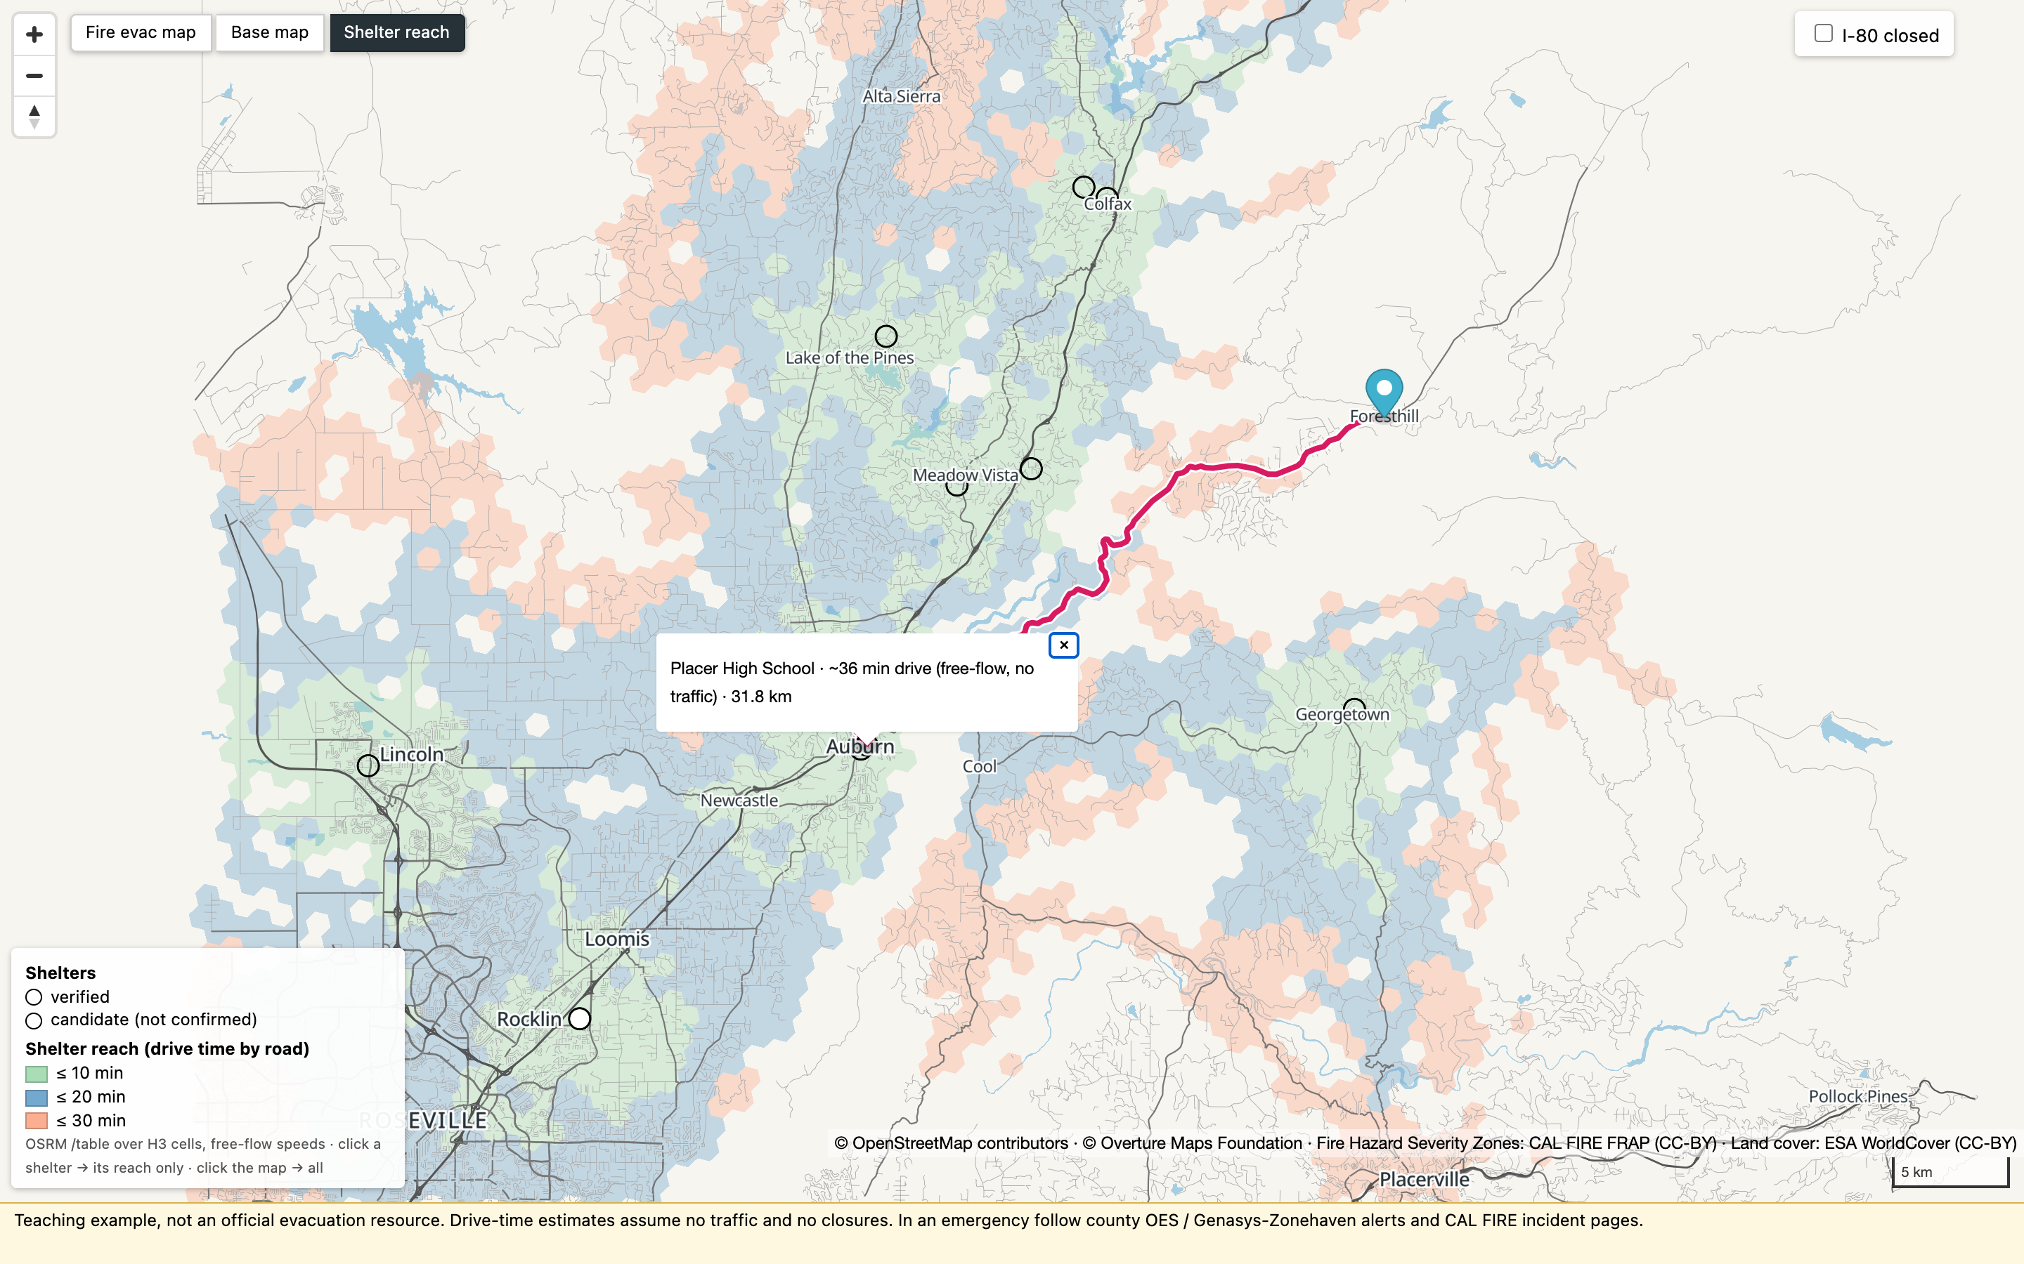
What Phase 3 produces: three views of the same tiles
Fire evac map — our tiles: FHSZ Moderate / High / Very High, dashed perimeters, city labels, shelters, route
Base map — a standard street raster (Esri, no API key); only shelters, the pin and the route on top (needs internet)
Shelter reach — ≤ 10 min green · ≤ 20 blue · ≤ 30 light red from every shelter; click a shelter for its own bands
Strictly one view at a time: Fire evac map, Base map or Shelter reach — the legend follows the view; the reach bands are never drawn on top of the hazard fill. Phase 3a checkpoint: Very High solid red · water blue · 10 shelter circles (1 filled) · Mosquito perimeter dashed · city labels · attribution visible. Hazard edges are zone boundaries, not a guarantee: a road just outside a polygon is not "safe".
Notes:
After the hands-on: load data/prebuilt/evac.pmtiles next to yours — same layers? Maputnik 60 s on the instructor machine if time.

Slide 24
PHASE 2a → 3b · hands-on — build and style the map
Open the page: Codespaces → Ports tab → 8080 → globe · Docker → http://localhost:8080/02-web/ · Native → npx serve -l 8080 . then the same URL
2a · Build the tiles
01-tiles/build.sh # = java -jar planetiler.jar generate-custom --schema=01-tiles/evac.yml --output=out/evac.pmtiles
pmtiles show out/evac.pmtiles
Expected: 1,607 tiles, zoom 4–14, 8 layers, ≈ 6.5 MB, ~4 s. · no PMTiles? →
cp data/prebuilt/evac.pmtiles out/
3a · Serve & render (step 1)
in 02-web/index.html find
// STEP 1: paste here → paste steps/step1-roads.json → reload; uncomment AttributionControl → grey roads + attribution bottom-right
3a · Restyle (steps 2–4)
step2: hazard match (OrRd) · water fill · land cover · shelters filled = verified, hollow = candidate · city labels
step3 (if time): fire perimeters dashed grey
step4 (finish early): click popup with name · fill-extrusion on buildings (zoom ≥ 13, tilt)
stuck? → paste steps/step3-styled.json; totally lost → open 02-web/solution.html
Checkpoint Very High solid red · water blue · 10 shelters (1 filled) · Mosquito perimeter dashed · attribution visible
3b · Three views — try the Base map and Shelter reach buttons, one view at a time: a plain street map, or each shelter's 10 / 20 / 30-min drive-time bands (click a shelter to isolate it); then come back, it is the same page.
Notes:
Phase card stays on screen. "By minute 5 if there is no PMTiles file, copy the prebuilt one."

Slide 25
PHASE 3c
Routing in the application (OSRM)
the routing graph (2b) · /nearest · /table → argmin → /route · I-80 closed OSRM v26.10.0 (MLD) · tiers 1–2 route, tiers 3–4 pair up

Slide 26
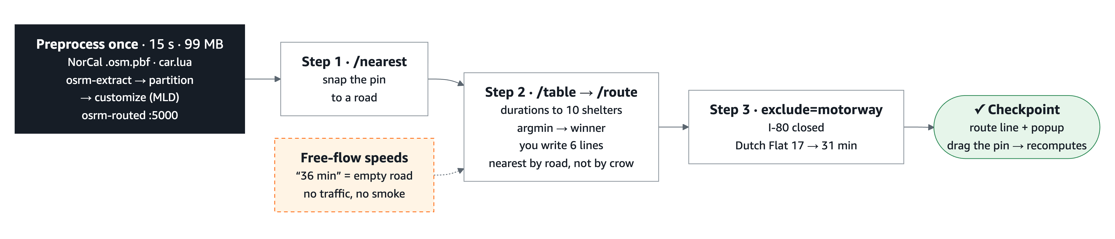
Phase 3c in one picture — preprocess once, then three HTTP calls
Phase 3c: hello route (/nearest) · nearest by road (/table → argmin → /route) · I-80 closed (exclude=motorway) · Teaching numbers Dutch Flat → Sierra Vista CC 17.1 min, 31.3 min with I-80 closed · Foresthill → Placer High 35.8 min / 31.8 km
Notes:
1 min. The graph is built once (15 s, 99 MB) and served by osrm-routed. The hands-on part is in the browser: snap the pin, ask /table for durations to all 10 shelters, take the minimum, draw the /route. Step 3 closes I-80 with exclude=motorway and the answer changes. Keep repeating the caveat: free-flow speeds, no traffic, no smoke.

Slide 27
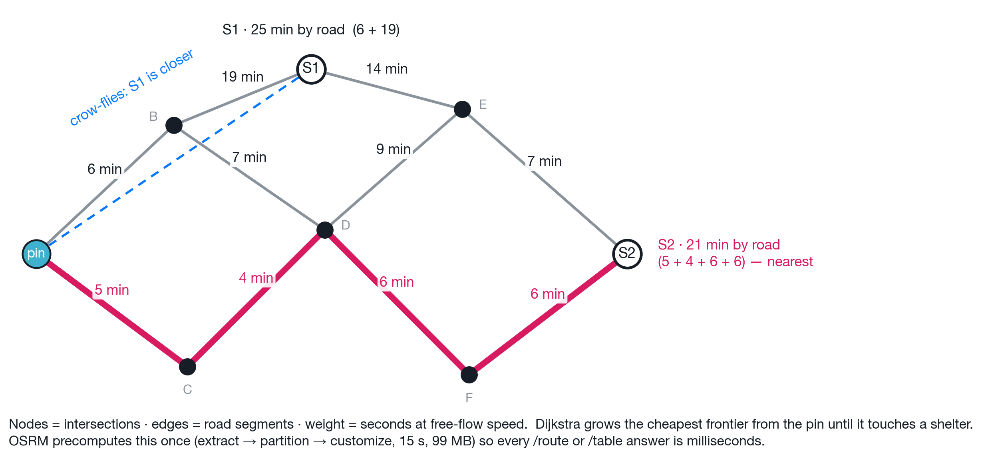
Why a routing graph: nearest on the map ≠ nearest by road
The crow lies
S1 is closest on the map, 25 min by road. S2 looks farther but is 21 min: a canyon, a river or a missing bridge bends the real distance.
A road network is a graph
nodes = intersections, edges = road segments weighted in seconds. Dijkstra grows outward from the pin, cheapest node first, until it has settled every shelter.
Why preprocess
on 36,294 roads a search per click is fine; on a region it is not. OSRM builds the graph once (15 s, 99 MB) and answers /nearest, /table and /route in milliseconds.
Build-once artifact
like the tiles: made in Phase 2, consumed by the app in Phase 3c.
Edge weights = length ÷ free-flow speed. Pink: the cheapest path pin → C → D → F → S2. Grey dashed: the straight line the map suggests.
Notes:
2 min. Point at S1 and S2: the map says S1, the road says S2. Then the graph: every intersection a node, every segment an edge with a cost in seconds. Dijkstra is "always expand the cheapest frontier node". MLD is Dijkstra with the homework done in advance.

Slide 28
Routing in three minutes, and three HTTP calls
A road map is a graph: intersections are nodes, segments are edges, each edge costs seconds (length ÷ free-flow speed).
A route is the cheapest path — Dijkstra explores outward until it reaches the target.
Too slow at scale → OSRM preprocesses once: MLD partitions the graph into cells and precomputes costs between cell borders. Our graph: 15 s to build, 99 MB.
Weights are free-flow speeds, not traffic. "36 minutes" means 36 minutes on an empty road.
Call | Question it answers
/nearest | Which road point is closest to this coordinate? (snap)
/route | Path + duration + distance between two points
/table | Durations (and distances) from many points to many points
GET $OSRM_URL/{service}/v1/driving/{lon},{lat};{lon},{lat} # longitude first!
Tier | $OSRM_URL
1 Codespaces | <forwarded-8080-URL>/osrm (Ports → globe; never forward 5000)
2 Local Docker / Finch | http://localhost:8080/osrm (Caddy strips /osrm → osrm:5000)
3 Native · 4 Browser | no routing — pair with a neighbour
Notes:
3 min + 2.5 min. "Three verbs: snap a point, route between two points, fill a matrix of times."

Slide 29
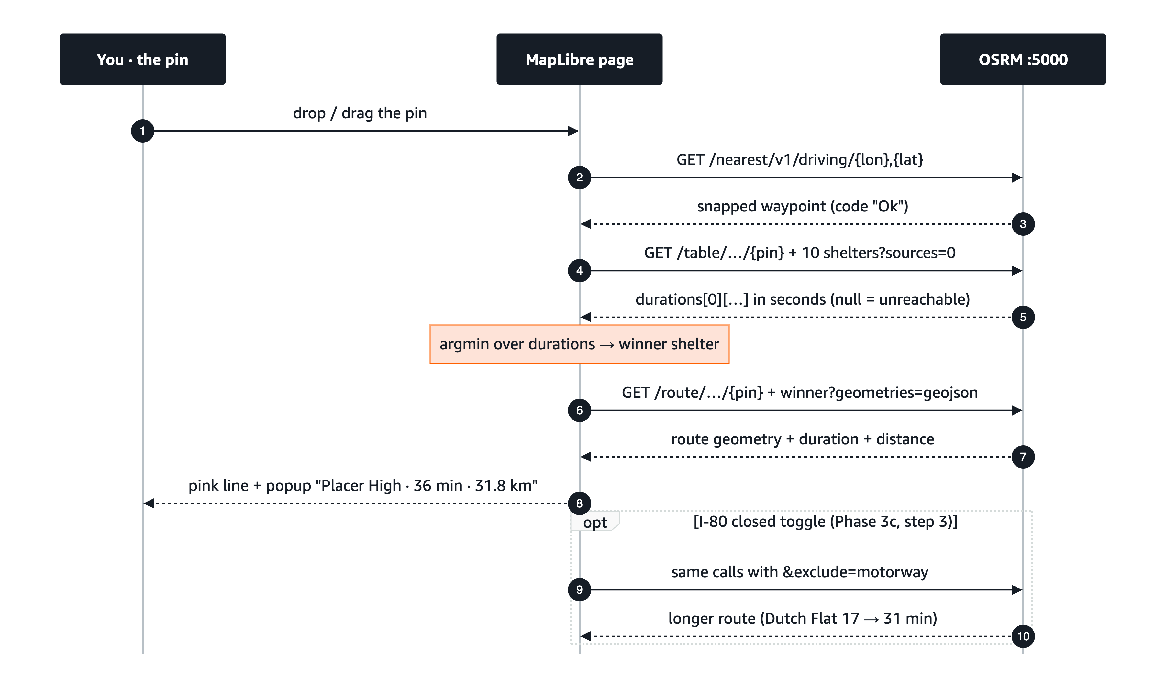
What the browser and OSRM say to each other
Notes:
1 min. This is the whole of "nearest shelter by road" in one exchange: snap, table, argmin, route. The six lines you write are the argmin and the /route call. The optional part at the bottom is the I-80 closure — same calls plus exclude=motorway.

Slide 30
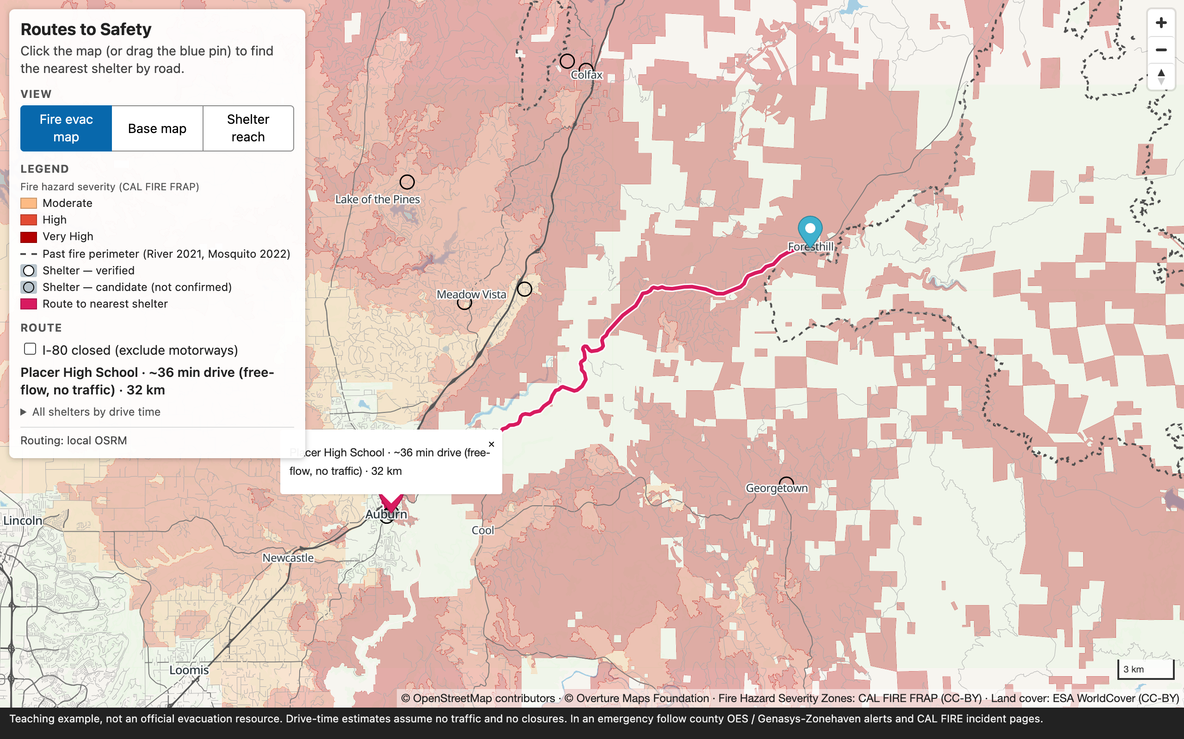
Nearest on the map ≠ nearest by road
Foresthill sits on a ridge above the American River canyon.
Exercise B (crow-flies): Georgetown School, 12.4 km
Phase 3c (/table, by road): Placer High School, 35.8 min / 31.8 km. Georgetown is 59.7 min / 54 km by road.
A ridge, a river canyon or a missing bridge makes the "close" shelter far. This is why the shelter list is ranked by /table, not by ST_Distance.
How the graph was built: osmium extract -b <bbox> norcal-latest.osm.pbf → osrm-extract -p car.lua → osrm-partition → osrm-customize → osrm-routed --algorithm mld --max-table-size 500
Finish early? build the graph by hand: scripts/build-osrm.sh data/osm/colfax.osm.pbf
Demo at Foresthill (-120.8182, 39.0199): ranked list from one /table call, route from /route.
Notes:
1.5 min. "Remember your answer to Exercise B. In a minute you find out whether the road agrees with the crow."

Slide 31
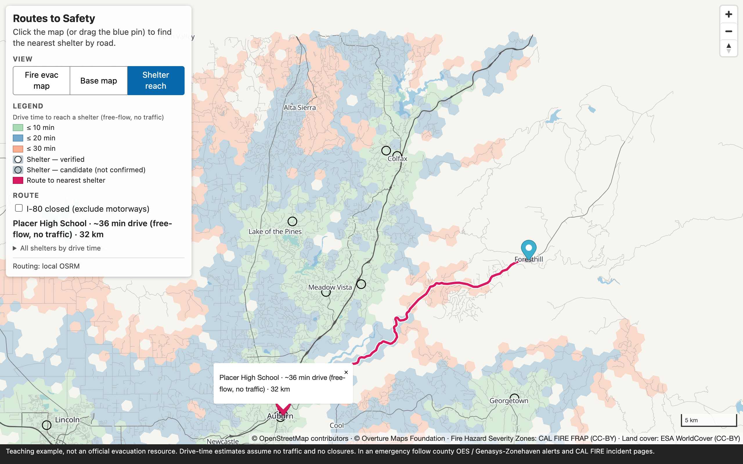
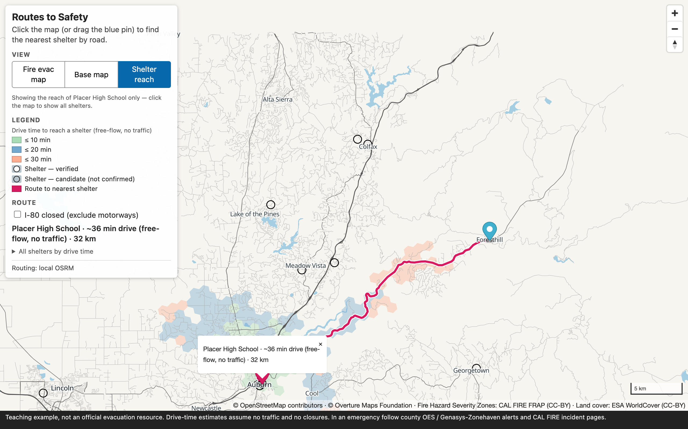
From routes to coverage: /table once, draw the reach
Shelter reach view — all shelters: ≤ 10 min green · ≤ 20 blue · ≤ 30 light red (dissolved H3 cells)
Click a shelter → only its 10 / 20 / 30-minute reach
scripts/make-coverage.py: H3 res-8 grid over the bbox (3,341 cells with a road) → one batched /table call (cells × 10 shelters) → DuckDB dissolves the cells into one band per shelter. Stretch A in Phase 3c is the 400-point version with grid.sql.
Notes:
Same call as step 2, more points. "Isochrone" here is a drive-time band on free-flow speeds. One view at a time: the hazard fill is off while the bands are on.

Slide 32
PHASE 3c · hands-on — routing
Step 1 · Hello route
curl "$OSRM_URL/nearest/v1/driving/-121.08,38.90" (PowerShell: curl.exe)
Expected: JSON with "code":"Ok" and a waypoints array. Then /route…?geometries=geojson; paste via steps/step1-route.js → pink line Foresthill → Placer High, console "Route: 35.8 min, 31.8 km".
Step 2 · Nearest shelter by road
in steps/step2-scaffold.js
we write 6 lines: /table URL → argmin durations[0] → /route → setData → popup. Compare with Exercise B. Drag either marker.
not routing? → open steps/step3-solution.js
Step 3 · I-80 is closed
add the
&exclude=motorway toggle; start from Dutch Flat (-120.838, 39.198): 17 → 31 min to Sierra Vista CC, the route leaves I-80 for Dutch Flat Rd / Rollins Lake Rd.
Real closures aren't a parameter — nobody flags a downed power line before someone drives into it. This shows the calculation, not detection.
Tiers 3/4: no routing by design — pair with a Docker/Codespaces neighbour or follow the screen.
Finish early? Stretch A 15-min reach: grid.sql → one /table POST (400 points) Stretch B build the graph for Colfax — finish at home, the repo has the solution.
Checkpoint drag anywhere → line + popup update; toggle changes the route; footer disclaimer visible.
Notes:
B is timekeeper. Swap instructors at the start of this phase. Checkpoint: drag anywhere → line + popup update.

Slide 33
PHASE 4
Adapt the pipeline to a community of our choice
one box → fetch → build → the same pages versions.env · fetch-overture.sh · fetch-osm.sh · build-osrm.sh · build.sh · make-coverage.py

Slide 34
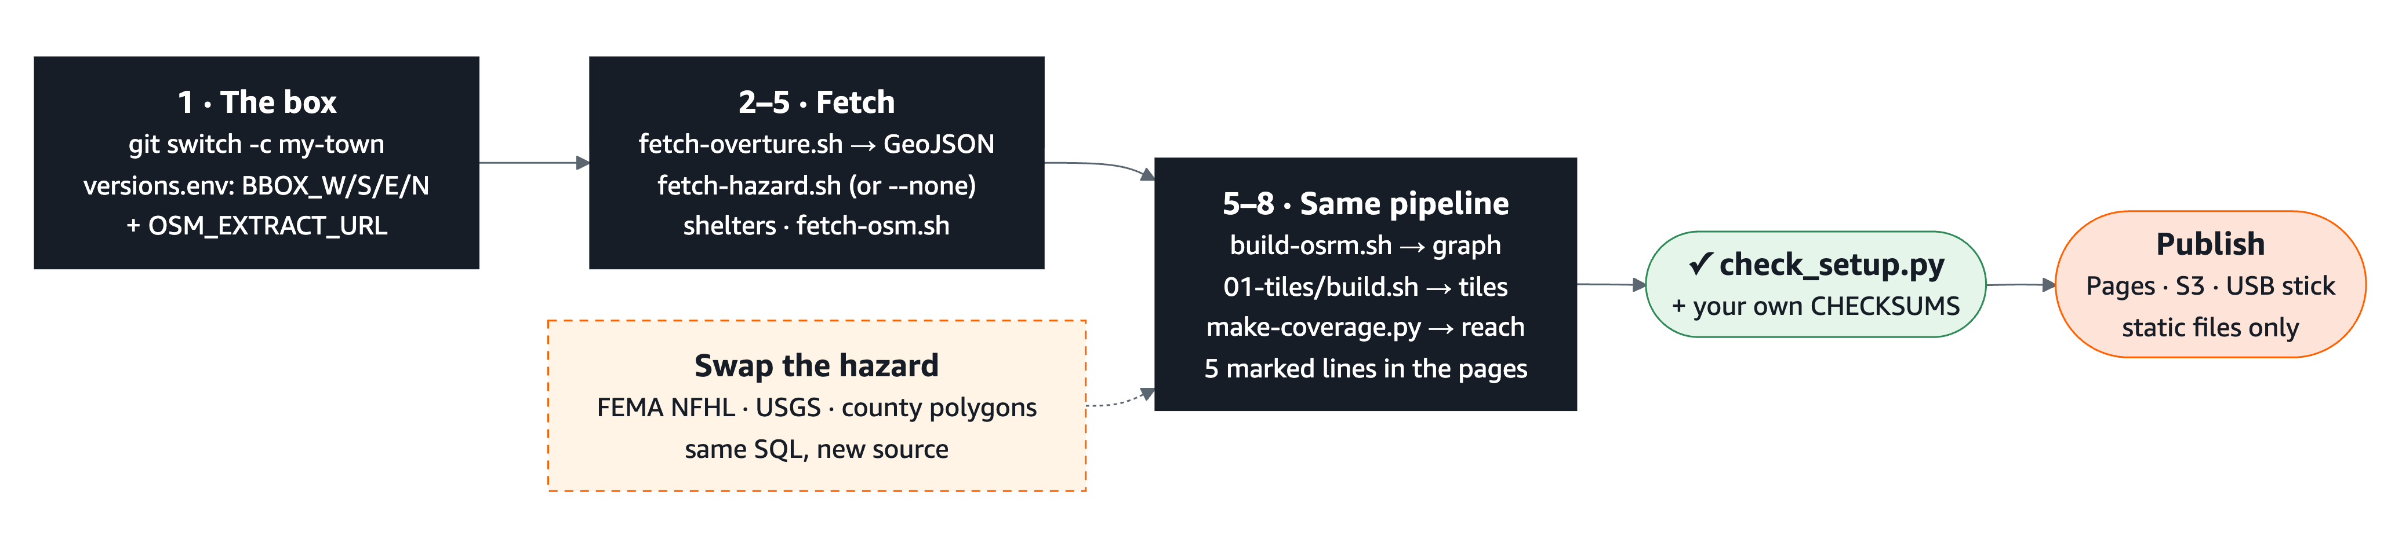
Phase 4 in one picture — one box, the same scripts, our own town
Phase 4: fetch-overture.sh → fetch-hazard.sh → shelters → fetch-osm.sh + build-osrm.sh → build.sh → make-coverage.py → 5 marked lines · Pinned: DuckDB 2.0.0 · Planetiler 0.10.2 · pmtiles 1.31.2 · MapLibre 6.14 · OSRM v26.10.0
Notes:
1 min. versions.env holds the box and every pinned version. Nine explicit steps: fetch the Overture themes (≈ 20 s), the hazard (or --none outside California), pick shelters, clip an OSM extract and build the OSRM graph, cut tiles, compute reach bands, point the two pages at the new centre. The worked example in the README is a 4 × 4 mile box over Bellevue, WA — verified end to end.

Slide 35
Reproducibility, then swap the community
If we can't rebuild it next year with the same answers, it's a demo, not a method.
versions.env — one file pins every tool and image; scripts/check-versions.sh fails CI on drift
Dated extracts: Overture 2026-09-23.1, a dated Geofabrik norcal snapshot (2026-10-22)
data/CHECKSUMS.sha256 — verify the 143 MB bundle (OSM clip, OSRM graph, tiles, planetiler.jar) we downloaded
One script per step: fetch-overture.sh · fetch-hazard.sh · fetch-osm.sh → build-osrm.sh · 01-tiles/build.sh · make-coverage.py — all GeoJSON in, artifacts out
PHASE 4 · Swap the community
1. git switch -c my-town · versions.env: BBOX_W/S/E/N + OSM_EXTRACT_URL
2. scripts/fetch-overture.sh (≈ 20 s) · scripts/fetch-hazard.sh --none
3. shelters → fetch-osm.sh + build-osrm.sh → build.sh → make-coverage.py
The OSM region download is the big one (a US state, 100 MB – 1 GB); everything else runs in seconds.
Swap the hazard
FEMA NFHL flood zones instead of fire zones: polygons → ST_Intersects → tiles → match on a zone field. A data change, not a code change.
Going live (CAL FIRE perimeters feed) raises the stakes on every caveat from "what we leave out": status, drive time, closures, capacity.
Notes:
Phase 4 live part is the first thing cut on a hard stop. "Pick a town you know. Four lines in versions.env, then the same scripts you have been running all morning. The README has a Bellevue walk-through with every count and timing."

Slide 36
Laptop → planet: same shape, bigger inputs
Stage | Today (0.4 sq°) | At scale
Extract | DuckDB bbox pushdown, 24 s, six GeoJSON files (38 MB) | same SQL; a region at a time; run where the data lives
Tiles | Planetiler 4 s → 6.5 MB PMTiles | planet-scale builds are a documented Planetiler use case (bigger heap, more disk)
Serve | npx serve / Caddy on :8080 | PMTiles on object storage behind a CDN — one file, Range requests, no tile server
Routing | OSRM MLD graph 15 s, 99 MB | one regional graph per region, not one planet graph per laptop; Valhalla / GraphHopper for isochrones, traffic
Freshness | pinned release 2026-09-23.1 | Overture publishes monthly — bump the pin in versions.env, rerun, diff the answers
In the wild: OSM underlies OSRM (public server router.project-osrm.org) · Planetiler builds OpenMapTiles-style and custom tiles · PMTiles is the Protomaps single-file format · Overture releases under the Linux Foundation · MapLibre is the open fork lineage of Mapbox GL. Real systems add live closures, shelter status, capacity and traffic. We didn't.
Notes:
3 min. No specific build times claimed for planet scale — not measured by us.

Slide 37
WRAP-UP
Recap, licences, feedback
What we built · where it lives · how to ask for help

Slide 38
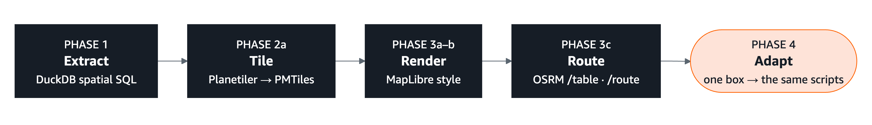
Recap — the pipeline we built
Open data + open tools: no accounts, no licences to buy, no server to rent — all of it re-runs on a laptop.
Two questions, one extract: where are the safe places, and how do people reach them in time — a basemap and routes from the same data.
It answers them on a good day. It cannot tell anyone if today is a good day: shelter status, traffic, live closures and capacity are not in it.
Keep: the repo (MIT code, CC BY-SA 4.0 materials), the 143 MB data bundle (release data-v2), the public demo, and the habit: one box, one script per step.
Notes:
2 min.

Slide 39
Licences, attribution, links
What | Licence
Code | MIT
Materials (slides, docs) | CC BY-SA 4.0
OpenStreetMap | ODbL
Overture Maps | ODbL / CDLA-Permissive 2.0 (by theme)
CAL FIRE FHSZ, perimeters | CC-BY
ESA WorldCover | CC-BY 4.0
Noto Sans glyphs | SIL OFL 1.1
Repo github.com/vishal4c/routes-to-safety-workshop
Demo vishal4c.github.io/routes-to-safety-workshop/demo/
Data bundle …/releases/tag/data-v2 (143 MB; scripts/get-bundle.sh)
Learn more duckdb.org/docs/extensions/spatial · docs.overturemaps.org · github.com/onthegomap/planetiler · docs.protomaps.com/pmtiles · maplibre.org · project-osrm.org/docs
Attribution to keep on every map: © OpenStreetMap contributors · © Overture Maps Foundation · Fire Hazard Severity Zones: CAL FIRE FRAP (CC-BY) · Land cover: ESA WorldCover (CC-BY) · Base map: © Esri, HERE, Garmin, USGS
Feedback form: [URL / QR to add]
Notes:
1 min. Details in data/LICENSE-data.md.

Slide 40
Thank you.
Vishal Kumar · Shaishav Maisuria — questions: stay, or find us in the hallway. Teaching example, not an official evacuation resource. Drive-time estimates assume no traffic and no closures.
Notes:
Teaching example, not an official evacuation resource.

