Slide 1

BOWER POWER
Notes:
Bower is named after the bowerbird, a family of birds where males build a structure [the bower] and decorate it with sticks and brightly coloured objects in an attempt to attract a mate.

Slide 2
AGENDA
Why do I need this?
Why is it so awesome?
How does it work?

Slide 3
DEPENDENCY Management MESSES
Ever felt like this?
“Are we using already?”
“What version? Versions?!”
“Am I going to break it?”
“How can I optimize it?”
Notes:
BECAUSE…
You start asking yourself these questions.
CODING ON QUICKSAND
1. Unmaintainable situation.
2. Common to a lot of projects, especially those that have history, multiple owners.
You start asking yourself:
1. “This is impossible. I just need to rewrite this.”
2. There are clever ways to unravel and existing mess
a. Scalable and Modular Architecture for CSS (Mina Markham – fantastic session name)
b. What I’ll be presenting isn’t so much about unraveling an existing mess.
c. Instead it’s about (being lucky and) getting a clean start and do our best to maintain it.
d. Essentially preventing your X-Wing from getting stuck on a swamp.

Slide 4
DEPENDENCY Management MESSES
Increased Efficiency
Reduced Cost
Better Process
Better Products
Happy Team
$$$
Notes:
And, of course, there’s the bottom line factor.

Slide 5


BOWER KEEPS IT SIMPLE
Maintains a dependency manifest.
Fetches them when you need it.
Tracks dependencies.
Integrates with everything.
(NOT A BUILD TOOL LIKE OR )
Notes:
- Examples of dependencies

Slide 6




Prerequisites
JavaScript runtime
Node.js package manager
version control system
Suggestion:
The Git Bash shell for Windows:
Notes:
Funny note – you use NPM, the Node.JS package installer to install Bower.
I can hear the voice of all my DevOps colleagues
“Let me get this right? You’re using a package manager to install a package manager.”

Slide 7

PACKAGE Management Soup
“WHICH SHOULD I USE?!”
OR
Notes:
Now remember, at this point you’re already using NPM so the amount of “OR” in this equation is relative.

Slide 8
PACKAGE Management Soup
“I SAY BOTH!!!”
AND
They are similar in many ways,
but also have unique strengths.
Notes:
I say “Use them both” – which is fairly controversial and a topic of many opinions.
At first this seems contradictory because you might be saying to yourself:
“Eric, you just told me to keep things simple and here you are using both.”
But…
Note: By making this decision, we haven’t affected a project’s client-side footprint yet.

Slide 9
WHY BOWER TOO?
Bower focuses on client-side dependencies.
Abstracts, separates concerns.
Uses a flat dependency tree.
(For you & components developers too)
Notes:
“Why do I want to have two different manifests for dependencies?”
Separating Cioncerns:
1. This is an opportunity for abstraction, ultimately organization.
2. Lot unlike deciding how you want to separate files in a folder tree.
Flat Dependency Tree:
1. “One version to rule them all” - In the end, you’re have only one version of each dependency.
2. This is a huge concern for a front-end developer.
3. Note – recently NPM now has flat-tree capability – BUT I again defer to #1.
Lives and Breathes Git:
1. There are many git-related versioning choices that work very well.
2. In addition to selecting a repo – branch, tag, commit.
Accountability:
1. Since you have a flat dependency tree and one version of each dependency, your ultimately responsible for the version that works for you.
2. This also goes for people that develop the dependencies you’re using. They want to make sure that they’re also tracking their dependency resolutions.

Slide 10
Starting the Awesome
Crack open a command shell:
Use NPM to install Bower globally.
$ npm install –g bower
Initialize Bower configuration from your project root folder.
$ myProject bower init
Prepare for a bunch of questions.
Notes:
Many Questions:
Some defaults are taken from package package.json.
Keep in mind – some questions apply to the authoring of a bower package, so all may not apply.

Slide 11
THE bower.json MANIFAST
{
"name": "bower-power",
"version": ”1.0.0”,
"description": "Bower Power! Supercharging Front-End Manageability",
"main": “",
"authors": ["Eric Carlisle eric@ericcarlisle.com”],
"license": "MIT",
"keywords": ["Bower”, “Bower Training”],
"homepage": "https://github.com/ecarlisle/bower-power",
"moduleType": [],
"private": true,
"ignore": ["**/.*”, "node_modules”, "bower_components”, "test”, "tests”],
}
Included in your applications as well as the dependencies you will install.
Notes:
Fields:
You don’t need them all filled out.
Notice “private = true”
For dependencies you install, these fields can be more important:
Versioning
Dependency tracking (Backbone has a dependency on Underscore)

Slide 12
Bower API Commands
Typical Usage:
Component Dev:
Utility:
init
install
list
search
update
uninstall
register
unregister
link
login
version
cache
help
info
lookup
prune

Slide 13
Installing Dependencies
There are many installation options…
# install by name
$ bower install jquery
# By (Github) shortcut
$ bower install twbs/bootstrap
# By GitHub and Subversion endpoints (SSH, HTTPS, HTTP)
$ bower install git@github.com:Modernizr/Modernizr.git
# By URL
$ bower install http://http://bower.io/img/bower-logo.png
# By folder
$ bower install ~/assets/stylesheets/theme3/variables.sass
… and several, several ways to choose versions.
Notes:
INSTALL FILES – REAL EXAMPLE
WE’RE STILL NOT SENDING BYTES TO YOUR SITE

Slide 14
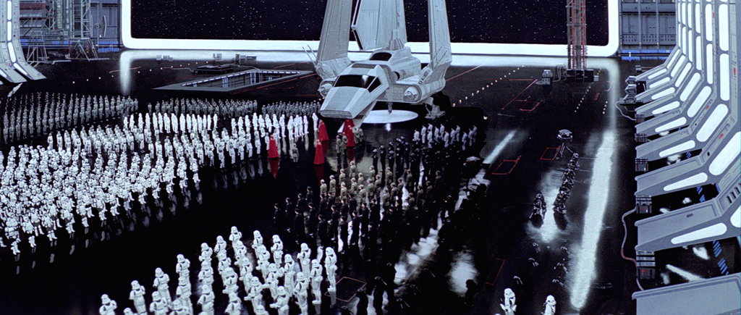
The bower_components folder
Contains EVERYTHING – often more than expected.
But that’s ok!
Notes:
Entire GitHub Repo:
Sometimes the natural reaction to this is
Only the ones you need:
This can differ from resource to resource.
jQuery – I just need jQuery.min.js and a sourcemap.
Bootstrap – I make just want variables.less and grid.less to get scaffolding on my site.
Integration:
Build tools
Build platforms like grunt and gulp.
Another Node module like Bower Installer.
.gitignore:
No need to keep these files around all the time.
Keep up with the versions you specify.

Slide 15
The bower_components folder
Usually gets the dependency’s entire GitHub repo.
Sometimes results in positive discovery (Hey, look!)
Empowered to use whatever you need.
Many ways to integrate needed files into your project.
Add bower_components to .gitignore!
Notes:
Entire GitHub Repo:
Sometimes the natural reaction to this is:
“Why do I need the ENTIRE repo”
“Am I also putting entire Git repos in my project”
Only the ones you need:
This can differ from resource to resource.
jQuery – I just need jQuery.min.js and a sourcemap.
Bootstrap – I make just want variables.less and grid.less to get scaffolding on my site.
Integration:
Build tools
Build platforms like grunt and gulp.
Another Node module like Bower Installer.
.gitignore:
No need to keep these files around all the time.
Keep up with the versions you specify.

Slide 16
Track what we need!
Production or Dev?
# install for production use.
$ bower install jquery --save
# Install for testing, debugging, development purposes only.
$ bower install modernizr --save-dev
Then in bower.json:
"dependencies": { "jquery": "~2.1.4" },
"devDependencies": { "modernizr": ”~3.1.0"},
Notes:
RUN GULP BUILD1

Slide 17
SEMANTIC VERSIONING (SEMVER)
Versioning Pattern:
MAJOR.MINOR.PATCH
EXAMPLES
STRICT
1.9.3
SIMPLE
>=1.9.3
CLOSE TO
~1.9.3
COMPATIBLE WITH
^1.9.3
Notes:
Important for you

Slide 18
INTEGRATE! INTEGRATE! INTEGRATE!
GRUNT
Notes:
Most of what we’re using now comes out of the Node runtime.
1. Bower-installer – command-line tool.
2. Bower – API that you can use within your own Node applications.
3.

Slide 19
Programs and APIS
Bower Programmatic API
bower-installer
Notes:
Clean and simple.

Slide 20
GULP INTEGRATION
gulp-bower
gulp-main-bower-files
Notes:
Clean and simple.

Slide 21
GRUNT INTEGRATION
grunt-wiredep
Notes:
Clean and simple.

Slide 22
BUILD & REGISTER A BOWER PACKAGE
Have a working GitHub repository.
Please don’t squat dependency names.
Make certain your bower.json is solid!
# Indicate package name and Github endpoint.
$ bower register my-package https://github.com/you/my-package.git
Bower Registry:
http://bower.io/search/

Slide 23
Q/A
Thank you!

