Slide 1

Debugging
goodbye console.log()

Slide 2
In the beginning there was ‘debugger’
http://nodejs.org/api/debugger.html
To debug in console:
This hook to V8's debugger is what all Node debug tools bind to.
node debug test.js
note: 'debug' not '--debug', this is a different command we'll see later

Slide 3
Debug command highlights
Stepping
cont, next, step, out - What you think they do
Breakpoints
setBreakpoint()/sb() - Set breakpoint on current line or at statement
clearBreakpoint/clearBreakpoint()/cb(...) - clear breakpoint (duh)

Slide 4
Debug command highlights
Info
backtrace/bt - Print backtrace of current execution frame
watch(expr) - Add expression to watch list
unwatch(expr) - Remove expression from watch list
watchers - List all watchers and their values
repl - Open debugger's repl for evaluation in debugging script's context
Execution control
run - Run script (automatically runs on debugger's start)
restart - Restart script
kill - Kill script

Slide 5
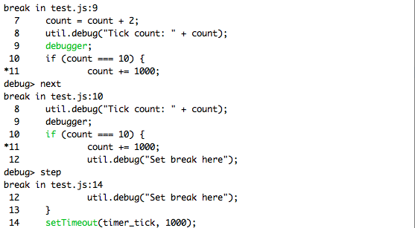
Can’t we use something a little less…
Arcane? Unusual? Ugly? 1990?

Slide 6
node-inspector
Webkit Inspector debugging
https://github.com/dannycoates/node-inspector
front-end JavaScript debugger reused for back-end JavaScript, what a great idea!
1.)
npm install –g node-inspector
2.)
node --debug-brk test.js
3.)
node-inspector
4.) Open browser to http://localhost:8080/debug?port=5858

Slide 7
Thanks! Questions?

