Slide 1
Knockout js
Presented by :Deepanjali Shinde

Slide 2
Document History
Version No. | Authored/ Modified by | Remarks/ Change History | Date <dd- mon-yy >
1 | Deepanjali Shinde | Initial | 19-Aug-16

Slide 3
Course Structure
Target audience | Fresher's
Level | Beginner
Pre-requisites | JavaScript and JQuery
Training methods | Sessions

Slide 4
Agenda
Introduction
SPA
Knockout
MVVM & MVC
Knockout Features
JQuery vs Knockout
Two way binding
Binding
Types of observables
Observable
Observable Array
Computed observable

Slide 5
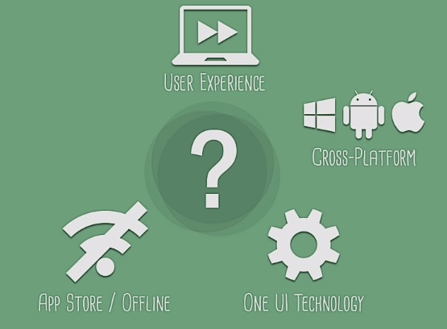
SPA

Slide 6
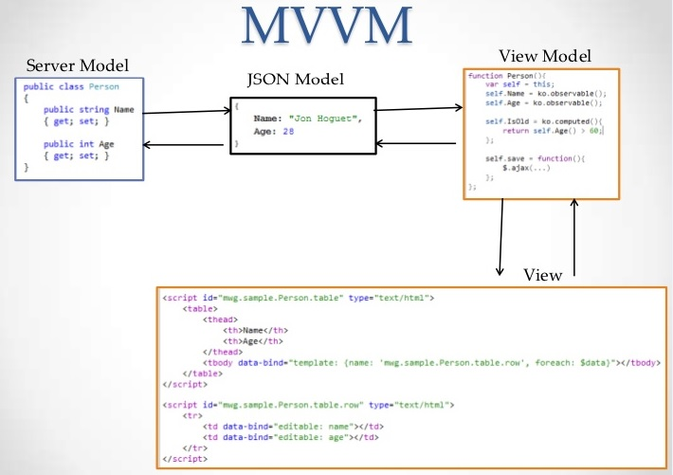
Model View View-Model

Slide 7
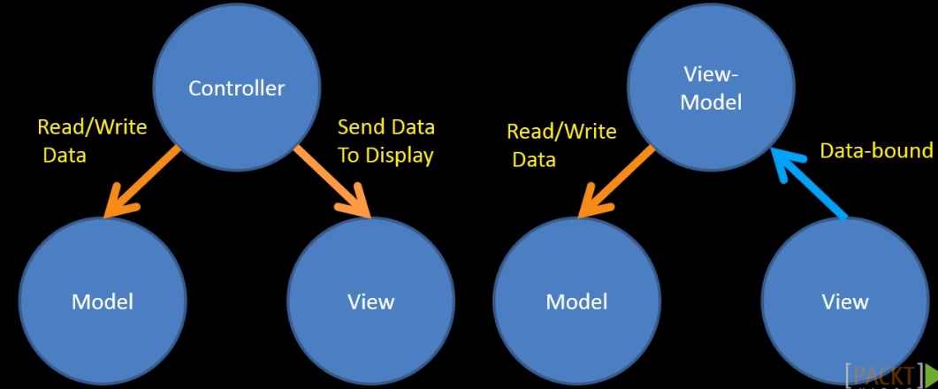
MVC vs MVVM

Slide 8

Knockout js & Benefits
Knockout js
JavaScript library based on MVVM pattern
Separates the application's Model, View and View Model
Helps to building rich and responsive websites
Allows us to bind html elements against any data model
ko is an abbreviation used for Knockout js
Benefits
Pure JavaScript library
Can be added on top of your existing web application
Free & Light weight (40kb)
Works on any browser

Slide 9
JQuery vs. Knockout
JQuery | Knockout
Provides low a low level way to manipulate elements and event handlers in a web page | Knockout provides a complementary, high level way to link data model to UI
Any update in UI or model needs to be handle manually | When you update a property of a JavaScript object(model) it will automatically cause the update to reflect in HTML(UI)
https://jsfiddle.net/bq9g321f/13/ | http://jsfiddle.net/bxfXd/7951/ http://jsfiddle.net/Deepanjali/okyutawL/1/

Slide 10
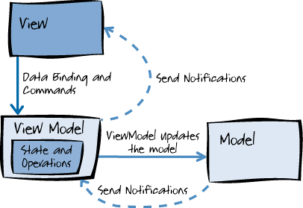
Two way binding

Slide 11




Knockout Features
Declarative bindings
Allows to define binding between DOM elements and ViewModel with declarative syntax
data-bind attribute allows to define this binding
AUTOMATIC UI REFRESH
Allows to automatically update UI when view-model changes and vice versa.
DEPENDENCY TRACKING
Automatically tracks the dependencies when the values get updated.
TEMPLATING
Allows dynamically compute the page’s DOM based on data available in ViewModel

Slide 12

Binding
View-Model is just a JavaScript object
function ViewModel() {
this.firstName = `John`;
this.lastName = `Doe`
}
Binding to DOM
ko.applyBinding(new ViewModel);
Bindings between DOM and elements and ViewModel

Slide 13
Observables
Previous example was one-way binding, i.e. The viewModel's property
will show up in UI but say some other function updates the ViewModel's
property then UI will not reflect the change.
To achieve this declare properties as observable.
Observable are used for viewModel properties will notify subscribers
about changes, and can automatically detect dependencies
function ViewModel() {
this.firstName = ko.observable(‘John’);
this.lastName = ko.observable(‘Doe’);
}

Slide 14


Reading and Writing Observables..
ko.observable objects are actually functions
Read:
ViewModel.firstName() // will return `John`
Write:
ViewModel.firstName(‘Bill')
//will update the name from John to `Bill`
Chaining syntax:
ViewModel.firstName(‘Bill').lastName(‘Fieldman’);
ViewModel.firstName = `Bill`
ViewModel.firstName(‘Bill')

Slide 15
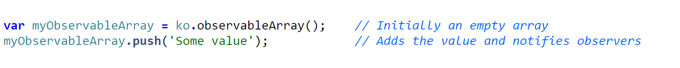
Observable Array
Observable Array is used when you want to detect and respond to
changes of a collection of things.
Is an array that notifies when value is added or removed from it.
This is useful in many scenarios where you’re displaying or editing
multiple values and need repeated sections of UI to appear and disappear
as items are added and removed.
Observable Array exposes standard array operations.
Like: pop, push, shift, unshift, reverse, sort, splice
Knockout provides few more operations
Like: remove, removeAll

Slide 16
Computed Observables
Computed observables are functions that are dependent on one or more
other observables, and will automatically update whenever any of these
dependencies change.
var ViewModel = function(first, last) {
var self = this;
self.firstName = ko.observable(‘Jim’);
self.lastName = ko.observable(‘Mathew’);
self.fullName = ko.computed(function() {
return self.firstName() + " " + self.lastName();
});
};
Hello, <span data-bind='text: fullName'> </span>

Slide 17
Any Questions?

Slide 18
Thank you!

