Slide 1
Knockout js
Presented by :Deepanjali Shinde

Slide 2
Document History
Version No. | Authored/ Modified by | Remarks/ Change History | Date <dd- mon-yy >
1 | Deepanjali Shinde | Initial | 22-Aug-16

Slide 3
Course Structure
Target audience | Fresher's
Level | Beginner
Pre-requisites | JavaScript and JQuery
Training methods | Sessions

Slide 4
Agenda
Binding
Text & Appearance
Form
control Flow (templating)

Slide 5
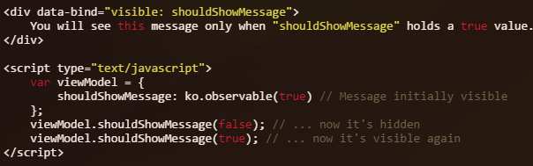
Text & Appearance
Visible
Controls the visibility of the element
Hide/show the element based on the value passed in binding
Binding removes the yourElement.style.display value, to become show or set yourElement.style.display value to none to hide the element
Parameter can be
Boolean
Numeric
Null
Undefined
Observable
JavaScript expression

Slide 6
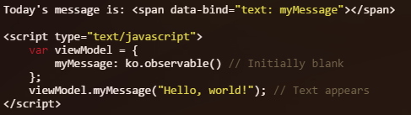
Text & Appearance
Text
Allow s to change the content of DOM element
Binding over writes the content of the DOM element with value passed in binding
Html entities will be escaped
Virtual element syntax (using “text” without a container element)
Parameter can be
Observable
String
If you supply something other than a number or a string (e.g., you pass an object or an array),
the displayed text will be equivalent to yourParameter.toString()
http://jsfiddle.net/Deepanjali/er4n880w/5/

Slide 7
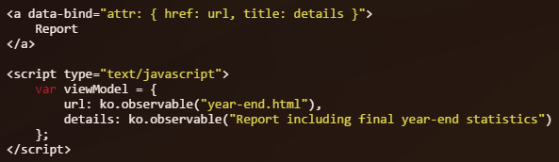
Text & Appearance
HTML
Allow to display the HTML specified by your parameter passed in binding
Html entities will not be escaped
Parameter can be
Observable
String have html elements
If you supply something other than a number or a string (e.g., you pass an object or an array),
it will be equivalent to yourParameter.toString()
Attribute
Set the value of any attribute of DOM element like title, src, href etc
Parameter
JavaScript object in which the property names correspond to attribute names, and the values correspond to the attribute values

Slide 8

Text & Appearance
CSS
Adds or removes one or more classes to DOM element based on value binded
Non-boolean values are interpreted loosely as boolean. For example, 0 and null are treated as false, whereas 21 and non-null objects are treated as true.
Parameter
observable value
JavaScript object in which the property names are your CSS classes, and their values evaluate to true or false according to whether the class should currently be applied.
http://jsfiddle.net/Deepanjali/ec2fc08c/3/
Style
The style binding adds or removes one or more style values to the associated DOM element.
Parameter
JavaScript object in which the property names correspond to style names, and the values correspond to the style values you wish to apply.

Slide 9

Control Flow
foreach
foreach binding duplicates a section of markup for each entry in an array
Parameter
Pass the array that you wish to iterate over
JavaScript object
1. Referring to each array entry using $data
2. Using context properties like $index, $parent
$index is an observable and is updated whenever the index of the item changes
$parent to refer to data from outside the foreach,
3. Using “as” to give an alias to foreach items

Slide 10
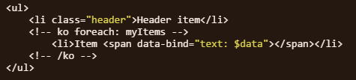
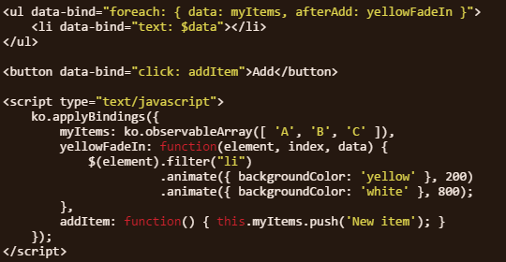
Control Flow
4. Using foreach without a container element
2. Using context post-processing or animating the generated DOM elements
afterAdd, beforeRemove, beforeMove, afterMove

Slide 11

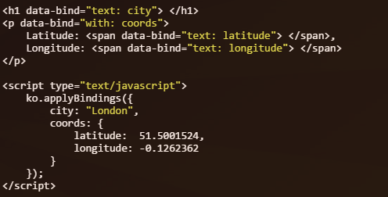
Control Flow
if
Content of current element is removed from the DOM if the expression evaluates to false
if” without a container element
with
with binding creates a new binding context, so that descendant elements are bound in the
context of a specified object.

Slide 12
Control Flow
with
with binding creates a new binding context, so that descendant elements are bound in the
context of a specified object.

Slide 13
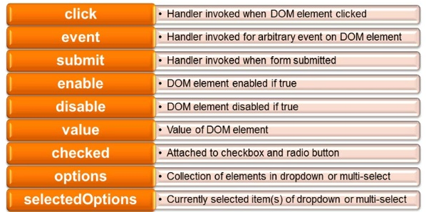
Form bindings

Slide 14
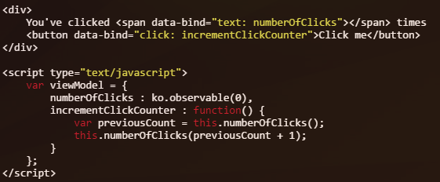
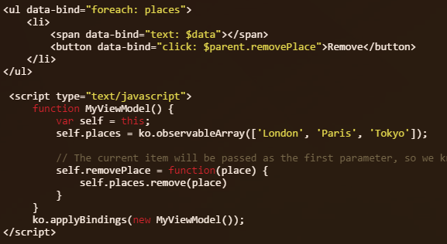
click

Slide 15
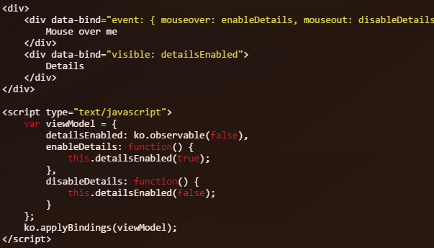
event

Slide 16
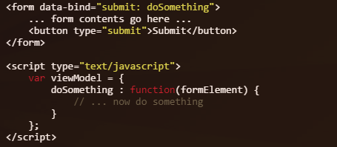
submit

Slide 17
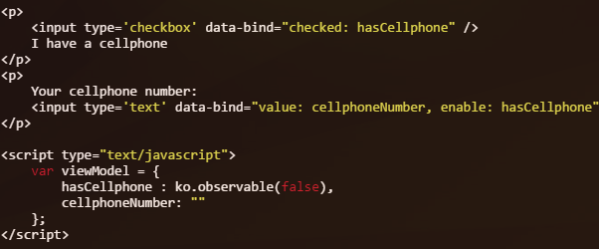
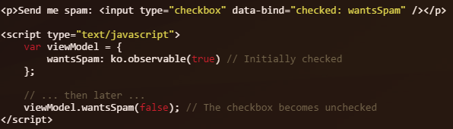
Enable & checked

Slide 18
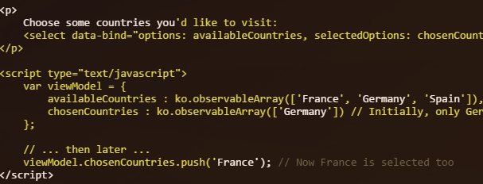
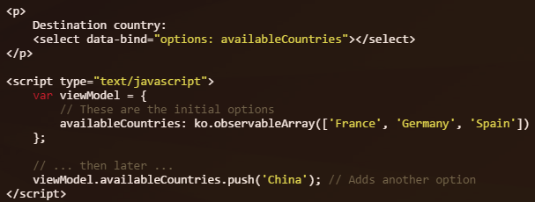
Option & selected Options

Slide 19
Any Questions?

Slide 20
Thank you!

