Slide 1
HTML Questions
Date: 29th Aug 2021

Slide 2
Contents
What is html how it works ?
Is some compiler required to run html?
What new update in html?
What is the meaning of<DOCTYPE html>?
Difference between HTML and XML.
What do you mean by a markup language?
Can you share examples of other markup languages and how they differ from HTML?
What version of HTML do you use in your projects? How is HTML 5 different from HTML 4?
What are attributes in HTML?
What are data- attributes good for?
Describe the difference between &<script>, <script async> and <script defer>.
Why is it generally a good idea to position CSS <link>s between <head></head&> and JS <script>s just before </body>? Do you know any exceptions?

Slide 3
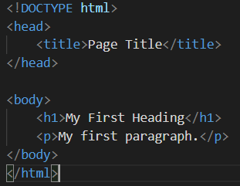
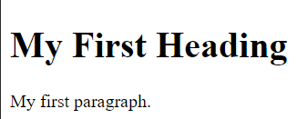
What is html how it works ?
HTML stands for Hyper Text Markup Language
HTML is the standard markup language for creating Web pages
HTML describes the structure of a Web page
HTML consists of a series of elements
HTML elements tell the browser how to display the content
HTML elements label pieces of content such as "this is a heading", "this is a paragraph", "this is a link", etc.

Slide 4
Is some compiler required to run html?
There are no interpreter or compiler for HTML.
HTML is a language used to design web pages. So, HTML is NOT a programming language.
Use of compiler: It changes the source code into its ASCII value creating a file with .
What new update in html?
It provides support for local storage
New form controls, like calendar, date, time, email, url, search
<canvas> element is provided to facilitate 2D drawing
The <video> and <audio> elements are provided for media playback
New content-specific elements are provided. For e.g. <article>, <header>, <footer>, <nav>, <section>
Added semantic elements, like <form>, <table>, <article> etc.

Slide 5
What is the meaning of<DOCTYPE html>?
The <!DOCTYPE> is an instruction to the web browser about what version of HTML the page is written in.
The <!DOCTYPE> tag does not have an end tag.
It is not case sensitive.
The <!DOCTYPE> declaration must be the very first thing in HTML5 document
As In HTML 4.01, all <! DOCTYPE > declarations require a reference to a Document Type Definition (DTD), because HTML 4.01 was based on Standard Generalized Markup Language (SGML). WHERE AS HTML5 is not based on SGML, and therefore does not require a reference to a Document Type Definition (DTD).
Doctype for HTML5

Slide 6
Difference between HTML and XML.
XML is abbreviation for eXtensible Markup Language whereas HTML stands for Hypertext Markup Language
XML was designed to carry data - with focus on what data is
HTML was designed to display data - with focus on how data looks
XML tags are not predefined like HTML tags are
XML is Case sensitive while HTML is Case insensitive
XML is strict for closing tag while HTML is not strict.
What do you mean by a markup language?
A markup language is a computer language that uses tags to define elements within a document.
It is human-readable, meaning markup files contain standard words, rather than typical programming syntax.
HTML, XML, SGML.

Slide 7
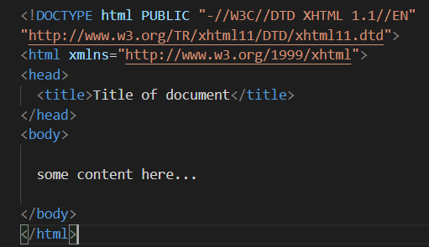


Can you share examples of other markup languages and how they differ from HTML?
XML, HTML, XHTML
Difference between HTML and XHTML
<!DOCTYPE> is mandatory
The xmlns attribute in <html> is mandatory
<html>, <head>, <title>, and <body> are mandatory
Elements must always be properly nested
Elements must always be closed
Elements must always be in lowercase
Attribute names must always be in lowercase
Attribute values must always be quoted
Attribute minimization is forbidden

Slide 8
What version of HTML do you use in your projects? How is HTML 5 different from HTML 4?
HTML or Hyper-Text Markup Language can be referred to as the Worldwide Web’s primary language. HTML has seen many updates over time, and currently, the newest HTML version is HTML5. Some of the major differences between the two versions
HTML5 supports both audio and video whereas none of these was a part of HTML
HTML does not allow JavaScript to run within the web browser whereas HTML5 provides full support for JavaScript to run in the background.
HTML5 supports new kinds of form controls, for example: dates and times, email, number, range, tel, url, search etc.
There are many new elements introduced in HTML5. Some of the most important ones are: summary, time, audio, details, embed, figcaption, figure, footer, header, article, canvas, nav, output, section, source, track, video, etc..
Semantic Elements
Doctype declaration: In HTML,it is too longer as compared to that in HTML5

Slide 9
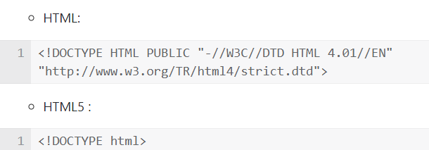
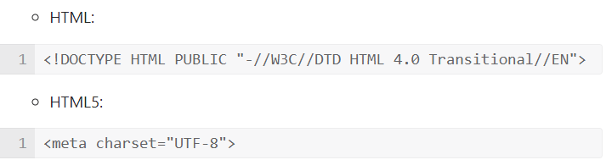
Doctype declaration: In HTML,it is too longer as compared to that in HTML5
Character encoding: in HTML,it is more complex as compared to that in HTML
Vector Graphics
HTML: Vector Graphics is possible with the help of technologies such as VML, Silverlight, Flash etc
HTML5: Vector graphics is integral part of HTML5 e.g. SVG and canvas
Shapes
HTML: Not possible to draw shapes like circle, rectangle, triangle.
HTML5: You can draw shapes like circle, rectangle, triangle.

Slide 10
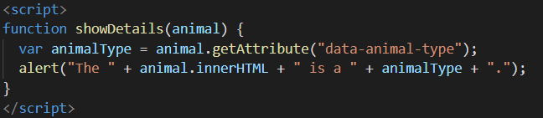
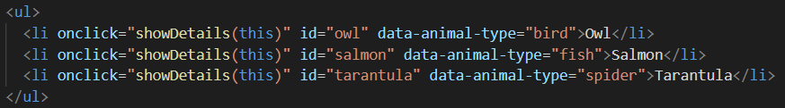
What are attributes in HTML?
Attribute in html is used to describe the characteristic or the properties of the element
HTML attributes provide additional information about HTML elements
Attributes usually come in name/value pairs like: name="value"
<a href="https://www.w3schools.com">Visit W3Schools</a>
<img src="img_girl.jpg">
<img src="img_girl.jpg" width="500" height="600">
<img src="img_girl.jpg" alt="Girl with a jacket">
What are data- attributes good for?
Data attribute allows you to add custom data to add you in your html tags
The attribute name should not contain any uppercase letters, and must be at least one character long after the prefix "data-"
The attribute value can be any string

Slide 11
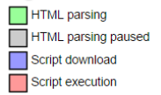
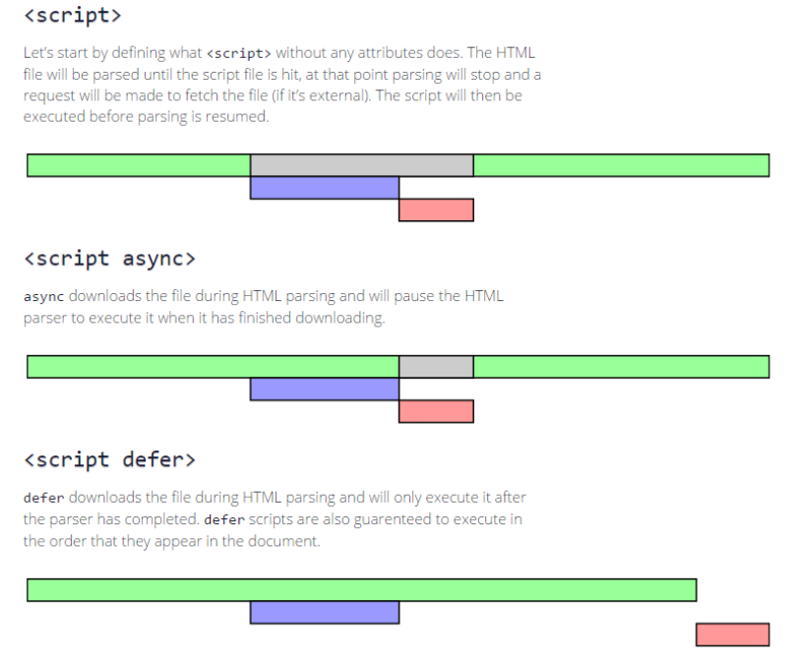
Describe the difference between &<script>, <script async> and <script defer>.

Slide 12
Why is it generally a good idea to position CSS <link>s between <head></head&> and JS <script>s just before </body>? Do you know any exceptions?
The main reason as to why JS files are linked at the bottom of the body is because whenever a browser encounters any JS, it parses it and executes that on the spot. Hence if it was to be added at the top, it would make the page rendering slow and thus it would take more time for page load. Moreover since the DOM won't be rendered fully, JS won't be able to manipulate the elements.
On the contrary, CSS files are linked in the head because they get applied regardless of DOM already rendered or not. Hence the webpage looks elegant as soon as the page loads. However just like JS you can link the CSS at the end which would mean that the webpage first loads with just plain HTML and then the CSS is applied to it. This shift is clearly visible to the user and moreover an important thing to remember is that the page would load with bare minimum HTML and if the user has slow Internet connection, the CSS load would take considerable amount of time, which means that the webpage shows just the HTML meanwhile. This might make the user close the website without waiting for it to load fully.

Slide 13
Why is it generally a good idea to position CSS <link>s between <head></head&> and JS <script>s just before </body>? Do you know any exceptions?
An exception for positioning of <script>s at the bottom is when your script contains document.write(), but these days it's not a good practice to use document.write()
Also, placing <script>s at the bottom means that the browser cannot start downloading the scripts until the entire document is parsed.
One possible workaround is to put <script>in the <head> and use the defer attribute.

Slide 14
Thank You

