Slide 1
CSS Questions

Slide 2
Contents
What is Position related
What are Pseudo Elements and what they are used for?
What is the Box model in CSS?
What are the advantages of using CSS?
What are the limitations of CSS?
What is CSS and how does it work with HTML?
What are selectors and what are their different types?
What is CSS selector speciﬁcity and how does it work?
Describe z-index and how stacking context is formed.
Describe BFC (Block Formatting Context) and how it works.
Have you ever used a grid system, and if so, what do you prefer?
Have you used or implemented media queries or mobile speciﬁc layouts/CSS?
Explain how a browser determines what elements match a CSS selector.
Describe pseudo-classes and what they are used for?
Explain your understanding of the box mode.
What does * { box-sizing: border-box; } do? What are its advantages?
What is the CSS display property and can you give a few examples of its use?

Slide 3
What's the difference between inline and inline-block?
What's the difference between the "nth-of-type()" and "nth-child()" selectors?
What's the difference between a relative, ﬁxed, absolute and statically positioned element?
What existing CSS frameworks have you used locally, or in production? How would you change/improve them?
Have you used CSS Grid?

Slide 4
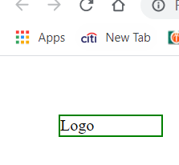
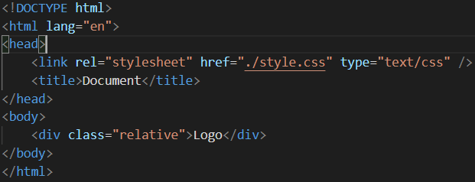
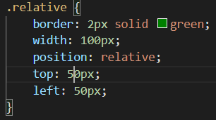
What is Position related?
This type of positioning is probably the most confusing and misused.
What it really means is “relative to itself”.
If you set position: relative;on an element but no other positioning attributes (top, left, bottom or right), it will not affect on it’s positioning at all, it will be exactly as it would be if you left it as position: static;
But if you do give it some other positioning attribute, say, top: 10px;, it will shift it’s position 10 pixels DOWN from where it would NORMALLY be.

Slide 5


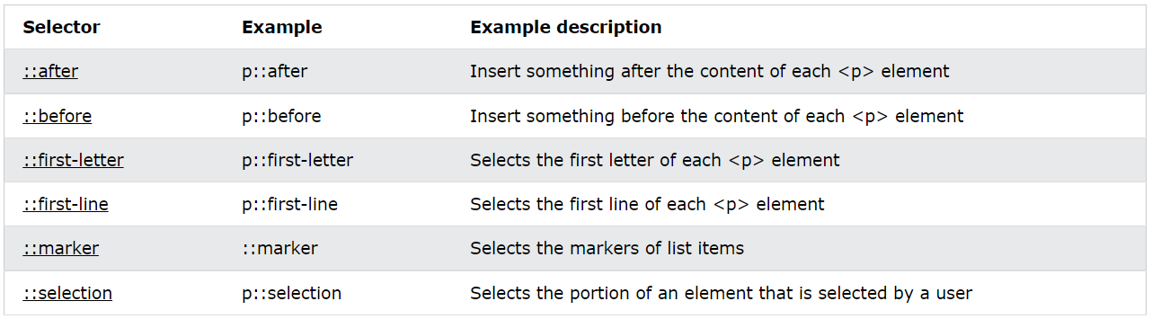

What are Pseudo-Elements?
A CSS pseudo-element is used to style specified parts of an element.
For example, it can be used to:
Style the first letter, or line, of an element
Insert content before, or after, the content of an element
General syntax of pseudo-elements:
Can only be applied to block-level elements
Below are the CSS pseudo-Elements

Slide 6
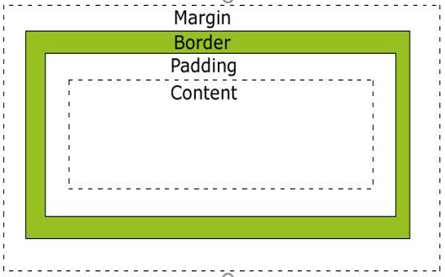
What is the Box model in CSS?
All HTML elements can be considered as boxes.
In CSS, the term “box model” is used when talking about design and layout.
The CSS box model is essentially a box that wraps around HTML elements, and it consists of margins, borders, padding, and the actual content.
Box model provides a structured way to space elements in relationship to each other.
Content - The content of the box, where text and images appear
Padding - Clears an area around the content. The padding is transparent
Border - A border that goes around the padding and content
Margin - Clears an area outside the border. The margin is transparent

Slide 7
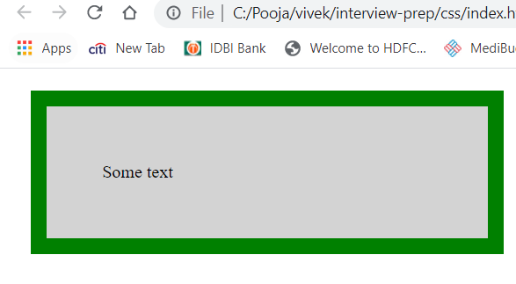
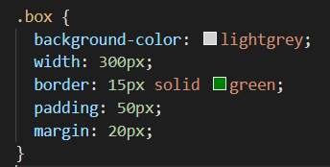

Slide 8
What are the advantages of using CSS?
CSS plays an important role, by using CSS you simply got to specify a repeated style for element once & use it multiple times
The main advantage of CSS is that style is applied consistently across variety of sites. One instruction can control several areas which is advantageous.
Cascading sheet not only simplifies website development, but also simplifies the maintenance as a change of one line of code affects the whole web site and maintenance time.
It is less complex therefore the effort are significantly reduced.
Separation of Style and Structure
What are the limitations of CSS?
CSS cannot perform any logical operations like if/else or for/while or +/-.
We can not read any files using CSS.
It can not interact with databases.
CSS can not request a web page

Slide 9
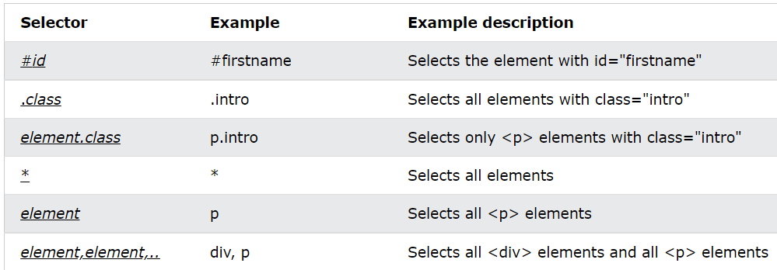
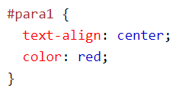
What is CSS and how does it work with HTML?
CSS stands for Cascading Style Sheets, and it do styling for the html structured web page.
What are selectors and what are their different types ?
CSS selectors are used to "find" (or select) the HTML elements you want to style.

Slide 10

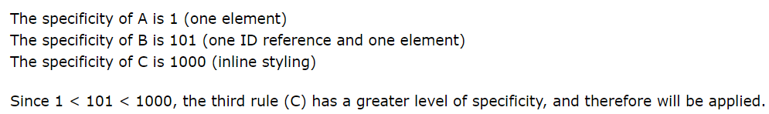
What is CSS selector speciﬁcity and how does it work?
If there are two or more conflicting CSS rules that point to the same element, the browser follows some rules to determine which one is most specific and therefore wins out.
Think of specificity as a score/rank that determines which style declarations are ultimately applied to an element.
The universal selector (*) has low specificity, while ID selectors are highly specific!
Basic order of css specificity is inline style>internal > external.
Inline styles> IDs> Classes, attributes and pseudo-classes> Elements and pseudo-elements
Start at 0, add 1000 for style attribute, add 100 for each ID, add 10 for each attribute, class or pseudo-class, add 1 for each element name or pseudo-element.

Slide 11
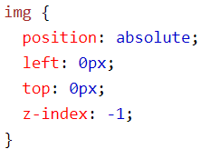
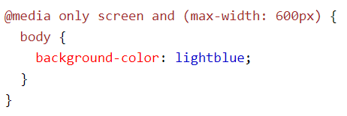
Describe z-index and how stacking context is formed
The z-index property specifies the stack order of an element.
An element with greater stack order is always in front of an element with a lower stack order.
z-index only works on positioned elements (position: absolute, position: relative, position: fixed, or position: sticky) and flex items (elements that are direct children of display:flex elements).
Have you used or implemented media queries or mobile specific layouts/CSS?
Media query is a CSS technique introduced in CSS3.
It uses the @media rule to include a block of CSS properties only if a certain condition is true.
ref:-https://www.w3schools.com/css/css_rwd_mediaqueries.asp
If the browser window is 600px or smaller, the background color will be lightblue

Slide 12
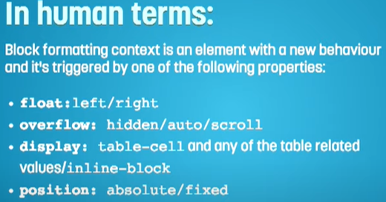


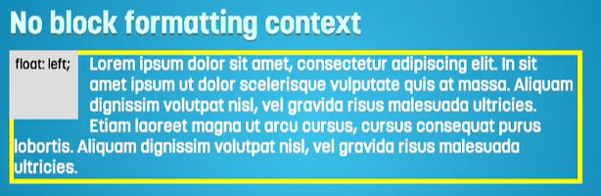
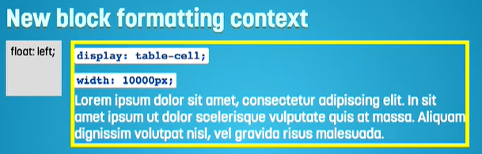
Describe BFC (Block Formatting Context) and how it works.
https://developer.mozilla.org/en-US/docs/Web/Guide/CSS/Block_formatting_context

Slide 13
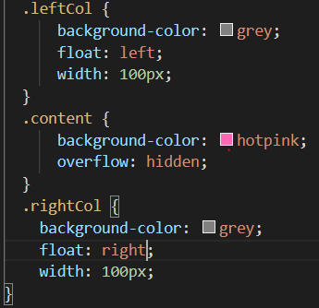
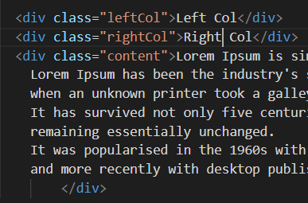
Describe BFC (Block Formatting Context) and how it works.

Slide 14
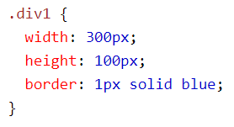
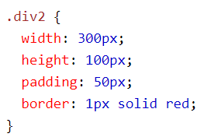
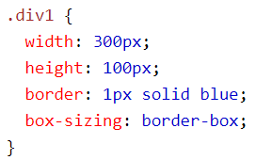
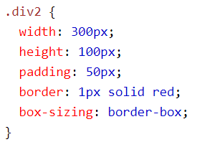

What does * { box-sizing: border-box; } do? What are its advantages?
The CSS box-sizing property allows us to include the padding and border in an element's total width and height.
By default, the width and height of an element is calculated like this:
If you set box-sizing: border-box; on an element, padding and border are included in the width and height
Since the result of using the box-sizing: border-box; is so much better, many developers want all elements on their pages to work this way.
Applying this to all elements is safe and wise:

Slide 15
Describe pseudo-classes and what they are used for?
Pseudo classes are similar to classes, but are not explicitly defined in the markup, and are used to add additional effects to selected HTML elements such as link colors, hover actions, etc.
Pseudo classes are defined by first listing the selector, followed by a colon and then pseudo-class element. E.g., a:link{ color: blue }, or a:visited { color: red }
selector:pseudo-class { property:value;}
:link, :visited, :hover, :active, :first_line are all examples of pseudo classes, used to call a specific action on an element, such as the changing of a link color after it has been visited.
The following CSS makes all visited links red and green, the actual link text becomes yellow when the mouse pointer is positioned over it, and the text of the first element of a paragraph is bold.
a:link {font-color: red;} a:visited {font-color: green;} a:hover {font-color: yellow;}
p.first-child {font-weight: bold;}

Slide 16
What is the CSS display property and can you give a few examples of its use?
The display property specifies the display behavior (the type of rendering box) of an element
There are many display options like display:none, display:block, display:flex, etc
https://www.w3schools.com/cssref/playit.asp?filename=playcss_display&preval=inline
What's the difference between inline and inline-block
Compared to display: inline, the major difference is that display: inline-block allows to set a width and height on the element.
Compared to display: block, the major difference is that display: inline-block does not add a line-break after the element, so the element can sit next to other elements.

Slide 17
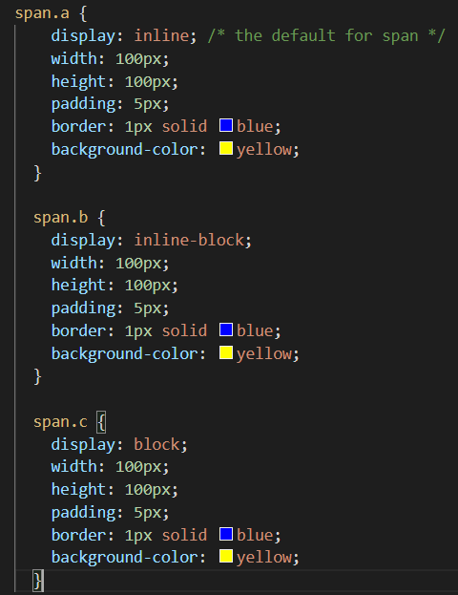
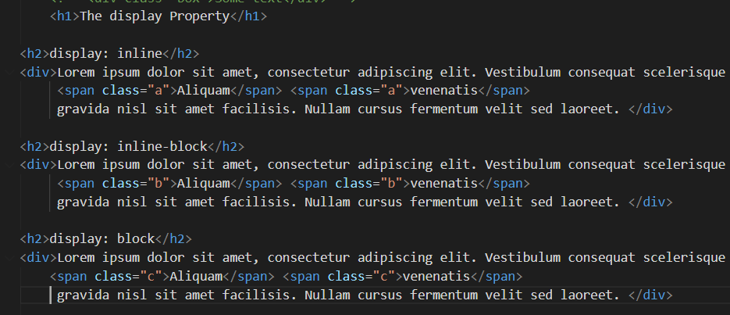

Slide 18
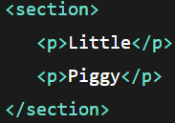

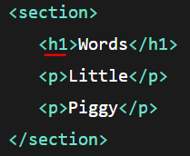

What's the difference between the "nth-of-type()" and "nth-child()" selectors?
Same result
If we were to add an <h2> after that <h1>, the :nth-child selector wouldn’t select anything at all, because now the second child is no longer a paragraph so that selector finds nothing. The :nth-of-type again still works.
https://css-tricks.com/the-difference-between-nth-child-and-nth-of-type/

Slide 19
What's the difference between a relative, ﬁxed, absolute and statically positioned element?
Position-Relative. This type of positioning is probably the most confusing and misused. What it really means is “relative to itself”. If you set position: relative;on an element but no other positioning attributes (top, left, bottom or right), it will no effect on it’s positioning at all, it will be exactly as it would be if you left it as position: static; But if you DO give it some other positioning attribute, say, top: 10px;, it will shift it’s position 10 pixels DOWN from where it would NORMALLY be.
Position-Absolute.This is a very powerful type of positioning that allows you to literally place any page element exactly where you want it. You use the positioning attributes top, left bottom and right to set the location. Remember that these values will be relative to the next parent element. If there is no such parent, it will default all the way back up to the <html> element itself meaning it will be placed relatively to the page itself.
Position-Fixed. This type of positioning is fairly rare but certainly has its uses. A fixed position element is positioned relative to the viewport, or the browser window itself. The viewport doesn’t change when the window is scrolled, so a fixed positioned element will stay right where it is when the page is scrolled.

Slide 20
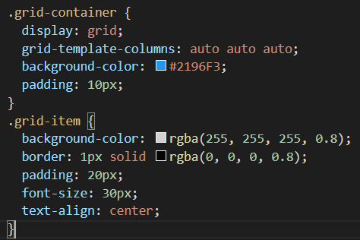
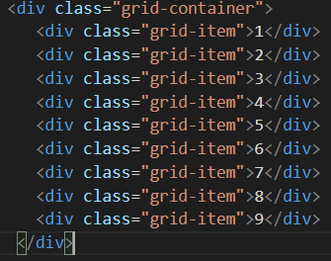
What existing CSS frameworks have you used locally, or in production? How would you change/improve them?
Bootstrap
Have you used CSS Grid?
The CSS Grid Layout Module offers a grid-based layout system, with rows and columns, making it easier to design web pages without having to use floats and positioning.
https://www.w3schools.com/css/css_grid.asp

Slide 21
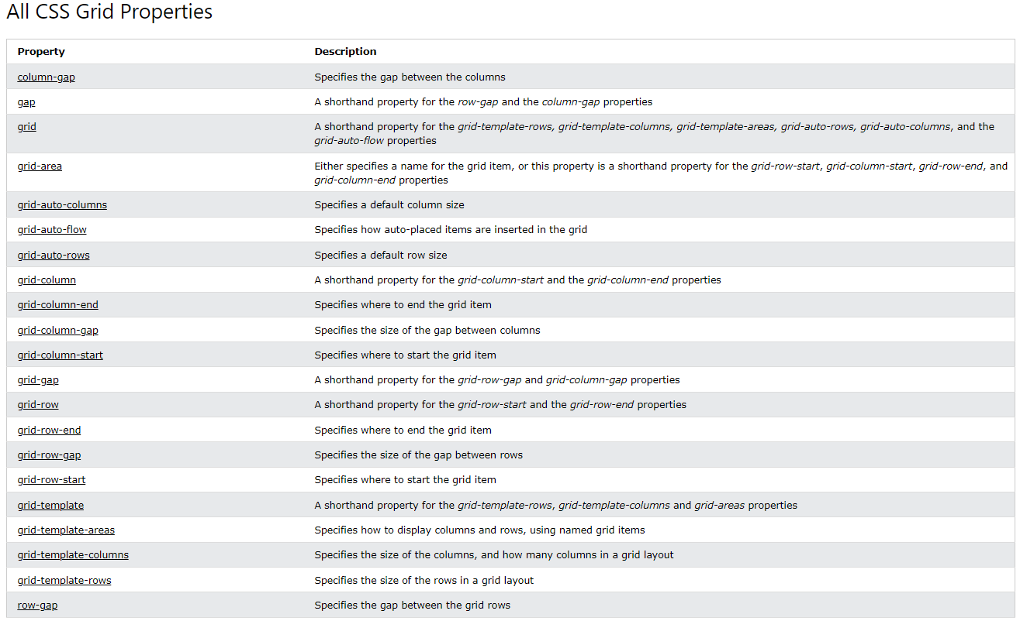

Slide 22
Thank You

