Slide 1
HTML Questions
Date: 29th Aug 2021

Slide 2
Contents
What is html how it works ?
Is some compiler required to run html?
What new update in html?
What is the meaning of<DOCTYPE html>?
Difference between HTML and XML.
What do you mean by a markup language?
Can you share examples of other markup languages and how they differ from HTML?
What version of HTML do you use in your projects? How is HTML 5 different from HTML 4?
What are attributes in HTML?
What are data- attributes good for?
Describe the difference between &<script>, <script async> and <script defer>.
Why is it generally a good idea to position CSS <link>s between <head></head&> and JS <script>s just before </body>? Do you know any exceptions?

Slide 3
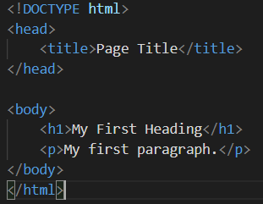
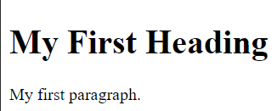
What is html how it works ?
HTML stands for Hyper Text Markup Language
HTML is the standard markup language for creating Web pages
HTML describes the structure of a Web page
HTML consists of a series of elements
HTML elements tell the browser how to display the content
HTML elements label pieces of content such as "this is a heading", "this is a paragraph", "this is a link", etc.

Slide 4
Is some compiler required to run html?
There are no interpreter or compiler for HTML.
HTML is a language used to design web pages. So, HTML is NOT a programming language.
Use of compiler: It changes the source code into its ASCII value creating a file with .
What new update in html?
It provides support for local storage
New form controls, like calendar, date, time, email, url, search
<canvas> element is provided to facilitate 2D drawing
The <video> and <audio> elements are provided for media playback
New content-specific elements are provided. For e.g. <article>, <header>, <footer>, <nav>, <section>
Added semantic elements, like <form>, <table>, <article> etc.

Slide 5
What is the meaning of<DOCTYPE html>?
The <!DOCTYPE> is an instruction to the web browser about what version of HTML the page is written in.
The <!DOCTYPE> tag does not have an end tag.
It is not case sensitive.
The <!DOCTYPE> declaration must be the very first thing in HTML5 document
As In HTML 4.01, all <! DOCTYPE > declarations require a reference to a Document Type Definition (DTD), because HTML 4.01 was based on Standard Generalized Markup Language (SGML). WHERE AS HTML5 is not based on SGML, and therefore does not require a reference to a Document Type Definition (DTD).
Doctype for HTML5

Slide 6
Difference between HTML and XML.
XML is abbreviation for eXtensible Markup Language whereas HTML stands for Hypertext Markup Language
XML was designed to carry data - with focus on what data is
HTML was designed to display data - with focus on how data looks
XML tags are not predefined like HTML tags are
XML is Case sensitive while HTML is Case insensitive
XML is strict for closing tag while HTML is not strict.
What do you mean by a markup language?
A markup language is a computer language that uses tags to define elements within a document.
It is human-readable, meaning markup files contain standard words, rather than typical programming syntax.
HTML, XML, SGML.

Slide 7
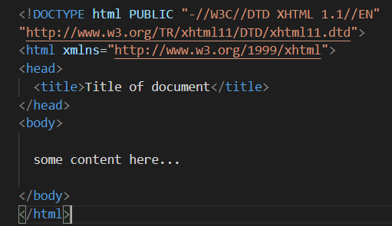


Can you share examples of other markup languages and how they differ from HTML?
XML, HTML, XHTML
Difference between HTML and XHTML
<!DOCTYPE> is mandatory
The xmlns attribute in <html> is mandatory
<html>, <head>, <title>, and <body> are mandatory
Elements must always be properly nested
Elements must always be closed
Elements must always be in lowercase
Attribute names must always be in lowercase
Attribute values must always be quoted
Attribute minimization is forbidden

Slide 8
What version of HTML do you use in your projects? How is HTML 5 different from HTML 4?
HTML or Hyper-Text Markup Language can be referred to as the Worldwide Web’s primary language. HTML has seen many updates over time, and currently, the newest HTML version is HTML5. Some of the major differences between the two versions
HTML5 supports both audio and video whereas none of these was a part of HTML
HTML does not allow JavaScript to run within the web browser whereas HTML5 provides full support for JavaScript to run in the background.
HTML5 supports new kinds of form controls, for example: dates and times, email, number, range, tel, url, search etc.
There are many new elements introduced in HTML5. Some of the most important ones are: summary, time, audio, details, embed, figcaption, figure, footer, header, article, canvas, nav, output, section, source, track, video, etc..
Semantic Elements
Doctype declaration: In HTML,it is too longer as compared to that in HTML5

Slide 9
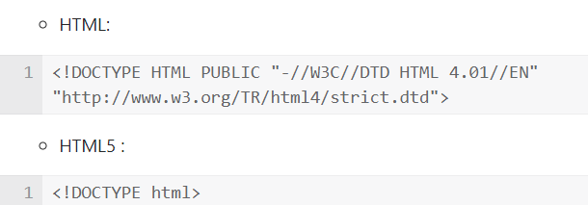
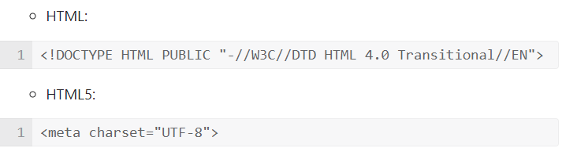
Doctype declaration: In HTML,it is too longer as compared to that in HTML5
Character encoding: in HTML,it is more complex as compared to that in HTML
Vector Graphics
HTML: Vector Graphics is possible with the help of technologies such as VML, Silverlight, Flash etc
HTML5: Vector graphics is integral part of HTML5 e.g. SVG and canvas
Shapes
HTML: Not possible to draw shapes like circle, rectangle, triangle.
HTML5: You can draw shapes like circle, rectangle, triangle.

Slide 10
What are attributes in HTML?
Attribute in html is used to describe the characteristic or the properties of the element
HTML attributes provide additional information about HTML elements
Attributes usually come in name/value pairs like: name="value"
<a href="https://www.w3schools.com">Visit W3Schools</a>
<img src="img_girl.jpg">
<img src="img_girl.jpg" width="500" height="600">
<img src="img_girl.jpg" alt="Girl with a jacket">
What are data- attributes good for?

Slide 11
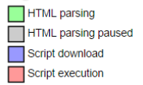
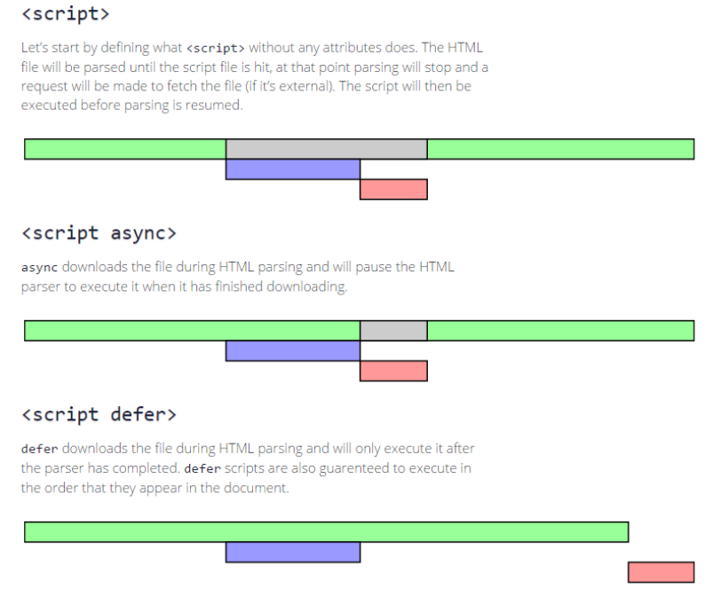
Describe the difference between &<script>, <script async> and <script defer>.

Slide 12
Why is it generally a good idea to position CSS <link>s between <head></head&> and JS <script>s just before </body>? Do you know any exceptions?
Attr

Slide 13
Thank You

