Slide 1

IILM UNIVERSITY, GREATER NOIDA
School of Computer Science and Engineering
Internship Report
SQL and Database Management Systems
8-Week AICTE – EduSkills Virtual Internship | April – June 2026
STUDENT NAME
ORGANIZATION
Vishal Kumar Ray
EduSkills Academy (AICTE)
ENROLLMENT NUMBER
BATCH
2410030125
2024-28
PROGRAM & SEMESTER
B.Tech CSE, Semester 5

Slide 2
OVERVIEW
Candidate & Program Overview
CANDIDATE DETAILS
INTERNSHIP PROFILE
Student Name
Program Name
Vishal Kumar Ray
AICTE – EduSkills Virtual Internship
Enrollment Number
Domain
2410030125
SQL and Database Management Systems (Hindi)
Degree
Duration
B.Tech (Computer Science & Engineering)
8 Weeks (April 2026 – June 2026)
Program & Semester
Certificate ID
Semester 5
2026-E8BEDF0F29
Academic Batch
Offer Letter Ref.
2024-2028
C16Y2026M081402213
University
AICTE Student ID
IILM University, Greater Noida, U.P.
STU6997da07c89721771559431
SQL and Database Management Systems | Vishal Kumar Ray
2

Slide 3
ABOUT THE ORGANIZATION
Organization Profile: EduSkills Academy
EduSkills Academy is an ISO 9001:2015 and ISO 20000-1:2018 certified organization operating under the vision of “Nation Building Through Skills.”
1
2
3
AICTE Collaboration
Industry Alignment
Core Focus Domains
Operates under the patronage of the AICTE National Internship Portal to empower engineering talent across India.
Partners with leading technology organizations to bridge the gap between academia and industry in emerging tech domains.
Databases, Business Intelligence, Cloud Computing, Full-Stack Development, and Enterprise Automation.
SQL and Database Management Systems | Vishal Kumar Ray
3

Slide 4
THE CHALLENGE
Problem Statement & Industry Context
THE INDUSTRY GAP
THE INTERNSHIP'S SCOPE OF SOLUTION
While academic coursework extensively covers relational theory – ER modeling, normalization, and basic SQL syntax – students often lack hands-on exposure to managing databases in real, production-grade environments.
Covers the complete database lifecycle: relational design, advanced SQL, NoSQL modeling, ETL, and BI dashboards.
Extends into full-stack integration – exposing databases through Node.js/Express and FastAPI REST APIs.
A well-designed schema on paper provides little business value until the data behind it is queried efficiently, secured, backed up, and scaled for real users.
Builds practical skill in performance tuning, security hardening, backup, and scalability for production-grade systems.
SQL and Database Management Systems | Vishal Kumar Ray
4

Slide 5
GOALS
Core Project Objectives
1
Relational Foundations
2
Advanced SQL & NoSQL
3
ETL & Business Intelligence
Understand database concepts, ER modeling, normalization, and DDL/DML operations.
Master joins, subqueries, aggregation, and MongoDB's document model & CRUD operations.
Perform data aggregation and ETL, and build dashboards & visualizations using Power BI.
4
Full-Stack DB Integration
5
Performance, Security & Backup
6
Scalability & Capstone
Connect databases to full-stack apps using Node.js/Express and FastAPI with SQLAlchemy.
Apply indexing, query optimization, access control, SQL-injection prevention, and recovery strategies.
Study replication, sharding & clustering, and apply all concepts in an end-to-end capstone project.
SQL and Database Management Systems | Vishal Kumar Ray
5

Slide 6
TOOLCHAIN
Technologies & Tools Used
Databases
Business Intelligence
Backend & Integration
SQL (Relational)
Microsoft Power BI
Node.js & Express.js
PostgreSQL
DAX
FastAPI
MongoDB (NoSQL)
Data Modeling
SQLAlchemy
Programming Languages
Performance & Security
Reliability & Scale
Python
Indexing Strategies
Backup & Recovery
JavaScript
Query Optimization
Replication
SQL
Role-Based Access Control
Sharding & Clustering
SQL and Database Management Systems | Vishal Kumar Ray
6

Slide 7
DATABASE SOLUTION LAYERS
System Architecture
1
Data Layer
Relational (SQL/PostgreSQL) and non-relational (MongoDB) databases storing structured & unstructured data.
2
Query & Aggregation Layer
Advanced SQL joins/subqueries and MongoDB's aggregation pipeline process the underlying data.
3
ETL & BI Layer
Data pipelines feed Power BI dashboards built with relational models and DAX measures.
4
API Layer
FastAPI + SQLAlchemy and Node.js/Express expose the databases as RESTful CRUD APIs.
5
Application Layer
Full-stack applications consume the APIs to perform CRUD operations for end users.
6
Security, Performance & Scale Layer
Indexing, access control, SQL-injection prevention, backup, replication, and sharding.
SQL and Database Management Systems | Vishal Kumar Ray
7

Slide 8
WEEK-WISE CURRICULUM
Curriculum Timeline – Weeks 1 to 4
WEEK 1
WEEK 2
WEEK 3
WEEK 4
Database Foundations & Relational Design
Advanced SQL & NoSQL (MongoDB)
Data Aggregation, ETL & Power BI
Data Modeling & Full-Stack DB Integration
DB concepts, SQL vs NoSQL, ER modeling, normalization, DDL & basic DML operations.
Joins, subqueries, aggregation, GROUP BY/HAVING, MongoDB document model & CRUD.
Advanced SQL aggregation, ETL concepts, Power BI interface, dashboards & visuals.
Power BI relationships & DAX; Node.js/Express with PostgreSQL; CRUD API development.
SQL and Database Management Systems | Vishal Kumar Ray
8

Slide 9
WEEK-WISE CURRICULUM
Curriculum Timeline – Weeks 5 to 8
WEEK 5
WEEK 6
WEEK 7
WEEK 8
Backend APIs & Data Integration (FastAPI)
Database Performance, Security & Backup
Scalability & High Availability
Advanced NoSQL & Capstone Project
FastAPI with SQLAlchemy, RESTful CRUD APIs, API consumption, combining datasets.
Indexing, query optimization, roles & permissions, SQL-injection prevention, backup/recovery.
Replication, sharding, clustering, and real-world case studies across industries.
MongoDB aggregation pipeline, geospatial & time-series modeling, capstone dashboard.
SQL and Database Management Systems | Vishal Kumar Ray
9

Slide 10
CAPSTONE HIGHLIGHTS
Key Projects & Demonstrated Skills
1
Relational Database Design
2
Advanced SQL Querying
Designed a normalized schema with ER modeling and implemented it using DDL/DML operations.
Wrote multi-table joins, subqueries, and aggregate queries with GROUP BY/HAVING for reporting.
3
NoSQL with MongoDB
4
Business Analytics Dashboard
Modeled documents and built CRUD operations and aggregation pipelines in MongoDB.
Built a data-driven Power BI dashboard using ETL pipelines, relationships, and DAX measures.
5
Full-Stack API Integration
6
Performance, Security & Scale
Connected PostgreSQL and MongoDB to full-stack apps via Node.js/Express and FastAPI CRUD APIs.
Applied indexing, SQL-injection prevention, backups, and studied replication/sharding for scale.
SQL and Database Management Systems | Vishal Kumar Ray
10

Slide 11
CREDENTIAL DETAILS
Certification & Official Verification
Internship Title
SQL and Database Management Systems Virtual Internship (Hindi)
Issuing Organization
EduSkills Academy (ISO 9001:2015 & ISO 20000-1:2018 Certified)
Academic Patronage
AICTE National Internship Portal, Ministry of Education
Certificate ID
2026-E8BEDF0F29 (Issued: Aug 04, 2026)
Offer Letter Ref.
C16Y2026M081402213
AICTE Student ID
STU6997da07c89721771559431
Duration
8 Weeks | April 2026 – June 2026
SQL and Database Management Systems | Vishal Kumar Ray
11

Slide 12
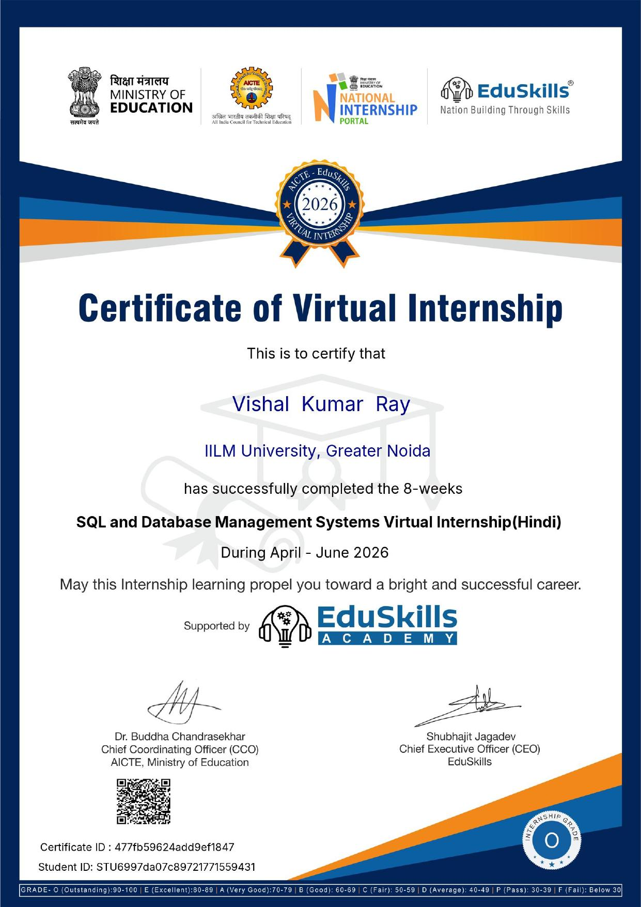
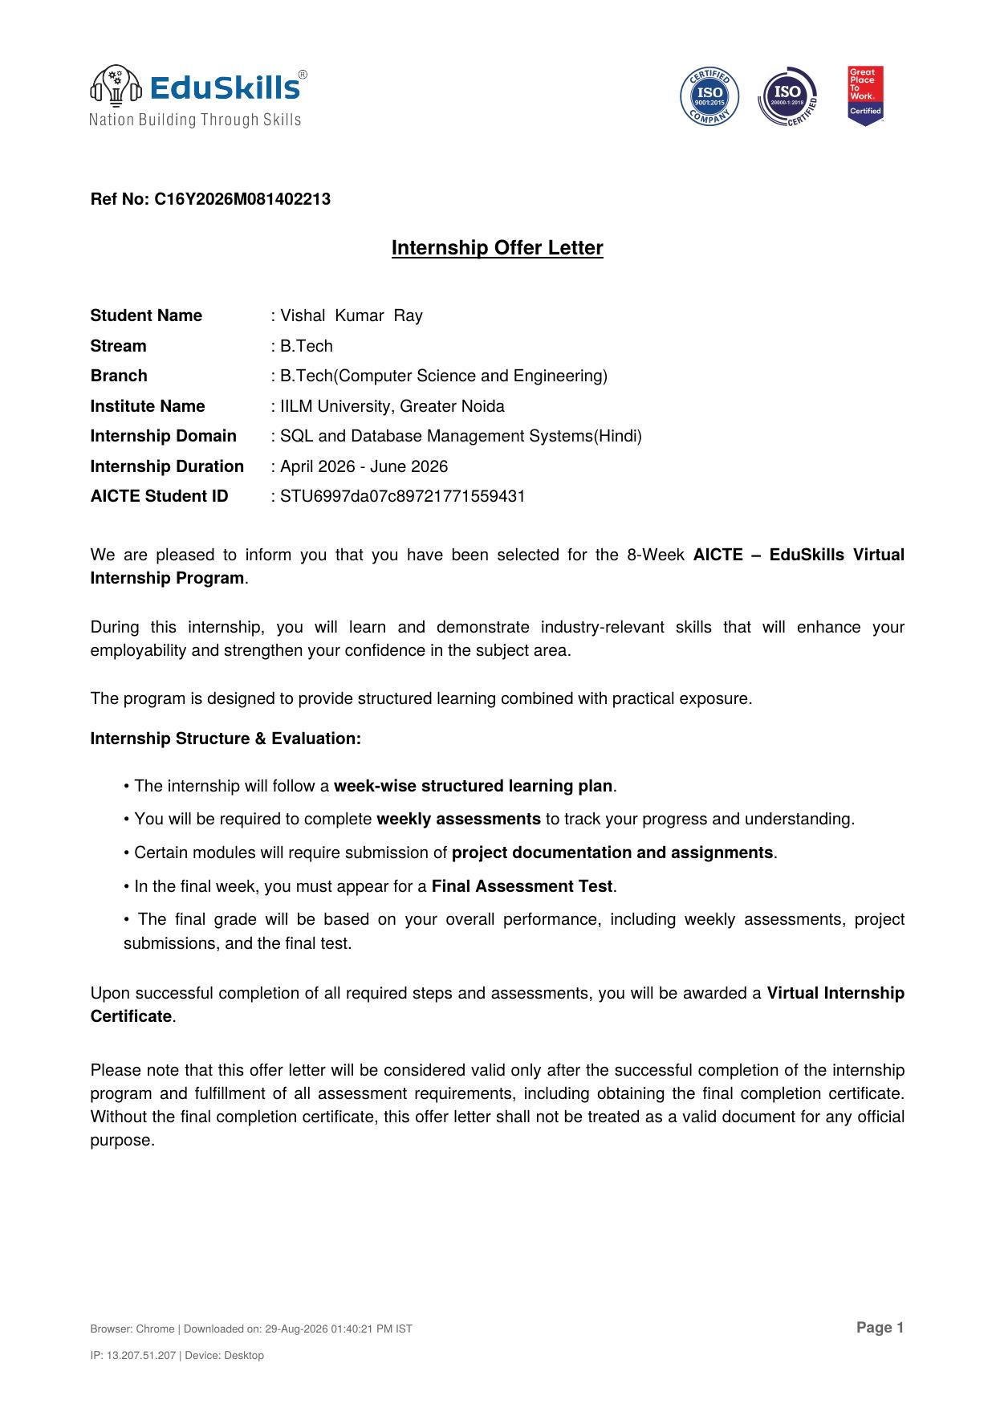
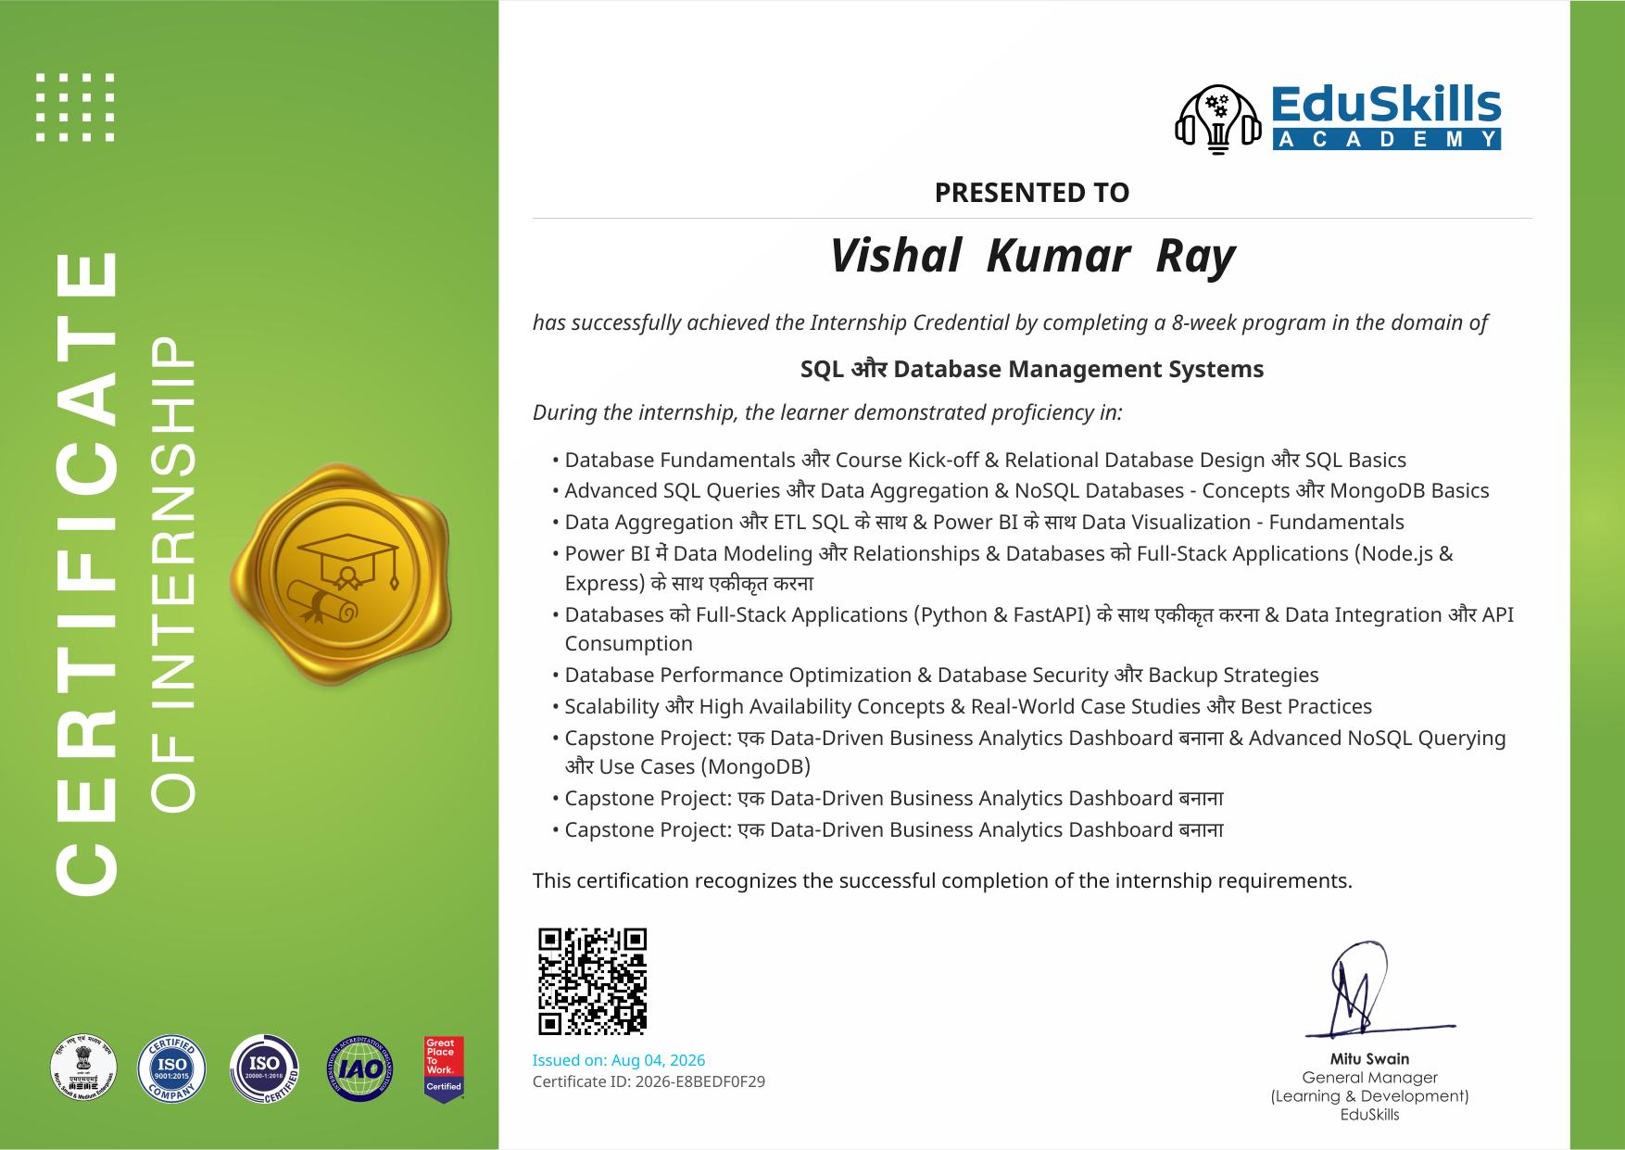
SUPPORTING DOCUMENTS
Certification & Official Verification
Course Certificate
Certificate of Virtual Internship
Internship Offer Letter
SQL and Database Management Systems | Vishal Kumar Ray
12

Slide 13
Thank You
Vishal Kumar Ray
Roll No: 2410030125 | Semester 5
School of Computer Science & Engineering, IILM University, Greater Noida, U.P.

