Slide 1
NAGARSEVA
Plan safer homes.
Prove services arrive.
AI-powered decision support for affordable housing, slum redevelopment and everyday service assurance across the Mumbai Metropolitan Region.
A hackathon demo · working title · 2026
Every neighbourhood safer, healthier and heard.

Slide 2
002 / THE PROBLEM
Housing is delivered as a project. Services are experienced as a promise.
Fragmented priority
Viability uncertainty
Post-handover blind spot
Cities know the need is large, but cannot compare pockets on vulnerability, hazard, density and service deficits in one view.
Cross-subsidy projects depend on land, FSI, rehab entitlement, construction cost, market rate and TDR moving together.
A new building does not guarantee water, sanitation, power, waste collection, health access or a response to grievances.
India’s housing and service gap is a systems problem — not only a construction problem.
NagarSeva · Synthetic, calibrated demo data
MMR · Maharashtra

Slide 3
003 / WHY NOW
Three failure modes keep repeating.
01 Data silos
02 One-size intervention
03 No closed loop
Census, ward assets, complaints, land and project histories live in separate rooms. A decision is made with a partial picture.
In-situ, upgrading, relocation and rental housing have different risk, tenure and financial logic. The wrong default creates delay.
Success is counted at handover. Residents experience the next 90 days. Without assurance signals, the gap becomes invisible.
NagarSeva closes the loop from prioritise → plan → simulate → assure.
NagarSeva · Synthetic, calibrated demo data
MMR · Maharashtra

Slide 4
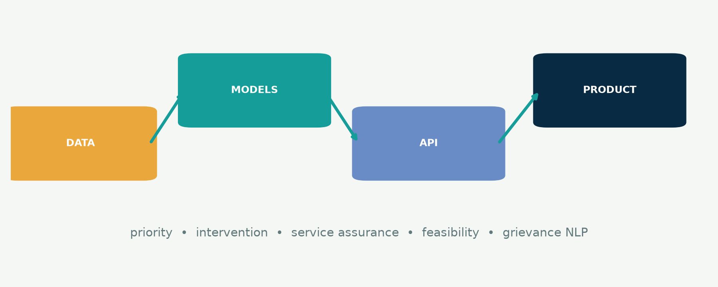
004 / THE SOLUTION
One evidence layer for four public decisions.
Synthetic data is a safe, reproducible starting point. Approved real sources plug into the same contracts.
NagarSeva · Synthetic, calibrated demo data
MMR · Maharashtra

Slide 5
005 / DATA & METHOD
Seeded, reproducible and honest about what it is.
1,500 pockets
20,000 grievances
Ward-safe validation
MMR-like coordinates, vulnerability, density, land signals and hazard scores. GeoJSON polygons are illustrative.
English, Hindi, Marathi and Hinglish-style text across water, sanitation, power, waste, drainage, health, safety and housing.
Train/validation/test logic avoids pocket leakage by splitting on ward. Missingness and outliers are deliberately injected.
Calibration direction: Census 2011 · NFHS-5 · PMAY-U · SBM-U · MoHUA · SRA norms
NagarSeva · Synthetic, calibrated demo data
MMR · Maharashtra

Slide 6
006 / AI MODELS
Small, explainable models that run on a laptop.
Priority
Intervention
Service gap
R² 0.981 · MAE 1.72
0–100 score + tiers
Macro-F1 0.760
top 2 options
F1 0.890 · AUC 0.954
90-day failure
Cost / delay
Grievance NLP
Optimiser
MAE + intervals
P50 → P80 band
Macro-F1 1.000*
category + urgency
ILP + fallback
budget + fairness
* Template-heavy synthetic split; not evidence of real-world multilingual performance.
Explainability is a product feature: SHAP-compatible helpers + plain-language reasons.
NagarSeva · Synthetic, calibrated demo data
MMR · Maharashtra

Slide 7
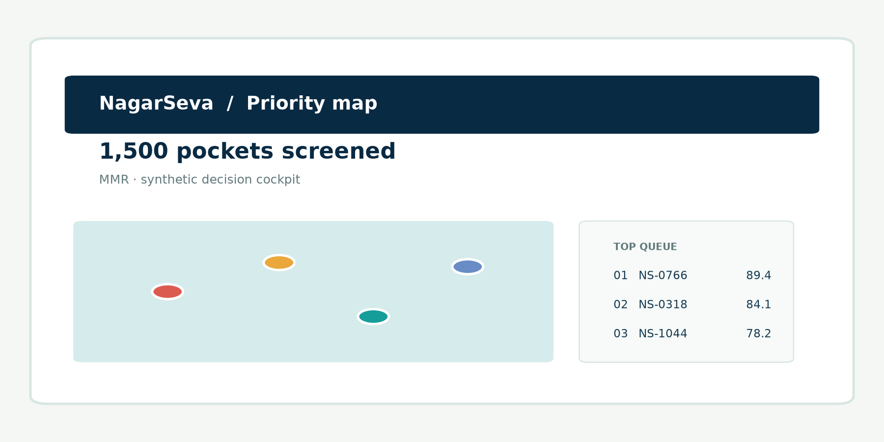
007 / PRODUCT WALKTHROUGH
See the decision, then challenge the assumption.
Priority map
Click the red dot.
Ask: why this pocket?
Pocket profile
Radar + top-two pathway
+ uncertainty band.
Resident voice
Report in your language.
Track the handoff.
NagarSeva · Synthetic, calibrated demo data
MMR · Maharashtra

Slide 8
008 / FINANCIAL VIABILITY
Make cross-subsidy assumptions visible before the DPR.
gross built-up area
Output
Demo moment
land × FSI
Viable / Borderline / Not viable
Developer margin
Indicative IRR proxy
Break-even market rate
Sensitivity tornado
Move FSI from 2.7× to 2.0×.
The verdict changes because the assumptions change — not because the model hides a preference.
− free rehab area
eligible homes × entitlement
= saleable area
market rate × sales share
A screening engine for better conversations; not a replacement for a project finance model.
NagarSeva · Synthetic, calibrated demo data
MMR · Maharashtra

Slide 9
009 / RESIDENT-FIRST
A service promise needs a voice and a reference number.
Simple eligibility
Multilingual grievance
Accountability
Large-button wizard
PMAY-U / SRA / rental screening
Documents checklist
Next steps in plain language
English · हिन्दी · मराठी
Voice-input button
Auto category + urgency
Expected response time
Complaint status tracker
Officer queue sorted by urgency
SLA breach alerts
Human review at every handoff
AI recommends. Officials decide. Residents participate.
NagarSeva · Synthetic, calibrated demo data
MMR · Maharashtra

Slide 10
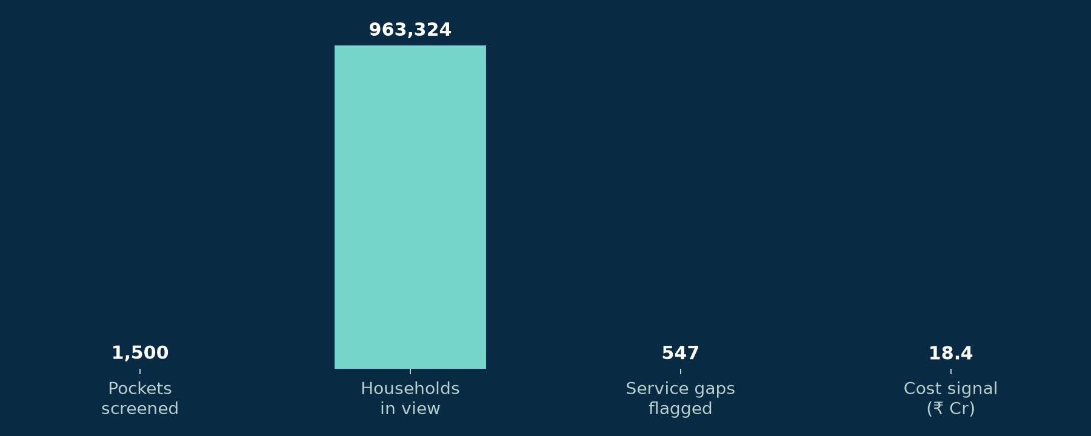
010 / IMPACT
A transparent planning scenario, with the assumptions on the slide.
What this means
Prioritise 1,500 demo pockets
Flag 547 service gaps against demo thresholds
Compare plans before committing the envelope
Keep a ward-by-ward accountability trail
Not a claim of realised savings or people covered. These are synthetic impact counters for product demonstration.
SDG 6 clean water & sanitation · SDG 11 sustainable cities
NagarSeva · Synthetic, calibrated demo data
MMR · Maharashtra

Slide 11
011 / FEASIBILITY & SCALE
Start as a shared cockpit. Scale as a trusted municipal capability.
First customer
Funding model
Roadmap
ULBs · SRA / MHADA teams
Ward prioritisation
DPR pre-screening
Service assurance pilots
Municipal licence
CSR-backed resident layer
PPP / developer due diligence
Open standards for data
Now demo + data contracts
Next 2 pilot wards + real grievance link
Then satellite/asset signals + drift audits
The defensible asset is the decision trail: data provenance → reason → consultation → outcome.
NagarSeva · Synthetic, calibrated demo data
MMR · Maharashtra

Slide 12
012 / ETHICS & LIMITS
Better decisions require stronger guardrails than a better score.
Privacy
Fairness
No automation of harm
Minimise data. No direct identifiers in the demo. Use consent, role-based access, retention limits and an approved grievance system in production.
Audit outcomes by city, income band, language, gender, disability and tenure. Offer explanations, appeals and resident validation.
The model must not decide demolition, displacement or eligibility. Officers and residents stay in the loop; hazard and tenure require statutory review.
Synthetic data is a limitation — and a deliberate safety boundary.
NagarSeva · Synthetic, calibrated demo data
MMR · Maharashtra

Slide 13
THE ASK
Let’s pilot one ward.
Then measure what residents receive.
NagarSeva turns a fragmented housing-and-services problem into a visible, explainable, accountable loop.
Plan safer homes. Prove services arrive.
Thank you
Synthetic, calibrated demo · human-in-the-loop · built for MMR

