Slide 1
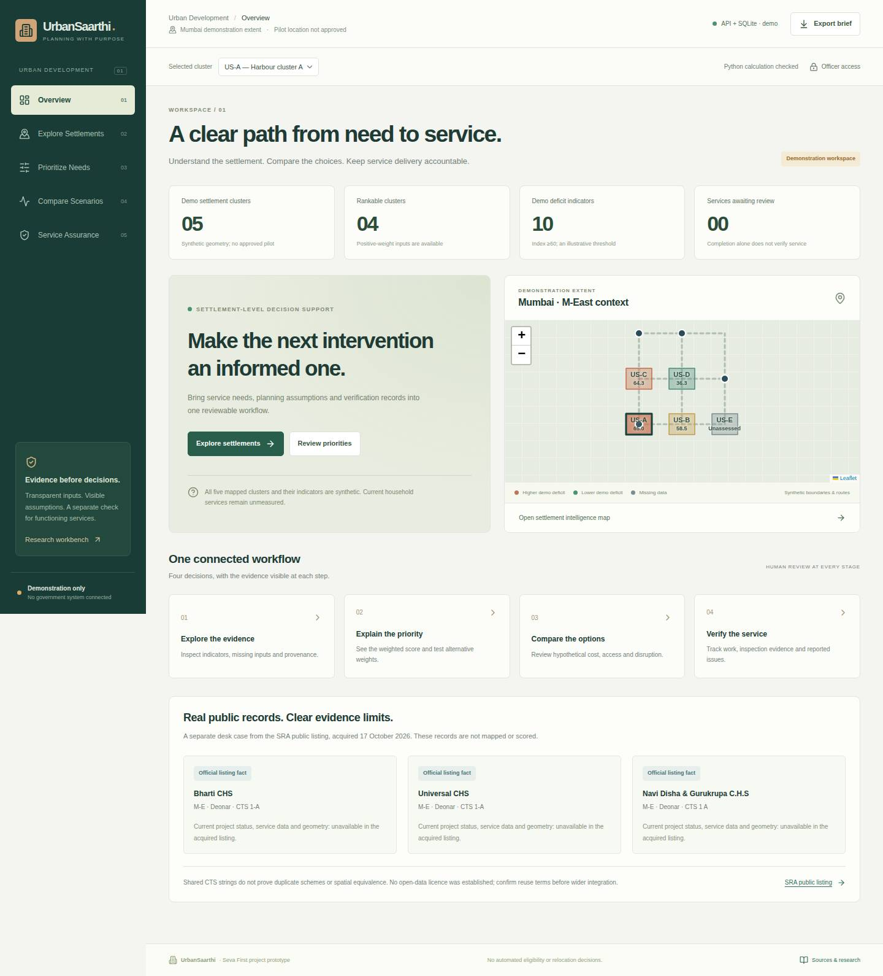
SEVA INNOVATION CHALLENGE 2026 • REFERENCE PITCH DECK
UrbanSaarthi
Explainable settlement planning
and basic-service assurance
Working software prototype
Mumbai demonstration context
No approved field pilot or measured resident impact
Notes:
UrbanSaarthi is an individual participant’s working software prototype. The screenshot is an actual Chromium capture of its synthetic demonstration, from the recorded test run. It is not a field survey. Personal details remain omitted at the applicant’s request. The official template was acquired unchanged on 18 October 2026, SHA-256 f1759dcb60e2953769ad8a535fa4fd7e870c5702c80cef70e6b465fab3e4aa92. Website guidance says PPTX while the template says PDF under 10 MB. Both formats are supplied; confirm accepted format in the authenticated portal. Sources: https://sevainnovationchallenge.in/guidelines.html and the template download linked there. Software evidence: integration/urban-validation.json in the repository.

Slide 2
2
The Problem
Proposed task: the next water-service inspection in one agreed M-East cluster
What is the problem?
Who is affected, and where?
A work can be physically complete while reliable service still needs checking. Reviewers need dated evidence for the next inspection and closure decision.
Prospective users: BMC M-East water-service reviewers, asset operators and residents. No operational cluster or agency partner is confirmed.
Unmeasured
Current affected-household count in the proposed pilot area
Evidence
Current gaps
Why it matters
Mumbai water research documents reliability concerns. Three acquired SRA listing rows supply locality leads, with no acquired service observations.
SRA GIS, SBM monitoring and Swachhata already exist. Local omissions, review effort and the benefit of this workflow still need testing.
An unverified closure may leave a service problem unresolved.
Seva Innovation Challenge 2026 | Slide 2 of 6
Notes:
Proposed local task: select the next water-service inspection and review closure evidence in one agreed M-East cluster. Historical/local research supports attention to service reliability, not a current ward prevalence estimate. Three SRA listing records were acquired on 17 October 2026. Their geometry and current service observations were not acquired. Existing systems constrain the novelty claim. Sources accessed 17–18 October 2026: https://link.springer.com/article/10.1186/1471-2458-13-173 ; https://dms.sra.gov.in/SRAPUBLIC/ ; https://maharashtra.nic.in/news/gis-sra/ ; https://mahadma.maharashtra.gov.in/wp-content/uploads/2025/07/swachh-bharat-2.pdf ; https://www.pib.gov.in/PressReleasePage.aspx?PRID=2162194&lang=2&reg=48 .

Slide 3
3
Our Solution & Innovation
One reviewable workflow, with assumptions and unknowns visible
Our solution in brief
What makes it new?
Five screens connect a settlement map, explainable priority scores, hypothetical intervention options and a separate service-evidence review.
 | Existing approach | UrbanSaarthi
Cost | Not measured | Assumed INR 132,000
Speed / time | Not measured | Paired test planned
Reach / access | Existing channels | Five demo clusters
Ease of use | Not measured | User testing needed
How it works
1
2
3
Input
›
Process
›
Output
Dated indicators
and source records
Transparent scores
and scenario costs
Inspection brief
and service review
Proposed contribution
Traceability across planning and verification. Incremental value remains to be tested against the current process.
Seva Innovation Challenge 2026 | Slide 3 of 6
Notes:
Five screens implement the requested software workflow. The mapped clusters, deficit indices, graph, household counts and construction scenarios are synthetic assumptions. P=.30W+.25S+.20H+.15A+.10R gives 65.0 for 80,70,60,50,40. Weights and the 60/100 demo cutoff are design assumptions. Missing positive-weight inputs produce an interval and no rank. Costs, speed and usability have no independent comparative measurements. INR 132,000 is an illustrative review-trial budget, not software price, a quotation or construction cost. No patent or AI advantage is claimed. Sources: repository README, model/src/urban_planning.py, shared/urban-demo.json, submission/financial_model.md and integration validation records.

Slide 4
4
Feasibility & Implementation
Current stage: working prototype. Field validation and operating ownership remain pending.
Current stage: Working Prototype
Idea
Proof of Concept
Working Prototype
Field Pilot
Ready to Deploy
Technology
Estimated cost
Timeline
Partners
React / Leaflet
FastAPI / SQLite
Deterministic scoring
Python consistency checks
Synthetic service inputs
INR 132,000 assumed
20 asset review scopes
INR 6,600 / scope
Household cost unknown
Construction excluded
3 months: bounded trial
6 months: second-site test
12 months: conditional handover
Each step needs evidence and approval
Prospective: BMC M-East ward and Assistant Engineer, Water Works
No office, operator or partner has agreed
Seva Innovation Challenge 2026 | Slide 4 of 6
Notes:
Only the Working Prototype stage applies. Automated tests cover calculations, API behavior, persistence and the actual Chromium workflow. They do not validate current service conditions. A conditional 90-day trial aims for up to 20 public water assets and three observation rounds. All rates need quotations. Budget: INR 120,000 subtotal + 10% contingency = INR 132,000. Dividing by 20 proposed asset review scopes gives INR 6,600 per scope, not per beneficiary or repaired asset. The BMC M-East department list includes Assistant Engineer (Water Works); its published manual describes ward-level water responsibilities. No current incumbent, adoption mandate or partnership is asserted. Sources accessed 18 October 2026: https://portal.mcgm.gov.in/irj/portal/anonymous/qlacmeward ; https://portal.mcgm.gov.in/irj/go/km/docs/documents/MCGM%20Department%20List/Wards/Assistant%20Commissioner%20%28MEast-Ward%29/RTI%20Manuals/Model%20RTI%2017%20Manual%20Assistant%20Engineer%20%28Water%20Works%29.pdf . Trial and cost details: pilot/README.md and submission/financial_model.md.

Slide 5
5
Impact & Scalability
Intended outcomes require an independent comparison and repeat observations
Unmeasured
Unmeasured
Unmeasured
Beneficiaries reached
Saving in cost / time
Jobs or livelihoods
No verified beneficiary denominator
Paired review comparison proposed
Employment-hub distance is a demo proxy
Social impact
Sustainability
Scale-up plan
Test critical evidence omissions, review effort and repeat service observations. Include voluntary assisted feedback and disability/access barriers.
Illustrative continuation: INR 162,360 / year. A recurring payer and maintenance owner remain unconfirmed.
Validate one task, then a second ward. Expansion needs permitted data, authenticated roles, approved integration and operating finance.
Seva Innovation Challenge 2026 | Slide 5 of 6
Notes:
Beneficiary reach, savings and livelihood impact remain unmeasured. Compare paired task effort and critical omissions against the current process, with independent assessments recorded before engine scores are shown. Report sample size, missing pairs and disagreement. Distance to a synthetic employment hub is not income or livelihood loss. Annual illustrative continuation is INR 147,600 +10% contingency = INR 162,360. No payer is committed. SDG 6, 11 and 1 alignment is intended only. Source: pilot/field_protocol.md, pilot/indicator_protocol.md, submission/impact_metrics.md and financial_model.md.

Slide 6
6
Team/Individual & Support Required
Individual participant. Personal and eligibility details will be completed privately.
Individual applicant
Support we are seeking
Mentorship & technical guidance
Working research-based prototype
Pilot with a government department
Personal details omitted at applicant request
No operational users or agency endorsement
Funding / grant support
Incubation & workspace
Testing, certification or IP support
A bounded review task, permitted records and independent field assessment before expansion.
Mentor and independent field partner: unconfirmed
Contact and eligibility details: complete privately
Seva Innovation Challenge 2026 | Slide 6 of 6
Notes:
The applicant has asked to omit personal profile details. Complete legal identity, domicile, category, contact and declarations privately before submission. No faculty mentor or field partner is invented. The support request is a domain mentor, permitted records, independent validation and a scoped trial budget subject to approval. No agency has been contacted or accepted this proposal. The draft office request is prepared but unsent. Source: pilot/adoption_request.md and submission/application_answers.md.

