Slide 1
01 / NAGARSEVA
Plan housing improvements.
Verify residents receive the promised services.
01
Housing planning + household affordability
02
Accountable action + resident verification
03
Working software; a field pilot is the next step
NagarSeva · Synthetic planning baseline · Pilot evidence is source-labelled

Slide 2
02 / THE PROBLEM
A home needs affordable living costs and functioning services.
01
Compare housing options alongside monthly household costs.
02
Connect a service problem to a responsible department and deadline.
03
Record evidence and keep the resident involved in resolution.
NagarSeva · Synthetic planning baseline · Pilot evidence is source-labelled

Slide 3
03 / ONE CONNECTED PROJECT
A shared record across the whole workflow.
01
Priority map → project brief → financial and household scenario
02
Resident report → officer assignment → dated repair measurement
03
Resident confirmation or dispute → updated service record
NagarSeva · Synthetic planning baseline · Pilot evidence is source-labelled

Slide 4
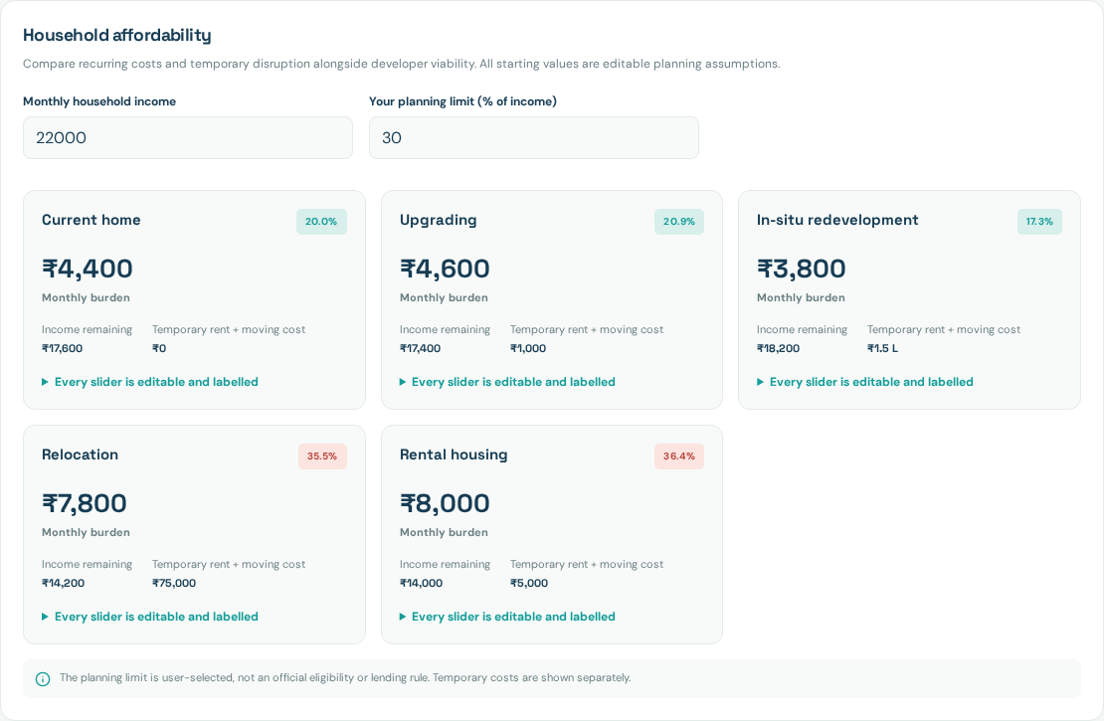
04 / AFFORDABILITY ON BOTH SIDES
Developer viability and household burden stay visible.
01
Project: area, rehab assumptions, market rates, construction and sensitivity.
02
Household: rent/EMI, maintenance, utilities, transport and income loss.
03
Temporary rent and moving costs are separate; all assumptions are editable.
Captured from the tested app · synthetic demo records
NagarSeva · Synthetic planning baseline · Pilot evidence is source-labelled

Slide 5
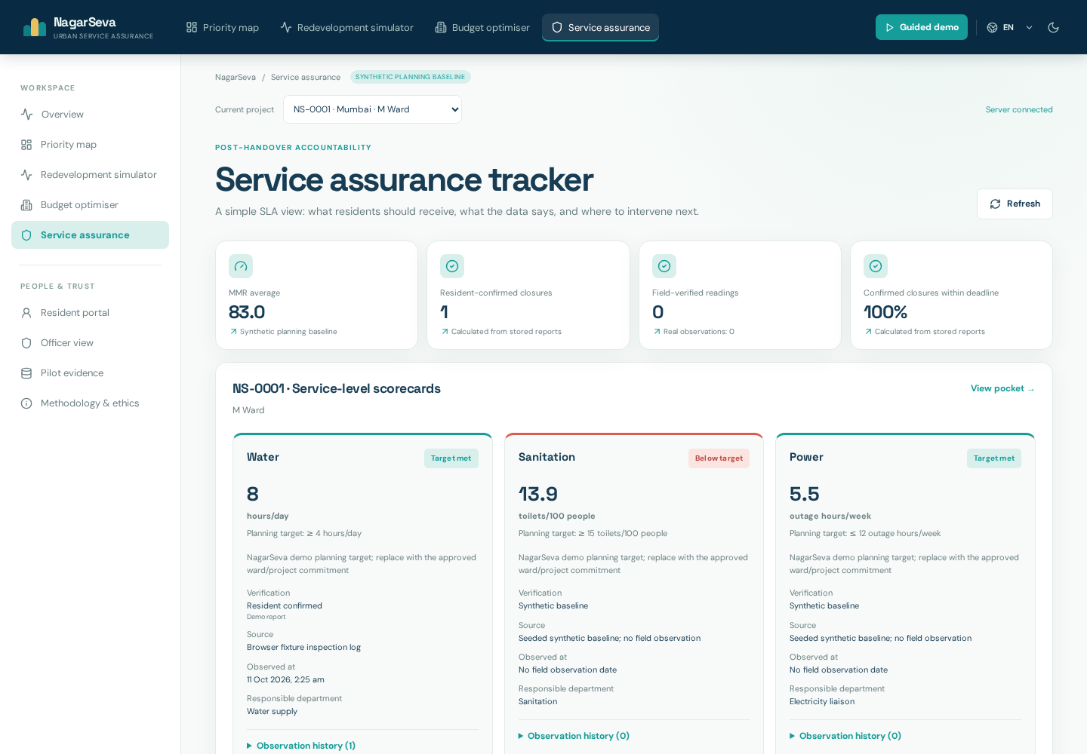
05 / WORKING SERVICE ASSURANCE
A repair is submitted for resident review.
01
SQLite records survive restarts; each resident receives a private receipt.
02
Officers review category/urgency, assign work and record after-repair evidence.
03
Confirmation accepts the reading. Dispute reopens the report and excludes it.
Captured from the tested app · synthetic demo records
NagarSeva · Synthetic planning baseline · Pilot evidence is source-labelled

Slide 6
06 / CREDIBLE ALLOCATION
Show the constraints and an actual baseline.
01
Distinct city/ward coverage, budget and vulnerable-share constraints are checked.
02
Equal-ward budget allocation is independently solved with its caps exposed.
03
Impact is a risk-weighted planning proxy; no realized savings are claimed.
NagarSeva · Synthetic planning baseline · Pilot evidence is source-labelled

Slide 7
07 / EVIDENCE AND LIMITS
Sources and sample sizes make the demonstration reviewable.
01
Public context: OpenStreetMap, dated Open-Meteo forecasts and official guidance.
02
Planning labels remain synthetic; forecasts do not validate settlement risk.
03
Consented field observations and user trials form separate pilot evidence.
NagarSeva · Synthetic planning baseline · Pilot evidence is source-labelled

Slide 8
08 / PILOT REQUEST
One approved project. A resident partner. A municipal reviewer.
01
Validate task completion, response, resident-confirmed resolution and measured services.
02
Record source-backed project commitments and evidence limitations.
03
PMAY-U 2.0 source: pmaymis.gov.in/pmaymis2_2024/PmayFAQ.aspx · reviewed 2026-10-11
NagarSeva · Synthetic planning baseline · Pilot evidence is source-labelled

