Slide 1

AI Generated Branding Slogans
Saas | AWS Lambda | Vercel | ReactJS | FastAPI | Docker

Slide 2
My Self
Roll no.: 434
Name: Vishal Ramkumar Chaurasiya
Guide: Mr. Mahavir Advaya & our Greaters

Slide 3
Introduction
This project is all about artificial intelligence generating attractive slogans and interesting hashtag for a shop/orgnizations/compeny etc.
Project Link:
https://branding-slogan.vercel.app/

Slide 4


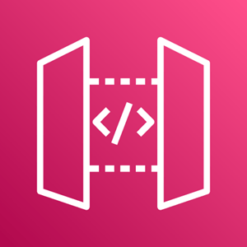

Project Architecture
Service (back-end)
Website (front-end)
OpenAI
GPT-3
main_api.py
NextJS
React
Tailwind CSS
3rd Party API
FastAPI
Vercel
AWS Lambda + API Gateway

Slide 5
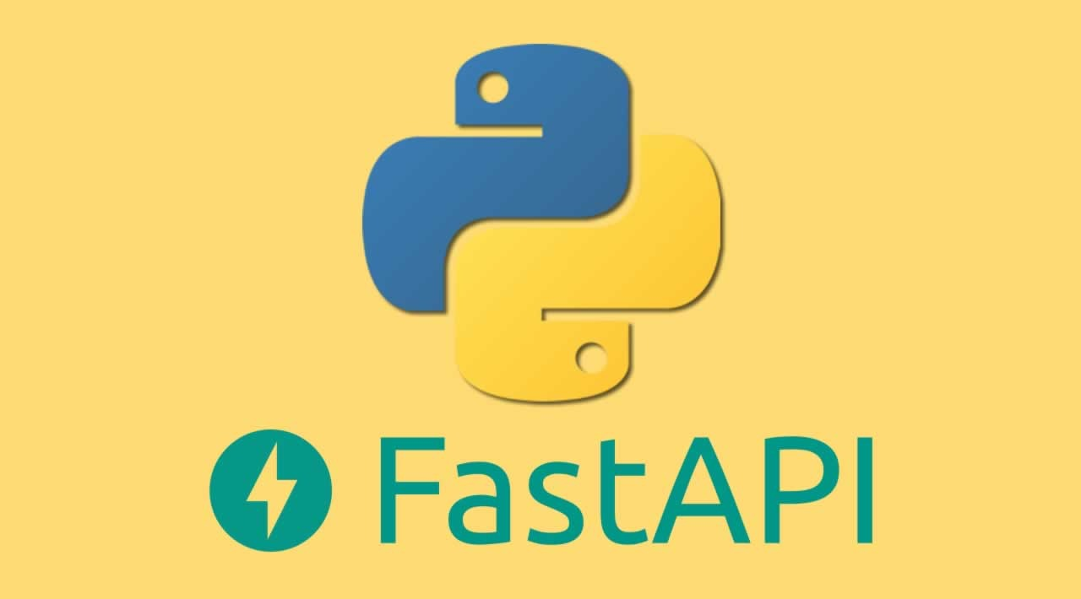
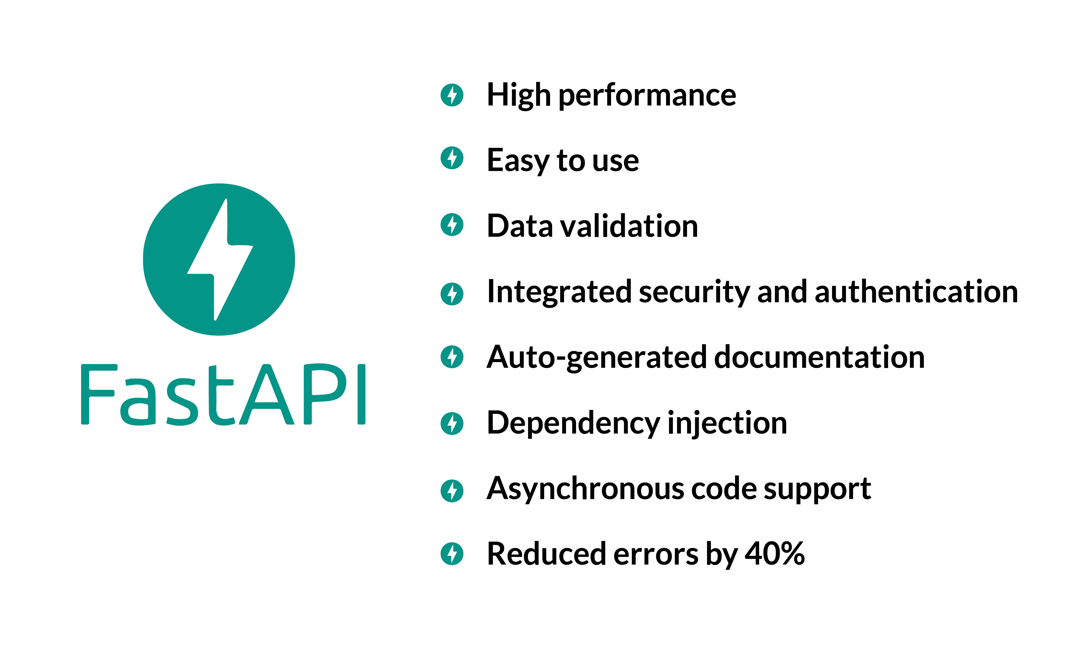
FastAPI | Back-end
FastAPI is a modern web framework for building RESTful APIs in Python.
FastAPI is based on Pydantic and uses type hints to validate, serialize and deserialize data.

Slide 6
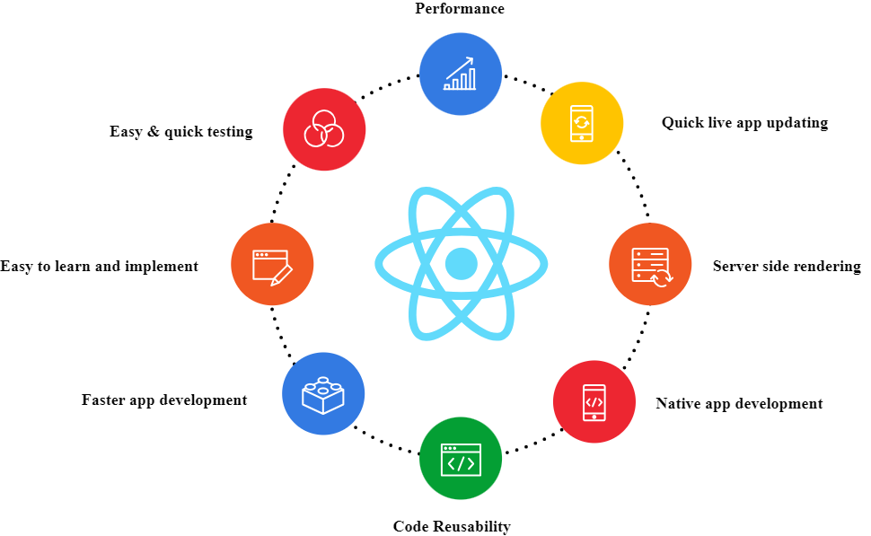
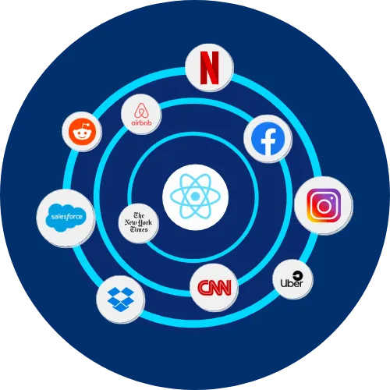
ReactJS | Front-end

Slide 7

CDK | Infrastructure
The AWS Cloud Development Kit is an open-source software development framework developed by Amazon Web Services for defining and provisioning cloud infrastructure resources using familiar programming languages.
CDK is used to define overall deployment process and infrastructure of the project.

Slide 8

AWS Lambda Function
AWS Lambda is an event-driven, serverless computing platform provided by Amazon as a part of Amazon Web Services.
It is a computing service that runs code in response to events and automatically manages the computing resources required by that code.

Slide 9
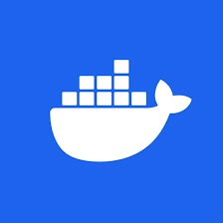
Docker
Docker is a set of platform as a service products that use OS-level virtualization to deliver software in packages called containers. The service has both free and premium tiers. The software that hosts the containers is called Docker Engine.
It was first released in 2013 and is developed by Docker, Inc.

Slide 10
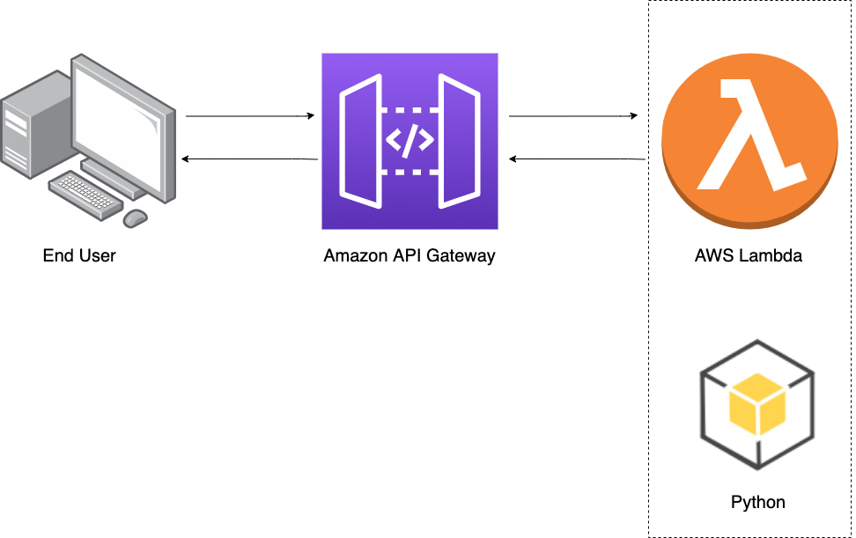
Simplified Structure

Slide 11
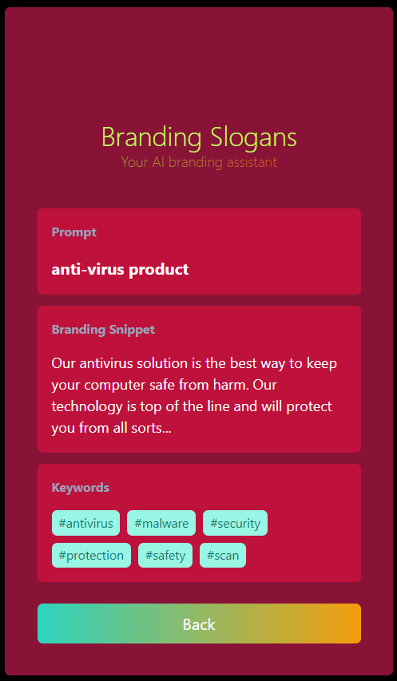
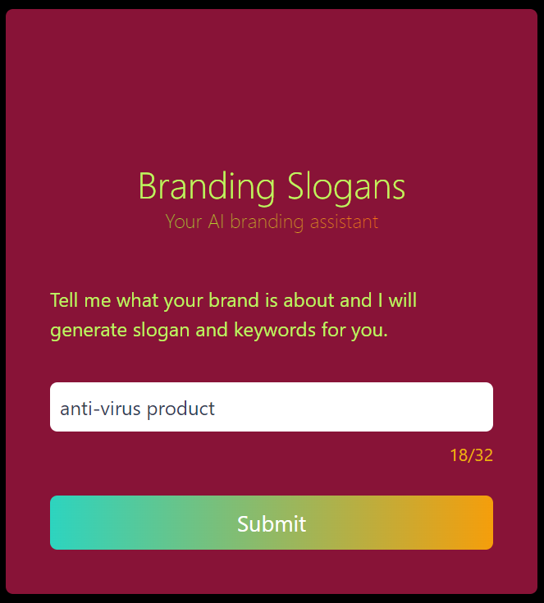
Execution

Slide 12
Thank You 🤗

