Slide 1

Distributed Storage Systems
Technology Use Case

Slide 2
Blockchain Technology
Group Members :
Vishal Chaurasiya
Aryan Patil
Sahil Bodke
Mrunmayee Badve
Class : MScIT Sem-1
Mentor : Mrs. Rasika Mundhe

Slide 3
Distributed Storage Systems
One of the fundamental open challenges for Web 3.0 is effective data storage.
Web 3.0 developers have been working to identify ways to ensure not only that digitally stored data endures but also that it is readily available, reliable, secure, and consistent.
In recent years, the massive generation of data coupled with frequent storage failures has increased the popularity of distributed storage systems, which allow data to be replicated in different, geographically dispersed, storage devices.

Slide 4
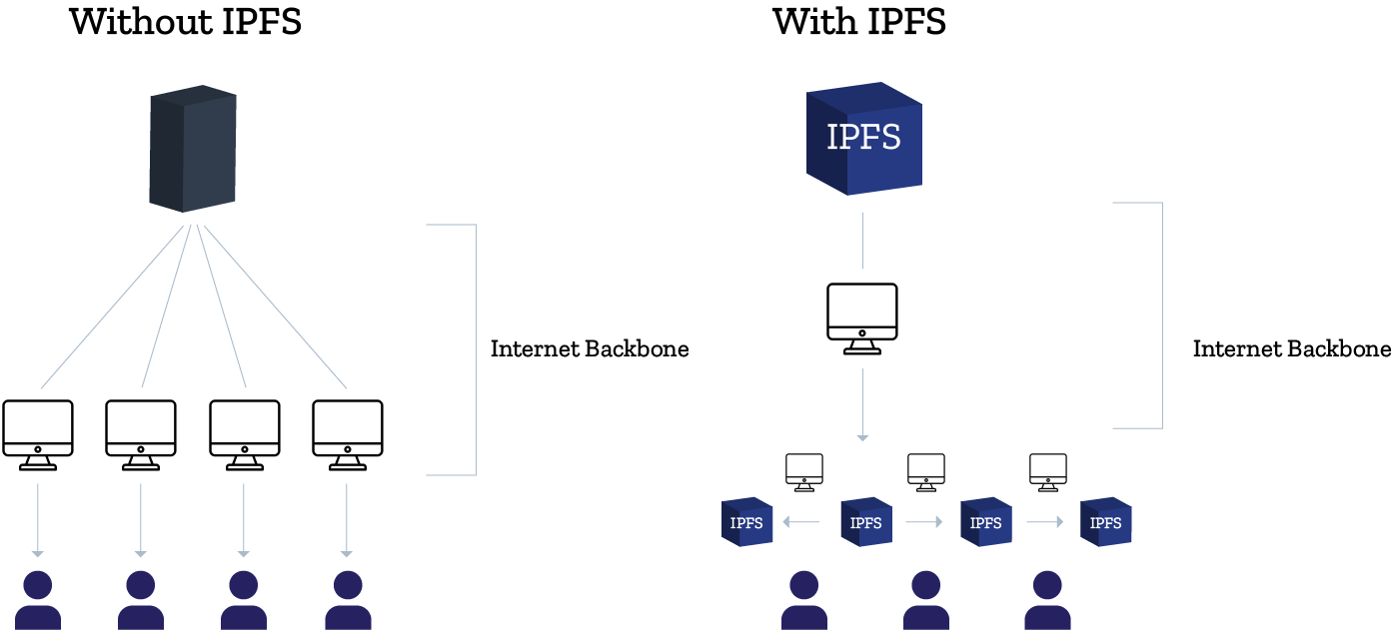

Slide 5
What is IPFS ?
The Interplanetary File System (IPFS) is a distributed file storage protocol that allows computers all over the globe to store and serve files as part of a giant peer-to-peer network.
IPFS uses content-addressing to uniquely identify each file in a global namespace connecting IPFS hosts.
Any computer, anywhere in the world, can download the IPFS software and start hosting and serving files.
If someone runs IPFS on their computer and uploads a file to the IPFS network, that file can be viewed and downloaded by anyone else in the world who is also running IPFS.

Slide 6
Where IPFS is used ?
IPFS’s incentive platform Filecoin and Swarm, an emerging Ethereum-oriented storage platform that uses IPFS.
Messaging systems like Whisper, which facilitates secure and decentralized communications.

Slide 7
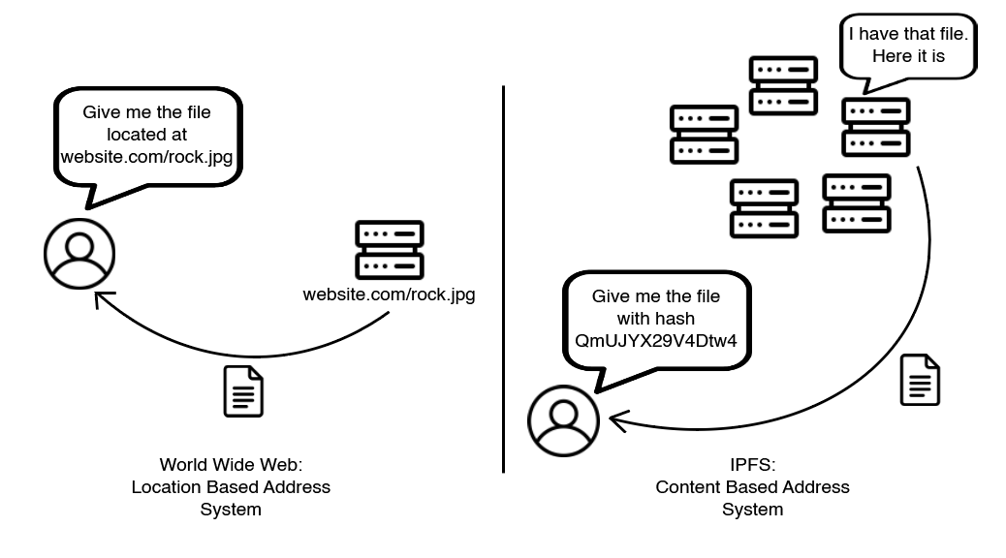
World Wide Web vs IPFS

Slide 8
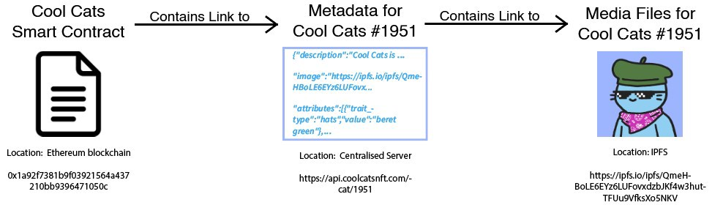
How IPFS URL looks like ?

Slide 9
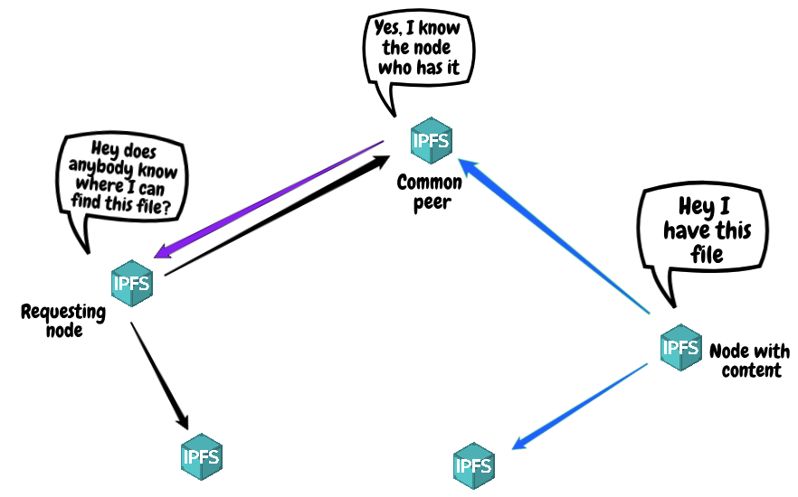
InterPlanetary File System
The InterPlanetary File System (IPFS) is a distributed file system that resulted from the evolution of prior peer-to-peer systems, including DHTs, BitTorrent, Git, and SFS.

Slide 10
More on IPFS
IPFS nodes store IPFS objects in local storage.
It is transport layer agnostic, meaning that it can communicate through TCP, μTP, UDT, QUIC, TOR, and even Bluetooth.
IPFS implements a distributed hash table (DHT) that provides a lookup service similar to a hash table: (key, value) pairs are stored in a DHT, and any participating node can efficiently retrieve the value associated with a given key.

Slide 11
IPFS Nodes
Nodes connect to each other and transfer objects.
These objects represent files and other data structures.

Slide 12
Thank you…

