Slide 1
Social Media Engagement Analysis
MKT 568 - Final Project - Group 4
By
Ishan Ratnakar Deshpande
Brennan Garcia Hillger
Vishal Patidar

Slide 2
Introduction
Exploration: Begin by analyzing the data to understand trends and identify factors influencing engagement.
Key Features: Focus on attributes such as post type (photo, video), captions, hashtags, posting time, and content themes.
Analysis Tools: Utilize statistical analysis and machine learning (e.g., linear regression) to uncover patterns and predict optimal engagement strategies.
Goal: Develop actionable recommendations for influencers, including the best times to post, effective content types, and strategic use of captions and hashtags.

Slide 3
Model Performance
Model | R squared | Adjusted R square | F statistic
LIKES | 0.438 | 0.438 | Significant
COMMENTS | 0.070 | 0.069 | Significant

Slide 4
Key Insights
Followers: Strongest positive impact on both Likes (β = 0.0482) and Comments (β = 0.0016), indicating the importance of increasing audience size.
Videos: Significantly reduce Likes (-876) and Comments (-24).
Posting Times:
Morning and night time posts tend to decrease engagement.
Afternoon posts are more likely to drive higher Likes, avoid weekends
To maximize Likes: Focus on growing your follower base and posting in the afternoon.
To boost Comments: Use interactive captions with questions and avoid late-night posts.

Slide 5
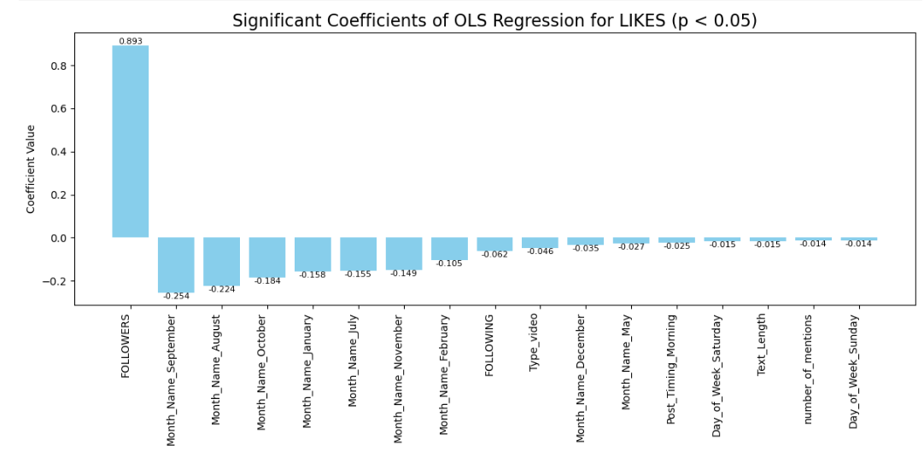
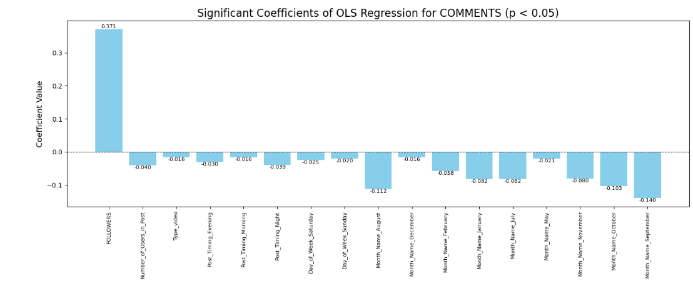

Slide 6
New Variables added
question_mark_count: Counts question marks in the TEXT. Posts with questions encourage interaction, leading to more likes and comments.
Exclamation_mark_count: Counts exclamation marks in the TEXT. Posts with exclamation encourage interaction, leading to more likes and comments.
engagement_keywords_count: Counts engagement-focused words in TEXT. Prompts like "like" or "comment" directly drive user interaction.
emoji_count: Counts emojis in TEXT. Emojis make posts more engaging and visually appealing, encouraging reactions.

Slide 7
Model Performance
Model | R squared | Adjusted R square | F statistic
LIKES | 0.439 | 0.438 | Significant
COMMENTS | 0.081 | 0.080 | Significant

Slide 8
Key Insights
Positive Influencers: Higher follower counts, use of question marks, and engagement keywords boost both likes and comments.
Negative Influencers: More following, mentions, longer text, videos, and posts made during certain times (e.g., morning, evening, night) or days (e.g., weekends) negatively impact both likes and comments.
Timing & Seasonal Trends: Avoid posting in months like August, January, and July, as well as weekends and mornings, to maximize engagement.
Content Style: Short, engaging posts with questions and keywords tend to perform better, while excessive tags, mentions, and videos reduce engagement.

Slide 9
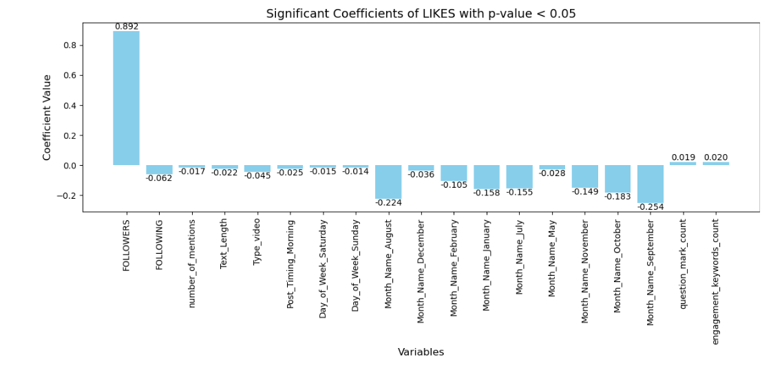
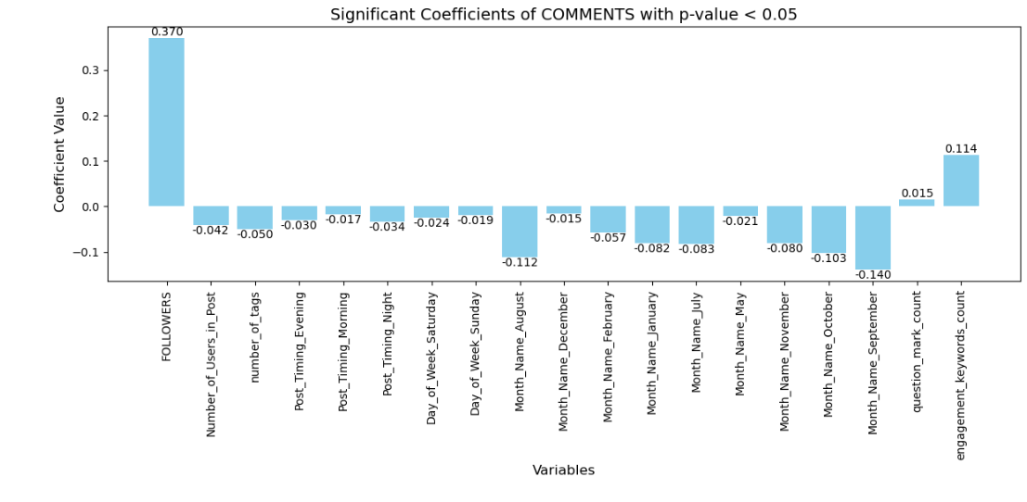
The figures above present the standardized beta coefficients from the linear regression model.

Slide 10
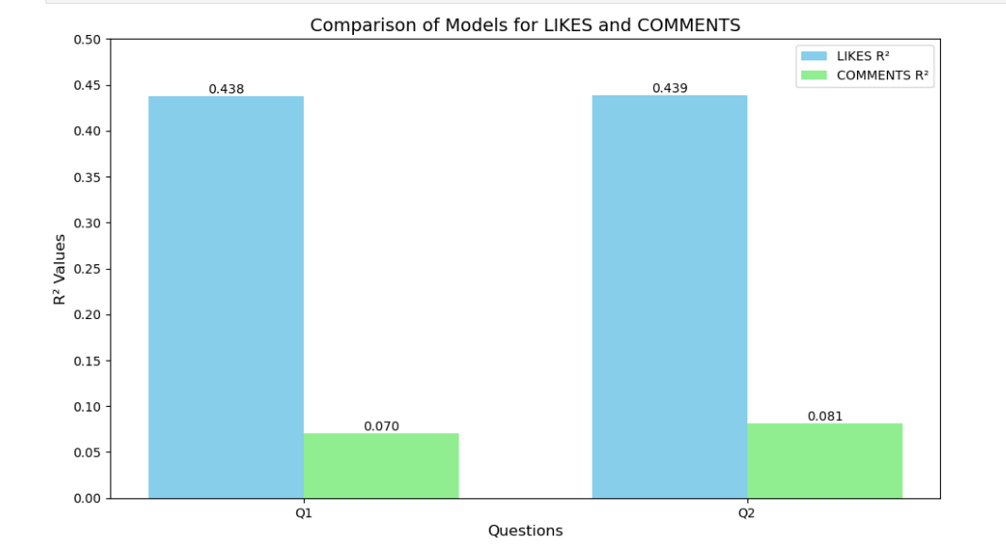
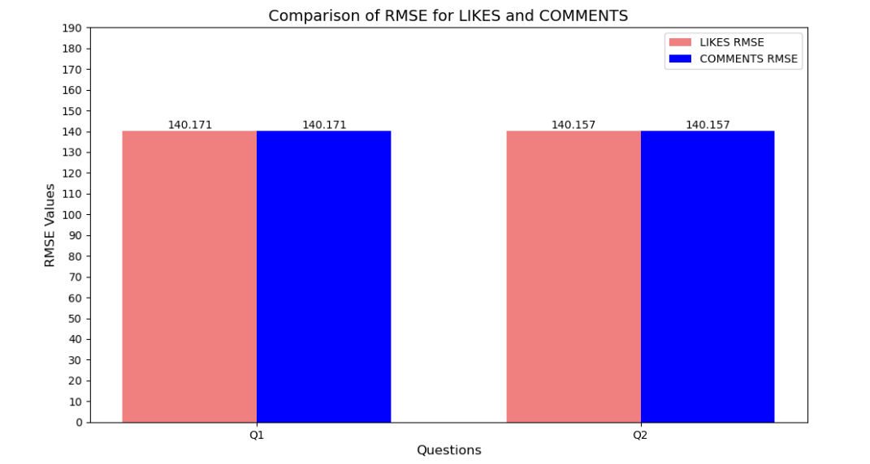
Model Comparison
Adding the new variables resulted in a slight improvement in model accuracy and a small reduction in the RMSE value.

Slide 11
Model Performance
Model | R squared | Adjusted R square | F statistic
LIKES | 0.438 | 0.438 | Significant
COMMENTS | 0.070 | 0.069 | Significant

Slide 12
Key Insights
LIKES
Positive Influence:
Followers: A larger follower count significantly increases likes (coefficient: 0.0482).
Negative Influence:
Following: More followings result in fewer likes.
Mentions and Text Length: Posts with more mentions and longer captions receive fewer likes.
Content Type: Video posts get significantly fewer likes than photo posts.
Timing and Season: Morning posts, weekends, and months like August, January, and September reduce likes.
COMMENTS
Positive Influence:
Followers: Higher follower counts lead to more comments (coefficient: 0.0016).
Negative Influence:
Tagged Users: More tagged users reduce comments.
Content Type: Video posts receive fewer comments.
Timing and Season: Posts in the evening, night, weekends, and months like August, January, and September have lower comment engagement.

Slide 13
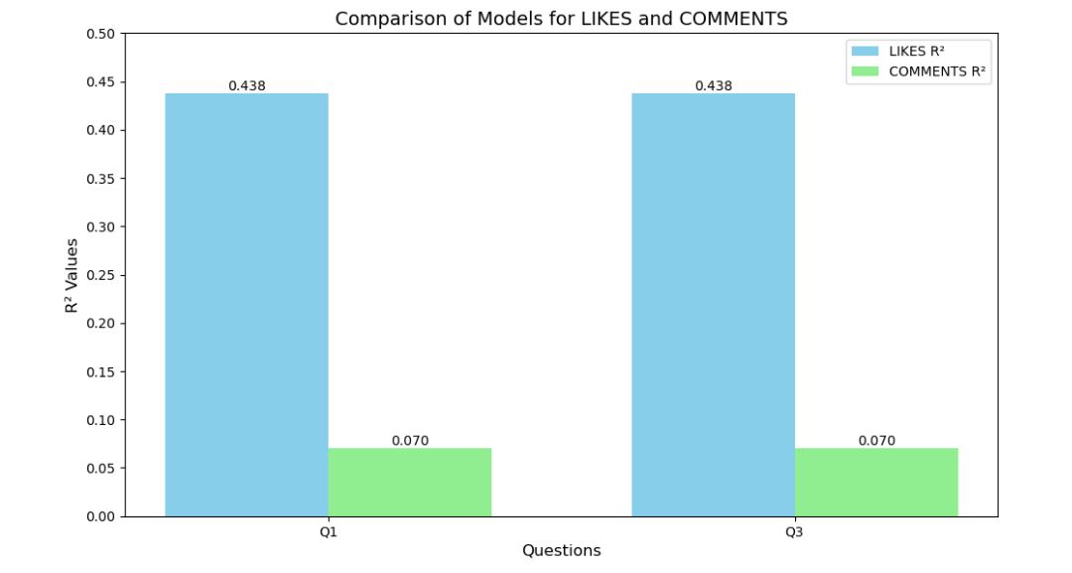
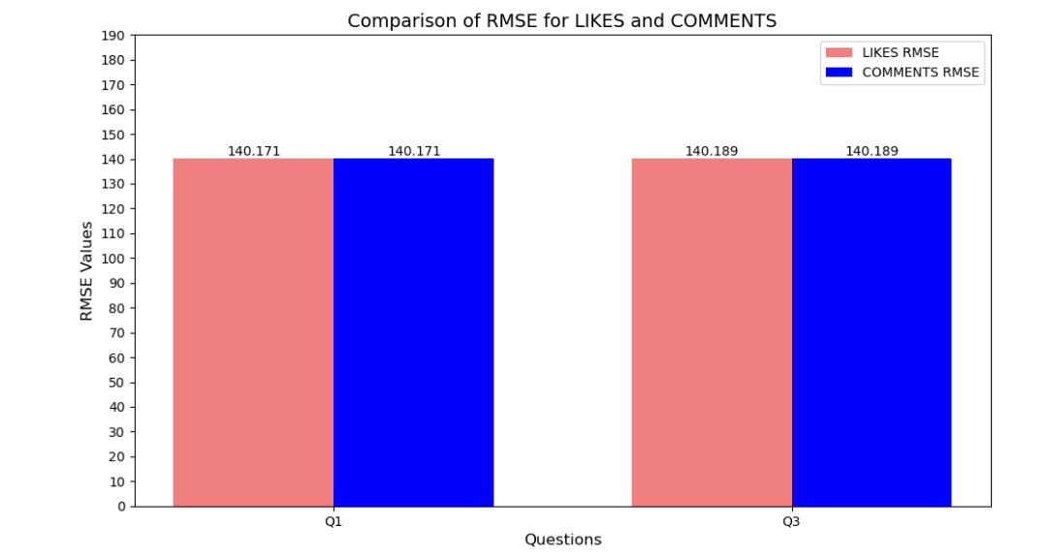
Model Comparison
The model's accuracy remained unchanged after replacing the weekdays variables with the Is_Weekend variable, though the RMSE value increased slightly.

Slide 14
Model Performance
Influencer Type | R squared (LIKES) | R squared (COMMENTS)
Micro Influencer (followers <50000) | 0.097 | 0.015
Macro Influencer (followers >50000) | 0.421 | 0.120

Slide 15
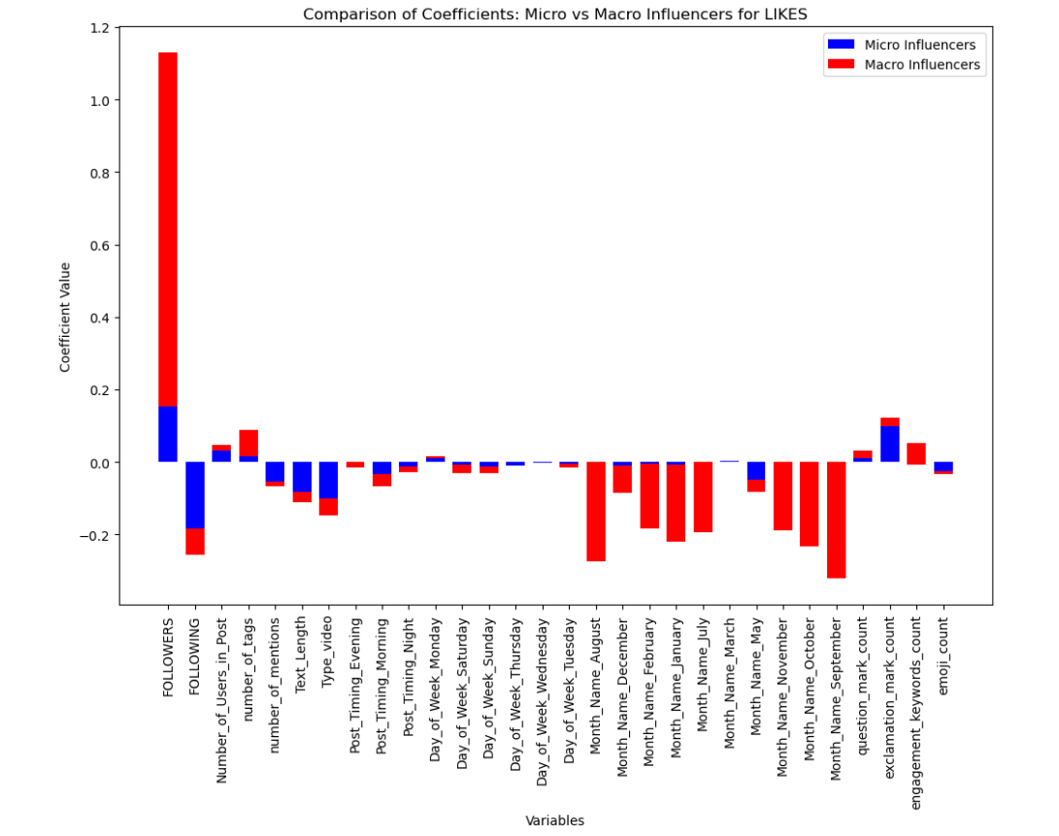
Coefficient Comparison (LIKES)

Slide 16
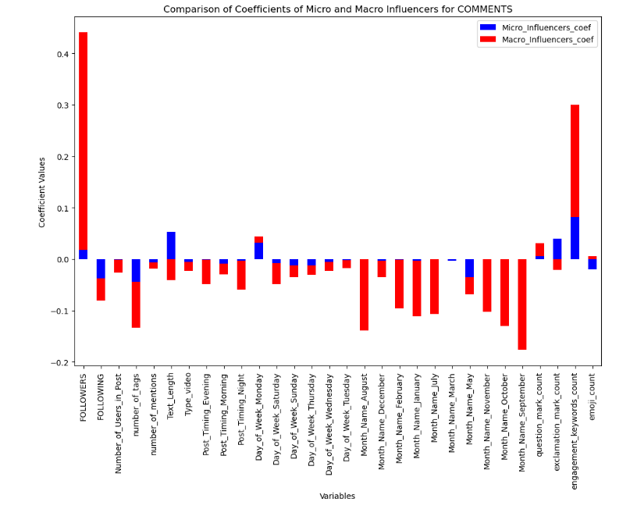
Coefficient Comparison (COMMENTS)

Slide 17
Insights and Recommendations
Micro Influencers
Post on weekdays, especially Mondays.
Use photos and concise captions.
Include moderate hashtags (1–2) and engagement keywords.
Use 1–2 exclamation marks to enhance likes.
Opt for longer captions and questions to increase comments.
Avoid excessive emojis.
Macro Influencers
Focus on afternoon posts for better engagement.
Use short captions and engagement keywords.
Minimize hashtags and avoid excessive emojis.
Photos perform better than videos.
Avoid posting at night.
Overall Recommendations
Post during afternoons on weekdays for optimal engagement.
Use photos and short captions to boost likes.
Write longer captions with engagement keywords to encourage comments.
Limit emojis and use hashtags moderately.

Slide 18
Lessons from the Project
Ishan - I learned how to enhance the accuracy of linear regression models by creating new columns and interpreting coefficients to derive meaningful insights
Vishal - I realized how critical timing and content type are for maximizing interaction.
Brennan - I think a massive take away for me was finding different preconceived ideas I had about success as an influencer to be proven true or untrue; for example, I would’ve thought summer and weekends to be popular due to free time, but I was quickly proven wrong.

Slide 19
THANK YOU!

