Slide 1




Credit card customer segmentation
Major Project Presentation on

Slide 2
Project Supervisor
Mr. Binayak Panda
Assistant Professor
Department of CSE
Gandhi Engineering College
Team Members
Pooja
1501292214
Vijay Kumar
1501292255
Vishal Kumar
1501292258

Slide 3
Presentation Outline
Introduction
Scope and Objective
Process and Software Specification
Dimensionality Reduction
K-Means
Conclusion

Slide 4
Introduction
Machine Learning has become increasingly popular tool in almost every industry out there be it Smartphone Industry, Healthcare or Banks. With Machine Learning we can achieve so much. We will be using clustering algorithms along with some data analysis techniques in our project.
Each individual is so different that ideally we would want to reach out to each one of them in a different way.
Problem: The volume is too large for customization at individual level
Solution: Identify segments where people have same characters and target each of these segments in a different way
Our project focus is to divide credit card customers into various segments using clustering techniques.

Slide 5

What is Machine Learning ?
Past Data
Analyses
Output
Learns
Decisions/Predictions

Slide 6
Machine Learning
Supervised Learning
Unsupervised Learning
Reinforcement Learning
Classification
Regression
Association
Clustering

Slide 7
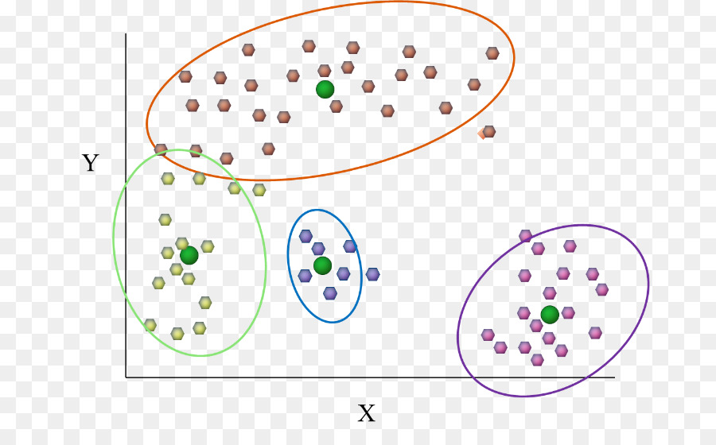
Clustering
Clustering of data is a method by which large sets of data are grouped into clusters of smaller sets of similar data.
Cluster: a collection of data objects
Similar to one another within the same cluster
Dissimilar to the objects in other clusters
Examples of Clustering Applications:
Marketing: Help marketers discover distinct groups in their
customer bases, and then use this knowledge to develop targeted
marketing programs

Slide 8
Problem Statement
The dataset we selected for this project contains 8950 rows and 18 columns. We have to create multiple segments and divide the customers into those segments accordingly. Also in order to do that we need to clean the dataset and it also requires feature engineering.
What we have?
Customer details like Balance, purchase frequency,credit limit, tenure etc.
What is to be done?
Data cleaning, feature engineering, apply clustering algorithms and finally create segments and get insights from these segments.

Slide 9
Scope and Objective
The prime objective of our project is very clear from the project title itself. We want to segment the customers into various segments using clustering techniques.
Analyze given data by performing exploratory data analysis.
Perform feature engineering and advanced reporting based on these features.
Reduce dimension using Principal component analysis.
Apply K-Means for segmentation.
Getting insights from the created segments.

Slide 10
Process and Software Requirement
Understanding the Data
Exploratory Data Analysis
Feature Engineering and insights
Missing Value and Outlier Treatment
Standardizing the data
Reducing Dimensions using PCA
Applying K-Means
Selecting optimum number of clusters using Silhouette Coefficient
Getting insights from these segments using Profiling

Slide 11
Software Requirement
Python
Jupyter Notebook
Libraries used:
Pandas
SciKit Learn
Matplotlib
Numpy
Seaborn
Pandas Profiling

Slide 12
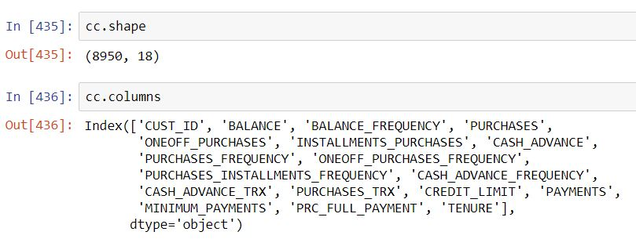
Understanding Data
Our dataset contains 8950 rows and 18 columns.

Slide 13
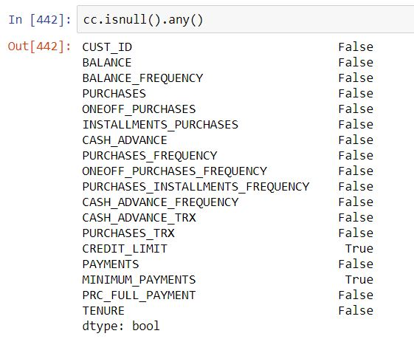
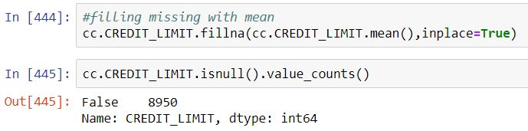
Missing Value Imputation
Credit Limit and Minimum Payments contains missing values.
Since they are continuous therefore we used mean to impute
missing values.

Slide 14
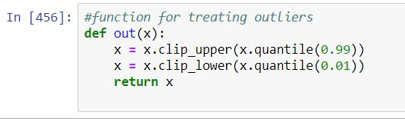

Outlier Treatment
In statistics, an outlier is an observation point that is distant from other observations.
An outlier may be due to variability in the measurement or it may indicate experimental error; the latter are sometimes excluded from the data set. An outlier can cause serious problems in statistical analyses.
We wrote a function to clip outliers using 99 percentile rule and applied this function to the dataset.

Slide 15
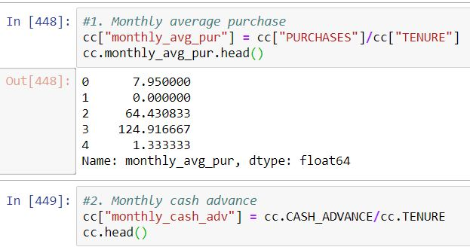
Feature Engineering & Insights
Based on the domain knowledge, we came up with new features that might affect the segmentation. We created the following five new features:
Average monthly purchase
Monthly cash advance

Slide 16
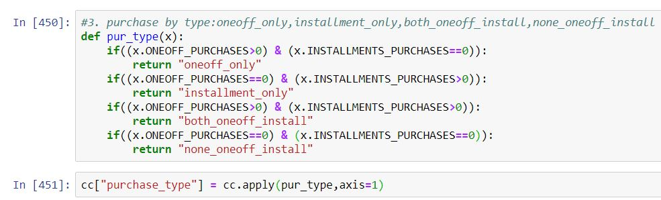
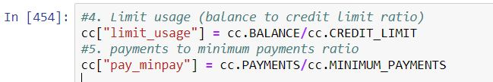
3. Purchase by type (one off, installment…)
4. Limit Usage (balance to credit limit ratio)
5. Payments to minimum payments ratio

Slide 17
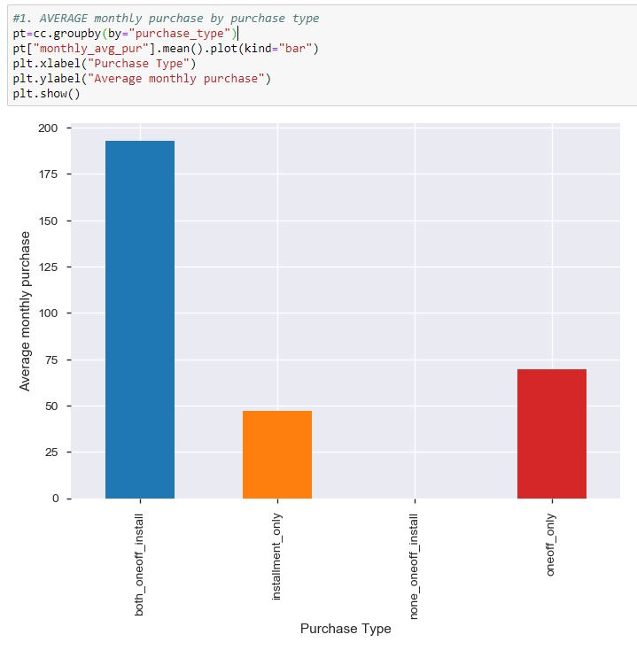
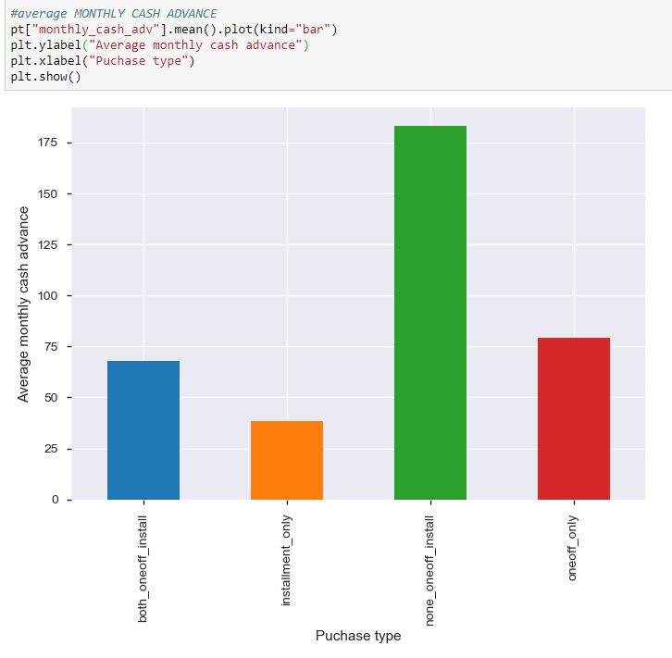
Insights
Average monthly purchase using both one-off and installments are very high almost 193 whereas average monthly purchase using installments only is very low i.e. around 47.
Customers who didn't do either of one-off or installment purchases take highest monthly cash advance

Slide 18
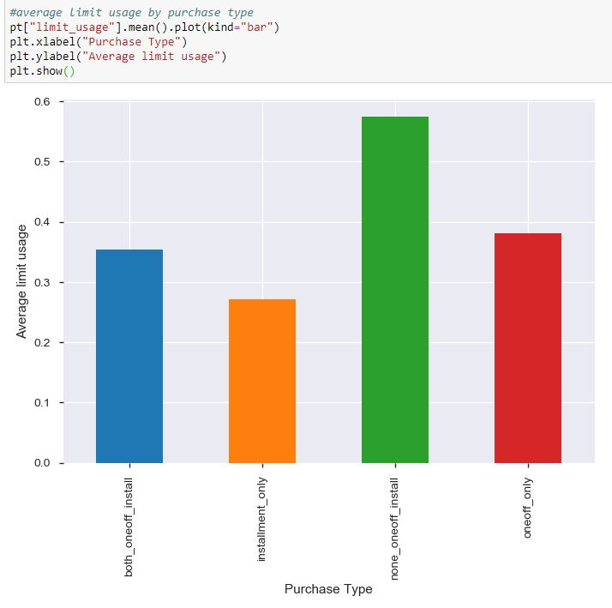
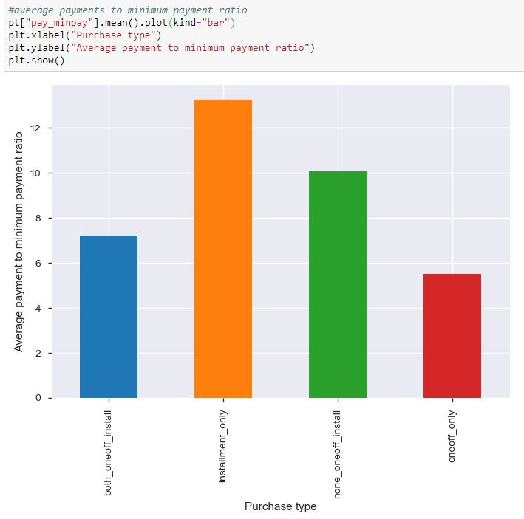
Customers with installments only purchases have good balance to credit limit ratio.
Customers with installments only purchases are paying their dues fast.

Slide 19
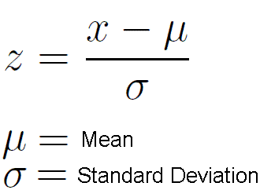
Standardizing the Data
In statistics, standardization is the process of putting different variables on the same scale. This process allows you to compare scores between different types of variables.
Our data may be at different levels or may contain different units. It will definitely not be suitable to move ahead and use this data without solving this problem. This can be done by standardizing the data.

Slide 20
Apply PCA
The main idea of principal component analysis (PCA) is to reduce the dimensionality of a data set consisting of many variables correlated with each other, either heavily or lightly, while retaining the variation present in the dataset, up to the maximum extent.
The same is done by transforming the variables to a new set of variables, which are known as the principal components (or simply, the PCs) and are orthogonal that means they are unrelated, ordered such that the retention of variation present in the original variables decreases as we move down in the order.
So, in this way, the 1st principal component retains maximum variation that was present in the original components.

Slide 21
K-Means
K-means clustering is one of the simplest and popular unsupervised machine learning algorithms.
We define a target number k, which refers to the number of centroids you need in the dataset. A centroid is the imaginary or real location representing the center of the cluster.
Every data point is allocated to each of the clusters through reducing the in-cluster sum of squares.
In other words, the K-means algorithm identifies k number of centroids, and then allocates every data point to the nearest cluster, while keeping the centroids as small as possible.
The ‘means’ in the K-means refers to averaging of the data; that is, finding the centroid.

Slide 22
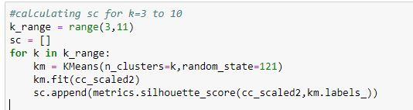
Identifying best number of segments
Silhouette Coefficient:
The silhouette value is a measure of how similar an object is to its own cluster (cohesion) compared to other clusters (separation). The silhouette ranges from −1 to +1, where a high value indicates that the object is well matched to its own cluster and poorly matched to neighboring clusters. If most objects have a high value, then the clustering configuration is appropriate. If many points have a low or negative value, then the clustering configuration may have too many or too few clusters.
The silhouette can be calculated with any distance
metric, such as the Euclidean distance.

Slide 23
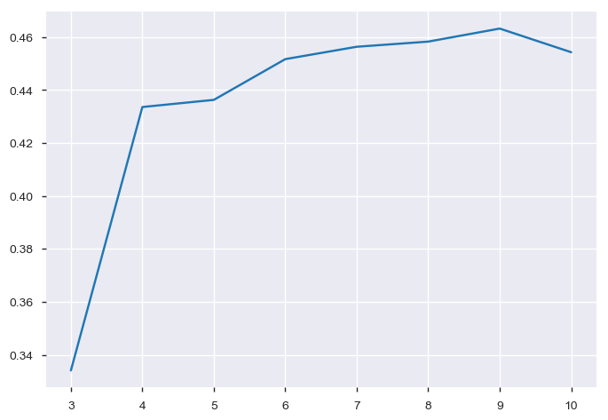
Based on Silhouette coefficient there can be 9 or 8 clusters depending on the business requirement. However the best score is for 9 clusters.

Slide 24
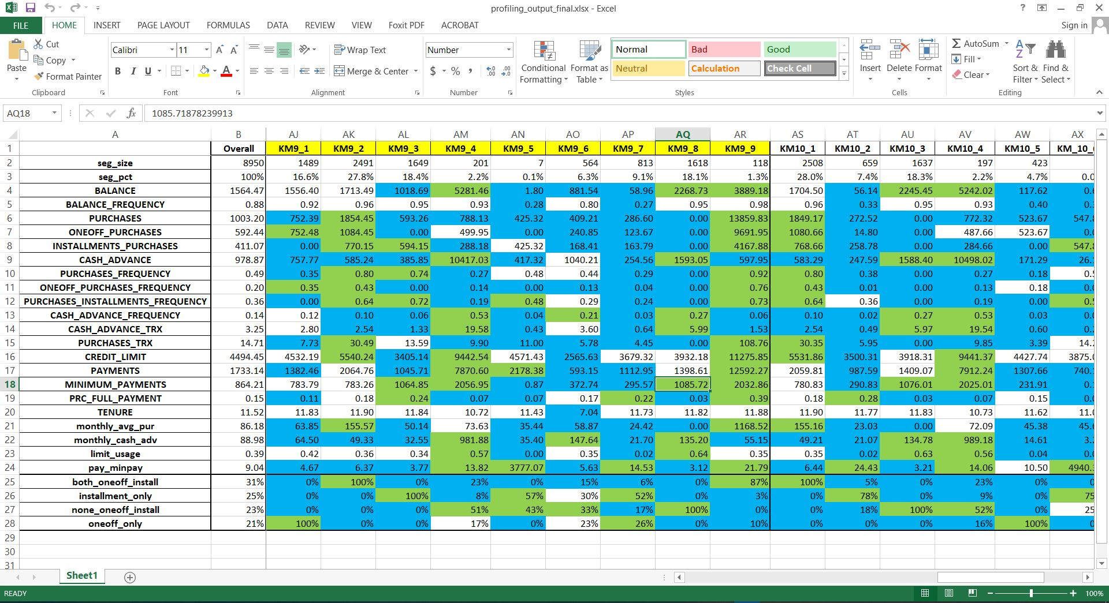
Profiling
Profiling is another way to make sure the number of segments are correctly chosen.
Profiling refers to segment customers based on the clusters created by observing and analyzing the customers in segments. Mean gives a very good indication of distribution of data so we are finding mean for each variable grouped by each clusters.
The profiling is done using an Excel sheet.

Slide 25
Conclusion
Insights with 9 clusters:
Segment 1: Customers of this segment do 100% purchases one off purchases.
Segment 2: This is the largest segment consisting of 27.8% of total customers. All the purchases made by these customers are done using both one off and installments.
Segment 3: Less transacting customers and prefer only purchasing through installments. Second highest segment consisting of 18.4% customers.
Segment 4: Customers with highest balance, highest monthly cash advance and highest minimum payment amount.
Segment 5: Customers with lowest balance and highest payment to minimum payment ratio and almost zero limit usage. Lowest segment consisting of only 0.1% customers.
Segment 6: Customers with lowest credit limit and lowest payments. But these are newest customers. Overall low transacting segment.
Segment 7: These are the customers with lowest transactions .
Segment 8: Third highest segment. These customers have taken cash advance only and not done any purchase at all.
Segment 9: These are the customers with highest transactions but consists only 1.3% of total customers.

Slide 26


