Slide 1




Loan Approval Prediction
Minor Project Presentation on

Slide 2
Project Supervisor
Binayak Panda Sir
Professor
Department of CSE
Gandhi Engineering College
Team Members
Pooja
CSE-B
1501292214
Vishal Kumar
CSE-B
1501292258

Slide 3
Presentation Outline
Introduction
  What is machine learning?
  Kinds of machine Learning
  Problem Statement
Scope and Objective
Process and Software Specification
Process Model(Use case Diagram)
Demonstration
Conclusion and Future Scope

Slide 4
Introduction
Machine Learning has become increasingly popular tool in almost every industry out there be it Smartphone Industry, Healthcare or Banks. With Machine Learning we can achieve so much. We will be using machine learning algorithms along with some data analysis techniques in our project.
Our project focus is to use existing customer’s details and analyze it further by applying a few machine learning techniques and predict which future applicant can be approved the loan.

Slide 5

What is Machine Learning ?
Past Data
Analyses
Output
Learns
Decisions/Predictions

Slide 6
Machine Learning
Supervised Learning
Unsupervised Learning
Reinforcement Learning
Classification
Regression
Association
Clustering

Slide 7

Problem Statement
Dream Housing Finance company deals in all home loans.
Time Taking : Customer first apply for home loan after that company validates the customer eligibility for loan.
What company knows?
Customer details like Gender, Marital Status, Education, Number of Dependents, Income, Loan Amount, Credit History and others.
What company wants?
Company wants to automate the loan eligibility process based on customer details provided while filling online application form.

Slide 8
Scope and Objective
The prime objective of our project is very clear from the project title itself. We want to predict whether an applicant can be approved of home loan or not by applying machine learning techniques.
Learn to analyze given data by performing exploratory data analysis.
Learn to deal with missing data and treat Outliers.
Understand and perform Feature engineering.
Go through different Machine Learning algorithms and understand how they work.
Finally build a Machine Learning Model to predict loan approval.

Slide 9
Process and Software Requirement
Hypothesis Generation
Exploratory Data Analysis
  Univariate Analysis
  Bivariate Analysis
Missing Value and Outlier Treatment
Feature Engineering
Model Building
  Logistic Regression
  Decision Tree
  Random Forest
  XGBoost

Slide 10
Software Requirement
Python
Jupyter Notebook
Libraries used:
Pandas
SciKit Learn
Matplotlib
Numpy
Seaborn
XGBoost

Slide 11
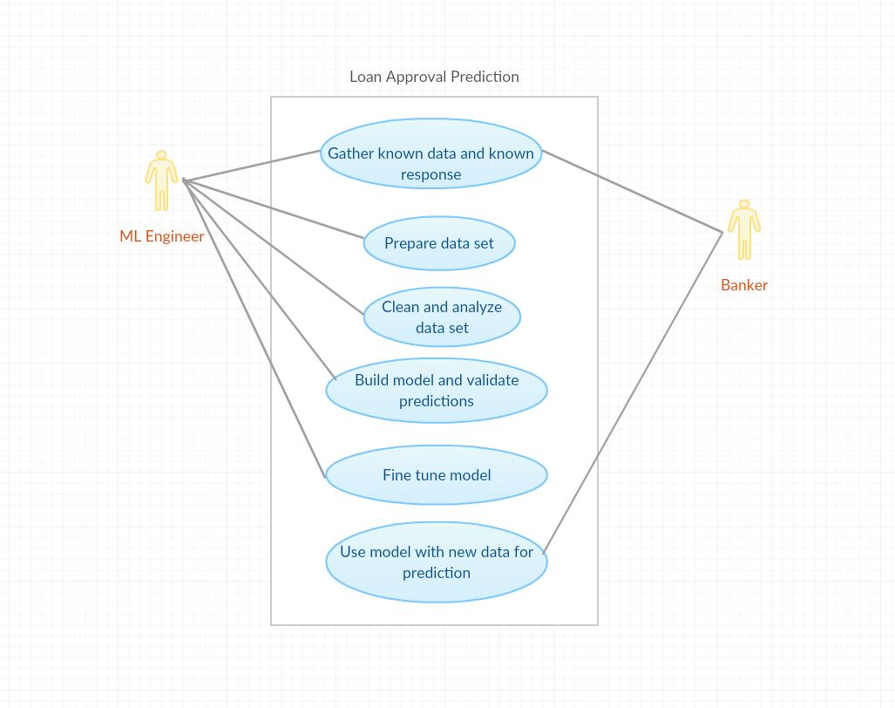
Process Model
Use Case Diagram for Loan Approval Prediction

Slide 12
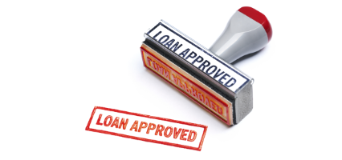
Demonstration
Sample code and their output

Slide 13
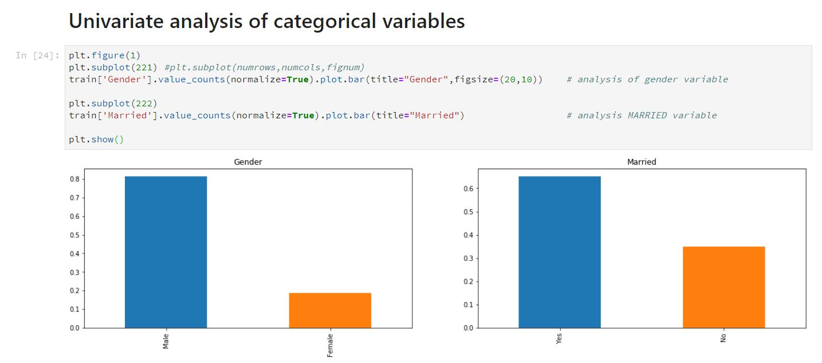
Univariate Analysis
Around 80% of the applicants were male.
Around 65% applicants were married.

Slide 14
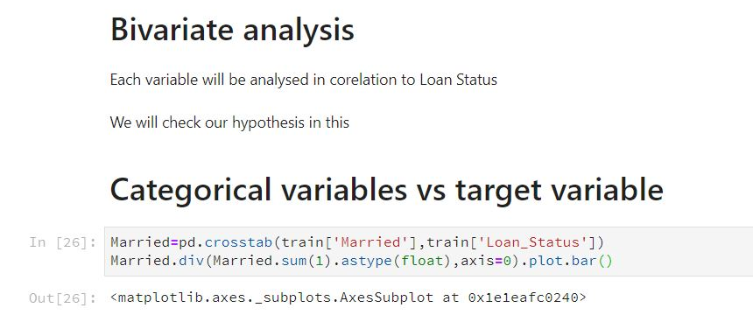
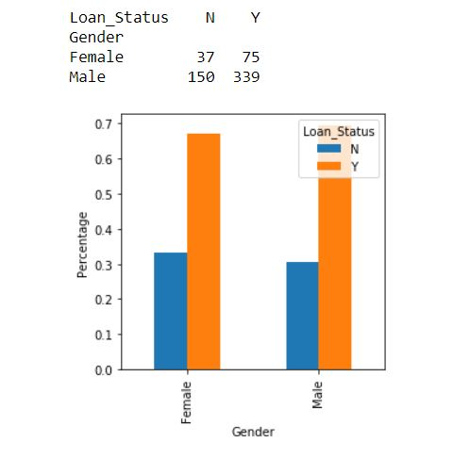
Bivariate analysis
Married Applicants have a higher rate of loan approval compared to unmarried.

Slide 15
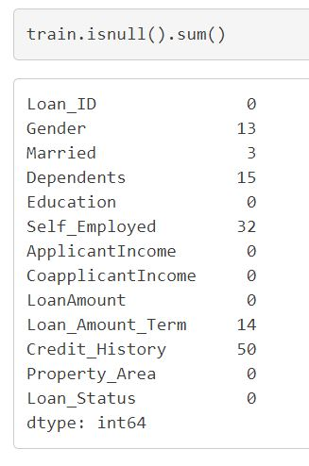
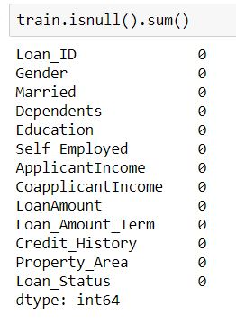
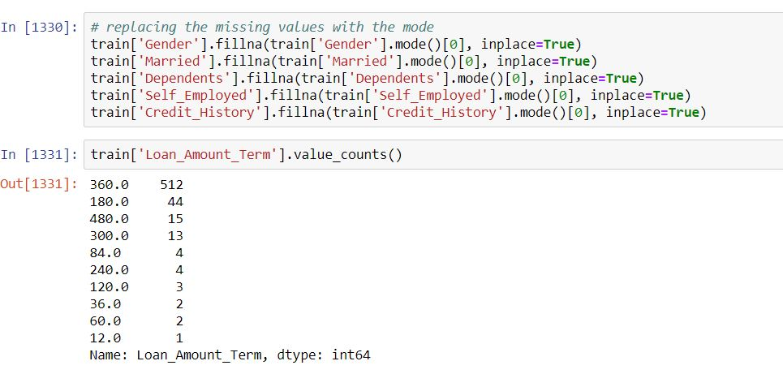
Missing Value Imputation
For numerical variables: imputation using mean or median
For categorical variables: imputation using mode

Slide 16
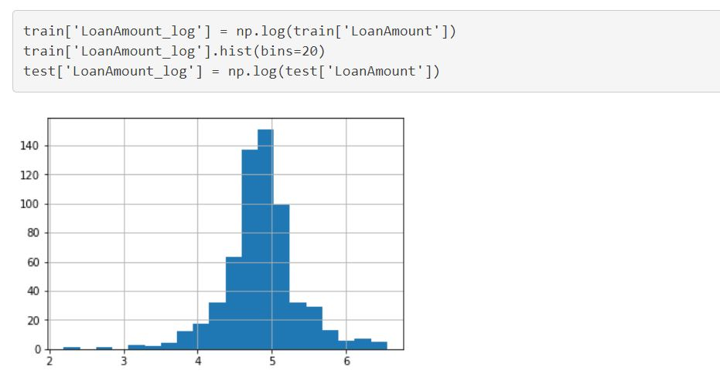
Outlier Treatment
As we take the log transformation, it does not affect the smaller values much, but reduces the larger values. So, we get a distribution similar to normal distribution.

Slide 17
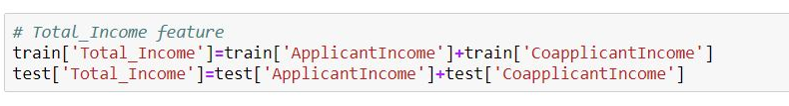


Feature Engineering
Total Income
EMI
Balance income

Slide 18
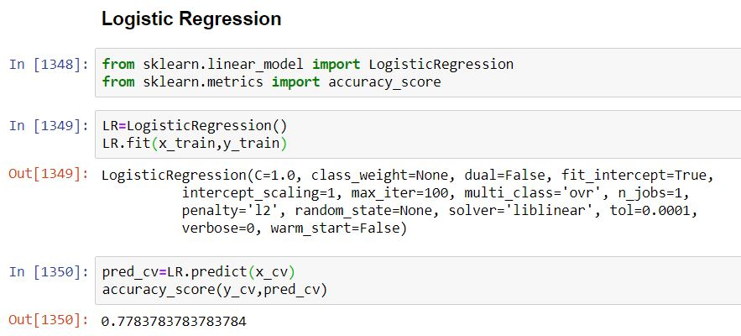
Model Building
Logistic Regression

Slide 19
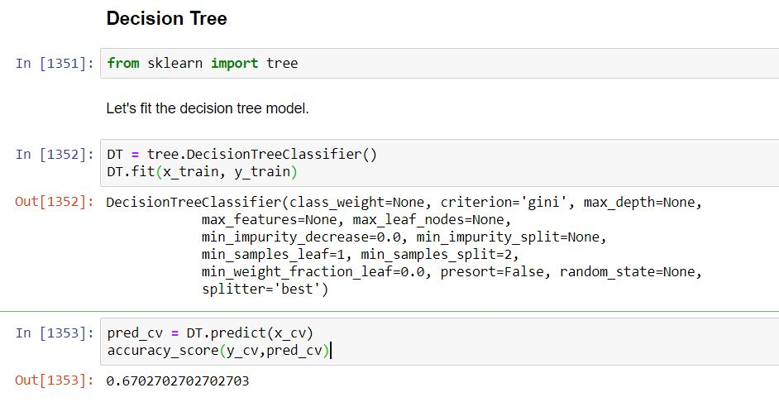
Decision Tree

Slide 20
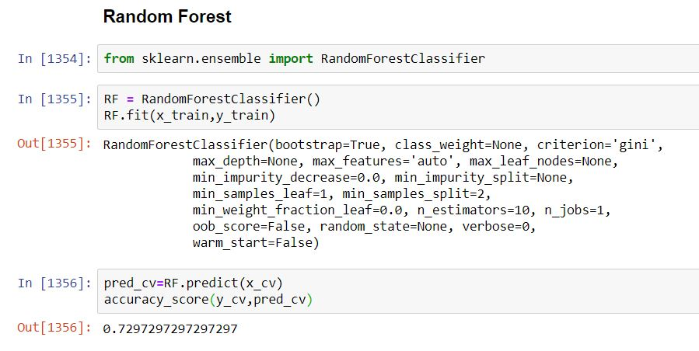
Random Forest

Slide 21
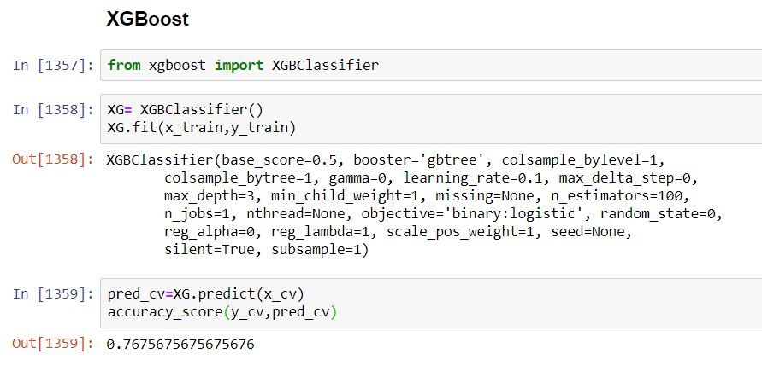
XGBoost

Slide 22
Conclusion and Future Scope
Out of all the classification algorithms used on the dataset, Logistic Regression algorithm gives the best overall prediction accuracy.
Credit History, Balance Income, Property Area were the most important factors for predicting the class of the loan applicant.
We can optimize the hyper parameters of our model and improve the accuracy.
An app with proper UI can be built, which will take various inputs from the user like income, loan amount, loan duration, etc. and give a prediction of whether their Home loan application can be approved by the banks.

Slide 23
Bibliography
Machine Learning Courses
  Coursera(Andrew NG)
  YouTube(SimpliLearn, Edureka)
Machine Learning Repository
  Kaggle
  UCI
Websites
  www.kdnuggets.com
  www.analyticsvidhya.com
  www.machinelearningmastery.com

