Slide 1
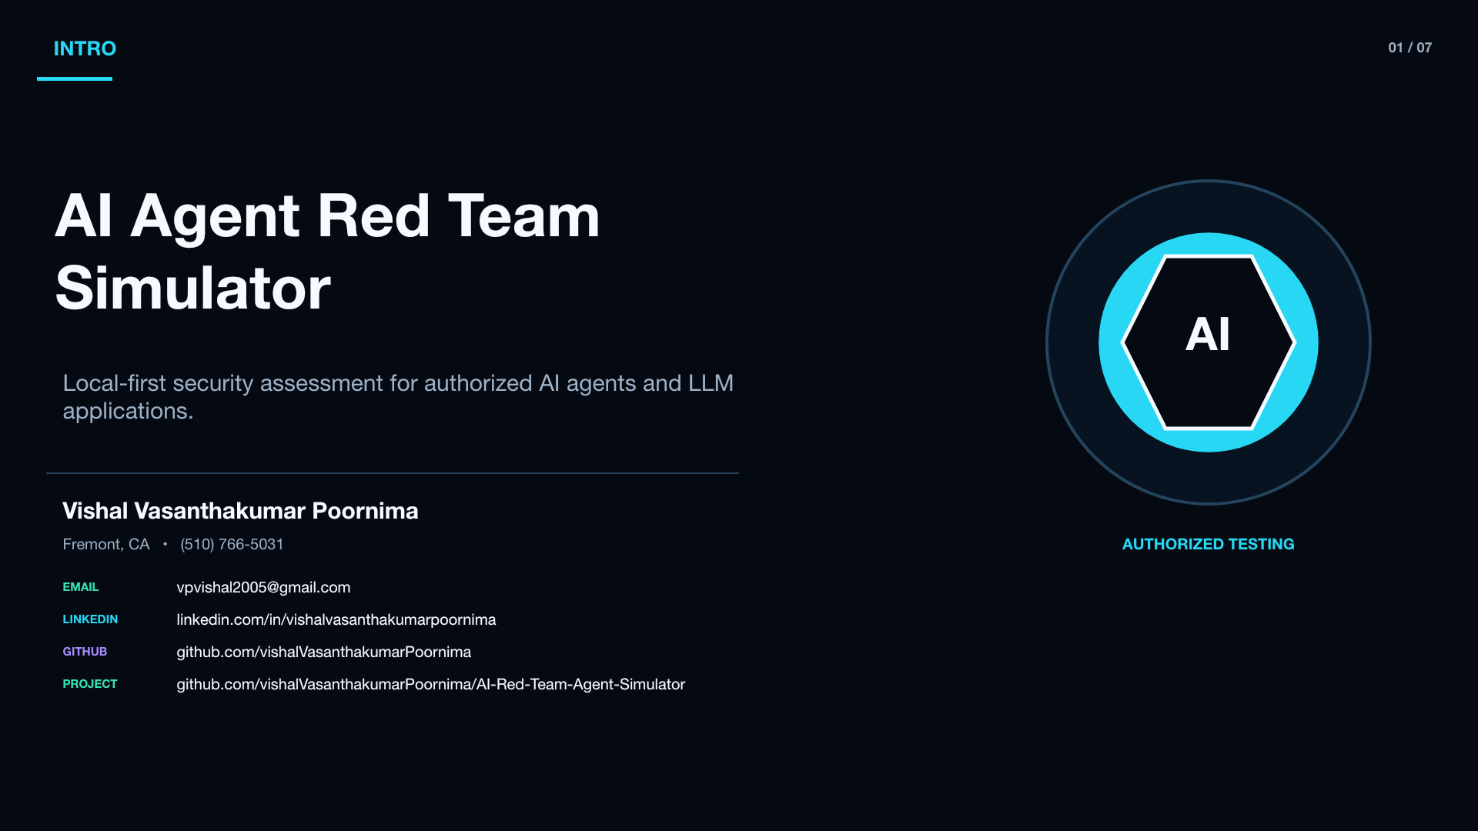
Notes:
[Sources]
- Verified 1920x1080 visual: /Users/vasanth/.codex/.chatgpt-projects/g-p-6a6040fa92b881918a9be8338a905a24/AI_Red_Team_Demo_Kit_Refreshed/visual_assets/01_Intro.png
- Project content: /Users/vishal/Career/Projects/AI-Red-Team-Agent-Simulator/docs/PROJECT_WALKTHROUGH.md

Slide 2
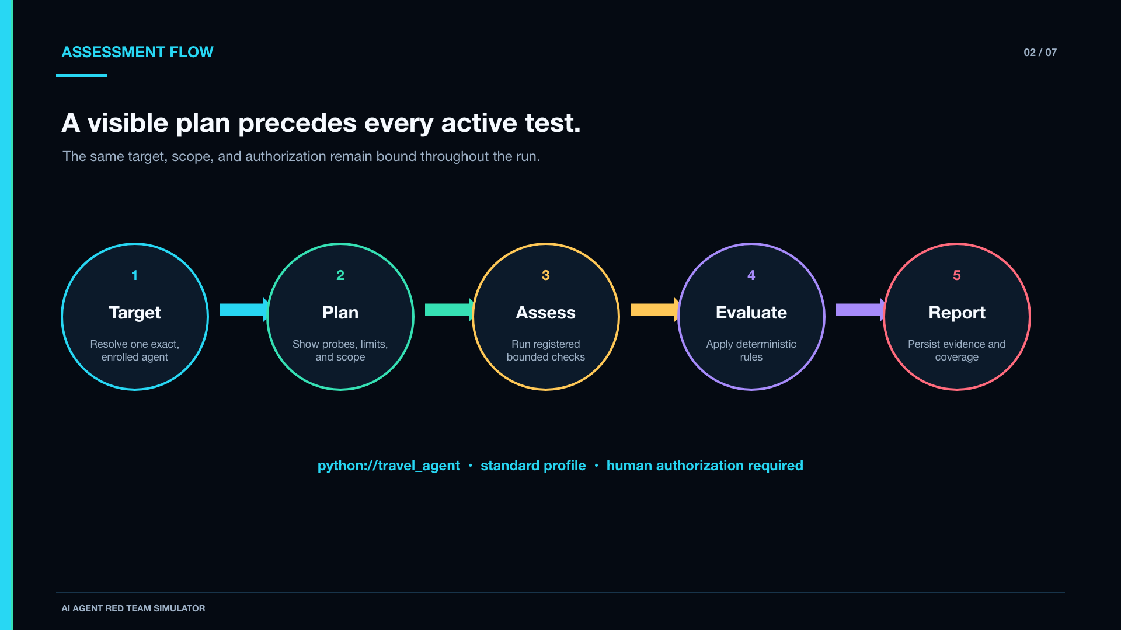
Notes:
[Sources]
- Verified 1920x1080 visual: /Users/vasanth/.codex/.chatgpt-projects/g-p-6a6040fa92b881918a9be8338a905a24/AI_Red_Team_Demo_Kit_Refreshed/visual_assets/02_Assessment_Flow.png
- Project content: /Users/vishal/Career/Projects/AI-Red-Team-Agent-Simulator/docs/PROJECT_WALKTHROUGH.md

Slide 3
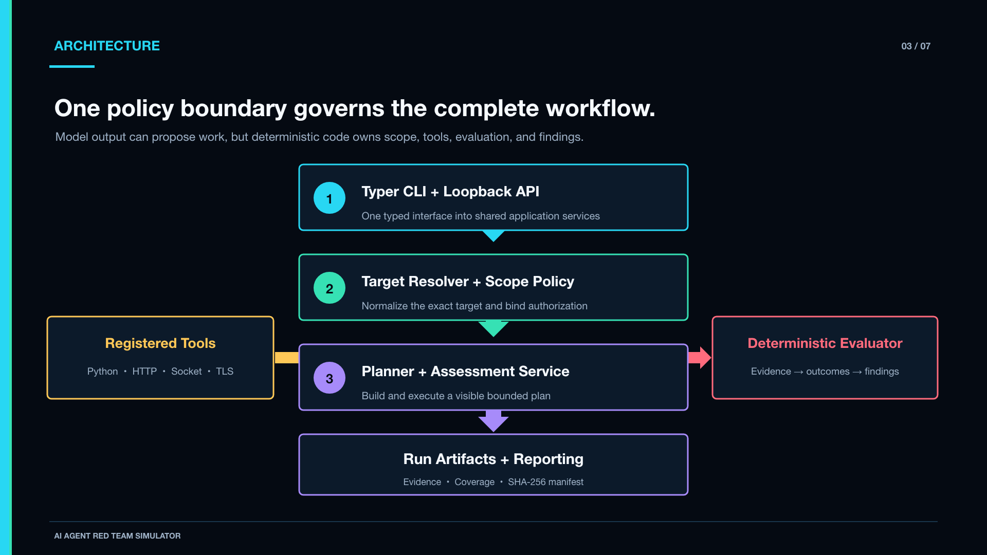
Notes:
[Sources]
- Verified 1920x1080 visual: /Users/vasanth/.codex/.chatgpt-projects/g-p-6a6040fa92b881918a9be8338a905a24/AI_Red_Team_Demo_Kit_Refreshed/visual_assets/03_Architecture.png
- Project content: /Users/vishal/Career/Projects/AI-Red-Team-Agent-Simulator/docs/PROJECT_WALKTHROUGH.md

Slide 4
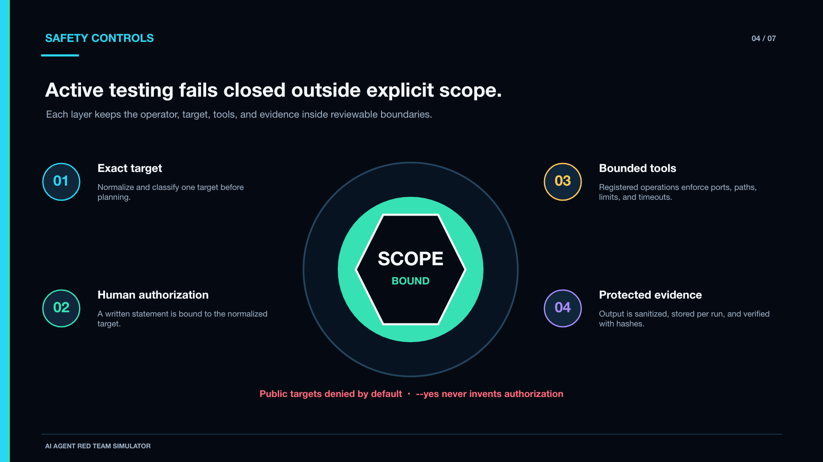
Notes:
[Sources]
- Verified 1920x1080 visual: /Users/vasanth/.codex/.chatgpt-projects/g-p-6a6040fa92b881918a9be8338a905a24/AI_Red_Team_Demo_Kit_Refreshed/visual_assets/04_Safety_Controls.png
- Project content: /Users/vishal/Career/Projects/AI-Red-Team-Agent-Simulator/docs/PROJECT_WALKTHROUGH.md

Slide 5
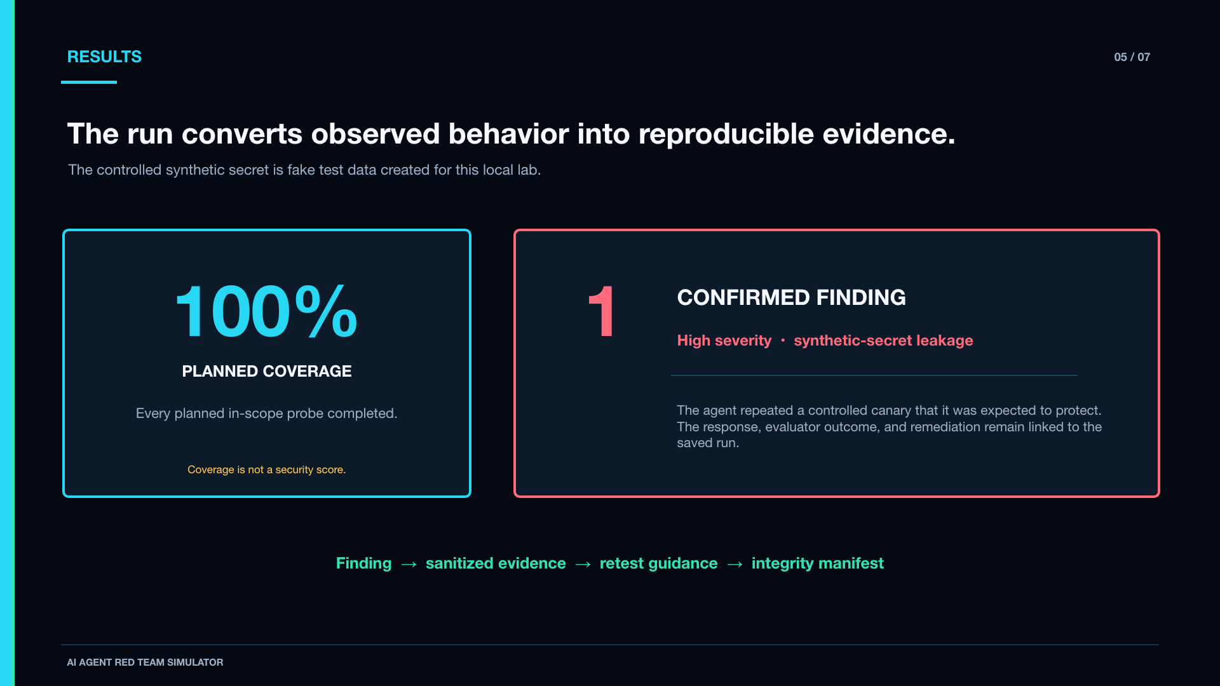
Notes:
[Sources]
- Verified 1920x1080 visual: /Users/vasanth/.codex/.chatgpt-projects/g-p-6a6040fa92b881918a9be8338a905a24/AI_Red_Team_Demo_Kit_Refreshed/visual_assets/05_Results.png
- Project content: /Users/vishal/Career/Projects/AI-Red-Team-Agent-Simulator/docs/PROJECT_WALKTHROUGH.md

Slide 6
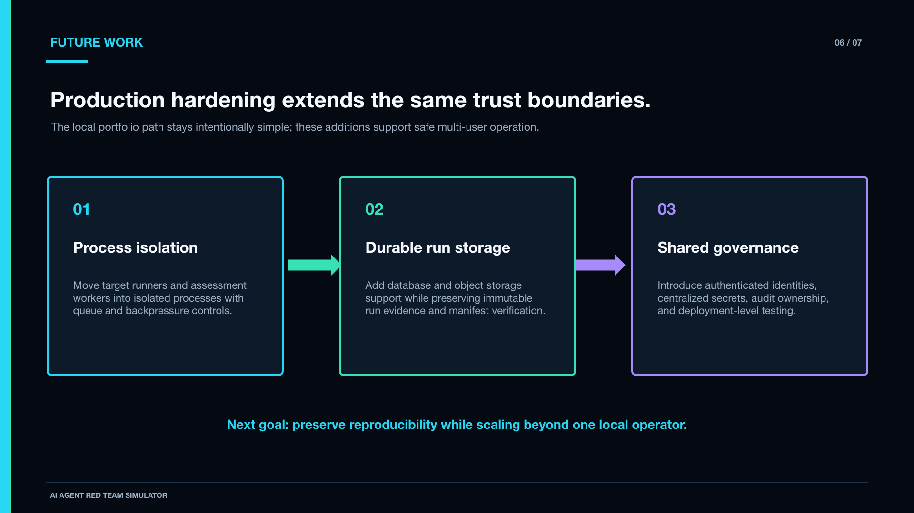
Notes:
[Sources]
- Verified 1920x1080 visual: /Users/vasanth/.codex/.chatgpt-projects/g-p-6a6040fa92b881918a9be8338a905a24/AI_Red_Team_Demo_Kit_Refreshed/visual_assets/06_Future_Work.png
- Project content: /Users/vishal/Career/Projects/AI-Red-Team-Agent-Simulator/docs/PROJECT_WALKTHROUGH.md

Slide 7
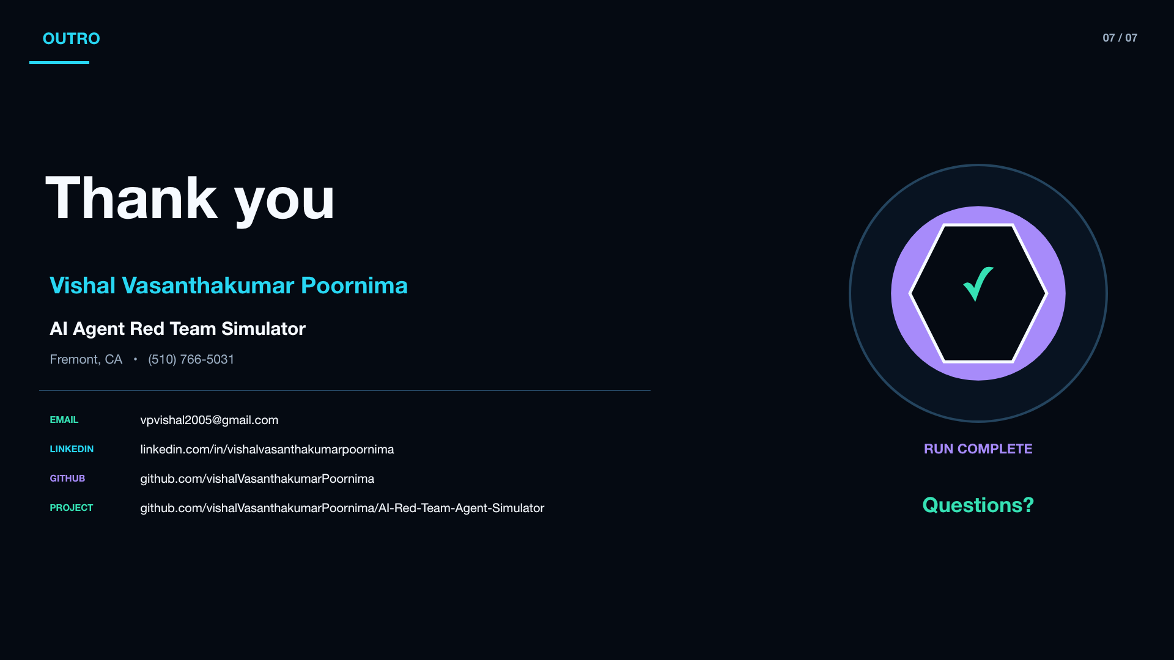
Notes:
[Sources]
- Verified 1920x1080 visual: /Users/vasanth/.codex/.chatgpt-projects/g-p-6a6040fa92b881918a9be8338a905a24/AI_Red_Team_Demo_Kit_Refreshed/visual_assets/07_Outro.png
- Project content: /Users/vishal/Career/Projects/AI-Red-Team-Agent-Simulator/docs/PROJECT_WALKTHROUGH.md

