Slide 1
Automated Lab-as-a-Service LaaS: Open Source Evaluation
257391888
259039328
257391888
259039328
257391888
259039328
257391888
259039328
257391888
259039328

Slide 2
Agenda
Objective
List of LaaS Features
Key considerations for evaluation
Evaluated tools
Recommended tools

Slide 3
Objective
Below is the main objective of the activity:
To evaluate the various open-source tools available to deliver the identified features for LaaS
To recommend the best open-source tool out of the available options

Slide 4
List of LAAS features
Service Requests
Change Management
Connection Management
Inventory Management
Asset Management
Process Automation
Blueprint Orchestration
Capacity Management
Reservation Management

Slide 5
Key considerations for evaluation
While evaluating the open-source tools for the identified features, below criteria have been kept in consideration:
Open source license type should not be GPL (General Public License)
Scalable for future requirements
Flexible and easy to integrate with other tools and system
Documentation availability for installation and usage
Support available from community
Notes:
13.08.2007
5
Autor / Thema der Präsentation

Slide 6
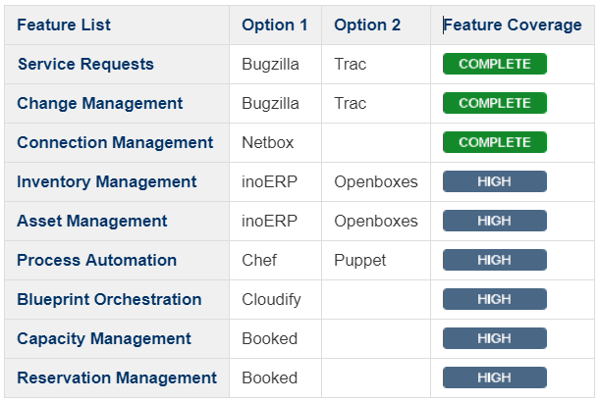
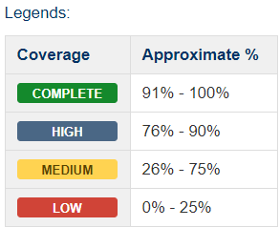
Evaluated Tools
Ref: https://gard.telekom.de/gardwiki/display/AUTOLAB/LaaS%3A+Open+Source+Evaluation
Notes:
13.08.2007
6
Autor / Thema der Präsentation

Slide 7
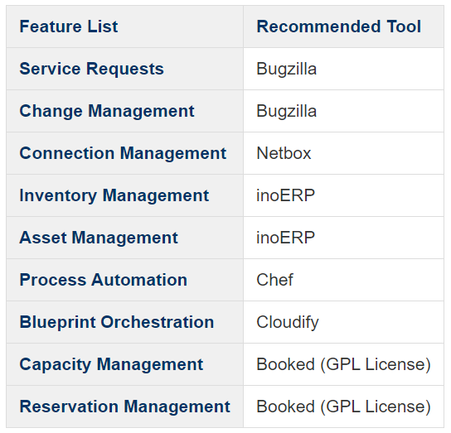
Recommended Tools
Notes:
13.08.2007
7
Autor / Thema der Präsentation

Slide 8
Thanks

